Slide 1
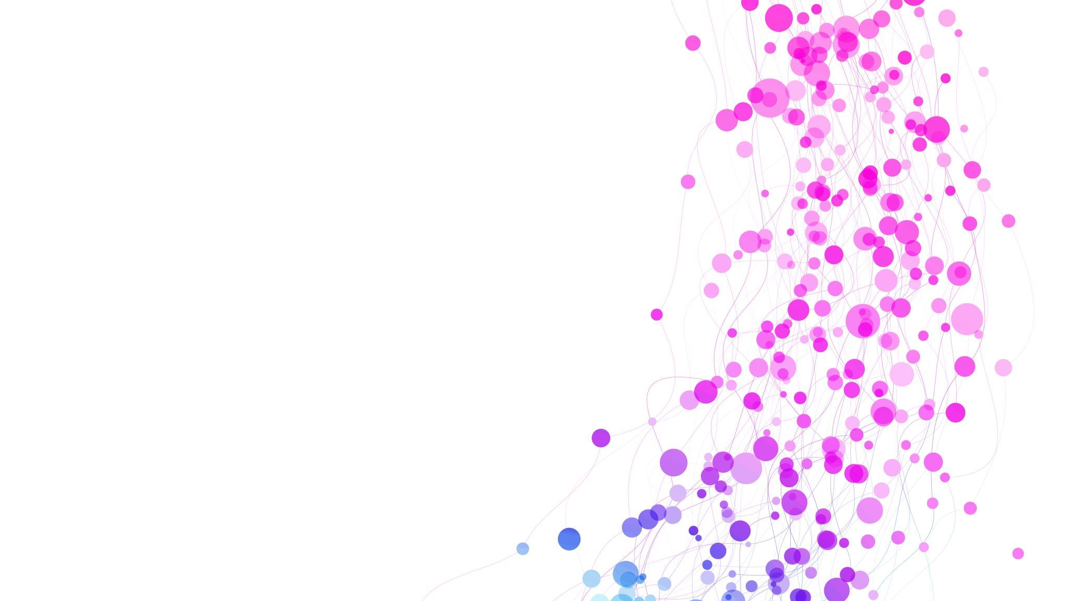
Cardiovascular Disease Prediction
Leshan ZHAO
Noah Heckenlively
Maram Aldiabat

Slide 2
test: Note from LeshanZ 2022-10-21 12:53

Slide 3
Potential Challenges
Noise in data and Data issues (nans, outliers, …). Especially in Age, Weight, and Height information.
Size of dataset.
Poor correlation of features with target which lead to low accuracy.
Low number of features.
Generalization and overfitting, maybe the nature of dataset cause to some problem in the accuracy.

Slide 4
Dataset Description
Kaggle set called cardiovascular disease dataset
Its size is 70k instances of data with 11 features. Contains features related to cardiovascular patients like Age, Height, Weight, Glucose, Smoking and so on.
The dataset link is :
https://www.kaggle.com/datasets/sulianova/cardiovascular-disease-dataset

Slide 5
Hyperparameters
We may need to define those parameters that helps in prediction process:
Number of Layers for ID3.
Learning Rate.
Epochs.
Batch Size.
Activation Function if it is Sigmoid, ReLU, or Tanh.
Error Rate (Stop Condition).
Fine Tune in cross fold validation (Data Splitting into train test validation).

Slide 6
Usefulness metrics
Predicting at 80% threshold could help hospitals, governments, and insurance companies with distribution and funding of tests
Highly indicative features can be useful for both patients and insurance companies for mitigating risks and establishing premiums

Slide 7
Timeline
Nov 10: Data preprocessing
Nov 13: Implement MLP forward direction
Nov 16: Implement backward propagation
Nov 18: Evaluation/validation
Nov 29: Final Bugfixes & Project Completed

