Slide 1
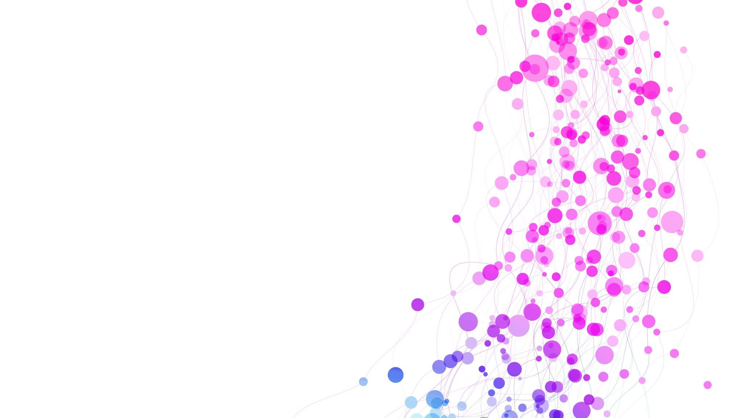
Cardiovascular Disease Risk Screening
Leshan ZHAO
Noah Heckenlively
Maram Aldiabat

Slide 2
Problems
Cardiovascular diseases (CVDs) are the leading cause of death globally, taking an estimated 17.9 million lives each year, which accounts for 31% of all deaths worldwide.
Find out the patients earlier and ensuring they receive appropriate treatment can prevent premature deaths.
Notes:
https://www.who.int/health-topics/cardiovascular-diseases#tab=tab_1

Slide 3
Problems
Cardiac Tests could be expensive:
Electrocardiogram
Chest X-ray
Heart (cardiac) CT scan
Heart (cardiac) magnetic resonance imaging (MRI) scan
etc ……

Slide 4
Solution
Build a model that:
Take the physical indexes and potential behavioural risk factors as inpiut
Predict whether a people is at high risk of CVDs with
Reveal behavioural factors that may increase the risk of heart diseases.

Slide 5
Solution
Input:
Potential behavioural risk factors & physical indexes
Output:
1 (high CVD risk)
0 (low CVD risk)

Slide 6
Apply MLP to solve this problem
A classification task.
Our MLP will take numeric or nominal values as inputs to train weights, and then output 0 or 1, indicating whether a people is at high risk of having cardiovascular diseases.
Limitation of linear models

Slide 7
Significance
1. Risk screening:
Governments and hospitals can use the model to identify those citizens who are at highest risk of CVDs and suggest them to do the cardiac tests.
Save money
2. Reveal behavioural risk factors of CVDs
Potential patients can try to eliminate their own risk factors

Slide 8
Potential Challenges
Noise in data and Data issues (nans, outliers, …). Especially in Age, Weight, and Height information.
Size of dataset.
Poor correlation of features with target which lead to low accuracy.
Low number of features.
Generalization and overfitting, maybe the nature of dataset cause to some problem in the accuracy.

Slide 9
Dataset Description
Kaggle set called cardiovascular disease dataset
Its size is 70k instances of data with 11 features. Contains features related to cardiovascular patients like Age, Height, Weight, Glucose, Smoking and so on.
The dataset link is :
https://www.kaggle.com/datasets/sulianova/cardiovascular-disease-dataset

Slide 10
Hyperparameters
We may need to define those parameters that helps in prediction process:
Number of Layers for ID3.
Learning Rate.
Epochs.
Batch Size.
Activation Function if it is Sigmoid, ReLU, or Tanh.
Error Rate (Stop Condition).
Fine Tune in cross fold validation (Data Splitting into train test validation).

Slide 11
Usefulness metrics
Predicting at 80% threshold could help hospitals, governments, and insurance companies with distribution and funding of tests
Highly indicative features can be useful for both patients and insurance companies for mitigating risks and establishing premiums

Slide 12
Timeline
Nov 10: Data preprocessing
Nov 13: Implement MLP forward direction
Nov 16: Implement backward propagation
Nov 18: Evaluation/validation
Nov 29: Final Bugfixes & Project Completed

Slide 13
Thank you!

