Slide 1
Query Execution
DSCI 551
Wensheng Wu

Slide 2
Components of Query Processor
SQL query
SQL query
Parse query
Catalyst
Query
compilation
query expression
tree
Metadata
Select logical
query plan
query plan
Query
optimization
Query
execution
logical query
plan tree
Select
physical plan
data
physical query
plan tree
Details on how the query is to be executed.
storage

Slide 3
Converting SQL to Logical Plans
Select a₁, …, a_{n}
From R₁, …, R_{k}
Where C
Π_{a1,…,an}(σ _{C}(R₁ × R₂ × … × R_{k}))
Select b₁, …, b_{m,} aggs
From R₁, …, R_{k}
Where C
Group by b₁, …, b_{m}
γ _{b1, …, bm, aggs} (σ _{C}(R₁ × R₂ × … × R_{k}))

Slide 4
Logical Query Optimization
Apply algebraic laws to turn initial query plan into more efficient one
Use heuristics
  E.g., do selections & projection as early as possible

Slide 5
Example of Algebraic Law
σ_{C} (R ⋈ S) = σ_{C} (R) ⋈ S
That is, we can push selection down to R if condition C only contains attributes in R

Slide 6
Physical Query Optimization
Turn logical query plan into physical ones
  That is, plan with physical operators
Pick a physical plan with the lowest cost (I/O's)
  I.e., cost-based optimization

Slide 7
Outline
Logical/physical operators
Cost model
One-pass algorithms
Nested-loop joins: 1.x
Two-pass algorithms
  Sorting-based
  Hashing-based
Index-based algorithms

Slide 8
Logical vs. Physical Operators
Logical operators
  what they do
  e.g., union, selection, projection, join, group-by
Physical operators
  how they do it
  Main methods: scanning, hashing, sorting, and index-based
  E.g., methods for implementing joins include:
    nested loop join, sort-merge join, hash join, index join
  Different methods may have different requirements on the amount of available memory & different costs

Slide 9
Logical Query Plans
SELECT P.buyer
FROM Purchase P, Person Q
WHERE P.buyer=Q.name
Construct logical plan…
NLJ (Purchase outer) :
for p in Purchase:
for q in Person:
if (p.buyer = q.name)
NLJ (Person is outer):…

Slide 10
Logical Query Plans
Purchase.buyer
John
John
Mary
John
(using h)
=> R1: mary
R2: john, john, john
Person.name
John
Mary
(using h)
P1: (mary)
P2: (john)
100MB
(purchase)
2GB= Part1: 900MB
P2: 900MB
P3: 200MB
SELECT P.buyer
FROM Purchase P, Person Q
WHERE P.buyer=Q.name AND
Q.city=‘LA’
P.buyer
σ
Q.City=‘LA’
M(memory) = 2GB
Query Plan:
Tree with logical operators
h(buyer)
h(name)
h(John) = 0/1
P.Buyer=Q.name
Purchase (m)
Person (n)
Scenario A:
100MB
200MB
B:
100MB
2GB = P1 (1GB), P2 (1GB)
C:
2GB
R1: 1GB
R2: 1GB
2GB
P1: 1GB
P2: 1GB

Slide 11
Notes
h(John) = (74+111+104+110) % 2 + 1 = 2
R join S join T
dynamic programming
Hive HiveQL => MapReduce
Spark (Catalyst)

Slide 12
Example
Purchase
Person
M = 1GB
A:
100MB
200MB
B:
100MB
2GB
C:
2GB
R1: 500M
R2: 500M
R3: 500M
R4: 500M
2GB
P1: 500M
P2: 500M
P3: 500M
P4: 500M
hash-based:
R1 join P1
R1 join P2
R1 join P3
R1 join P4
R2 join P1
…

Slide 13
Example (cont'd)
M = 1GB
Purchase
Person
A:
100MB
200MB
B:
100MB
2GB
C:
2GB
R1: 500M
R2: 500M
R3: 500M
R4: 500M
2GB
P1: 500M
P2: 500M
P3: 500M
P4: 500M
Block-based NLJ algorithm
4* (500 + 2G)
= 4* 500 + 4 * 2G
= 2GB + 4 * 2GB
= 2GB + 2GB/500MB * 2GB

Slide 14
Physical Query Plans
SELECT P.buyer
FROM Purchase P, Person Q
WHERE P.buyer=Q.name AND
Q.city=‘LA’
(On the fly)
P.buyer
σ
(On the fly)
Q.City=‘LA’
Query Plan:
Logical tree plus
Implementation
choice at each node
(Nested Loop/
Hashing/Sorting)
P.Buyer=Q.name
Purchase
Person
(Table scan)
(Table scan)

Slide 15
How do We Combine Operations?
class Operator:
def open():
def next():
def close():
class ProjOp(Operator):
def open()
def next():
…
class FilterOp(Operator):
def open()
class JoinOp(Operator):
def next():
…
The iterator model. Each operation is implemented by 3 functions:
  Open: sets up the data structures and performs initializations
  GetNext: returns the the next tuple of the result.
  Close: ends the operations. Cleans up the data structures.
Enables pipelining!
Contrast with data-driven materialized model

Slide 16
Cost Model
Cost parameters
  M = number of blocks/pages that are available in main memory
  B(R) = number of blocks holding R
  T(R) = number of tuples in R
  V(R,a) = number of distinct values of the attribute a of R
Estimating the cost of physical operators:
  Important in query optimization
  Here we consider I/O cost only
  We assume operands are relations stored on disk, but operator results will be left in main memory (e.g., pipelined to next operator in query plan)
  So we don’t include the cost of writing the result

Slide 17
Selectivity
    The larger V(R,a), the more selective a is for R
    Employee(ssn, name, age, gender)
      Which of the above attributes is most/least selective?
      V(Employee, gender) = 2
      V(Employee, ssn) = n

Slide 18
I/O Cost
# of blocks read from or written to disk
Recall that disk reads/writes data in the unit of block

Slide 19
Scanning Tables
Reading every row of tables
The table is clustered (i.e., block consists only of records from this table):
  # of I/O's = # of blocks
The table is unclustered (e.g. its records are placed in blocks with those of other tables)
  May need one block read for each record

Slide 20
Scanning Clustered/Uncluserted Tables
2 Block Reads
4 Reads
(B(R) = 2)
(T(R) = 4)
Clustered table
Unclustered table

Slide 21
Cost of the Scan Operator
Clustered relation:
  Table scan: B(R)
Unclustered relation:
  T(R)
We assume clustered relations to estimate the costs of other physical operators.

Slide 22
Classification of Physical Operators
One-pass algorithms
  Read the data only once from disk
  Usually, require at least one of the input relations fits in main memory
Nested-Loop Join algorithms (1.x)
  Read one relation only once, while the other will be read repeatedly from disk
Two-pass algorithms
  First pass: read data from disk, process it, write it to the disk
  Second pass: read the data for further processing

Slide 23
Classification of Physical Operators
K-pass algorithms
  If data are too big or memory is too small, the algorithm may need k > 2 passes over the data

Slide 24
One-pass algorithms

Slide 25
One-pass Algorithms
Selection σ(R), projection Π(R)
Both are tuple-at-a-time algorithms
Cost: B(R)
Input buffer
Unary
operator
Output buffer
Read a block
B(R) blocks
R
Disk

Slide 26
One-pass Algorithms
Duplicate elimination δ(R)
Need to keep a dictionary in memory:
  balanced search tree
  hash table
  Etc.
Cost: B(R)
Assumption:
B(δ(R)) <= M-2
or roughly M
La, 2
La, 3
Sfo, 2
Sfo, 4
La, 5
…
R
Seen
before?
Input
buffer
Output
buffer
M-2 buffers

Slide 27
One-pass Algorithms
Grouping: γ_{city, sum(price)} (R)
Need to keep a dictionary in memory
  Also store the sum(price) for each city
Cost: B(R)
Assumption: number of cities and sums fit in memory

Slide 28
One-pass Algorithms
Binary operations: R ∩ S, R U S, R – S, R S
Assumption: min(B(R), B(S)) <= M (or M-2 to be exact)
Scan a smaller table of R and S into main memory, then read the other one, block by block
Cost: B(R)+B(S) (assume both are clustered)
E.g. R ∩ S (assume set-based, no duplicates)
  Read S into M-2 buffers and build a search structure
  Read each block of R, and for each tuple t of R, see if t is also in S.
  If so, copy t to the output; if not, ignore t
⋈

Slide 29
One-pass join algorithm
R = 1000
S = 5000
1st: 100 + 5000
2nd: 100 + 5000
…
10th: 100 + 5000
R is outer:
cost = B(R) + B(R)/(M-2) * B(S)
S is outer:
cost = B(S) + B(S)/(M-2) * B(R)
R & S
Join Result
M-2 blocks for entire R
. . .
. . .
joined
tuples
. . .
Input buffer for S
Output buffer
M = 102
B(R) <= 100

Slide 30
Nested-loop join
(none of tables fits in memory…)

Slide 31
Tuple-based Nested Loop Joins
Join R S
Assume neither relation is clustered
Cost: T(R) T(S)
⋈
  for each tuple r in R do
  for each tuple s in S do
  if r and s join then output (r,s)

Slide 32
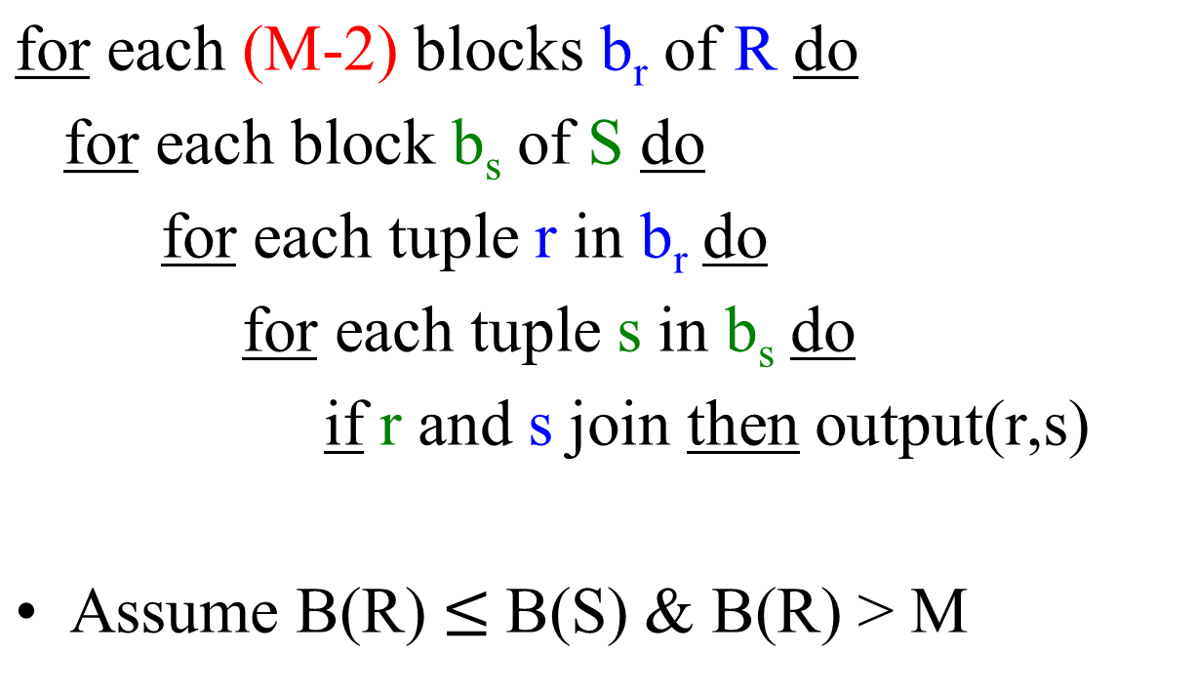
Block-based Nested Loop Joins
Assume both relations are clustered
cost (R is outer): 1+x (x = 10)
R: one pass
S: B(R)/(M-2) * B(S)
B(R) + B(R)/(M-2) * B(S)
for s in Sells:
for b in Beers:
if (s.beer = b.name):

Slide 33
Block-based Nested Loop Joins
R.a = S.a
load 100 blocks of R
R = 1,000 blocks
R & S
(M-2) blocks of R
. . .
. . .
joined
tuples
. . .
Input buffer for S
Output buffer
S = 5,000 blocks
M = 102
cost(R is outer) = B(R) + B(R)/(M-2) * B(S)
cost(S is outer) = B(S) + B(S)/(M-2) * B(R)

Slide 34
Block-based Nested Loop Joins
B(R) = 1000
B(S) = 5000
M = 102
1. Loading 100 blocks of R
loading S one at a time
2. Loading next 100 blocks of R
  loading S one at a time
...
10.
Cost so far
= 100 + 5000
Total cost (R is outer):
B(R) + B(R)/(M-2) * B(S)
= 1000 + 1000/100 * 5000
= 1000 + 50,000 = 51,000
R.a = S.a
cost1 = B(R) + B(R)/(M-2) * B(S)
cost2 = B(S) + B(S)/(M-2) * B(R)
load 100 blocks of R
R & S
B(S) + B(S)/(M-2) * B(R)
Hash table for (M-2) blocks of R
. . .
. . .
joined
tuples
. . .
S1
R = 1,000 blocks
Input buffer for S
Output buffer
R outer: B(R) + B(R)/(M-2) * B(S)
S outer: B(S) + B(S)/(M-2) * B(R)
M-2 >= 1 => M >= 3

Slide 35
Notes
B(R) = 1000 B(S) = 5000, M = 102 (smallest M = 3)
load 1st 100 blocks of R (R1), join with S (one
block a time)
100 + B(S)
load 2nd 100 blocks of R, join with S
100 + B(S)
…
load 10th 100 blocks, join with S
R is outer:
* Total cost: B(R) + B(R)/(M-2) * B(S)
= 1000 + 10 * 5000 = 1000 + 50,000
S is outer:
* Total cost: B(S) + B(S)/(M-2) * B(R)
lower cost if smaller relation (R) placed in the outer

Slide 36
notes
load 1st 100 blocks of R
  load one block of S for 5000 times
  => making one pass through S
load 2nd 100 blocks of R
  making one pass through S
…
load 10th 100 blocks of R
=> make one pass through S
cost (R is outer):
R: one pass
S: B(R)/(M-2) * B(S)
  10 passes through S
B(R) + B(R)/(M-2) * B(S)
cost (S is outer):
S: one pass
R: B(S)/(M-2) * B(R)
  50 passes through R
B(S) + B(S)/(M-2) * B(R)

Slide 37
Block-based Nested Loop Joins
Cost:
  Read R once: cost B(R)
  Outer loop runs B(R)/(M-2) times, and each time need to read S: costs B(R)B(S)/(M-2)
  Total cost: B(R) + B(R)B(S)/(M-2)
Notice: it is better to iterate over the smaller relation first
R S: R=outer relation, S=inner relation
What is the minimum memory requirement?
⋈

Slide 38
Example
select * from R natural join S
for each 100 blocks of R:
for each block in S:
…
B(R) + B(R)/(M-2) * B(S)
1.x where x = 10
B(S) + B(S)/(M-2) * B(R)
1.x where x = 50
Suppose M = 102 blocks (i.e., pages), B(R) = 1000 blocks, B(S) = 5,000 blocks
  # of chunks from R = 10, chunk size = 100 blocks
Cost of R S using blocked-based nested-loop join algorithm
  If R is outer relation: one pass R; 10 passes through S
    1000 blocks + 1000/(102-2) * 5000 = 51,000
  If S is outer relation: one pass S; 50 passes R
    + 5000/(102-2) * 1000 = 55,000
⋈

Slide 39
Two-pass algorithms

Slide 40
Two-pass Algorithms
If an operation can not be completed in one pass, can we design an algorithm to complete it in two passes?
  Yes, but with certain restriction on the relation size

Slide 41
Ideas
Sorting
  Sort relation(s) into runs
  Perform the needed operation while merging the runs
Hashing
  Hash relation(s) into buckets
  Only need to examine a bucket or a pair of buckets at a time

Slide 42
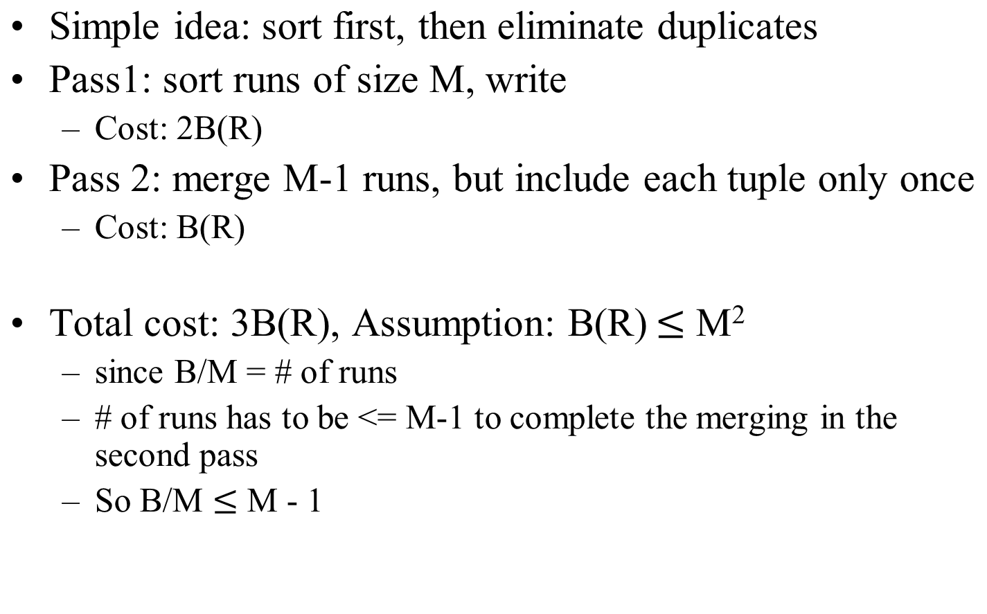
Duplicate Elimination δ(R)
Based on Sorting

Slide 43
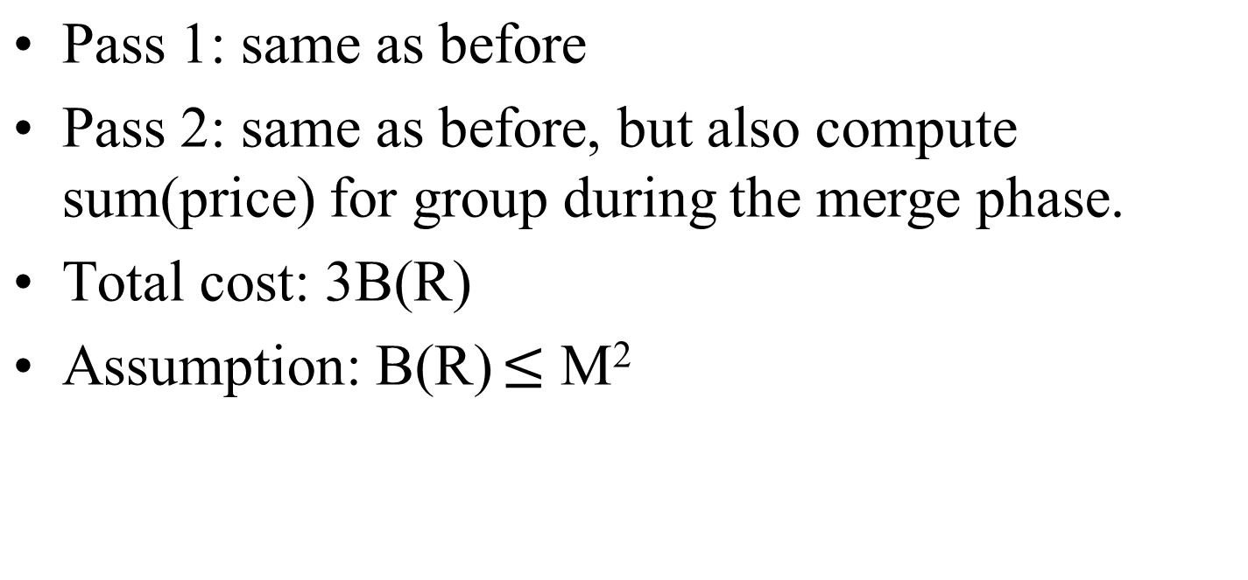
Grouping: γ_{city, sum(price)} (R)
Based on Sorting

Slide 44
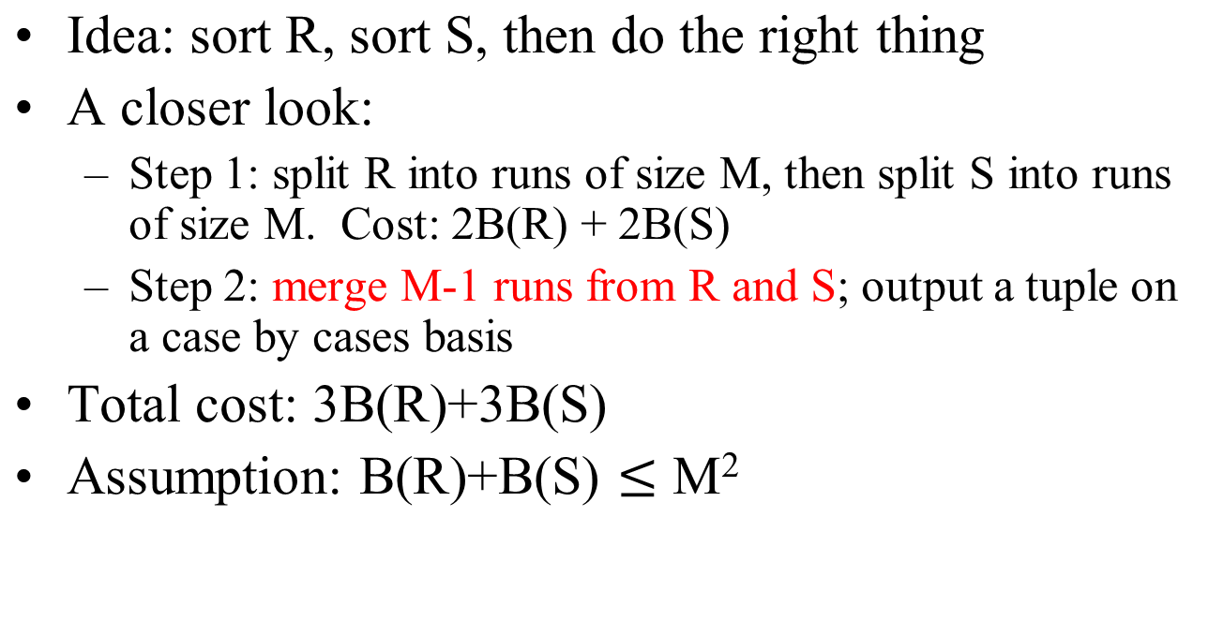
Binary operations: R ∩ S, R U S, R – S
Based on Sorting

Slide 45
Merging picture
Select *
from R join S on R.a=S.a
M=101
1
1
2
2
Output buffer
1
1
1
3
…
S(a)
===
1
1
1
3
...
R(a)
===
1
1
1
2
...
…
1 2
1 1
…
1 3
1 2
B(R)/M + B(S)/M <= M-1 ~ M
M >= sqrt[B(R)/M + B(S)/M]
B(R) + B(S) <= M(M-1) ~ M^2
1000+5000 <= 100^2 = 10,000
M
M
M
M
…
…
R join S = ?
B(R)/M
10 runs
B(S)/M
50 runs

Slide 46
notes (simple-sort)
completely sort R:
  R (1000) => 10 runs => 1 run
  cost: 4B(R)
completely sort S:
  S (50,000) => 500 runs => 5 runs => 1 run
  cost: 6B(S)
3. merge R and S (both sorted)
- cost: B(R) + B(S)
Total cost: 5B(R) +7B(S)

Slide 47
Notes (sort-merge)
R (1000 blocks) => 10 runs
  cost: 2 B(R)
S (50,000) => 500 runs => 5 runs
  cost: 4 B(S)
join by merging 10 runs with 5 runs
  cost: B(R) + B(S)
total: 3B(R) + 5B(S)

Slide 48
Problem with join
A large number of tuples with the same value on the join attribute(s)
But buffer can not hold all joining tuples (with the same value on join attribute) for at least one relation

Slide 49
Problem with join
Many tuples may have the same value on the join attribute
a a a
(a,a)
(a,a)
(a,a)
(a,a)
…
R.A
a a
Join
S.A
a a a a
a a
Output
buffer
Sorted lists
a a
Disk
Main memory
buffers
Remember the tuple may
have other attributes than A

Slide 50
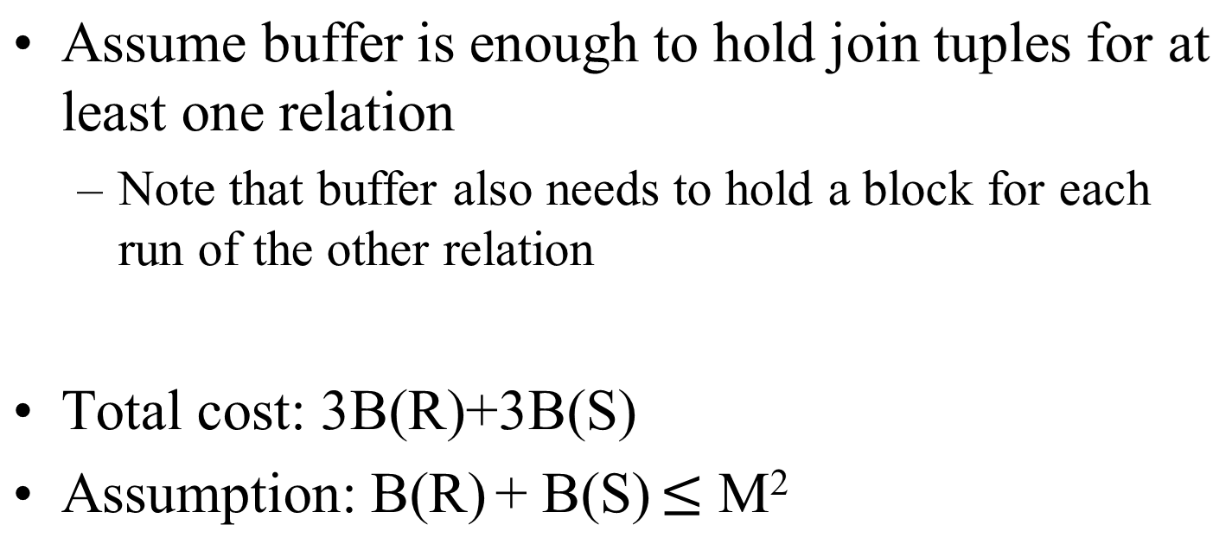
Sort-Merge Join

Slide 51
Example
Suppose M = 101 blocks (i.e., pages), B(R) = 1,000 blocks, B(S) = 5000 blocks (R.a = S.a)
  Suppose we use 100 blocks in sorting
Cost of R S using sort-merge join algorithm
  Pass 1: sort R => 10 runs, 100 blocks/run
  sort S => 50 runs, 100 blocks/run
  Pass 2 (merge): B(R) + B(S)
  total cost: 3B(R) + 3B(S) => 3B(R) + 3B(S)
What if B(S) = 50,000 blocks?
  3B(R) + 5B(S)
⋈
Writing cost:
B(R) + B(S)
Writing cost:
B(R) + B(S) +
B(S)

Slide 52
Example (continued)
Suppose M = 101 blocks (i.e., pages), B(R) = 1,000 blocks, B(S) = 50, 000 blocks (R.a = S.a)
  Suppose we use 100 blocks in sorting
Cost of R S using sort-merge join algorithm
  Pass 1: sort R => 10 runs, 100 blocks/run
  sort S => 500 runs, 100 blocks/run
  (merge S) => 5 runs, 10,000 blocks/run
  Pass 2 (merge): B(R) + B(S)
  total cost: 3B(R) + 5B(S)
  3B(R) + 5B(S)
⋈
Writing cost:
B(R) + B(S)
Writing cost:
B(R) + B(S) +
B(S)

Slide 53
Notes
Suppose M = 101 blocks (i.e., pages), B(R) = 1,000 blocks, B(S) = 5000 blocks (R.a = S.a)
  Suppose we use 100 blocks in sorting
Sort R => 10 runs, 100 blocks/run: 2B(R)
Sort S => 50 runs, 100 blocks/run: 2B(S)
merge 10 runs (from R) and 50 runs (from S)
  cost: B(R) + B(S)
Total cost: 3B(R) + 3B(S)

Slide 54
Notes
Suppose M = 101 blocks (i.e., pages), B(R) = 1,000 blocks, B(S) = 50, 000 blocks (R.a = S.a)
  Suppose we use 100 blocks in sorting
Sort R => 10 runs, 100 blocks/run: 2B(R)
Sort S
  sort into 500 runs, 100 blocks/run: 2B(S)
  merge 500 runs => 5 runs: 2B(S)
merge 10 runs (from R) and 50 runs (from S)
  cost: B(R) + B(S)
Total cost: 3B(R) + 3B(S)

Slide 55
Notes
Suppose M = 101 blocks (i.e., pages), B(R) = 1,000 blocks, B(S) = 5000 blocks (R.a = S.a)
  Suppose we use 100 blocks in sorting
Steps:
  sort R => 10 runs, 100 blocks/run
    cost = B(R) + B(R) = 2B(R) = 2000 blocks
  sort S => 50 runs, 100 blocks/run
    cost = 2 * B(S) = 10,000
  merge runs from R and S
    cost = B(R) + B(S)
  Total: 3B(R) + 3B(S) = 3 * 6000 = 18,000 (blocks)

Slide 56
Example
Suppose M = 101 blocks (i.e., pages), B(R) = 1,000 blocks, B(S) = 50,000 blocks (R.a = S.a)
  Suppose we use 100 blocks in sorting
Cost of R S using sort-merge join algorithm
  Pass 1: sort R => 10 runs, 100 blocks/run
  sort S => 500 runs, 100 blocks/run
  extra step: merging 500 runs from S => 5 runs
  Pass 2 (merge): B(R) + B(S)
  total cost: 3B(R) + 3B(S) => 3B(R) + 5B(S)
What if B(S) = 50,000 blocks?
  3B(R) + 5B(S)
⋈
Writing cost:
B(R) + B(S)
Writing cost:
B(R) + B(S) +
B(S)

Slide 57
Simple Sort-based Join
Start by completely sorting both R and S on the join attribute (assuming this can be done in 2 passes):
  Cost: 4B(R)+4B(S) (because we need to write result to disk)
Read both relations in sorted order, match tuples
  Cost: B(R)+B(S)
Can use as many buffers as possible to load join tuples from one relation (with the same join value), say R
  Only one buffer is needed for the other relation, say S
If we still can not fit all join tuples from R
  Need to use nested loop algorithm, higher cost

Slide 58
Simple Sort-based Join
Total cost: 5B(R)+5B(S)
Assumption: B(R) <= M², B(S) <= M², and at least one set of the tuples with a common value for the join attributes fit in M (or M-2 to be exact)
  Note that we only need one page buffer for the other relation

Slide 59
Example
Suppose M = 101 blocks (i.e., pages), B(R) = 1,000 blocks, B(S) = 5,000 blocks
  Assume that we use 100 blocks for sorting pass
Cost of R S using simple sort-based join algorithm
  Sort R (completely) => R': 4B(R) = 4000
  Sort S => S': 4B(S) = 20,000
  Join by merging R' with S': B(R) + B(S) (loading)
What if B(S) = 50,000 blocks?
  500 runs => 5 runs => 1 run
⋈

Slide 60
Notes
M = 101 (but 100 for sorting)
B(R) = 1000 blocks
completely sort R => R':
  pass 0: load 100 blocks of R at a time => 10 runs
  pass 1: merge 10 runs into a single run
  cost: 2 * 2 * 1000 = 4000 or 4B(R)
completely sort S => S':
  cost: 4B(S)

Slide 61
Notes
join R' with S', each having a single run
(1, 1)
(1, 1)
(1, 1)
(1, 1)
(2, 2)
(2, 2)
(3, 3)
(3, 3)
…
1 1
1 1
R'
1 1
2 2
3 3
…
S'
1 1
2 3
4 5
…

Slide 62
Notes
M = 101 (but 100 for sorting)
B(R) = 1000 blocks
completely sort R => R':
  cost: 2 * 2 * 1000 = 4000 or 4B(R)
completely sort S => S':
  pass 0: 50,000 blocks => 500 runs
  merge 1: 500 runs => 5 runs
  merge 2: runs => 1 run
  cost: 3* 2B(S) = 6B(S)

Slide 63
Notes
Sorting R (completely):
B(R) + B(R) // 10 runs
B(R) + B(R) // 1 run
= 4B(R)
Sorting S:
= 4B(S)
Merging R and S:
B(R) + B(S)

Slide 64
Two-Pass Algorithms
Based on Hashing

Slide 65
Hashing-Based Algorithms
Hash all the tuples of input relations using an appropriate hash key such that:
  All the tuples that need to be considered together to perform an operation go to the same bucket
Reduce the size of input relations by a factor of M
Perform the operation by working on a bucket (or a pair of buckets for binary operations) at a time
  Apply a one-pass algorithm for the operation

Slide 66
Sorting vs. Hashing
Size of run
Size of bucket
M
B/M
.
.
.
.
.
.
B/M
runs
M
buckets
Sorting
M-1
to be exact
Hashing
"Partitioning" picture

Slide 67
Hashing-Based Algorithm for δ
Recall: δ(R) = duplicate elimination
Step 1. Partition R into (M-1) buckets
Step 2. Apply δ to each bucket (must read it into main memory)
Cost: 3B(R)
Assumption: B(R) <= M²
  To be more exact: B(R)/(M-1) <= M-2

Slide 68
Two-Pass Duplicate Elimination
Based on Hashing
Idea: partition a relation R into buckets, on disk
Each bucket has size approx. B(R)/M
Duplicate tuples are hashed to the same bucket
Compute the hash value of a whole tuple
Relation R
OUTPUT
Buckets
1
1
R₁
2
INPUT
2
hash
function
h
R₂
. . .
B(R)
M-1
R_{M-1}
Disk
Disk
M main memory buffers

Slide 69
Two Pass Duplicate Elimination
Based on Hashing
Does each bucket fit in main memory ?
  Yes if B(R)/(M-1) <= M-2 (i.e., approx. B(R) <= M²)
Apply the one-pass δ algorithm for each R_{i}
Buckets
R₁
Seen
before?
Input
buffer
Output
buffer
R₂
Disk
R_{M-1}
M-2 buffers (Hash table)
Disk
Main memory buffers

Slide 70
Partitioned Hash Join
⋈
R S
Step 1.a:
  Hash S into M – 1 buckets
  send all buckets to disk
Step 1.b
  Hash R into M – 1 buckets
  Send all buckets to disk
Step 2
  Join every pair of corresponding buckets

Slide 71
Partitioned
Hash-Join
R.a = S.a
R.a
===
32
20
4
25
8
...
h(R.A) = 3%100
=> [0,99]+1
Relation
R
OUTPUT
Buckets
1
20
R₁
Partition tuples in R and S using join attributes as key for hash
Tuples in partition R_{i} only match tuples in partition S_{i}.
R.age = S.age
h(r.age) = h(25) = 2
h(s.age) = h(25) = ?
INPUT
2
hash
function
h
25,32
R₂
. . .
M-1
R_{M-1}
Relation
S
Buckets
OUTPUT
1
S₁
INPUT
2
25,32
S₂
. . .
hash
function
h
M-1
S_{M-1}
Notes:
14

Slide 72

notes
h(25) = 1
h(32) = 0
h(a) = a % 2
h'(a)
  (2+5)%2 = 1
  (3+2)%2 = 1

Slide 73
Partitioned Hash-Join: Second Pass
Read in a partition of S, say S_{i}, hash it using another hash function h’
Load the matching partition R_{i}, one block at a time, output joining tuples.
M= 101
Buckets
for S
Buckets
for R
S₁ = 10
hash
function
h’
18
R₁ = 50 (18, 9, 10, ..)
S₂
R₂
(25,32, ...)
H(25) = h(32)?
If h' = h, ...?
Join
S_{M-1}
R_{M-1}
M-3 blocks
Output buffer
Notes:
14

Slide 74
Partitioned Hash-Join: Second Pass
Read in a partition of S, say S_{i}, hash it using another hash function h’
Load the matching partition R_{i}, one block at a time, output joining tuples.
M= 101
Buckets
for R
Buckets
for S
R₁ = 10
S₁ = 500 (18, 9, 10, ..)
R₂
Join
S₂
(25,32, ...)
H(25) = h(32)?
If h' = h, ...?
R_{M-1}
S_{M-1}
M-2 blocks
Output buffer
Notes:
14

Slide 75
Partitioned Hash Join
Cost: 3B(R) + 3B(S)
Assumption: min(B(R), B(S)) <= M²
  Or to be more exact: min(B(R), B(S))/(M-1) <= M-3
  Or min(B(R), B(S))/(M-1) <= M-2 (if we do not use hash table to speed up the lookup)

Slide 76
Hashing notes
Suppose M = 101 blocks (i.e., pages), B(R) = 1,000 blocks, B(S) = 5000 blocks (R.a = S.a)
hash R into 100 buckets, 10 blocks/bucket: 2B(R)
  R1, R2, …, R100
hash S into 100 buckets, 50 blocks/bucket: 2B(S)
  S1, S2, …, S100
Join R1 with S1, R2 with S2, …, R100 with S100
  cost: B(R) + B(S)
total cost: 3B(R) + 3B(S)

Slide 77
Hashing notes
Suppose M = 101 blocks (i.e., pages), B(R) = 20,000 blocks, B(S) = 50,000 blocks (R.a = S.a)
Step 1 (hash function = h)
  hash R using h into 100 buckets, 200 blocks/bucket: 2B(R)
    R1, R2, …, R100 (cost: 2B(R))
  hash S using h into 100 buckets, 500 blocks/buck: 2B(S)
    S1, S2, …, S100 (cost: 2B(S))
Step 2 (hash function = h') question: h' =? h
  Join R1 (200 blocks) with S1 (500 blocks)
    step 1: partitioning (R1, R2, …, R100) cost: 2B(R)
    step 2: partitioning (…

Slide 78
Hashing notes
Suppose M = 101 blocks (i.e., pages), B(R) = 20,000 blocks, B(S) = 50,000 blocks (R.a = S.a)
hash R into 100 buckets, 200 blocks/bucket
  R1, R2, …, R100
hash S into 100 buckets, 500 blocks/buck: 2B(S)
  S1, S2, …, S100
* Join R1 (200 blocks) with S1 (500 blocks)
  hash R1 into R11, R12, …, R1-100
  hash S1 into …

Slide 79
Notes
Suppose M = 101 blocks (i.e., pages), B(R) = 1,000 blocks, B(S) = 50, 000 blocks (R.a = S.a)

Slide 80
Example
Suppose M = 101 blocks (i.e., pages), B(R) = 1,000 blocks, B(S) = 50,000 blocks (R.a = S.a)
Cost of R S using partitioned hash join algorithm
  Pass 1: hash R into 100 buckets, 10 blocks/bucket (R1)
  hash S into 100 buckets, 500 blocks/bucket (S1)
  cost: 2B(R) + 2B(S)
  - Pass 2: join Ri with Si
    cost: B(R) + B(S)
What if B(S) = 50,000 blocks?
⋈

Slide 81
Example
Suppose M = 101 blocks (i.e., pages), B(R) = 10,000 blocks, B(S) = 50,000 blocks (R.a = S.a)
Cost of R S using partitioned hash join algorithm
  Pass 1: hash R into 100 buckets, 100 blocks/bucket (R1)
  hash S into 100 buckets, 500 blocks/bucket (S1)
  cost: 2B(R) + 2B(S)
  -extra: hash (R1) => 100 buckets, 1 block/bucket (R11)
  hash(S1) => 100 buckets, 5 blocks/bucket (S11)
  join R11 with S11, R12 with S12, … R1,100 with S1,100
  Pass 2: join Ri with Si
    cost: B(R) + B(S)
What if B(S) = 50,000 blocks?
⋈

Slide 82
notes
size of Ri = B(R)/(M-1)
size of Si = B(S)/(M-1)
min[B(R)/(M-1), B(S)/M-1)] <= M – 2
min[B(R), B(S)] <= (M-1) (M-2) ~ M^2
  min(1000, 50000) <= 10,000
recall sorting formula
  B(R) + B(S) <= M^2
    1000 + 50,000 <= 10,000

Slide 83
Example
Suppose M = 101 blocks (i.e., pages), B(R) = 20,000 blocks, B(S) = 50,000 blocks
Cost of R S using partitioned hash join algorithm
  Pass 1: hash R into 100 buckets, 200 blocks/bucket (Ri)
  hash S into 100 buckets, 500 blocks/bucket (Si)
  cost: 2B(R) + 2B(S)
  -- pass 2: join R1 (200 blocks) with S1 (500 blocks)
  join R2 with S2, …
  Pass 3: ….
    cost: …
What if B(S) = 50,000 blocks?
⋈

Slide 84
Sort-based vs. Hash-based Algorithms
Hash-based algorithms for binary operations have a size requirement only on the smaller of two input relations
Sort-based algorithms sometimes allow us to produce a result in sorted order and take advantage of that sort later
Hash-based algorithm depends on the buckets being of equal size, which may not be true if data are skewed

Slide 85
Index-Based Algorithms

Slide 86
Index-based Algorithms
The existence of an index on one ore more attributes of a relation makes available some algorithms that would not be feasible without the index
Useful for selection operations
Also, algorithms for join and other binary operations use indexes to good advantage

Slide 87
Clustered indexes
In a clustered index, all tuples with the same value of the search key appear on roughly as the number of blocks as can hold them
  That is, they are clustered together
a a a
a a a a a
a a
All the ‘a’ tuples

Slide 88
Index Based Selection
Selection on equality: σ_{a=v}(R)
Clustered index on attribute a: cost = B(R)/V(R,a)
Unclustered index on a: cost = T(R)/V(R,a)
We here ignore the cost of reading index blocks

Slide 89
Index Based Selection
Example: B(R) = 2000, T(R) = 100,000, V(R, a) = 20, compute the cost of σ_{a=v}(R)
Cost of using table scan:
  If R is clustered: B(R) = 2000 I/Os
  If R is unclustered: T(R) = 100,000 I/Os
Cost of index-based selection:
  If index is clustered: B(R)/V(R,a) = 100
  If index is unclustered: T(R)/V(R,a) = 5000
Compare this

Slide 90
Index-Based Join
R S
Assume S has an index on the join attribute
Iterate over R, for each tuple, fetch corresponding tuple(s) from S
Assume R is clustered. Cost:
  If index is clustered: B(R) + T(R)B(S)/V(S,a)
  If index is unclustered: B(R) + T(R)T(S)/V(S,a)
Compare this to NLJ (both R & S clustered)
  B(R) + B(R)/(M-2) * B(S)
⋈

Slide 91
Indexed-Based Join vs. NLJ
Index-based (R clustered, clustered index S.a)
  B(R) + T(R)B(S)/V(S,a)
NLJ (R & S clustered)
  B(R) + B(R)/(M-2) * B(S)
Index-Based wins if:
  T(R)/V(S,a) < B(R)/(M-2), or
  V(S,a) > (M-2) * T(R)/B(R)

Slide 92
Index-Based Join: Clustered Index
Output buffer
M-2
Tuple r
r(a)
S blocks
w/ join tuples
# = B(S)/V(S,a)
I_{S}
Clustered index
on S.a
R(a, b)
S(a, c)

Slide 93
Index-Based Join: Unclustered Index
Output buffer
M-2
Tuple r
r(a)
S blocks
w/ join tuples
# = T(S)/V(S,a)
I_{S}
Unclustered index
on S.a
R(a, b)
S(a, c)

Slide 94
Example
Suppose M = 102 blocks (i.e., pages)
R(a, b) S(a, c)
S has an index on attribute "a" and V(S,a) = 100
B(R) = 1,000 blocks, B(S) = 5,000 blocks
T(R) = 10,000 tuples, T(S) = 50,000 tuples
Cost of R S using index-based join algorithm
  Index on S.a is clustered
  Index on S.a is unclustered
⋈
⋈

Slide 95
Index-Based Join: Two Indexes
Assume both R and S have a clustered index (e.g., B+-tree) on the join attribute
Then can perform a sort-merge join where sorting is already done (for free)
Cost: B(R) + B(S)
Index
1 3 4 4 4 5 6
…
2 2 4 4 6 7
Index

