Slide 1
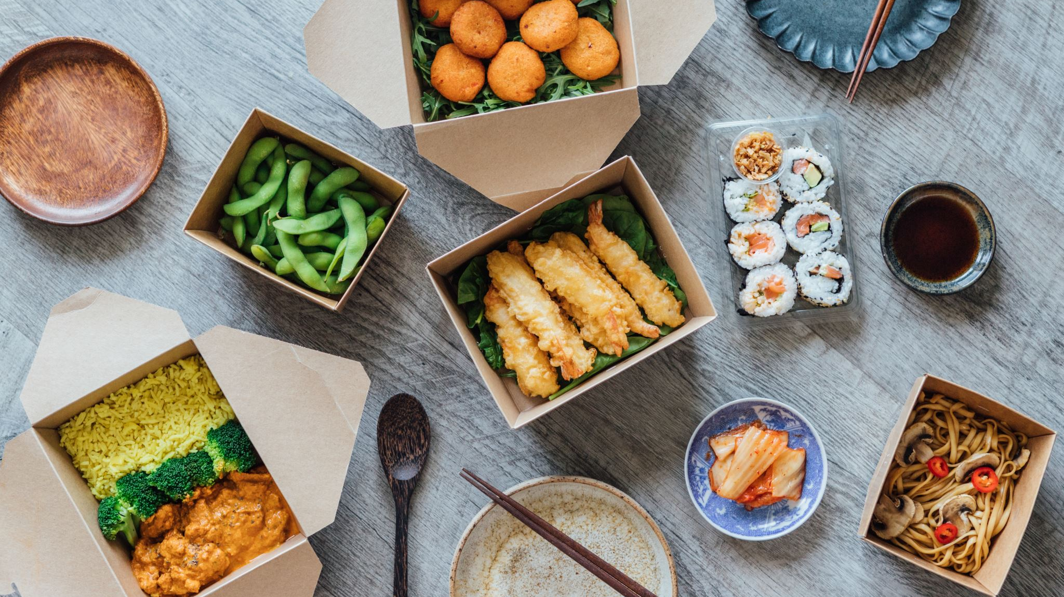
CampusBite – Smart Meal Planner & Food Social Hub
Development Timeline and Milestones
Presented by: SWE Ajayi

Slide 2
Project Overview
App Concept: 'CampusBite' is a meal-planning, recipe-finding, and social-sharing platform aimed at college students and young adults.
Objectives:
- Encourage affordable, nutritious meals.
- Build a campus-based social community.
- Improve budgeting and dietary tracking for students.

Slide 3
Development Phases Overview
Phases:
- Phase 1: Planning & Setup
- Phase 2: Core Backend & Database Setup
- Phase 3: Core Features Development
- Phase 4: Basic Frontend Development
- Phase 5: Social & Community Features
- Phase 6: Advanced Features & Integrations
- Phase 7: Testing & Optimization
- Phase 8: Launch Preparation & Beta Testing
- Phase 9: Post-Launch and Enhancements

Slide 4
Phase 1
Key Objectives:
- Finalize architecture, Spoonacular API capabilities, and core feature designs.
- Design wireframes for major app screens (onboarding, meal planner, etc.).
Setup Tasks:
- Set up GitHub repository, cloud environments (Firebase, Heroku).
- Configure Spoonacular API and manage API keys.

Slide 5
Phase 2
Backend Development:
- Set up Node.js and Express backend.
- Implement user authentication with Firebase Auth/Auth0.
Database Setup:
- Design MongoDB schema covering users, recipes, social posts, preferences.
- Implement CRUD operations for recipes, social posts, and grocery lists.

Slide 6
Phase 3
Features:
- Recipe Finder & Planner with budget, dietary, and time-based filters.
- Health Tracking Dashboard for basic nutrition insights.
- Grocery List Generator with cost estimation.

Slide 7
Phase 4
Frontend Tasks:
- Set up React Native project for iOS and Android.
- Build core UI screens and navigation structure.
- Implement state management with Redux or Context API.
Backend Integration:
- Connect frontend to backend API and ensure error handling.

Slide 8
Phase 5
Social Features:
- Develop a social feed for users to share recipes, meal photos, and comments.
- Implement like/comment interactions and challenges feature (e.g., meal-prep challenges).

Slide 9
Phase 6
Advanced Features:
- Group Meal Planning with shared grocery lists and real-time updates.
- On-Demand Cooking Help with video tutorials and a 'panic' button.
- Budget Analyzer to track monthly grocery spending.

Slide 10
Phase 7
Testing:
- Conduct unit and integration testing on backend and frontend.
- Validate flows for recipe search, grocery lists, and social interactions.
Optimization:
- Refactor code, improve readability, and cache recipe searches for performance.

Slide 11
Phase 8
Beta Testing:
- Release to a small group for initial feedback.
- Collect feedback, identify bugs, and make adjustments.
Deployment:
- Deploy backend to production, and publish on App Store and Google Play.

Slide 12
Phase 9
Post-Launch Goals:
- Gather user feedback and improve usability.
- Roll out regular updates and new content (challenges, tutorials).
Ongoing Maintenance:
- Monthly updates, bug fixes, and performance improvements.

Slide 13
Conclusion & Next Steps
Summary:
- CampusBite development timeline emphasizes a strategic, phased approach.
- Key focus on delivering value incrementally with room for future feature expansion.
Next Steps:
- Begin Spoonacular API testing for core feature endpoints.
- Set up backend scaffolding and database connections.

