Slide 1
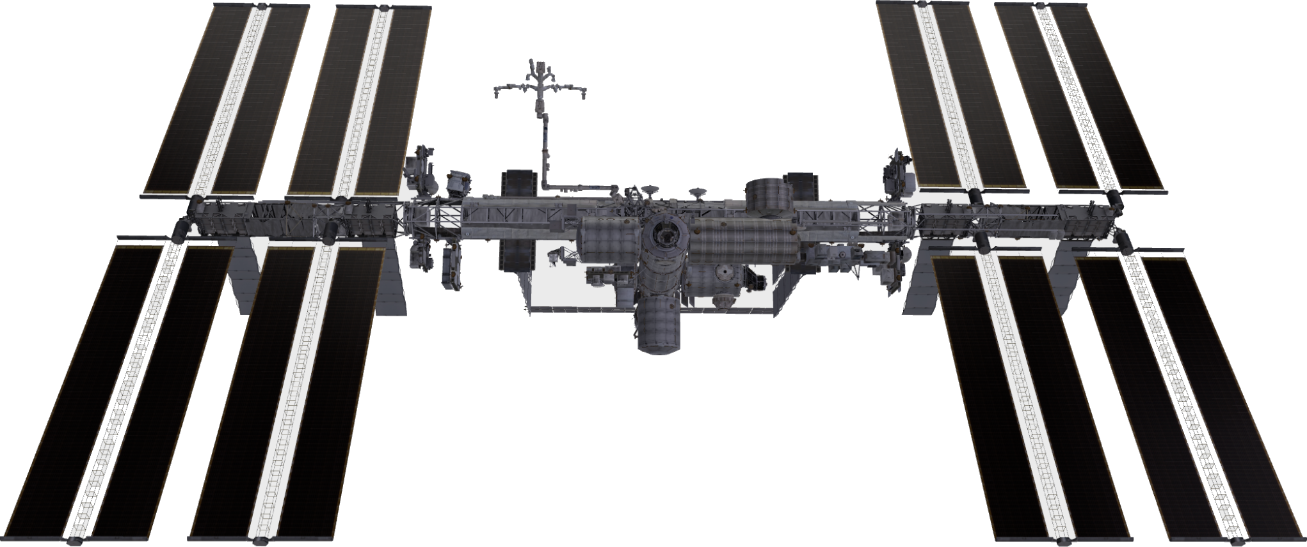
A
Orbital inspection in LVLH frame
B
Camera visibility model and dwell accumulation
range r ∈ [rmin, rmax]
n
FOV half-angle ϕ
line-of-sight visible
incidence angle θ
occluded / blocked
y (along-track)
Keep-out ellipsoid
Surface samples
t₁
t₂
⋯
tₙ
Dwell
Repeated visibility over time
^{Dᵢⱼ = Σ Δtₖ}
x (radial)
covered
z (cross-track)
initial state x₀
to be covered
candidate views
C
Finite candidate-view graph with HCW feasibility
D
Geometry-only versus dynamics-aware planning
r9
r10
Geometry-only planning
OrbInspect
r8
c₁₂
r11
^{attractive but infeasible}
^{dynamics-aware planning}
feasible HCW
high coverage
r12
moderate coverage
r7
infeasible/high-cost
r1
node reward
r6
cᵢⱼ = ∞
coverage gain
c₉₁₀
r5
r2
×
r4
r3
crosses keep-out
excessive input
clearance &lt; 0
safe transfer
clearance &gt; 0
Orbital inspection is formulated as finite camera-view selection under visibility, dwell, HCW transfer feasibility, keep-out clearance, and input limits.

