Slide 1
MOEN-IMS
System Update
Four new features changing how we plan, generate and track releases.
01
02
03
04
Projects page
BoQ-driven project segregation
Memo & Release Letter
Ghana Map — access rate
Prepared for the internal team · Read-through deck

Slide 2

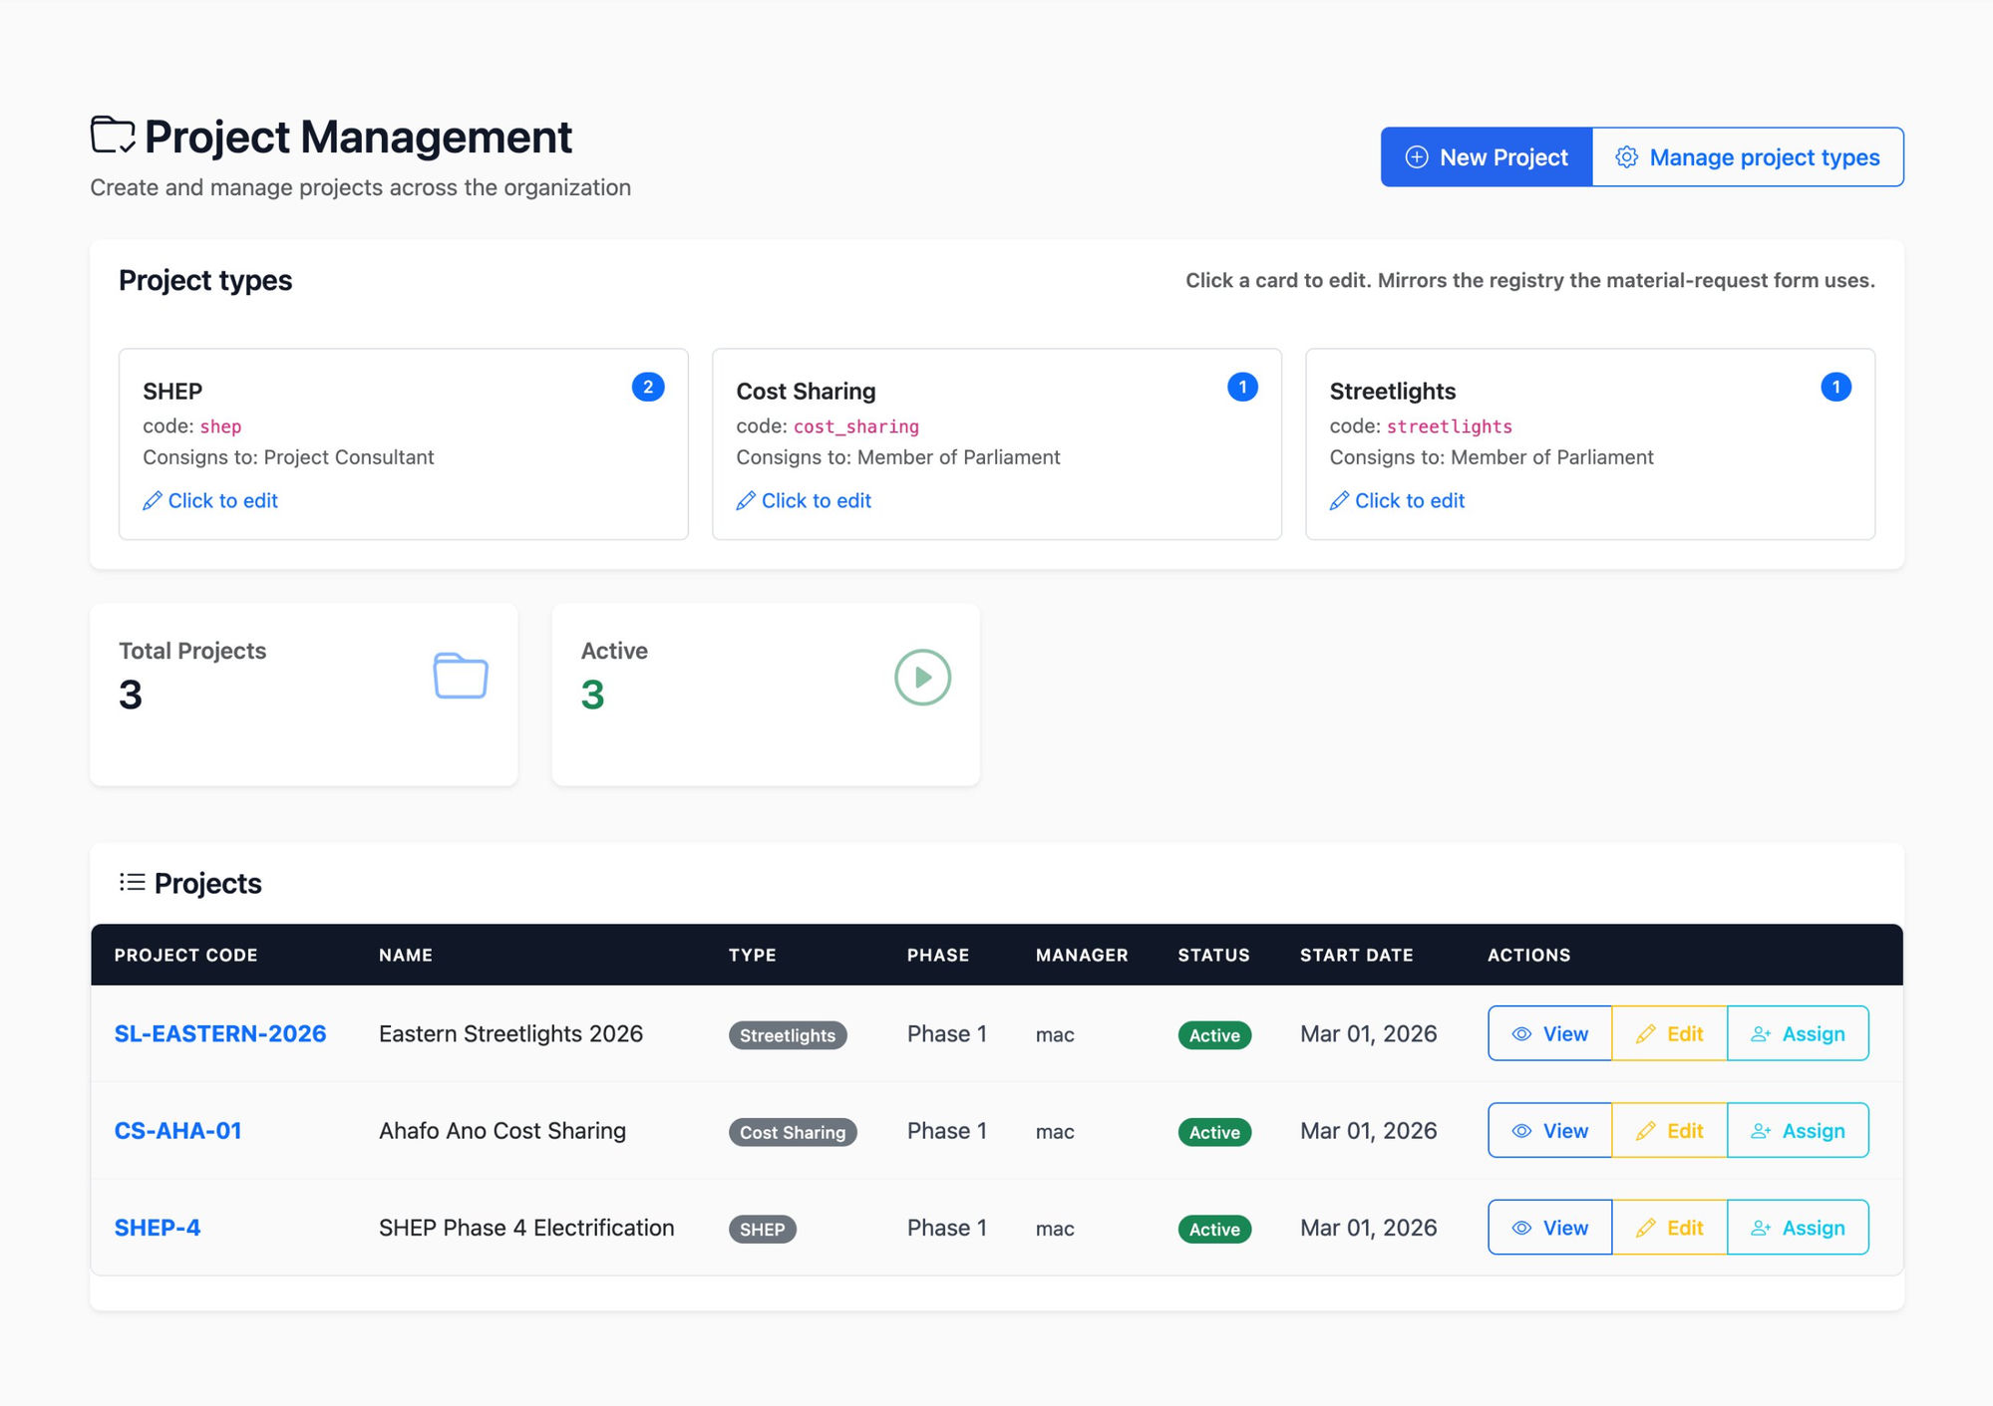



01 · PROJECTS PAGE
One place to set up and govern every project.
Create new projects
Click New Project, pick a type (SHEP, Cost Sharing, Streetlights), give it a code and a manager. Counted under the right project type immediately.
Project types you can edit
Three cards at the top — SHEP, Cost Sharing, Streetlights — show what each consigns to (Project Consultant or Member of Parliament). Click a card to update.
All projects in one list
Project code, name, type, phase, manager, status. View, Edit and Assign in line — no extra clicks.
No more waiting on a developer to add a project.
Project Management · /project-management/
MOEN-IMS · System Update
2 / 6

Slide 3
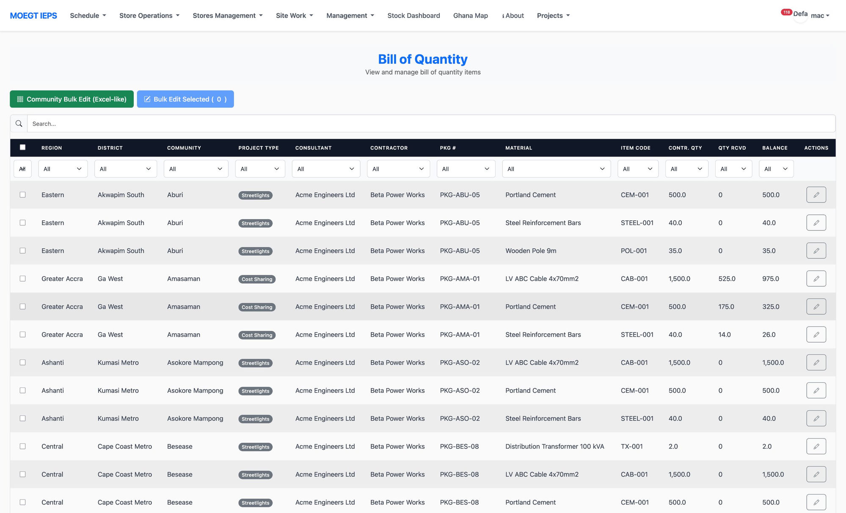

02 · BILL OF QUANTITY
Every line tagged by project — filter, sort, edit in bulk.
Project type on every row
Each BoQ line shows its project type — Streetlights, Cost Sharing, SHEP. No more mixed views.
Filter by anything
Region, district, community, project type, package, material. Filters stack — narrow to exactly what you want to see.
Bulk edit by community
Community Bulk Edit opens an Excel-like view. Tick rows and use Bulk Edit Selected for changes across many lines at once.
Contract vs. received vs. balance — visible at a glance.
Bill of Quantity · /bill-of-quantity/
MOEN-IMS · System Update
3 / 6

Slide 4
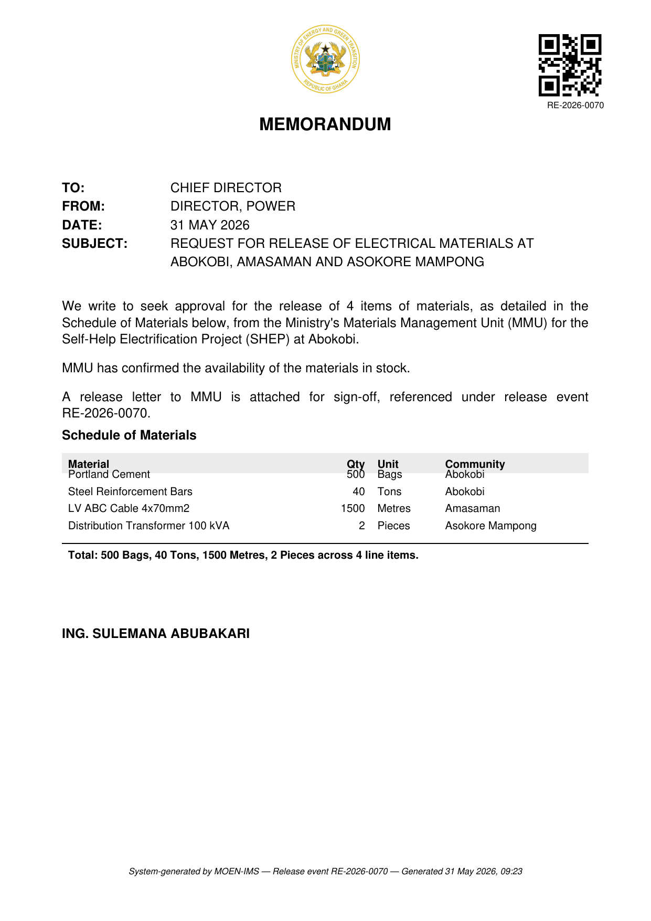
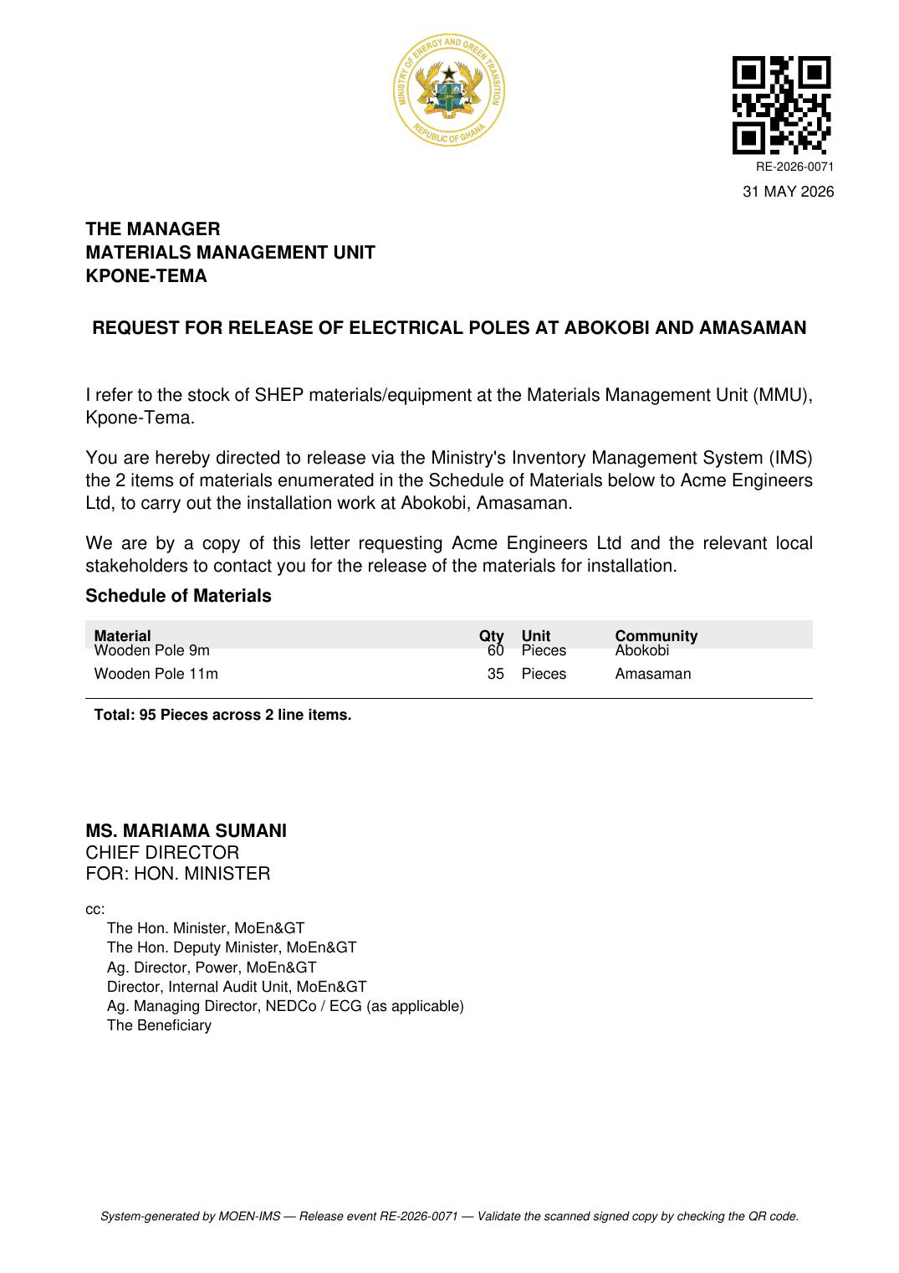


03 · MEMO & RELEASE LETTER
Two documents, generated in one click.
Pick a request code
Both PDFs generate together: the approval memo (internal) and the release letter (to the MMU).
Signed by the right officer
Designations are pulled live from the Signatory roster. Pick the title, the system attaches the name.
QR-verified scan upload
Print, sign, scan, upload. The QR code in the corner proves the scan matches what we generated.
Bulk uploads pre-fill signatories from the Excel.
Approval Memo · Director, Power → Chief Director
Release Letter · Chief Director FOR: Hon. Minister → MMU
MOEN-IMS · System Update
4 / 6

Slide 5

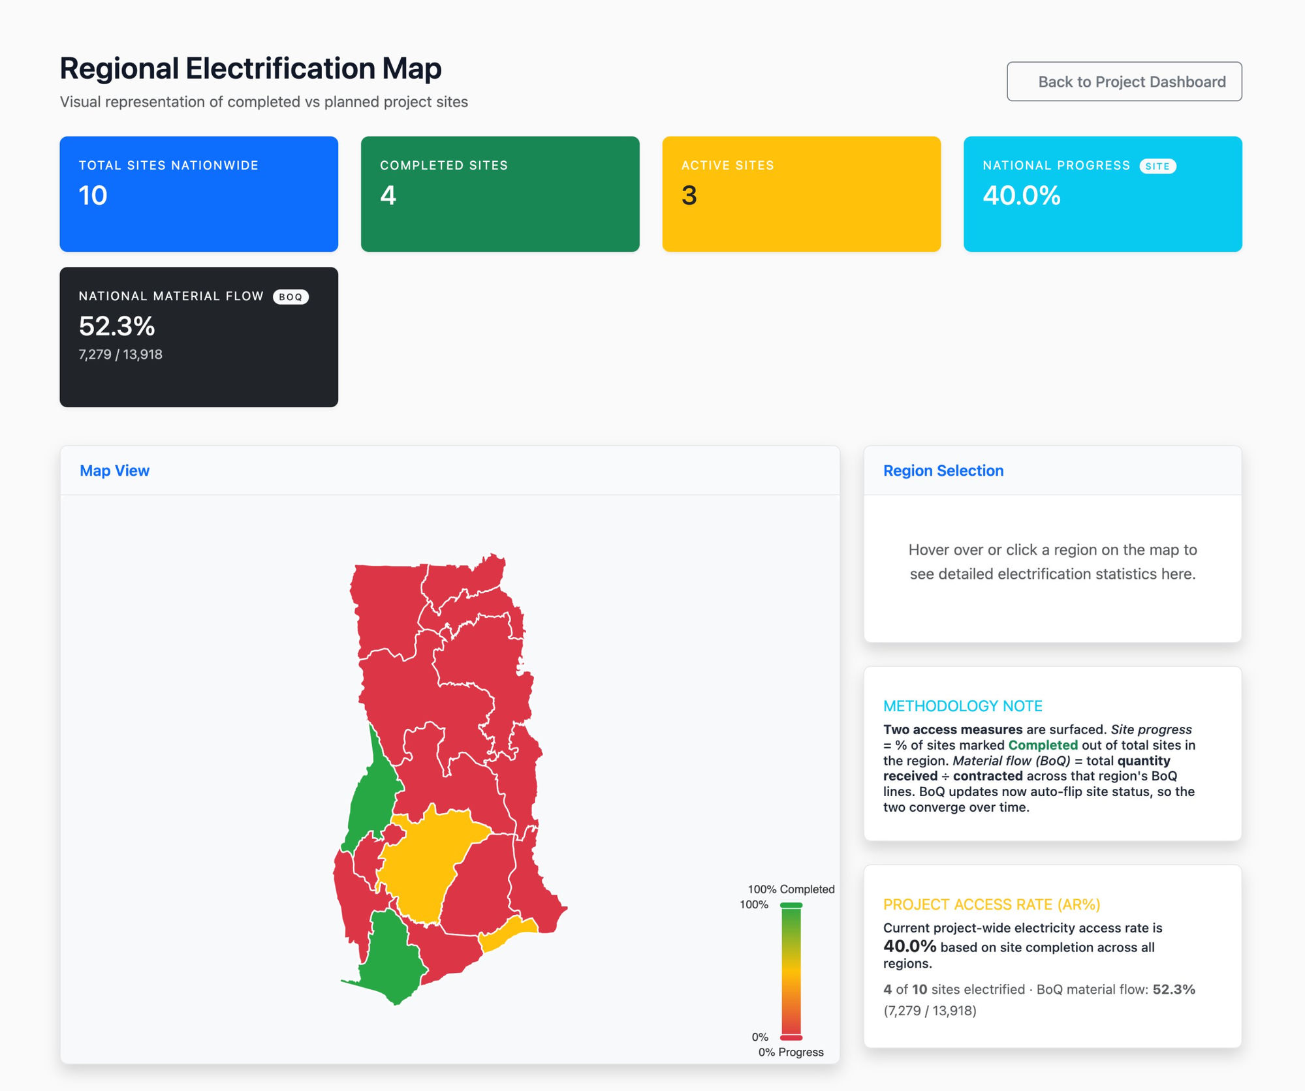
04 · GHANA MAP
See the access rate, region by region.
Click any region
The map colours each region by access rate. Click one to see total, completed and active sites.
Two measures, side by side
Site progress = completed sites ÷ total sites. Material flow = quantity received ÷ contract quantity from the BoQ.
Drill into any number
Click the headline tiles — Total, Completed, Active, National Progress — for the full table and the per-region breakdown.
40.0%
52.3%
10
site progress
material flow
tracked sites
Regional Electrification Map · /ghana-map/
MOEN-IMS · System Update
5 / 6

Slide 6
Recap
Four things you can do today that you couldn't last month.
Set up a project
Read the BoQ
From the Projects page — no developer needed.
Every line tagged by project; filter and bulk-edit.
Generate releases
Map the country
Memo + letter in one click, with a QR check.
Access rate per region, drillable.
Questions?

