Slide 1
MOEN INTEGRATED ENERGY PROJECT SYSTEM
Current Workflow, Email Alerts
& Document Automation
An executive summary of the request-to-BoQ-deduction process
Stages 1 – 9 · request → Bill of Quantity deduction
Technical brief · 24 May 2026 · Version 1.0

Slide 2



OVERVIEW
Three things to know
How MOEN-IMS moves materials — and the two capabilities that define the current build.
An end-to-end workflow
An email at every step
Documents on demand
Nine stages carry every material release from the initial request through to a deduction on the project Bill of Quantity.
Each handover now triggers an automatic email, so the process never waits on someone remembering to check a screen.
Approval memos and release letters are generated automatically as signed-ready PDFs, replacing manual typing.
MOEN-IMS · Executive Summary
2

Slide 3
THE WORKFLOW
From request to BoQ deduction
AUTHORISE
Stages 1 – 3
ISSUE & DELIVER
Stages 4 – 7
CONFIRM
Stages 8 – 9
1
Request raised
Schedule Officer logs the release
4
Processed by store
Storekeeper verifies and processes
8
Site receipt logged
Consultant confirms with proof
2
Documents generated
Approval memo & release letter
5
Stock deducted
Order completed; warehouse drawn down
9
BoQ deduction
Received quantity posted to the BoQ
→
→
3
Signed & verified
Scan uploaded, QR-checked, confirmed
6
Transport assigned
Carrier, vehicle and driver attached
7
Delivered to site
Tracked from in-transit to delivered
MOEN-IMS · Executive Summary
3

Slide 4



NOTIFICATIONS
An email alert at every step
Every handover, an email
WHO GETS TOLD, AND WHEN
Ten workflow events each raise an automatic email alert alongside an in-app notification.
New release request
Store Officers · Management
Straight to Outlook
Order completed
Alerts are delivered through Microsoft 365 — they arrive in the inboxes staff already watch.
Requester · Management
Transport delivered
Receiving group
Never blocks work
Site receipt logged
If an alert cannot be sent it is logged and the workflow continues; a notification problem can never stall a transaction.
Management · Store Officers
BoQ over-issuance raised
Management
+ 5 further events — processing, in-transit, low stock and more
MOEN-IMS · Executive Summary
4

Slide 5

NEW FEATURE
Approval memos & release letters, generated
BEFORE
NOW
Typed by hand
Generated in one click
Every release needed its memo and letter typed out in a word processor — slow, and open to inconsistent wording and transcription error.
→
From the release record, a single action produces both PDFs — correctly formatted, uniquely coded, and ready to print and sign.
WHAT THE GENERATOR HANDLES
Official memo & letter format
Signatory from an editable table
Wording adapts to project type
RE-code + QR on every document
MOEN-IMS · Executive Summary
5

Slide 6
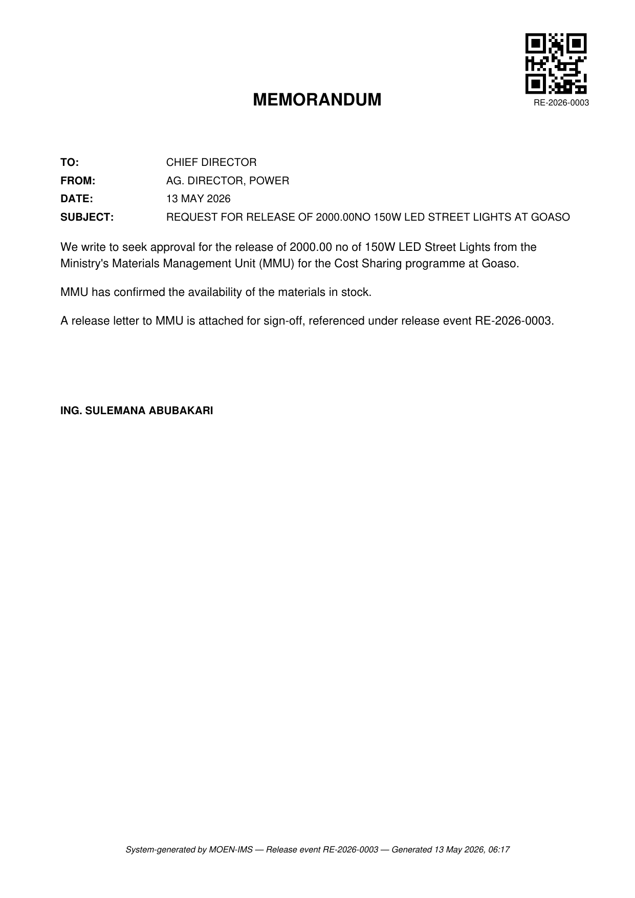
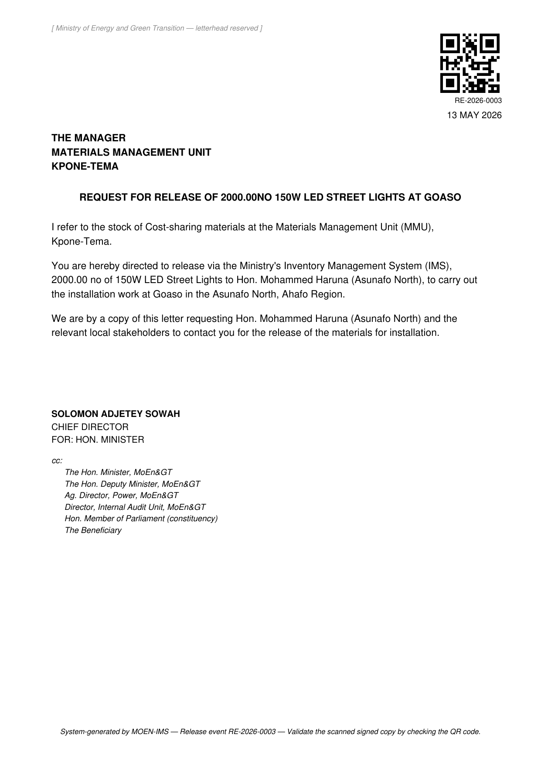
WORKED EXAMPLE
What the documents look like
Release RE-2026-0003 — 2,000 LED street lights for the Cost Sharing programme at Goaso.
WHAT TO NOTICE
One shared code
Both documents carry RE-2026-0003 — linking the memo, the letter and the signed scan.
QR-verified
The QR code lets a scanned, signed copy be matched back to this release automatically.
Correct signatories
Ag. Director, Power signs the memo; Chief Director, for the Hon. Minister, the letter.
Project-aware wording
The body text reflects the Cost Sharing programme and the Goaso beneficiary.
Approval memo
Release letter
MOEN-IMS · Executive Summary
6

Slide 7





ASSURANCE
Built-in safeguards on every document
Each release and its documents are protected by the same set of controls.
Unique RE-code
QR verification
Two-person review
Tracked status
Full audit log
Every release is coded RE-YYYY-NNNN, allocated automatically and rolling each year.
Uploaded signed scans are matched by QR code; the wrong document is flagged, not accepted.
The officer who uploads a signed scan cannot be the one who confirms it.
Each release is followed from draft through to released, always visible.
Every status change is recorded, giving a complete forensic trail.
MOEN-IMS · Executive Summary
7

Slide 8
AT A GLANCE
By the numbers
9
10
2
100%
workflow stages
alert events
documents
of status changes
from request to BoQ deduction
each triggering an automatic email
generated per release, in one action
captured in the audit log
The current build, in four figures — a workflow that is instrumented end to end.
MOEN-IMS · Executive Summary
8

Slide 9



THE PAYOFF
What this means in practice
End-to-end traceability
An alert at every handover
Signed-ready documents
A request can be followed from the form that created it to the exact quantity deducted from the project Bill of Quantity.
Each role is emailed when work reaches them, so the process advances without anyone needing to poll a screen.
Memos and letters are generated consistently, uniquely coded and QR-verifiable — replacing manual typing.
MOEN-IMS · Executive Summary
9

Slide 10
IN SUMMARY
From a line on a form to a verified deduction on the project's Bill of Quantity.
Traceable end to end, with an email at every handover and signed-ready documents produced in a single click.
Full detail is set out in the technical brief · MOEN-IMS · 24 May 2026

