Slide 1

Final Project presentation and report

Slide 2
Steps
Pick your dataset
The dataset can be one connected to your third year projects.
Advised to choose a dataset connected to health/biology ect.
Get it approved
Each group has to send me (Romi) the data they want to use by 26/6/22 so you will have enough time to work on the presentations.
Each group will choose a different dataset. I will upload the approved datasets of the different groups to the Moodle.
Work with your dataset
Presentation
Final Report

Slide 3
So where is all that data hiding?
https://github.com/awesomedata/awesome-public-datasets#biology
http://datadryad.org/
https://toolbox.google.com/datasetsearch
https://data.mendeley.com/
https://www.kaggle.com/tags/biology
https://en.wikipedia.org/wiki/List_of_datasets_for_machine-learning_research#Biological_data
https://datagious.com/datasets/

Slide 4
What makes a dataset a good one*?
Size
Variety/Ratio of types
Materia expertise
History/Relevance
Transformable
*Keep all of these in mind when selecting a dataset for the final project.

Slide 5
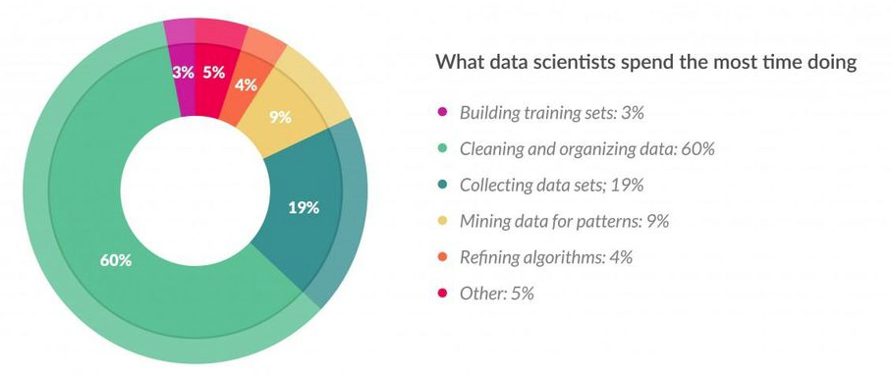
Source: https://www.forbes.com/sites/gilpress/2016/03/23/data-preparation-most-time-consuming-least-enjoyable-data-science-task-survey-says/#4607a6bb6f63

Slide 6
Presentation
Present the data for the final project.
Tell us why you chose this data, some information about the data itself (what class you plan to predict/classify, did you clean/modify the data in some way? what you hope to find at the end of the project?).
Present one algorithm that you applied on the data.
You can choose any algorithm.
we are just looking to see you were able to feed the data to the algorithm and get a result.
Talk about the next steps you are planning.

Slide 7
Presentation - Logistics
Each presentation will be 8 minutes, with 2 minutes for questions. Mind the time please.
All members in the group must speak.
Presentations will be on Thursday 16/06 and Thursday 23/06 in class.
If for some reason you cannot present, contact me (Romi) and we will find a solution.

Slide 8
Presentation – Order of Presenters
Presenting on 16/06 | Presenting on 23/06
Gil, Itamar, Yishay | Lilach, Lesli
Tomer, Vered, Michael | Hunter, Or
Eyal, Naama, Moshe | Rivka, Efi, Aviv
Yael | Shir, Roni, Inbal
Nick, Shani, Stav | Noa, Roza, Hodaya
Tamar, Or, Rachel | Zohar, Renana, Achiad
Nof, Noam, Mor | Itay, Dafna, Ido
Elichai, Asaf, Eden | Nadav, Rotem, Lidor

Slide 9
Presentation - Tips
Practice the time of the presentation.
If you want to change order of presenters, please do so between yourselves and let me know.
Number of slides is completely up to you, as well as what to include/exclude.
Presentation slides are advised to be in English.
Use as many graphs and visuals as possible.
Avoid using too much text in each slide.
The focus of the presentation is telling us why you chose this data, some information about it, and to present initial results.
We do NOT need to see code, fine tuning of algorithms, or any elaborate machine learning work (you can talk about it, and it will be included in the final report).
We DO need to see some exploratory data analysis.

Slide 10
Final Report
For the final report, you will apply dimensionality reduction and 4 algorithms taught in the course on your data.
For each algorithm, EXPLAIN why it was chosen based on your data analysis.
The focus is maximizing performance of the algorithms and finding the one that works best on your data.
The final report should include the EDA you’ve performed for the presentation, essential free text (introduction, summary, findings, conclusions) and the plots/results.
At the end of the report, you should decide what is the best approach and explain why it is most suited to analyze your data.

Slide 11
Final Report - Logistics
Submit the report in a PDF to the Moodle - include the names and ID of all group members please.
The report cannot be longer than 15 pages. If you have anything else that is important, put it in a supplementary section at the bottom of the report or in a separate file.
Tip – adjust the size of the plots and use up the space in the pages.
Tip – If you have an output you want to show for an algorithm before it was improved, put it in the supplementary section, and the final one put in the report.
Submit the report by August 1st
The final grade will be comprised of:
2 home assignments: 30% (15% each)
Presentation: 30%
Final report: 40%

Slide 12
Part 2 - List of Algorithms
Use one or more methods of dimensionality reduction (PCA, tSNE, UMAP, LDA).
You do not have to use the reduced data for the modeling.
Choose 4 algorithms taught in the course:
KNN
Decision Tree
Random Forest
SVM
Kmeans
LDA
Adaboost

Slide 13
Final report - Tips
The report is like the home assignments, only larger in scope. Use what you’ve learned.
Since the report will be large, consider using a table of content and other built-in features of markdown to organize the document. Here is a good guide: https://bookdown.org/yihui/rmarkdown/html-document.html.
You can think of the report as a large home assignment; everything that you did in the home assignments should be applicable here.

Slide 14
Good luck!

