Slide 1
Support Vector Machines (SVM) Recap and Code

Slide 2
Characteristics of SVM
Supervised
Non-probabilistic
Less straightforward than other methods we’ve learned (Black Box)
Used for Classification not Regression
Linear (although this can be bypassed with the kernel trick)

Slide 3
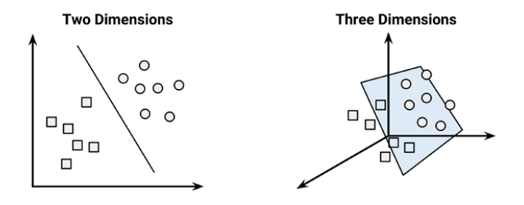
Low dimensionality SVM – easy enough!

Slide 4
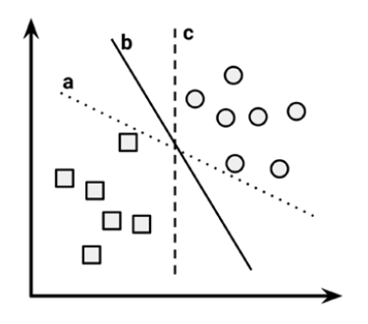
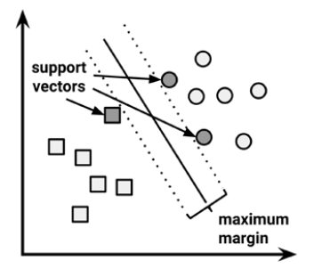
Which line separates the data best?
SVM will always aim for the maximum margin hyperplane (MMH)
While all 3 lines separate the data perfectly, line b gives the best MMH, and thus will be selected by SVM.
This comes in handy in the case of noisy data.

Slide 5
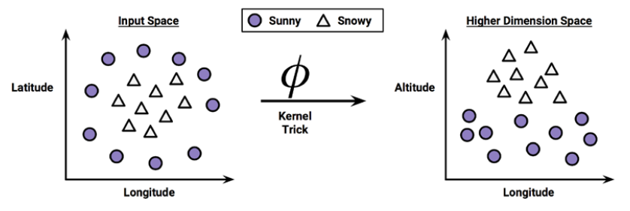
Using kernels for non-linear spaces

Slide 6
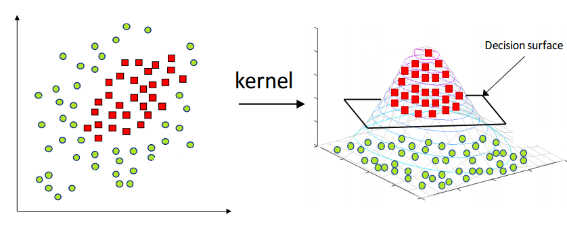
Another kernel example

Slide 7
Strengths and Weaknesses of SVM with non-linear kernals
Strengths | Weaknesses
Can be used for classification or numeric predictions problems. | Finding the best model requires testing of various combinations of kernels and parameters
Not overly influenced by noisy data and not very prone to overfitting. | Can be slow to train, especially whe the input has a large number of features or examples.
May be easier to use than neural networks, particularly due to the existence of several well supported SVM algorithms. | Results are in a ‘black box’ and can be diffucult to interpret.

