Slide 1
Glaucoma

Slide 2
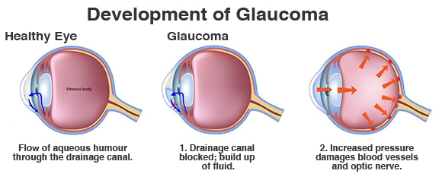
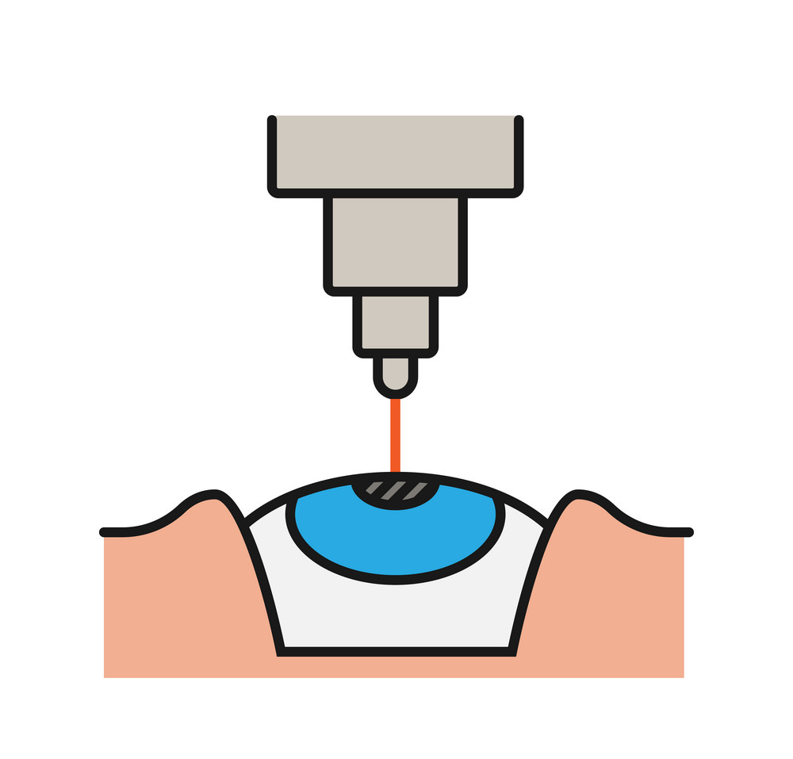

What is glaucoma disease ?
Damage eye’s optic nerve
Cause blindness
Affect people :40-70-year-old
May be asymptomatic
TEMPORARY SOLUTION
Notes:
glaucoma is the most common cause of irreversible blindness.
Glaucoma is a disease that damages your eye’s optic nerve. It usually happens when fluid builds up in the front part of your eye. That extra fluid increases the pressure in your eye, damaging the optic nerve.
This disease affect people from 40 years old to 60 years old.
In many cases, glaucoma may be asymptomatic.
Both laser and conventional surgeries are performed to treat glaucoma. Generally, these operations are a temporary solution, as there is not yet a cure for glaucoma.

Slide 3
Some statistics…
2010
2020
2040
111.8 million
79.6 million
44.7 million
Notes:
As of 2010, there were 44.7 million people in the world with open angle glaucoma.
internationally and in the United States, glaucoma is the second-leading cause of blindness.[
Based on prevalence studies, it is estimated that 79.6 million individuals will have glaucoma in 2020. This number is likely to increase to 111.8 million individuals in 2040.
In the USA, blindness is the third most feared health problem, after cancer and cardiac attacks.

Slide 4
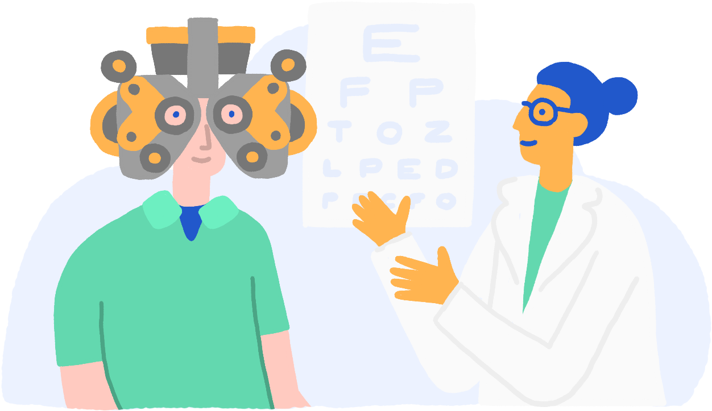

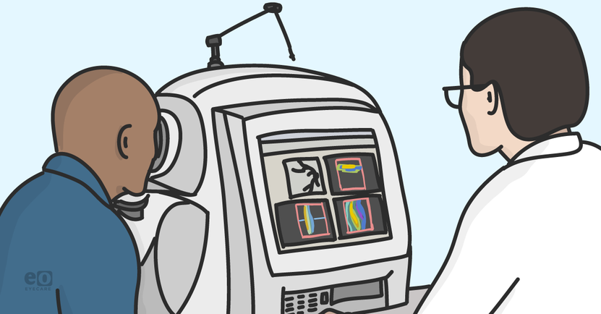
How to prevent ?
Ophthalmologist
appointment
90% of glaucoma is undetected
Only 10% is detected
Once a year
Optical Coherence Tomography Angiography
Notes:
Unfortunately, many individuals are unaware of the existence of glaucoma.
In some developing countries, 90% of glaucoma is undetected.
In most cases, blindness can be prevented with appropriate control and treatment.
A better awareness could prevent visual disability in many people.
How ? With a simple consultation once a year in the ophthalmologist.
The ophtalomogist can detect any abnormal pressure in eyes and can do some specific measurement with the help of
OCT angiography (
Optical Coherence Tomography Angiography
A classification of normal and sick patients can help us to predict if a patient has or could have a glaucoma very fast.

Slide 5
Our data set
Notes:
Our dataset is composed of 63 measurement in the eyes in normal and sick patients (patients with glaucoma).
We selected these dataset because:
No NA
Enough features
We would like to classify the data with KNN firstly.
But before, we need to understand our data and choose features that will help us to classify patients.

Slide 6
EDA
Notes:
For that we performed EDA.
Correlation matrix
PCA
Deletion of features,
PCA again.

Slide 7
KNN

Slide 8
Futurs plans
Decision tree?
Forest ?
Compare results with scores ?

