Slide 1
Tirgul 5 – Decision Trees

Slide 2
Benefits of DTs
A decision tree is good because it is:
Readable
Shareable
Understandable
A decision tree is NOT good for:
Lots of numeric data
Data with many levels
Data that might get overfitted

Slide 3
Growing a DT
A tree will continue to “grow” until:
There are no remaining features to distinguish among the examples
The tree has grown to a predefined size limit
The tree has reached its full size

Slide 4
Let’s say we want to produce a movie that will be successful but with as little cost as possible.

Slide 5
Or in other words, we created a DT

Slide 6
Strengths and Weaknesses of DTs
Strengths | Weaknesses
An all-purpose classifier that does well on most problems | Large trees can be diffucult to interpret and decision they make may seem counterintuitive
Highly automatic learning process, which can handle numeric or nominal features, as well as missing data | It is easy to overfit or underfit the model
Excludes unimportant features | Can have trouble modeling some relashionships
Can be used on both small and large datasets | Small changes in the training data can result in large changes to decision logic
Results in a model can be interpreted without mathematical backgroud (for smaller trees) | Decision tree models are often biased toward splits in features having a large number of levels
More efficient than other complex models

Slide 7
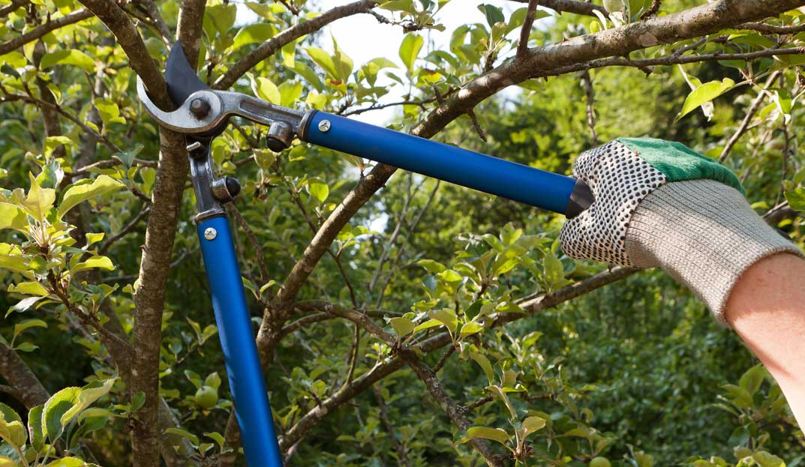
Pruning Decision Trees
Pruning reduces the size of decision trees by removing sections of the tree that are non-critical.
Pruning is done to make the algorithm generalize unseen data better.
Pre-Pruning – forcing our tree to not grow beyond a certain size.
Post-Pruning – Growing an intentionally large tree and removing nodes once it is done growing.

Slide 8
Our code example will use the C50 package

