Slide 1
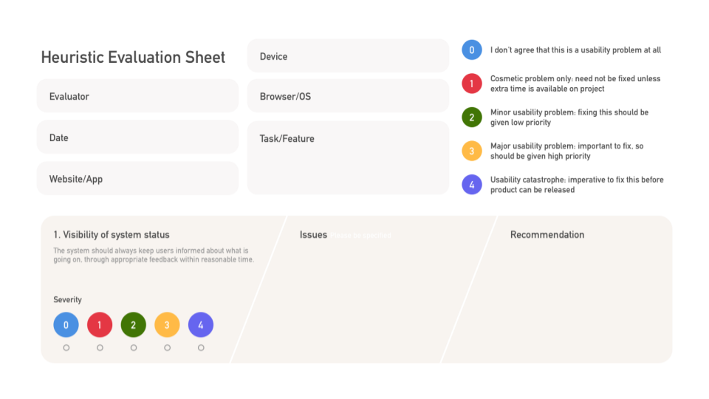
Macbook Air
Sprinkles Team
Google Chrome
5/10/23
ordering 12 birthday cupcakes
online
sprinkles.com
No concerns
None at this time

Slide 2
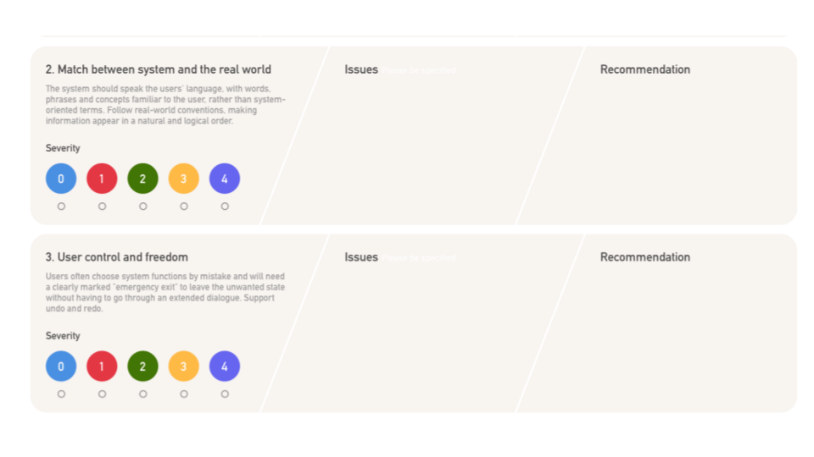
No concerns
None at this time
Doesn’t give user the ability to modify or edit orders easily without starting the order over.
Put an “edit” button & “remove” button to allow users more control over the ordering process.

Slide 3
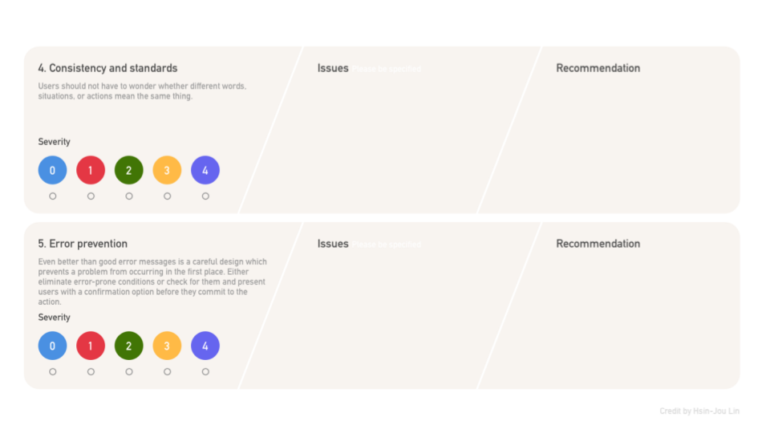
The scroll bar for customization under “decorate your box” doesn’t list prices, but charges an additional fee at checkout
Include prices next to customization choices in the scroll bar to avoid call-ins to store
Email address bar doesn’t indicate errors w/ incorrect or invalid input.
Have website notify when invalid responses are entered; error messages to prevent loss of repeat customers because of incorrect emails

Slide 4
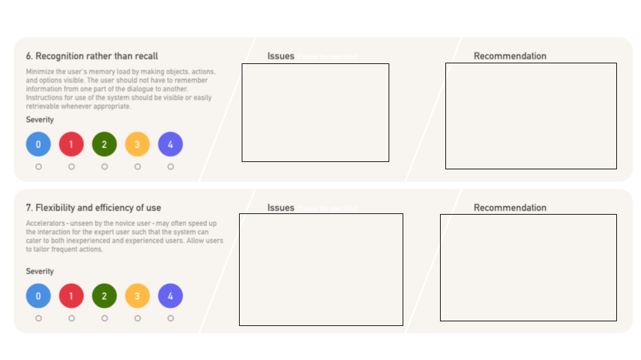
No concerns
None at this time
No concerns
None at this time

Slide 5
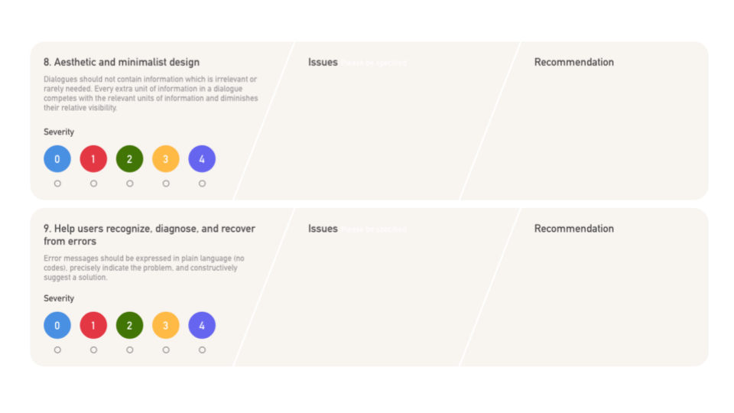
No concerns
None at this time
No concerns
None at this time

Slide 6
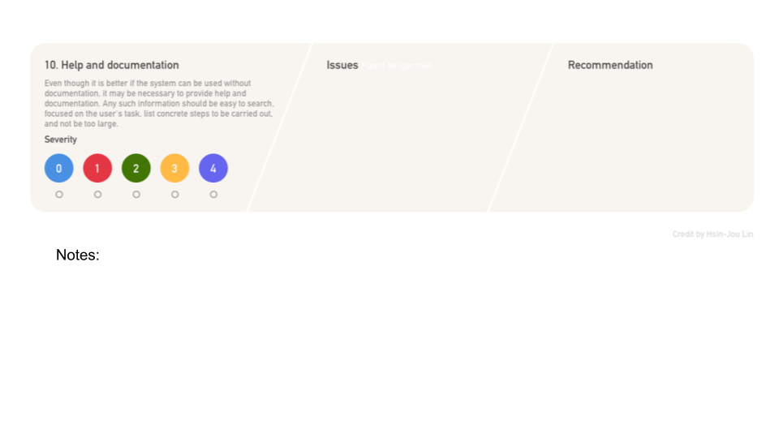
No concerns
None at this time
There is a messed up hover action line under the apply promo button at check out that is not correct in the code, it doesn’t disappear when not hoovering.
The X button is very light and hard to read in the corner of order preview when reviewing the order before checkout- consider removing it after adding an “edit” / “remove” button.

