Slide 1
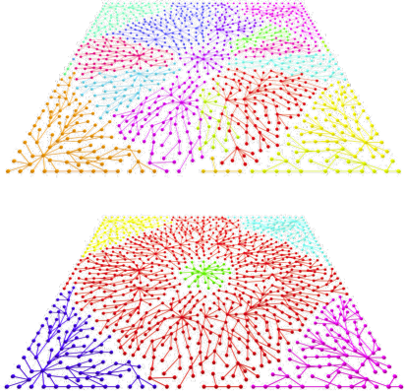
Intrinsic Dimension, Persistent Homology and Generalization in Neural Networks
许笑颜 智能科学与技术（数据科学）

Slide 2
Research Framework
Research Framework
Mathematical Definition & Preliminaries
Main Algorithm
Estimation of Generalization Error & PH Dimension
Evaluation of Generalization & PH Dimension

Slide 3
Research Framework
Lack of theoretical understanding has motivated a plethora of work focusing on explaining what, how, and why a neural network learns. → the generalization error !!
How to study the generalization error?
the generalization error can be linked to the fractal dimension of a parametric hypothesis class (which can then be taken as the optimization trajectories).
Hence, the fractal dimension acts as a ‘capacity metric’ for generalization.

Slide 4
Research Framework
Idea:
Construct each cloud point as a cell complex;
Instead of TwoNN, MLE, use Homology Dimension as ID Estimator;
By relating the box dimension and the recently proposed persistent homology (PH) dimension, we relax the assumptions to develop a topological intrinsic dimension (ID) estimator.
Learn the relationship between generalization error and Homology Dimension(Intrinsic Dimension).
Regularize the training of neural network leverage the differentiable properties of persistent homology.

Slide 5
Mathematical Definition & Preliminaries
Research Framework
Mathematical Definition & Preliminaries
Main Algorithm
Estimation of Generalization Error & PH Dimension
Evaluation of Generalization & PH Dimension

Slide 6
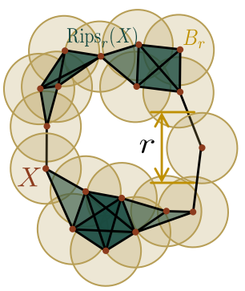





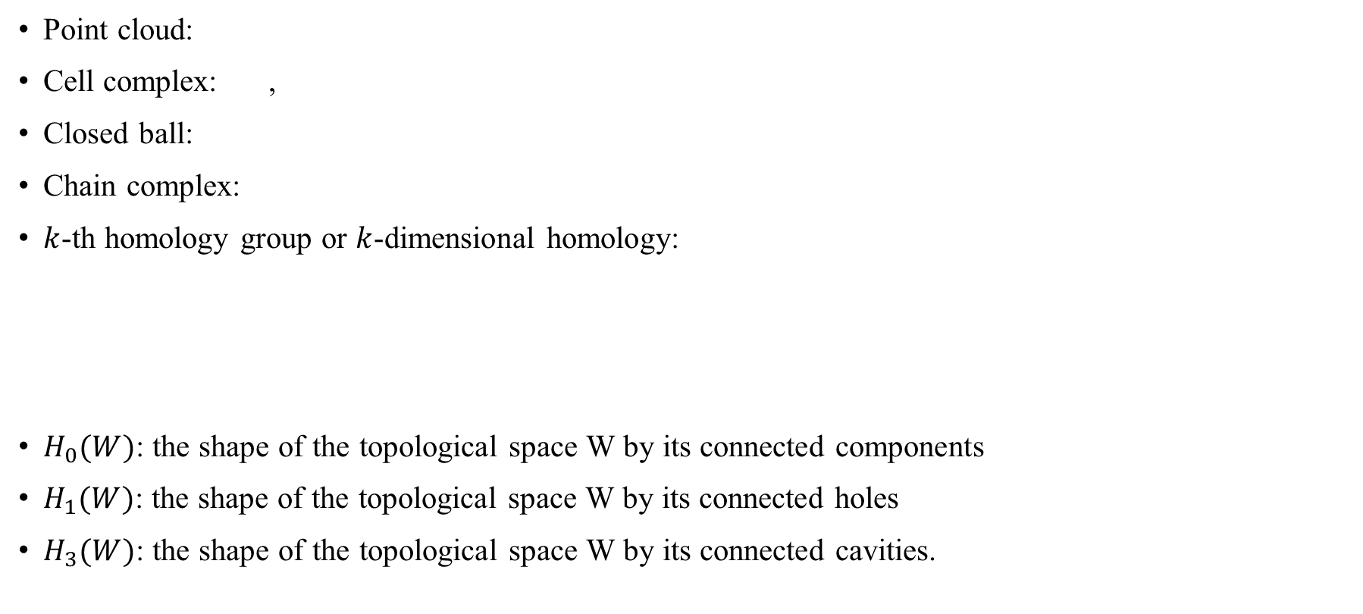
Mathematical Definition & Preliminaries
Point cloud:
Cell complex: ,
Closed ball:
Chain complex:
$k$-th homology group or $k$-dimensional homology:
$H_{0}(W)$: the shape of the topological space W by its connected components
$H_{1}(W)$: the shape of the topological space W by its connected holes
$H_{3}(W)$: the shape of the topological space W by its connected cavities.

Slide 7

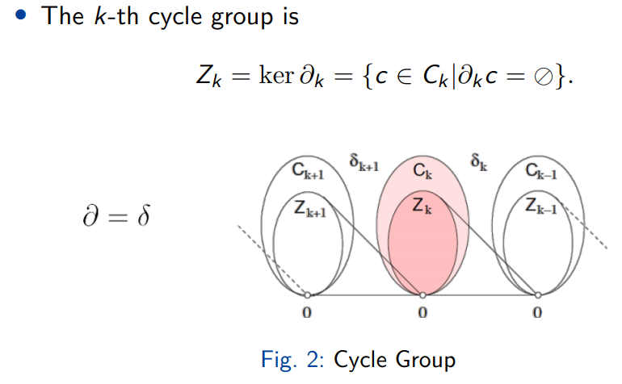
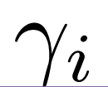


Mathematical Definition & Preliminaries
Cech cell complex:
Vietoris-Rips complex:
Filtration:
𝑘-persistence cycle:
(类比于cycle group)
Persistence module:
keeps track of a single $k$-persistence cycle $γ_{i}$ from birth to death.
Lifetime Cycle:

Slide 8
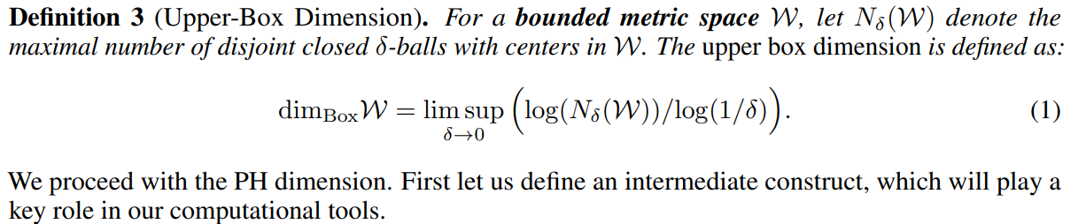
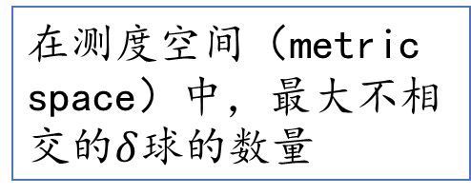
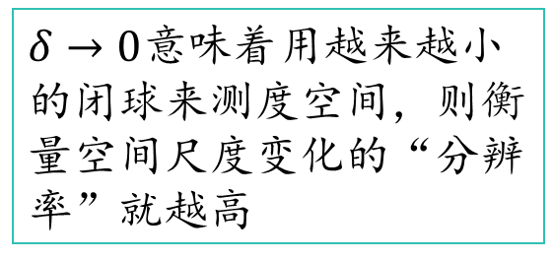
Mathematical Definition & Preliminaries
在测度空间（metric space）中，最大不相交的$δ$球的数量
$δ→0$意味着用越来越小的闭球来测度空间，则衡量空间尺度变化的“分辨率”就越高

Slide 9
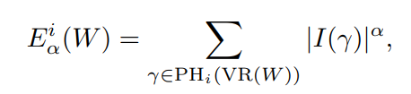
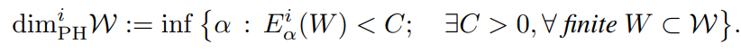
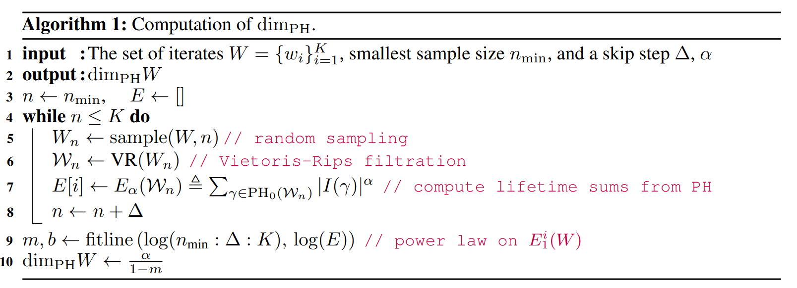
Mathematical Definition & Preliminaries
i-th homology lifetime sum
Persistent Homology Dimension:

Slide 10
Estimation of Generalization Error
Research Framework
Mathematical Definition & Preliminaries
Main Algorithm
Estimation of Generalization Error & PH Dimension
Evaluation of Generalization & PH Dimension

Slide 11



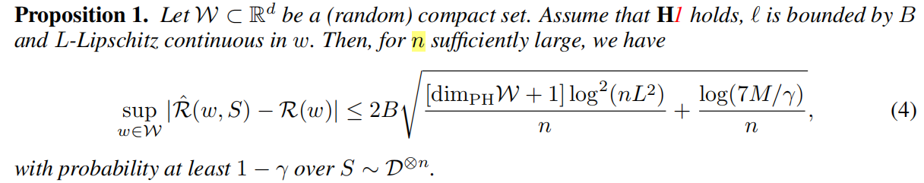

Generalization Error Upper Bound
$w$: training trajectories
$L$: L-Lipschitz continuous
$M$: constant
Grid:

Slide 12





Persistent Homology Dimension Upper Bound
Step 1: Estimate the homology lifetime sum
Step 2: Rewrite for logarithmic values
Regularization:
We will instead optimize over our topological loss function:
$λ$: the scale of the regularization
$W$: a sliding window of iterates

Slide 13
Evaluation of Generalization & PH Dimension
Research Framework
Mathematical Definition & Preliminaries
Main Algorithm
Estimation of Generalization Error
Evaluation of Generalization & PH Dimension

Slide 14
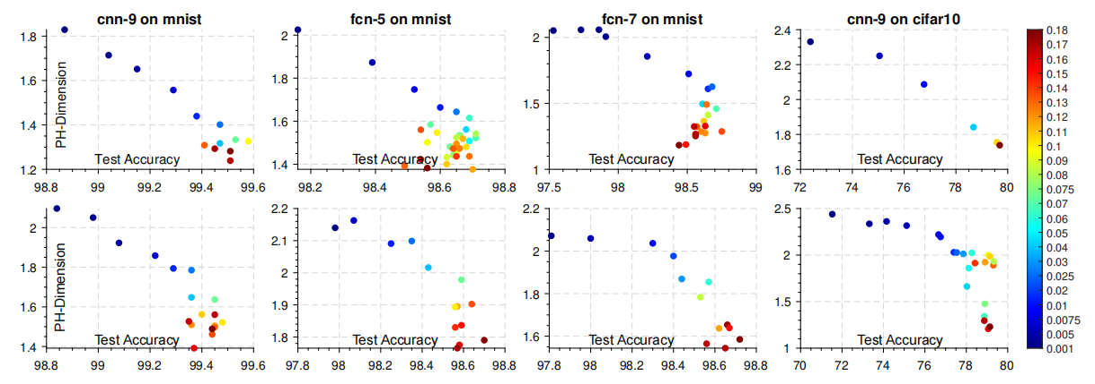
dimPH & Test Accuracy?
Architecture: AlexNet, a 5-layer (fcn-5) and 7-layer (fcn-7) fully connected networks, and a 9-layer convolutional netowork (cnn-9)
Dataset: MNIST, CIFAR10 and CIFAR100

Slide 15
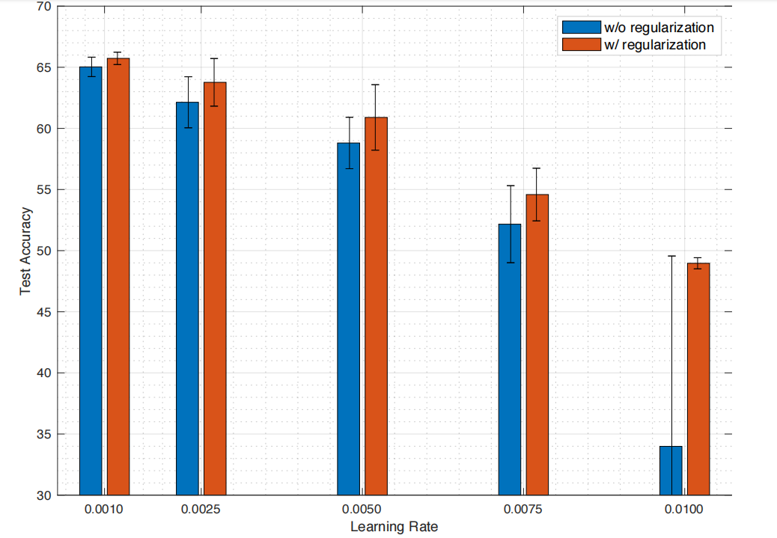
Whether to use dimPH regularization?
Architecture: a Lenet-5 network
Dataset: Cifar10
Epoch: 200
Batchsize: 128
Our topological optimizer is able to produce the best improvements when our network is not able to converge well.
The regularizer is able to recover poor training dynamics.

Slide 16
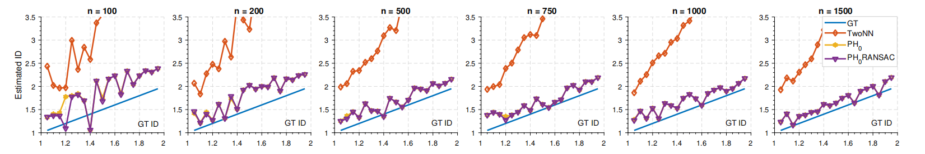
Whether dimPH matches the gound truth ID?
Simulate a d = 128 dimensional stable Levy process
number of points: 100 ≤ n ≤ 1500
tail indices: 1 ≤ β ≤ 2. (Tail Indice is the Ground Truth! )

