Slide 1
Inverse Problem for Partial Differential Equation
algebraicfrost@mail.ustc.edu.cn

Slide 2
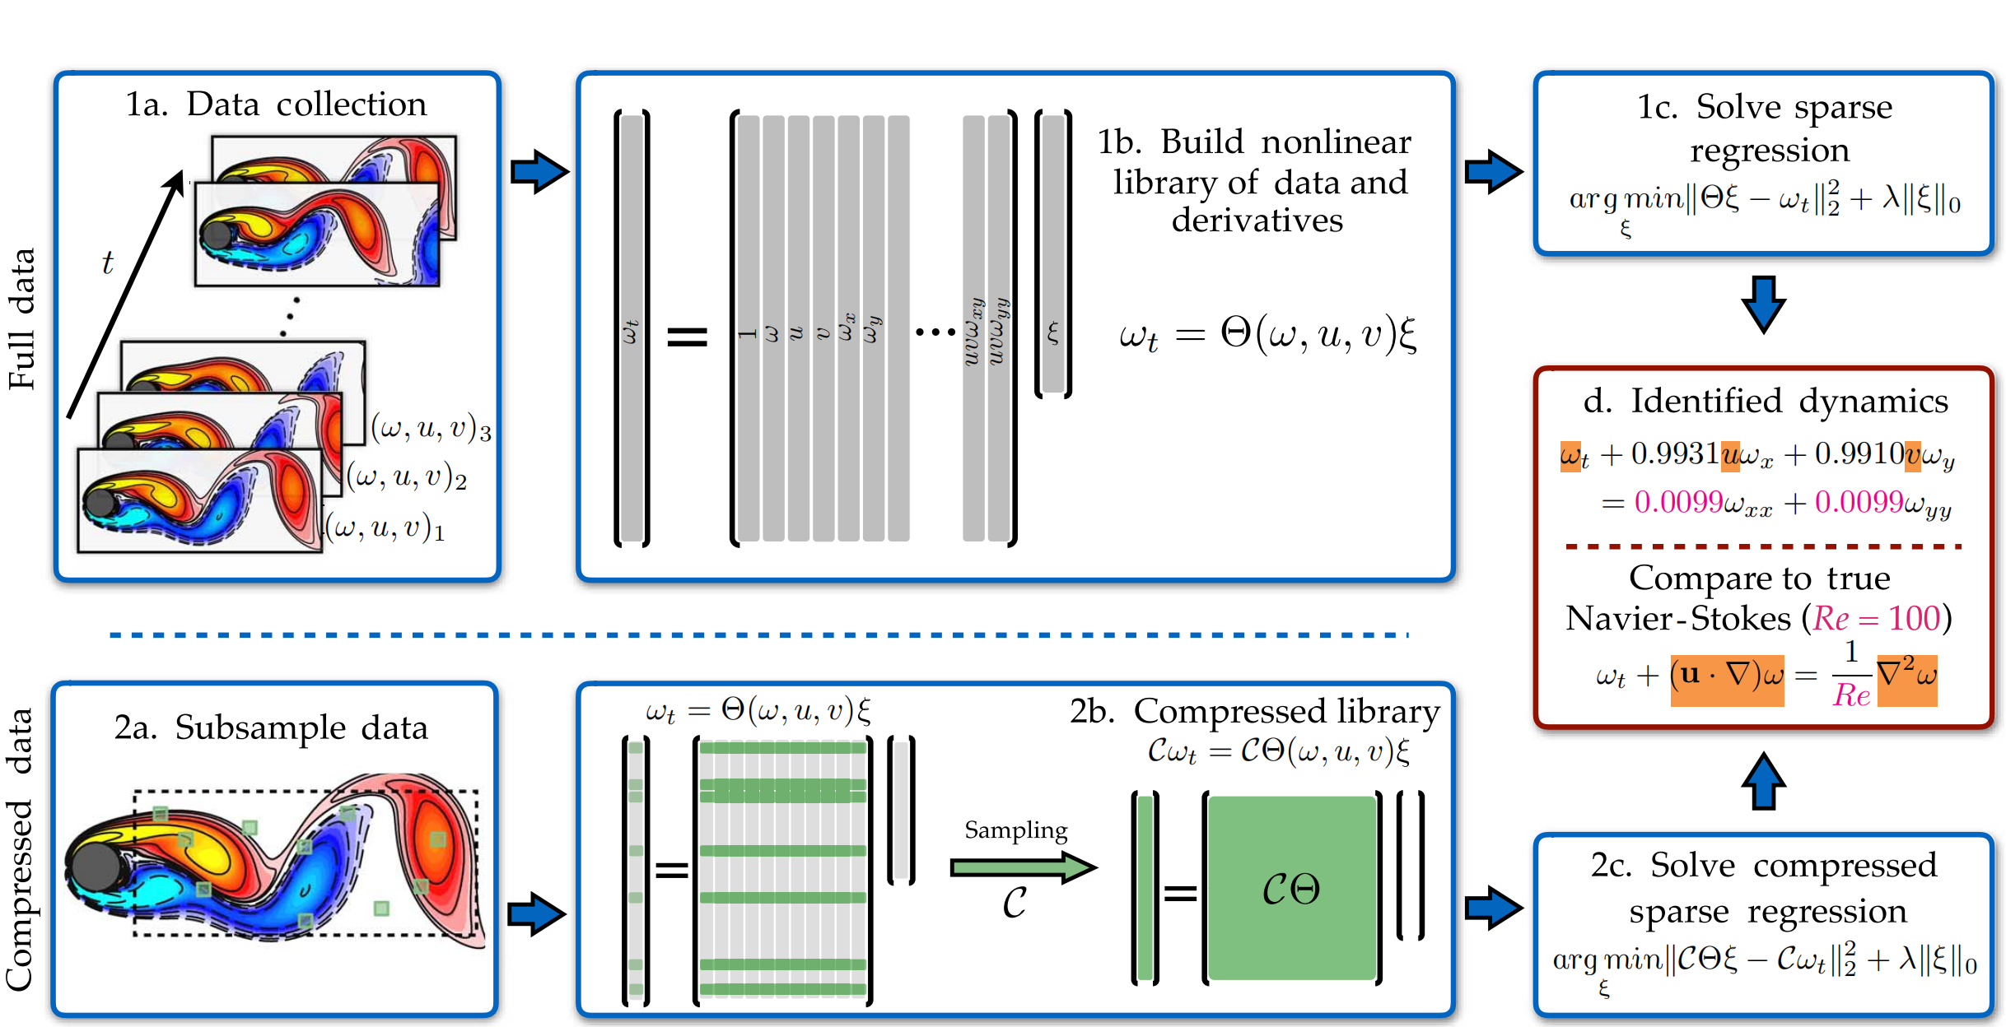
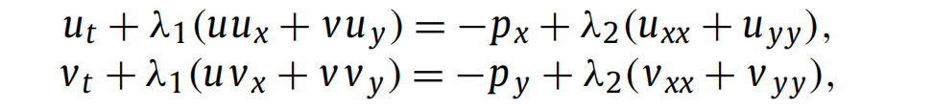
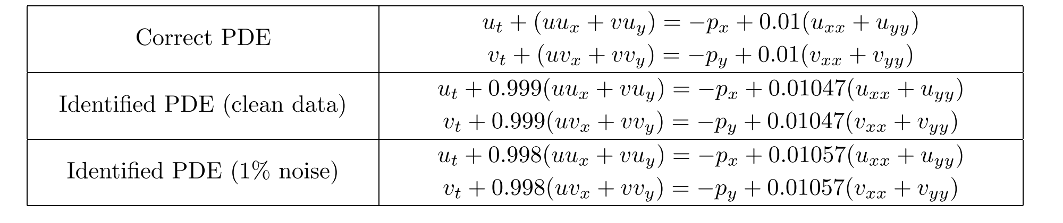
Definition
Examples:
Given a set of data, find the dominant control equation from the data;
Examples:
Given a set of data and the equation corresponding to the data, identify the missing a% of the parameters and forms of the equation from the data;
Use PINN to discover parameters!

Slide 3
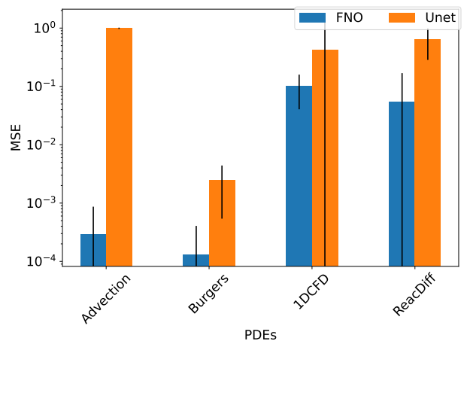
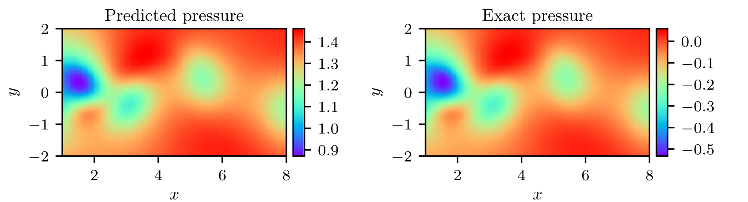
Definition
Example:
Given an incomplete data set and the equation corresponding to the data set, solve the missing physical quantities in the data set from the data;
PINN
OmniArch !
Given a data set, solve the initial value of the equation from the data.
- PDE Bench！
Use PINN to discover pressure given velocity field!

Slide 4
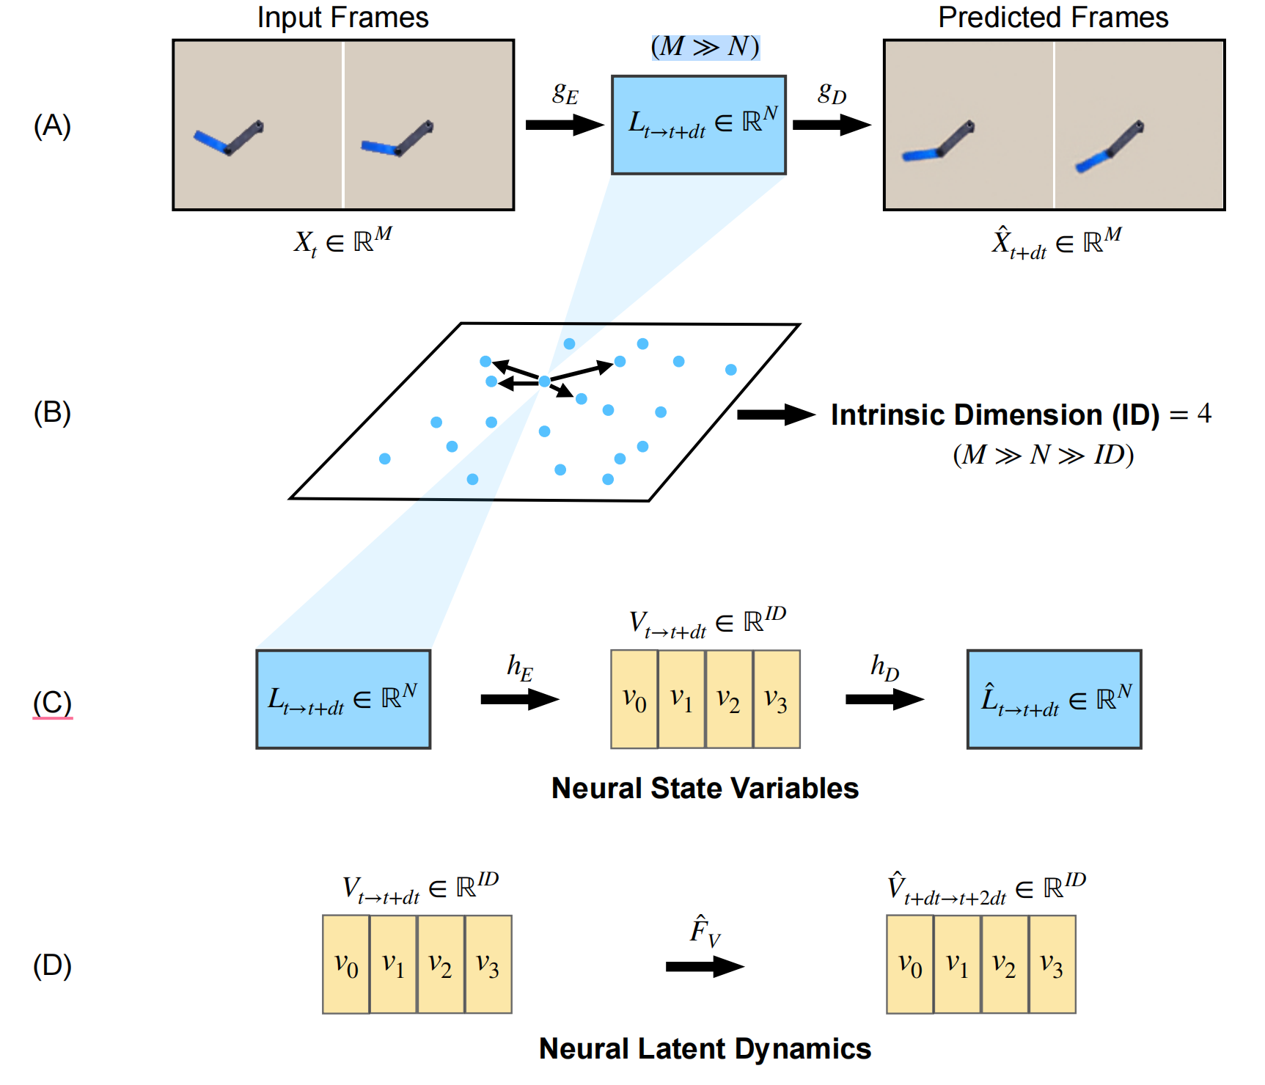
Definition
Discovering control parameters from observed data (phenomenon inversion problem):

Slide 5
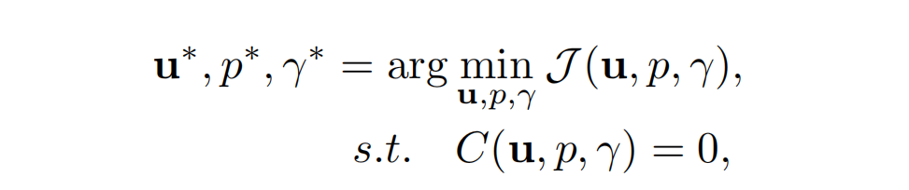

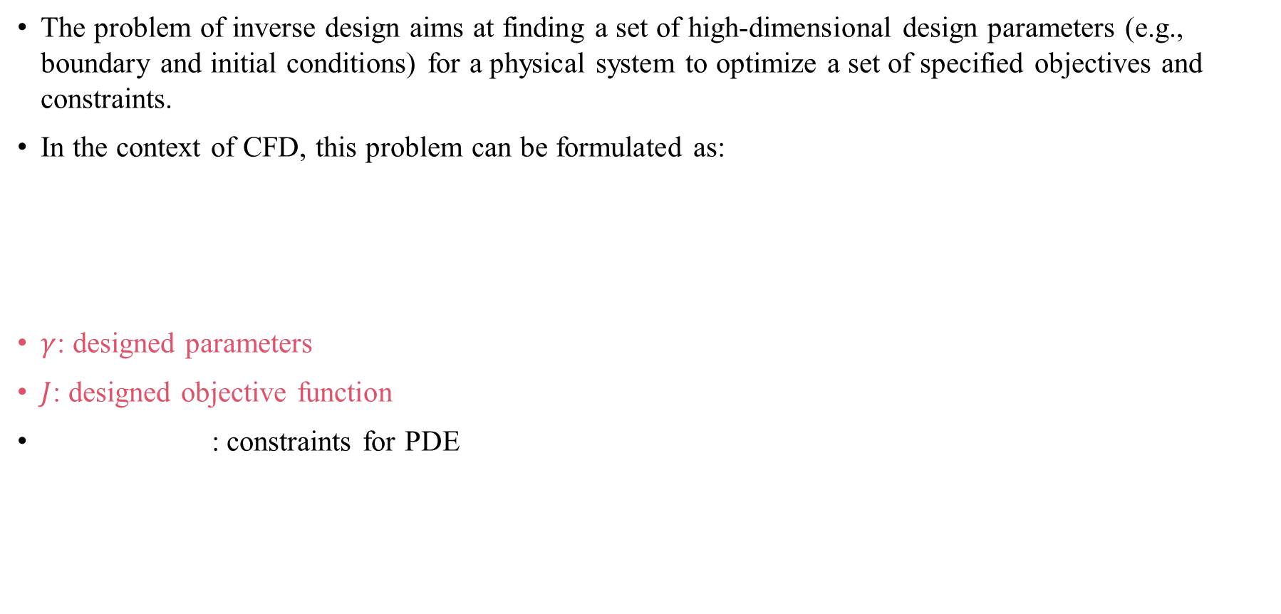
Math Definition
The problem of inverse design aims at finding a set of high-dimensional design parameters (e.g., boundary and initial conditions) for a physical system to optimize a set of specified objectives and constraints.
In the context of CFD, this problem can be formulated as:
$γ$: designed parameters
$J$: designed objective function
: constraints for PDE

Slide 6
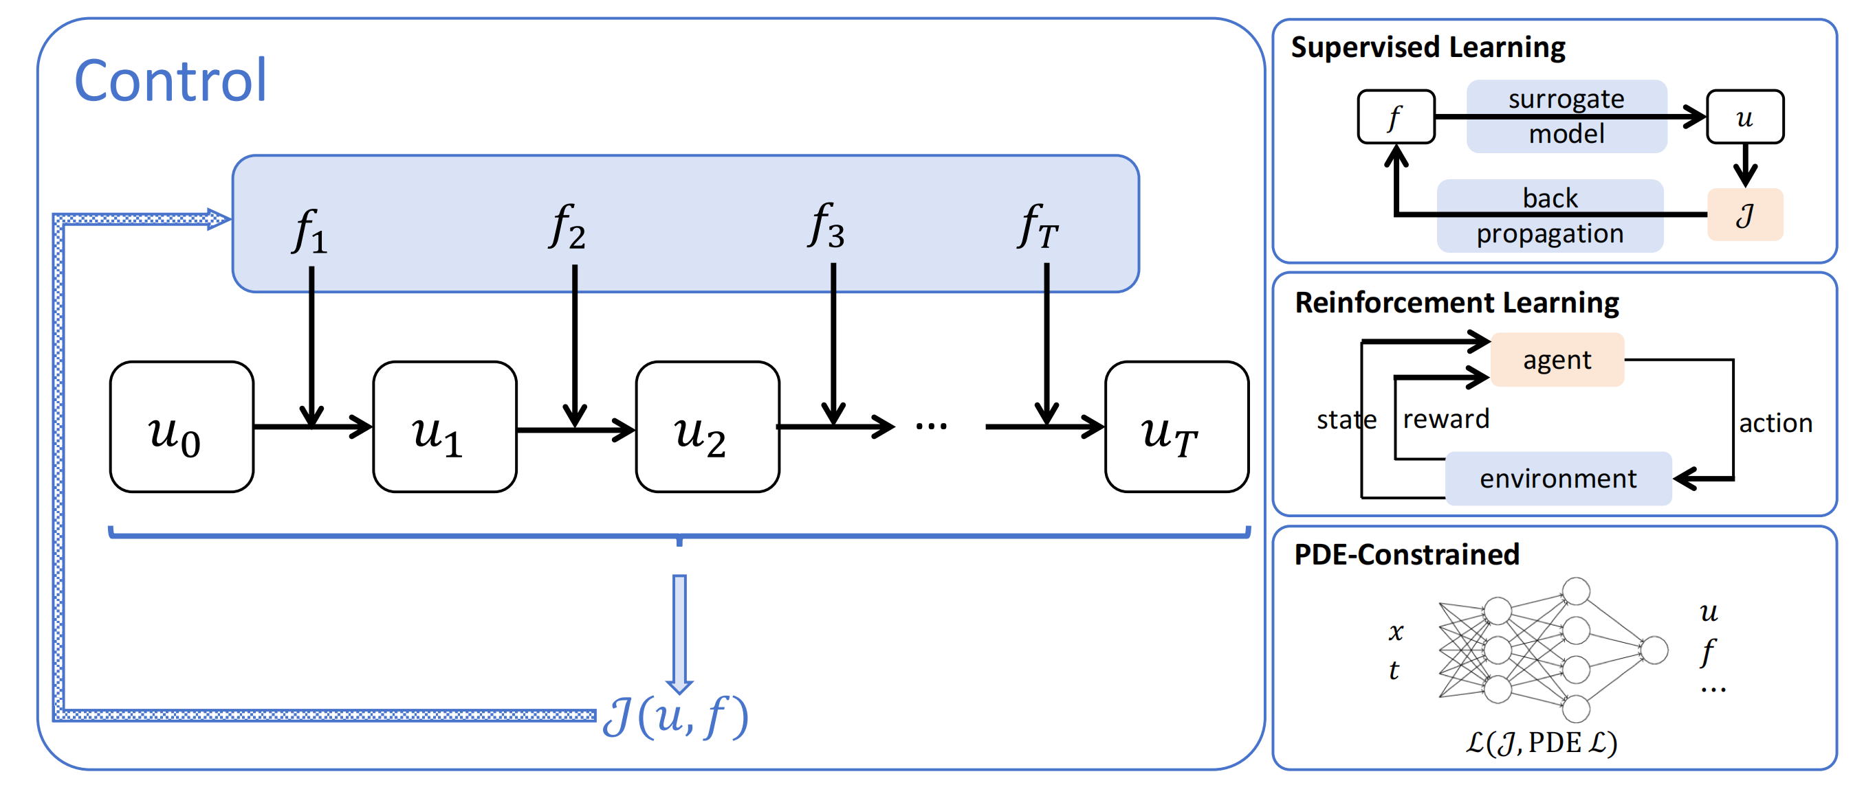
General Pipeline

Slide 7
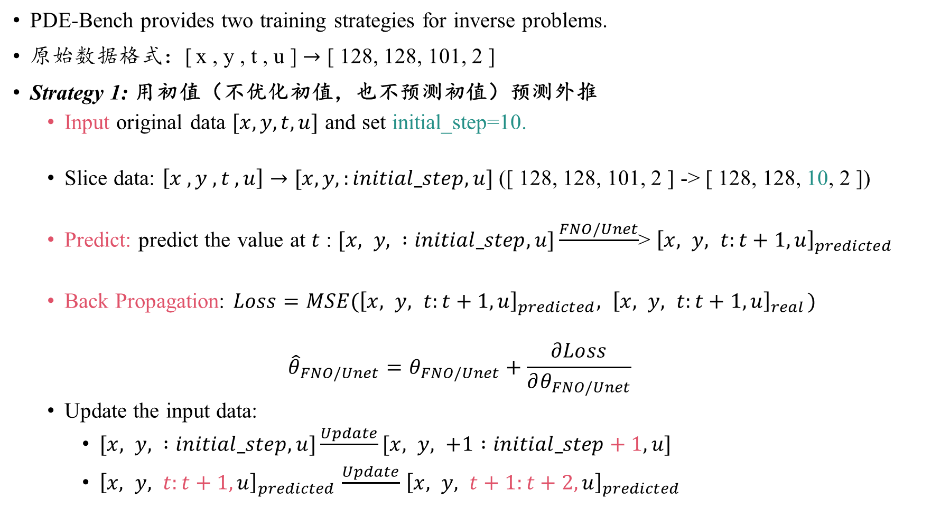
PDE-BENCH vs Inverse Problem
PDE-Bench provides two training strategies for inverse problems.
原始数据格式：[ x , y , t , u ] $→$ [ 128, 128, 101, 2 ]
Strategy 1: 用初值（不优化初值，也不预测初值）预测外推
Input original data $[x,y,t,u]$ and set initial_step=10.
Slice data: $\left[x , y ,t ,u\right]→[x,y,:initial_step,u]$ ([ 128, 128, 101, 2 ] -> [ 128, 128, 10, 2 ])
Predict: predict the value at $t$ : $[x, y, :initial_step,u]\frac{FNO/Unet}{}$> ${\left[x, y, t:t+1,u\right]}_{predicted}$
Back Propagation: $Loss=MSE({\left[x, y, t:t+1,u\right]}_{predicted},{ \left[x, y, t:t+1,u\right]}_{real})$
$${\hat{θ}}_{FNO/Unet}=θ_{FNO/Unet}+\frac{∂Loss}{∂θ_{FNO/Unet}}$$
Update the input data:
$[x, y, :initial_step,u]\frac{Update}{}[x, y, +1 :initial_step+1,u]$
${\left[x, y, t:t+1,u\right]}_{predicted}$ $\frac{Update}{}$ ${\left[x, y, t+1:t+2,u\right]}_{predicted}$
后移数据！

Slide 8
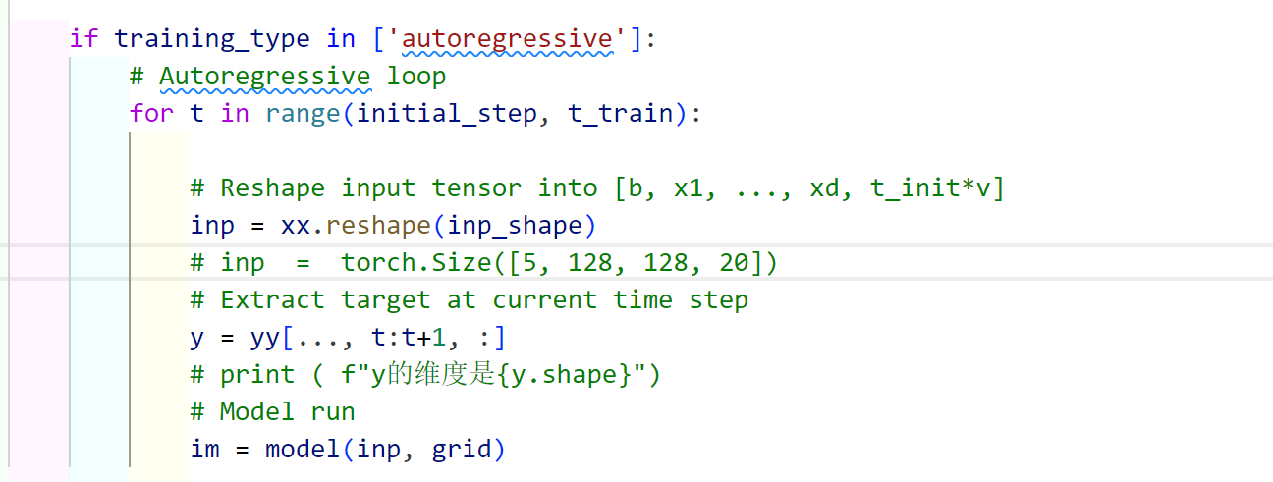
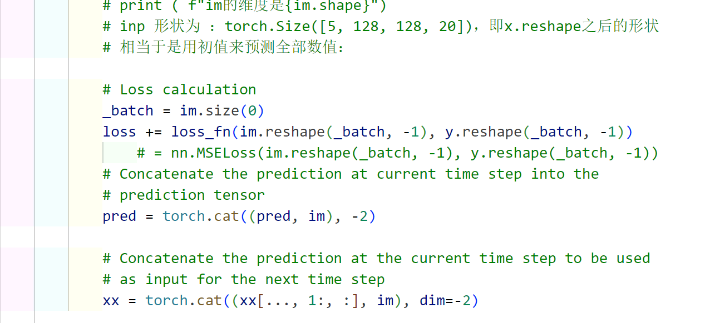
PDE-BENCH vs Inverse Problem
t 时刻数据的真值
用 0:initial_step的数据推断 t 时刻的数据
即 t 时刻数据的推断值
梯度传播
更新输入数据的形状

Slide 9
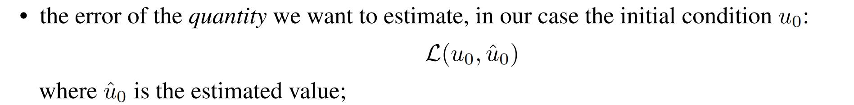
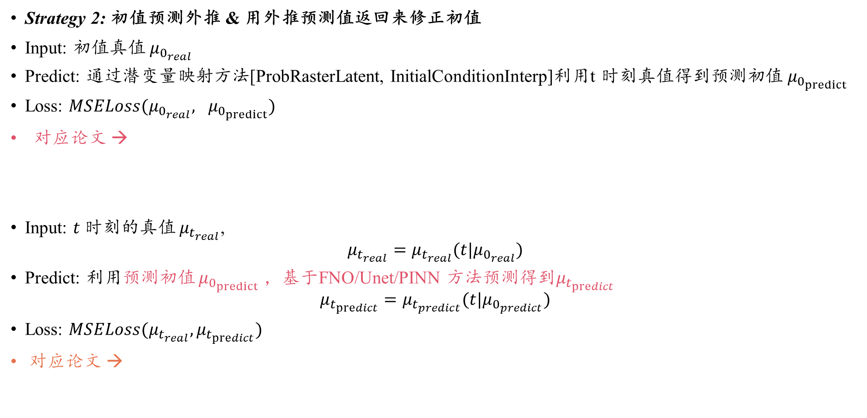
PDE-BENCH vs Inverse Problem
Strategy 2: 初值预测外推 & 用外推预测值返回来修正初值
Input: 初值真值 $μ_{0_{real}}$
Predict: 通过潜变量映射方法[ProbRasterLatent, InitialConditionInterp]利用t 时刻真值得到预测初值 $μ_{0_{predict}}$
Loss: $MSELoss(μ_{0_{real}}, μ_{0_{predict}})$
对应论文 →
Input: $t$ 时刻的真值 $μ_{t_{real}}$,
$${μ_{t_{real}}=μ}_{t_{real}}(t|μ_{0_{real}})$$
Predict: 利用预测初值 $μ_{0_{predict}}$ ，基于FNO/Unet/PINN 方法预测得到$μ_{t_{predict}}$
$$μ_{t_{predict}}=μ_{t_{predict}}(t|μ_{0_{predict}})$$
Loss: $MSELoss(μ_{t_{real}},μ_{t_{predict}})$
对应论文 →

Slide 10

PDE-BENCH vs Inverse Problem
Strategy 2: 初值预测外推 & 用外推预测值返回来修正初值
用什么办法预测 $t$ 时刻的值？即利用预测初值 $μ_{0_{predict}}$ ，如何预测得到$μ_{t_{predict}}$？
FNO / PINN / Unet！（DPOT）
用什么办法预测 $μ_{0}$ 初值？
ProbRasterLatent
InitialConditionInterp

Slide 11
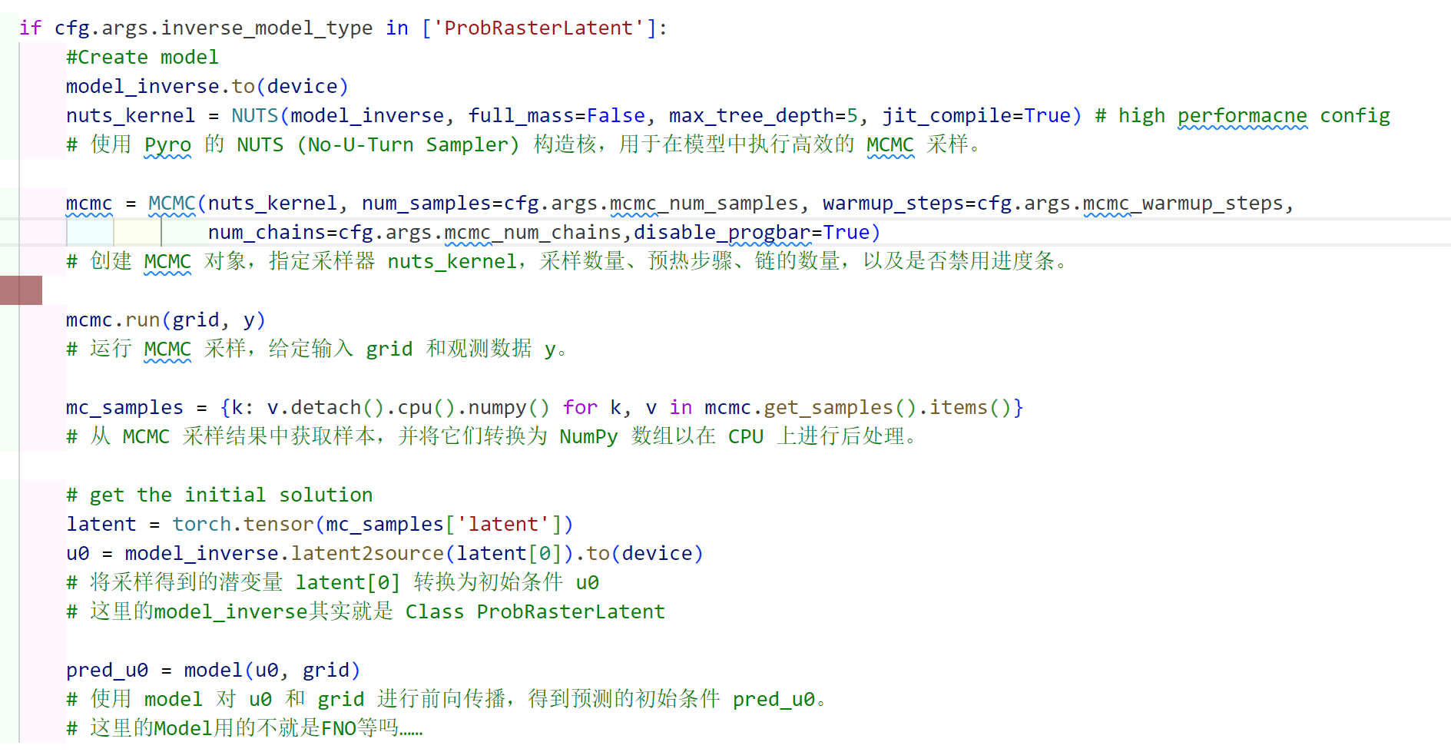
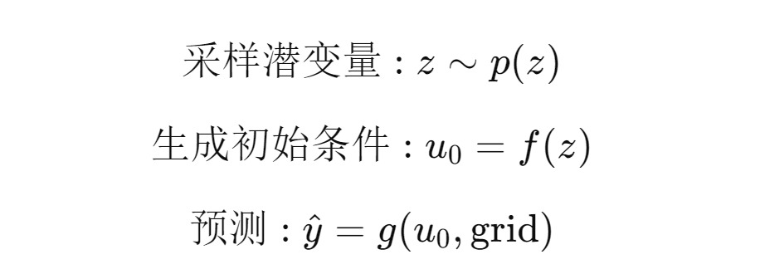
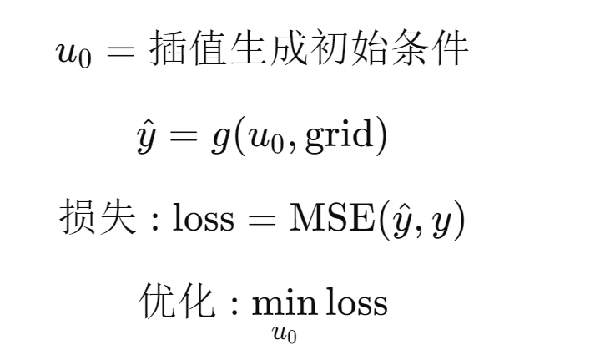
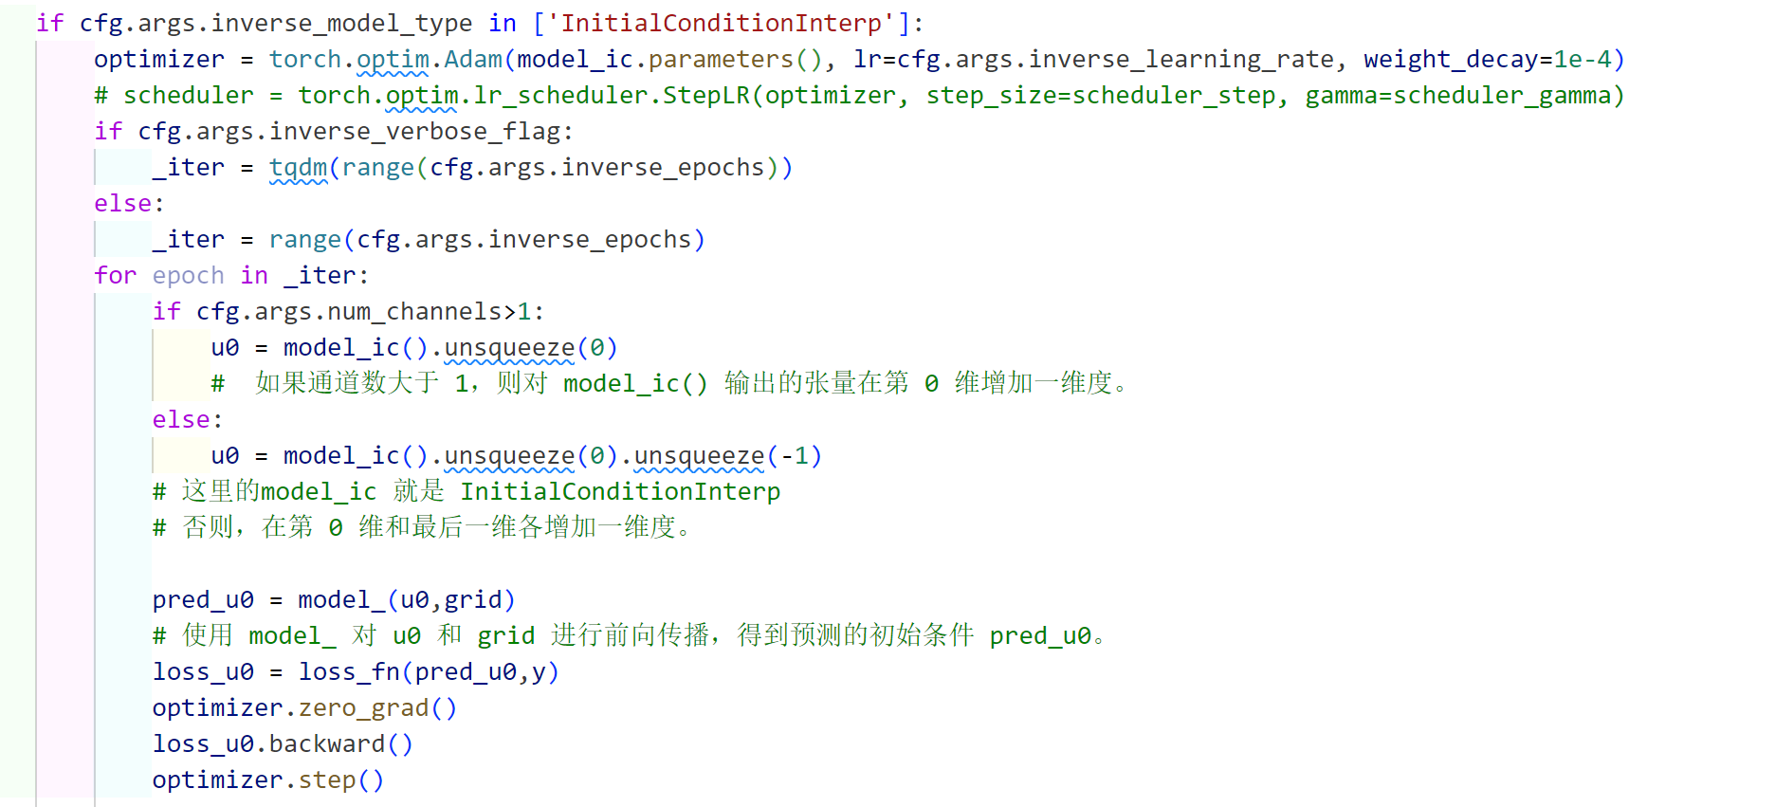
PDE-BENCH vs Inverse Problem
Strategy 2: 初值预测外推 & 用外推预测值返回来修正初值
ProbRasterLatent 方法：
InitialConditionInterp方法：

