Slide 1
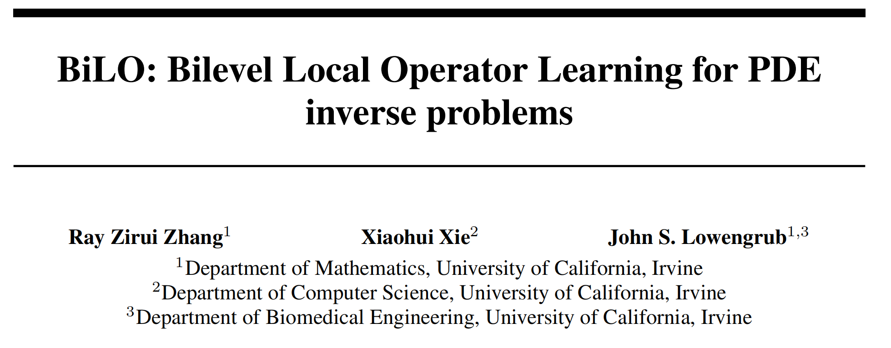
BiLO: Bilevel Local Operator Learning for PDE inverse problems

Slide 4
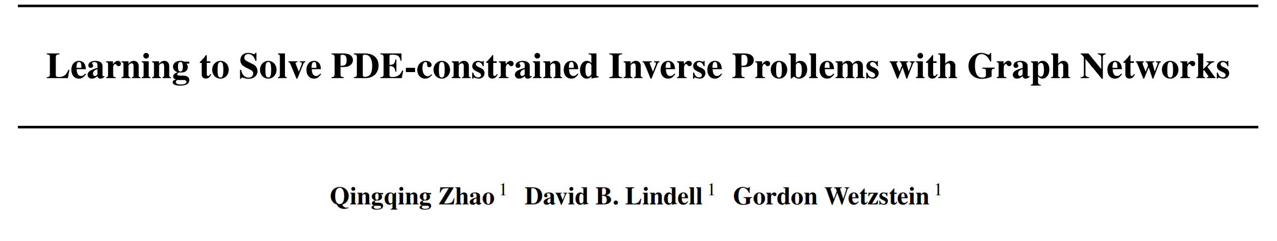
Learning to Solve PDE-constrained Inverse Problems with Graph Networks

Slide 7
DeltaPhi: Learning Physical Trajectory Residual for PDE Solving
（疑似和我们的idea轻微的撞了，但是问题背景还不太一样的）
（感觉他们做的还不错）

