Slide 1

ChengetAI
Check it. Report it safely. Know who to call next.
Scam protection for African mobile money — detection that ends in help, not just a verdict.
"Chengeta" — Shona: to protect, to guard
OSF × Andela Hackathon · Safety, Reporting & Protection
chengetai.vercel.app
Notes:
Chengeta is Shona for 'to protect'. The one line to land: detection alone is not protection. A verdict that doesn't tell you who to call leaves the user exactly where it found them — that gap is what this product closes.

Slide 2
THE PROBLEM
Mobile money is Africa's payment rail —
and its primary fraud surface.
Losses land hardest on the poorest, exactly where financial inclusion is deepening fastest. Four gaps make it worse than it needs to be.
1
The scam crosses borders. The warning doesn't.
A number burned in Lagos works fine in Accra the next day — nothing connects the two.
2
Generic filters don't know the local scripts.
Western-trained spam filters miss every local wallet's terminology and the scams built on it.
3
Reporting goes nowhere.
People are told to report it — not to whom, in what order, or how fast. The money is gone by then.
4
Reporting costs safety.
Demanding an identity silences exactly the people most exposed to retaliation.
Notes:
Gaps 3 and 4 are the ones most scam tools ignore entirely. They are also exactly what the Safety, Reporting & Protection track asks for: safe reporting, and clear pathways to timely support.

Slide 3
THE INSIGHT
One script. Every wallet. Seven borders.
“
Confirmed. You have received $80. This was sent to you in error — please reverse the money to 077… and we will not report it.
The wrong-deposit scam — the single most reported pattern across every market we cover.
Runs identically on:
EcoCash
M-PESA
MTN MoMo
Airtel Money
OPay
Capitec Pay
So the defence has to cross borders too.
One shared scam-number database across all seven markets. A number reported in Lagos is visible to someone in Accra — and a number reported from two countries goes to high risk regardless of volume, because cross-border reach means an organised operation rather than a local dispute.
Notes:
This is the slide that justifies the whole multi-country design. The scam generalises, so the model and the database have to generalise with it.

Slide 4
THE SOLUTION
Detect → report safely → reach help.
Most scam tools stop at the first beat. The second and third are what the Safety, Reporting & Protection track actually asks for.
01
02
03
Check it
Report it safely
Reach help
Paste a suspicious message. Verdict, the exact phrases that triggered it, and a plain-language reason — grounded in your own market's wallets and currency.
Anonymous by default: no account, no name, and the report still counts. Phone numbers, one-time codes and ID numbers are stripped before it is ever stored.
What to do in the next five minutes, then who to contact in your country — wallet provider first, because it is the only one that can still stop the transfer.
A verdict without a next step is only half an answer — so every non-safe verdict ships with the pathway attached, not behind another tap.
Notes:
If you only remember one slide, this is it. Detection is table stakes; the pathway is the product.

Slide 5
WHAT'S BUILT
Six modules, one backend, one shared database.
Check Message
Get Help
AI classifier, grounded per market. Verdict, confidence, risk phrases, plain-language reason.
The ordered escalation ladder per country: wallet → regulator → police → support.
Report
Number Lookup
Anonymous by default. Excerpts redacted at intake, before anything is stored.
Crowd-sourced reputation, including which countries a number has been reported from.
Trending & Hotspots
Agent Fraud Sentinel
Live weighted-rules ranking, a regional map and a cross-country rollup.
B2B: upload an agent transaction log, get flagged anomalies with readable reasons.
Plus a public landing page and a moderation dashboard. 8 scam categories, named by mechanism rather than by wallet brand — so one taxonomy holds in every market.

Slide 6
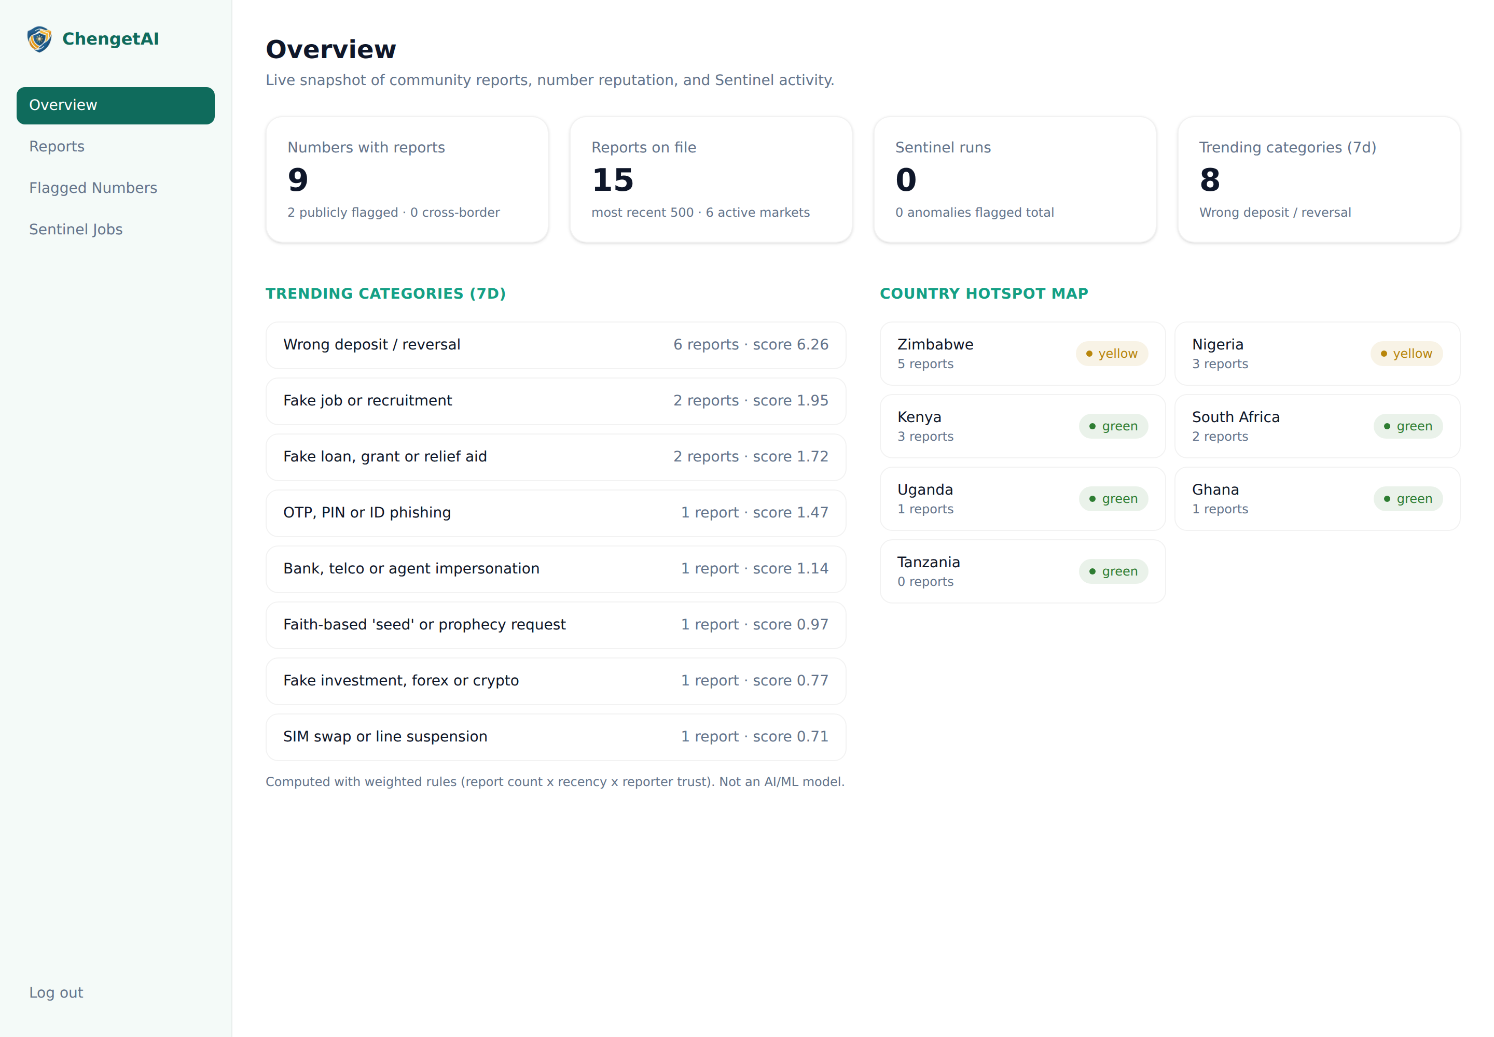
IT RUNS
Not slideware — this is the running product.
Live data
Trending categories and the country hotspot map are computed from the reports table on every request.
Cross-border
Numbers reported from more than one market are flagged for moderators as an operation, not a dispute.
Stated method
The feed carries a method_note saying it is weighted rules, not a model — shown in the UI verbatim.
Moderation dashboard · captured against a running backend

Slide 7
ARCHITECTURE
One backend. Two clients. Zero setup to evaluate.
Runs with no external services
Clients
The full API surface works on the in-memory store — no Supabase project, no API key. A reviewer clones and runs.
Flutter app (Android-first)
Next.js landing page + admin dashboard
↓
Adding a market is a data change
FastAPI backend
Two files: the country registry and the support-channel table. No service logic, no model, no client release.
classifier · reputation · feed · support
countries · taxonomy · redaction · sentinel
↓
Same code ships to production
Storage
USE_SUPABASE=true swaps the store behind a protocol. Nothing above the persistence layer changes.
In-memory store by default
Supabase Postgres + RLS with one env var

Slide 8
JUDGEMENT
We justify AI case by case — and say so at runtime.
AI
—
Where AI earns its place
Where it deliberately isn't
Message classification — scam text is adversarial and mutates constantly; a keyword blocklist catches yesterday's scripts, not tomorrow's. We ship a trained baseline and an LLM strategy so the trade-off is demonstrable, not asserted.
Sentinel anomaly detection — agent fraud is unlabelled and drifts, which is what unsupervised learning is for. Paired with explicit rules as an honest baseline.
Number reputation and the trending feed — plain CRUD and weighted rules. The API returns a method_note field saying so, and the UI shows it verbatim.
Support pathways — a curated registry, never generated. A hallucinated police hotline is worse than no hotline, so unverified contacts are shown to the user as unverified rather than hidden.
Evidence redaction — deterministic regex, so what is removed from a stored excerpt is auditable and testable rather than a model's judgement call.
Notes:
The support-registry decision is the one to dwell on in questions: it is the clearest case where the responsible choice was to not use the model.

Slide 9
COVERAGE
One codebase, 7 markets.
Zimbabwe
Kenya
Nigeria
Uganda
South Africa
Ghana
Tanzania
Numbers stored in E.164
0771234567 is a valid Zimbabwean, Ugandan and Tanzanian number. A national-format key would have silently merged three unrelated people's reputations — invisible in a demo, catastrophic in production.
One classifier, localised grounding
The mechanism generalises even when the vocabulary doesn't, so one model trained across all markets sees more of each pattern than seven per-country models would.
Coarse regions, two hotspot maps
A 47-county map splits reports too thin to mean anything. Cross-country rollup always; the regional breakdown only when a country is named.

Slide 10
TRACTION
What already exists, not what's promised.
7
73
647
6
markets live
passing tests
labelled messages
API modules
behind one country registry
run in CI on every push
332 scam, spread evenly across markets
classify · support · reputation · feed · reference · sentinel
Also shipped
FastAPI backend with a full API surface that runs with zero external services
Flutter Android-first app: check, help, report, lookup, feed, sentinel
Deployed landing page and a password-gated moderation dashboard
Supabase schema with Row Level Security, and a synthetic dataset disclosed in full
Version-pinned dependencies, CI running pytest plus web build and lint on every push

Slide 11
SUSTAINABILITY
Who pays, and what happens next.
Free
B2B
Institutional
Consumers
Agents & SMEs
Telcos, banks, regulators
Checking, reporting, lookup and the support pathway stay free. This is the part that protects people and the part least able to pay for itself.
Agent Fraud Sentinel licensed per agent or per till to mobile-money agent networks and SMEs who have no fraud tooling today.
Licensed access to aggregated, anonymised cross-border scam signal — the asset no single-country tool can offer.
Path to pilot — sequenced by market, not launched everywhere at once
Now
Month 1–3
Month 4–6
Month 7–12
Harden the MVP
One named partner in one launch market; that market's support contacts verified; dispute flow built
On-device classifier, multi-agent Sentinel dashboards, second market
Telco, regulator and bank partnerships; iOS; per-jurisdiction data-protection audit
Notes:
The code is market-agnostic; partnerships, support-contact verification and language coverage are not. That is why the plan sequences markets instead of claiming seven at launch.

Slide 12
HONESTY
What we are not claiming.
Every one of these is disclosed in the repository rather than left for a reviewer to find.
!
Support contacts are mostly unverified
Only long-standing national short codes are marked verified. The rest name the right organisation with an unconfirmed number — surfaced to the user as unverified, and blocking before a pilot in that market.
!
The product is English-only
Interface, corpus, prompt and explanations. Across these markets the people most exposed to mobile-money fraud overlap heavily with those least likely to read English comfortably.
!
The data is synthetic
647 generated messages and 200 generated transactions, fully disclosed. No real user messages or transactions were collected.
!
No per-jurisdiction privacy review
Seven overlapping regimes. The design targets their common floor; the country-by-country audit is required before real user data and is not done.
!
No pilot partner yet
A target profile, not a secured partnership. Stated as pending rather than filled with a name.
Notes:
A reviewer will find these anyway. Naming them first is both more useful and more credible than a checklist of unqualified yeses — and it is the same posture the product takes with users when a support contact is unverified.

Slide 13
The ask
People can only act on information they can verify.
ChengetAI makes a suspicious message checkable, a report safe to file, and help findable — in that order.
1
2
3
A pilot partner
Contact verification
Mentorship
An introduction to one agent network or telco district in a single launch market.
Help confirming national support-desk numbers — the blocker before any pilot.
On the dispute and human-review flow, and on what non-English coverage really takes.
Built by
Lester Rusike
chengetai.vercel.app
Product, backend and AI engineering, architecture, compliance
github.com/Lesruez93/ChengetAi
Frontend contribution: Agnes Goora (Flutter and web UI)
Notes:
Close on the first line: people can only act on information they can trust. That is the OSF framing, and it is what this product does in three concrete steps.

