Slide 1
01 OUR GOAL
What Are We Building?
We are not studying contracts — we are hunting for tradeable signals.
01
The Target
02
The Constraint
03
The Implication
Predict r_{t,t+5}: the 5-second-ahead return at every second
Signals must survive transaction costs and execute at market
Every design choice — features, filters, model — serves this one objective

Slide 2
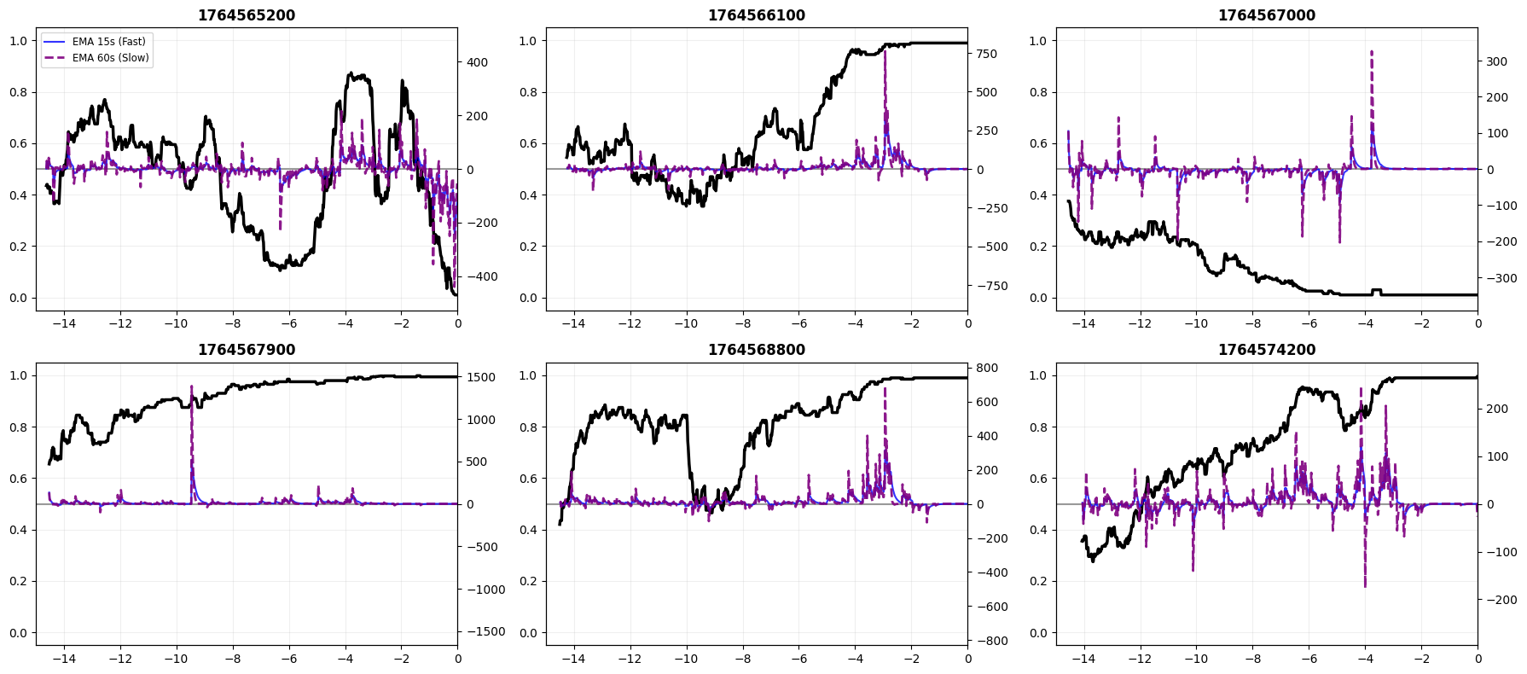
02 DATA PROCESSING
Four Sources, One Panel
01
Order Book Snapshot
tick-level · top 5 bid/ask · last snapshot per second
02
Transaction Records
taker-initiated · both up & down sides · directional flow
03
Chainlink Oracle
BTC reference price · resampled to 1s · forward-filled
04
Contract Metadata
Order Flow EMA vs. Contract Price Path
trader_week · strike price K · outcome labels (auxiliary)
All sources resampled → 1-second · Final: contract × second panel

Slide 3
02 FEATURE CONSTRUCTION
Three Layers of Market Information
A
OPTION PRICING
B
MICROSTRUCTURE
C
MACRO REGIME
Valuation Anchor
Instantaneous Pressure
Market Environment
TTM · Moneyness · σ realized
OBI · Spread · Micro-price imbalance
Rolling return: 15min · 1h
BSM theoretical price · Delta
Net Flow EMA (15s / 60s) · CVD
Realized volatility: 15min · 1h
BSM mispricing (market vs. fair value)
Buy urgency · Whale imbalance
Calm vs. trending vs. high-vol regime
Treat contract as short-horizon binary option
Who is trading, how aggressively, right now
Context in which each second is traded

Slide 4
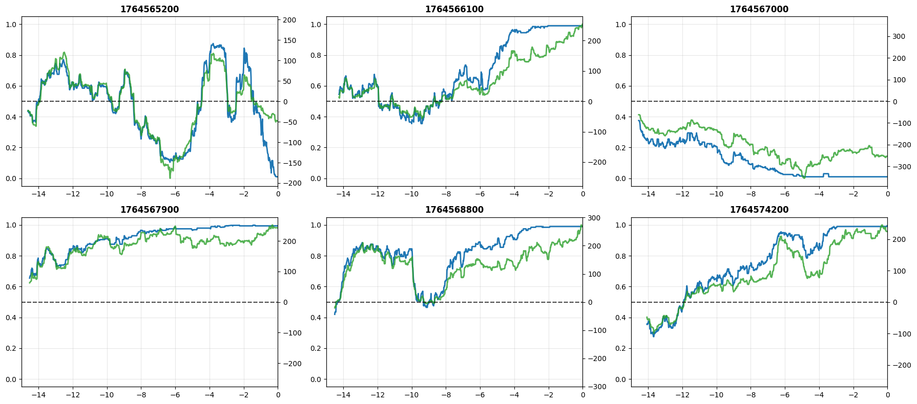
02 SAMPLE REFINEMENT
Filtering for Tradeable Moments
Remove structurally incomplete contracts
KEY INSIGHT
1
Exclude contracts where Chainlink data is missing or stale — pricing features cannot be reliably constructed
At this stage, contracts are irrelevant.
Only individual tradeable seconds matter.
Drop warm-up intervals
2
Rolling & EWMA features need time to mature — early seconds in each contract are discarded
Note: contract-level features (moneyness, TTM) were computed per-contract before this step — the two stages do not conflict.
Trim end-of-contract intervals
3
Liquidity collapses near expiry — prices become uninformative and execution is unreliable
Liquidity filter
4
Only keep seconds where a market order can actually execute — signals must be actionable
Moneyness vs. Mid-Price — active trading period

Slide 5
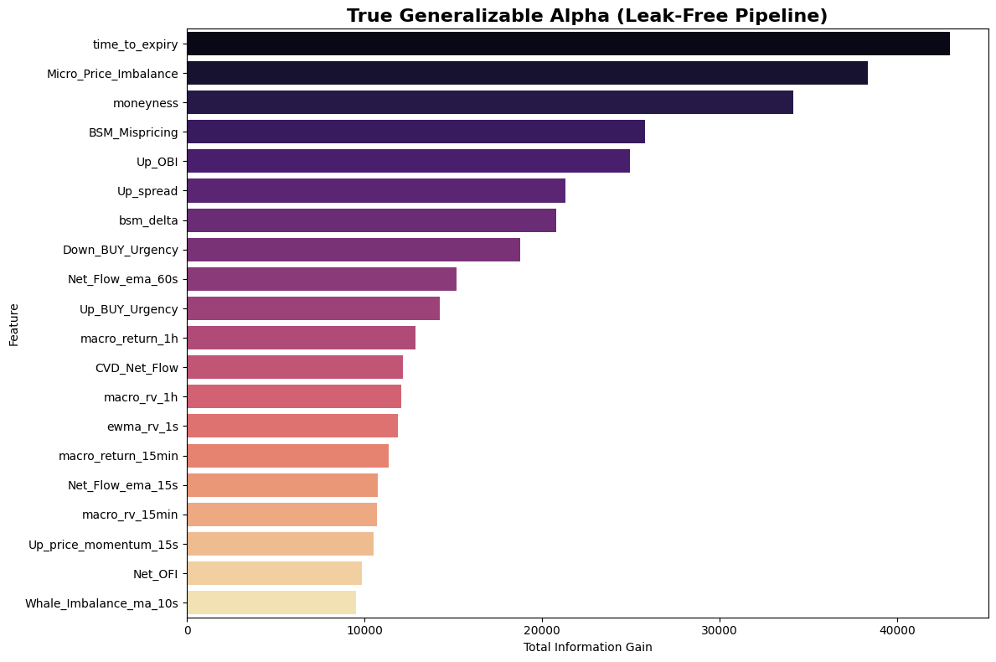
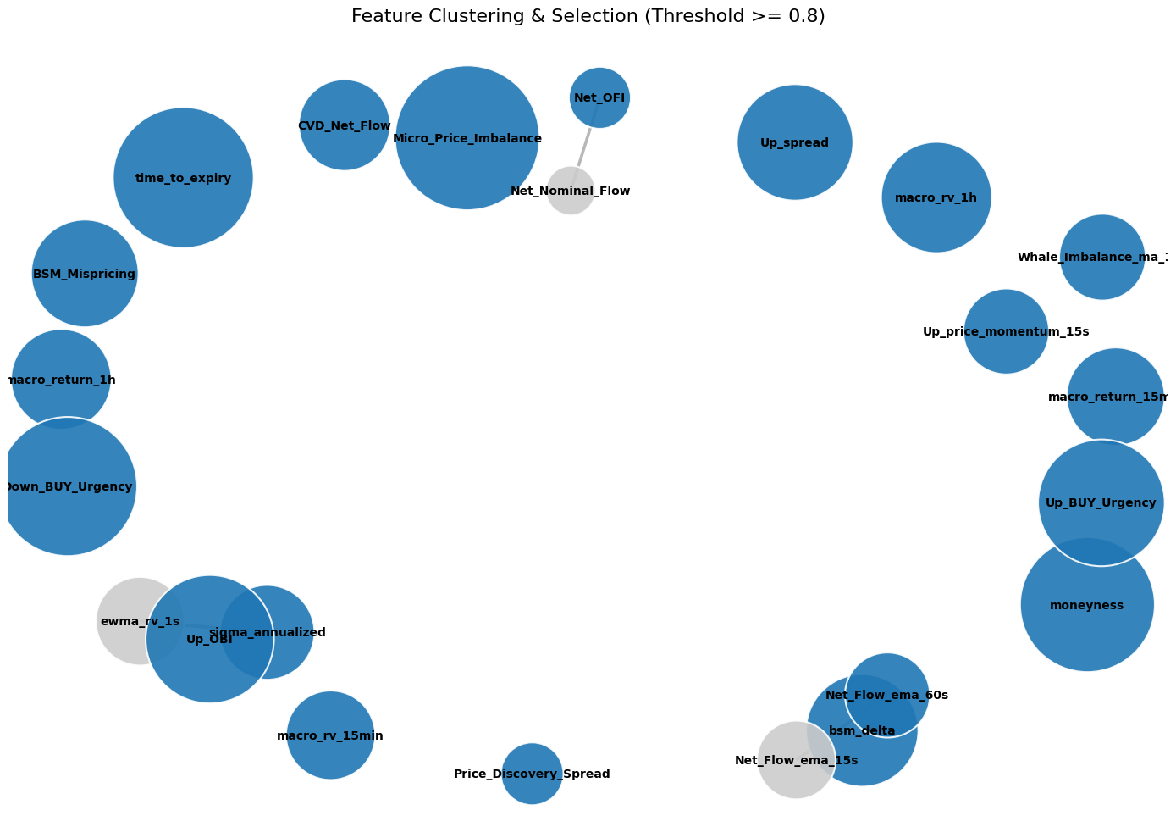
05 FEATURE SELECTION
From 29 Candidates to 21 Final Features
01
LightGBM Screening
02
Stability Filter (CV)
03
Graph Clustering
Rank all candidates by information gain across multiple random seeds + grid search
Retain only features with both high mean gain AND low coefficient of variation
Features with correlation ≥ 0.8 form a cluster — keep the best, drop the rest
Feature importance by information gain
Graph clustering — blue = selected, grey = eliminated

