Slide 1

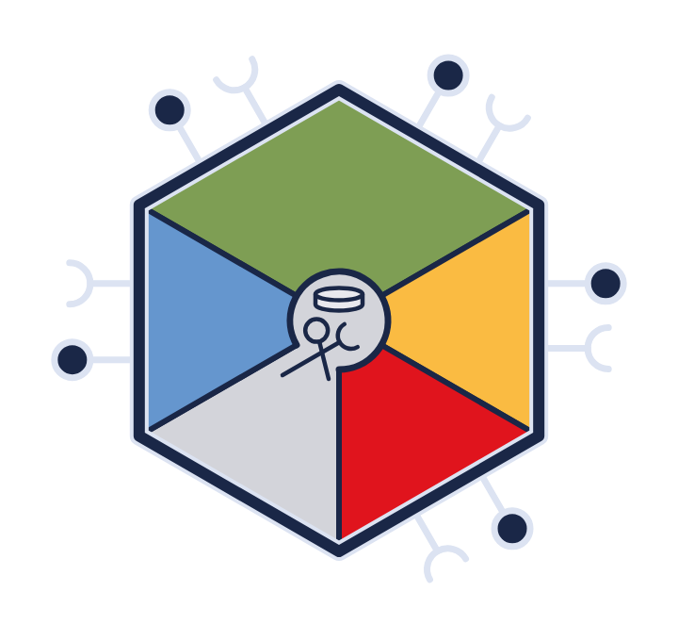

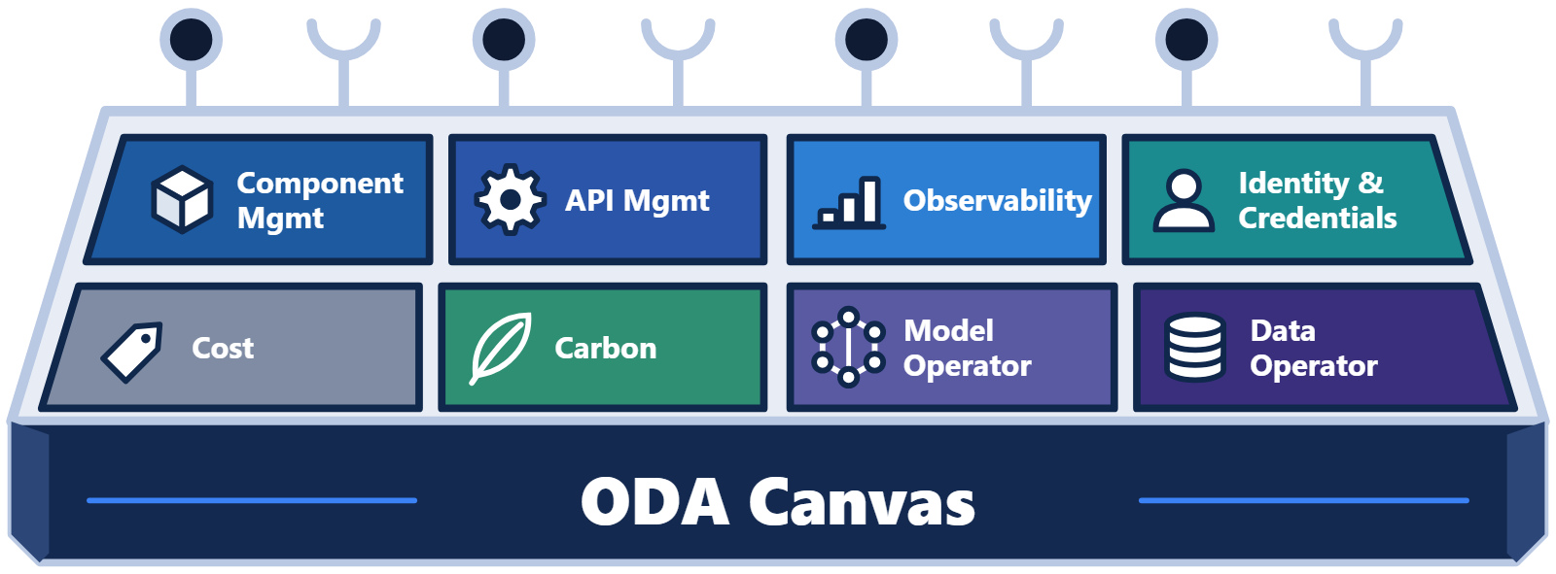
How do I buy or build an ODA Canvas? (presenter introduction)
Training series · Part 2
How do I buy or build
an ODA Canvas?
With the Canvas running on a real cluster
Notes:
One question we're asked a lot is how do I buy or build an ODA Canvas?
With a traditional application, you buy the software and its platform together. Each vendor brings its own gateway, identity and monitoring. The ODA Canvas separates those. Components declare what they need, and the Canvas provides it, using the platform services you choose.
So the Canvas isn't one product. It's a modular platform, built from Canvas operators. In this video we'll look at the three ways to get a Canvas. We'll see how to check that it really is one. Then we'll look at the types of operator, with examples, and at the Canvas running on a real cluster. Finally, we'll see what's coming next.

Slide 2
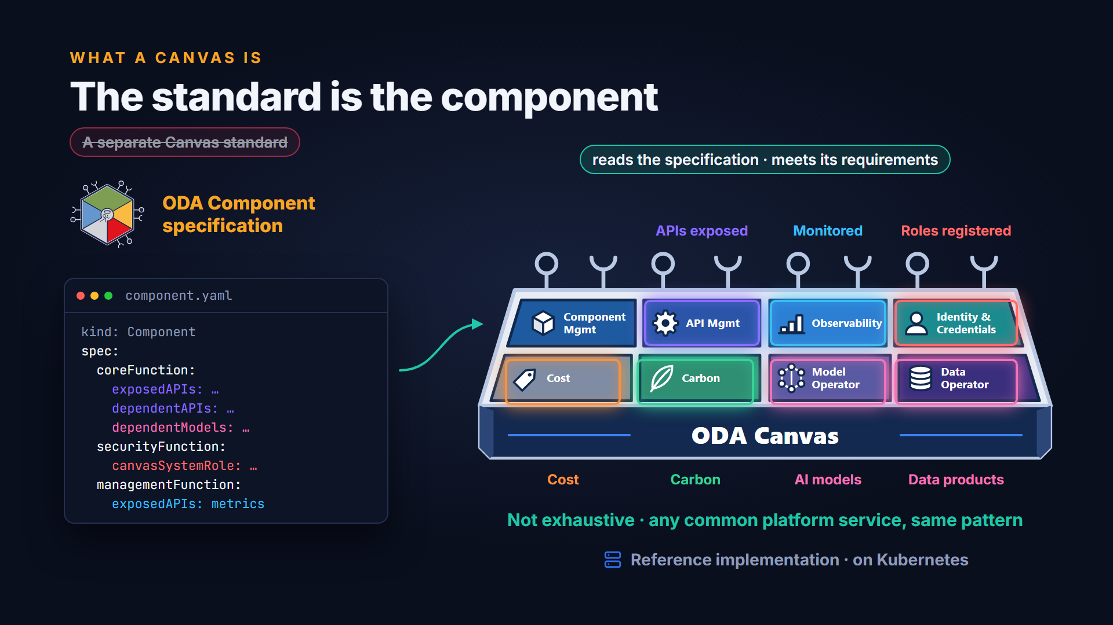
The standard is the component
Notes:
There is no separate standard for the Canvas itself. The standard is the ODA Component specification. A Canvas is any platform that reads a component's specification and meets its requirements. It exposes the component's APIs, registers its roles, and monitors it. A component can also declare the AI models it needs, through the Model-as-a-Service operator. It can ask for data products through the Data operator. It can even manage its cost and carbon footprint, through the cost and carbon operators. This list isn't exhaustive. Any common platform service can be offered through the same pattern. The reference implementation does this on Kubernetes.

Slide 3




Three ways to get a Canvas
THREE ROUTES
Three ways to get a Canvas
1
Public cloud offerings
A managed Canvas on the provider's Kubernetes services
PoCs at DTW Copenhagen
AWS
Microsoft Azure
China Mobile
Google Cloud
Oracle Cloud
2
Roll your own
The reference implementation · Apache 2.0 · extensible
github.com/tmforum-oda/oda-canvas
3
Vendor and open-source operators
Products that already manage themselves on Kubernetes
Istio
Kong
or another product's operator
Notes:
There are three ways to get a Canvas. First, a managed Canvas from a public cloud provider. At DTW Copenhagen, AWS, Microsoft Azure, China Mobile, Google Cloud and Oracle Cloud showed proofs of concept. They build on the reference implementation and the provider's own services.
Second, roll your own. The reference implementation is open source, under the Apache two dot O licence, and designed to be extended.
Third, use operators from software vendors and open-source projects, such as Istio and Kong.

Slide 4
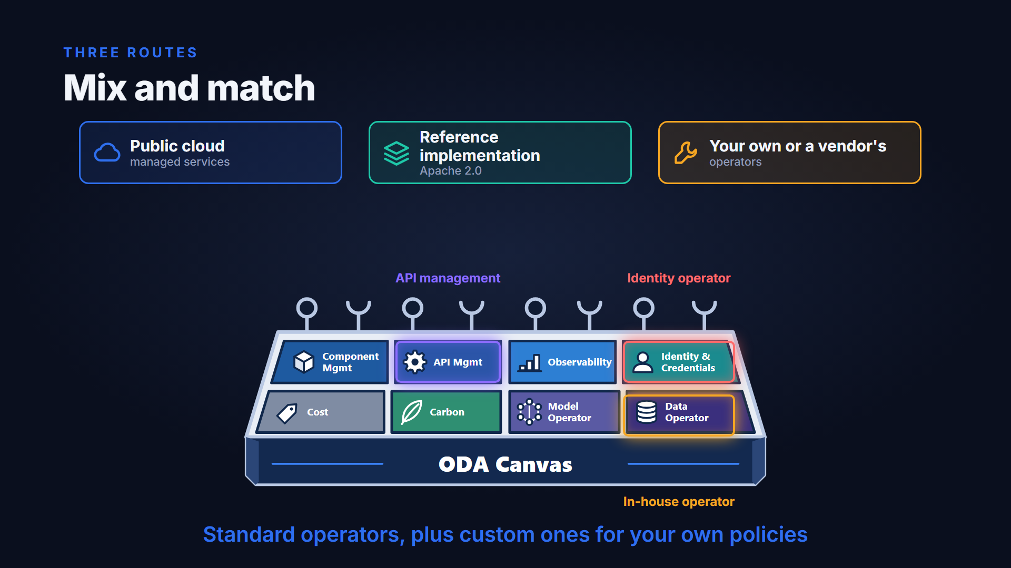
Mix and match
Notes:
These aren't either-or choices. The Canvas is modular, so you can mix and match. You might take a cloud provider's API management, the reference identity operator, and your own operator for an in-house system. A typical production Canvas combines standard operators with custom ones that apply the organisation's own policies.

Slide 5
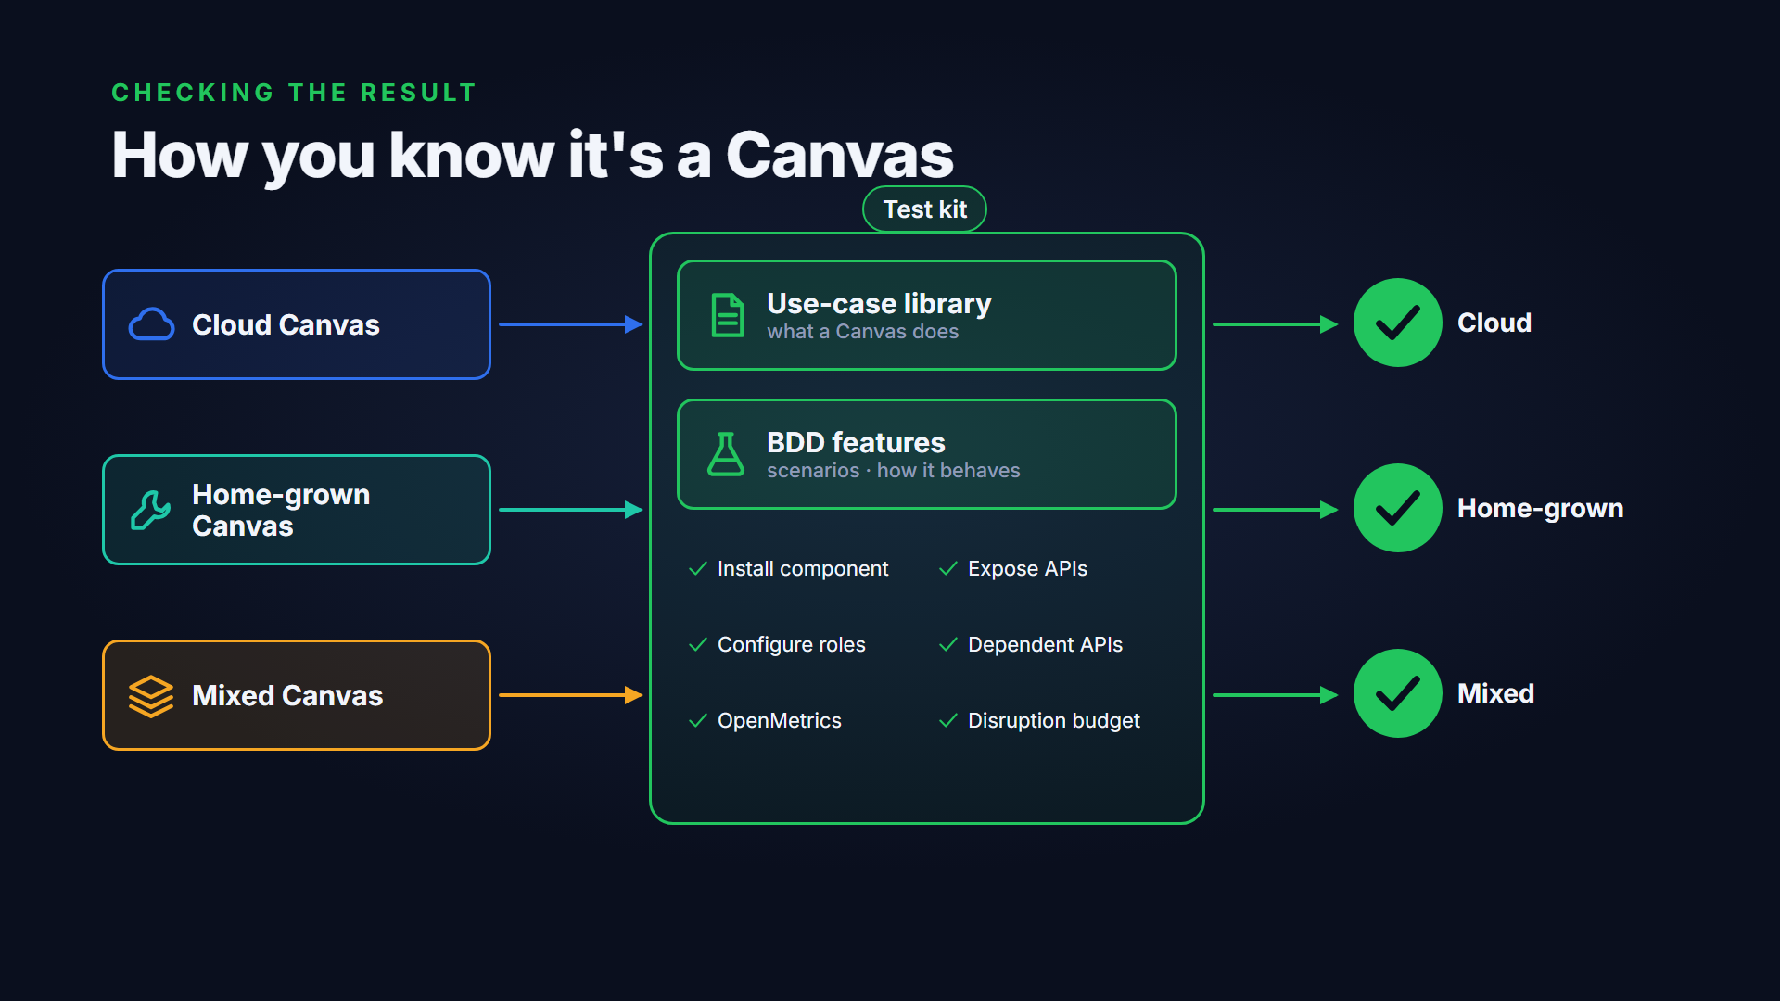
How you know it's a Canvas
Notes:
Whichever route you take, there's an objective way to check the result. The behaviour every Canvas must show is written down in two places. The use-case library describes it at a high level. Behaviour-driven development features describe it in detail, as scenarios. The test kit turns those scenarios into executable tests that can validate any Canvas implementation.

Slide 6
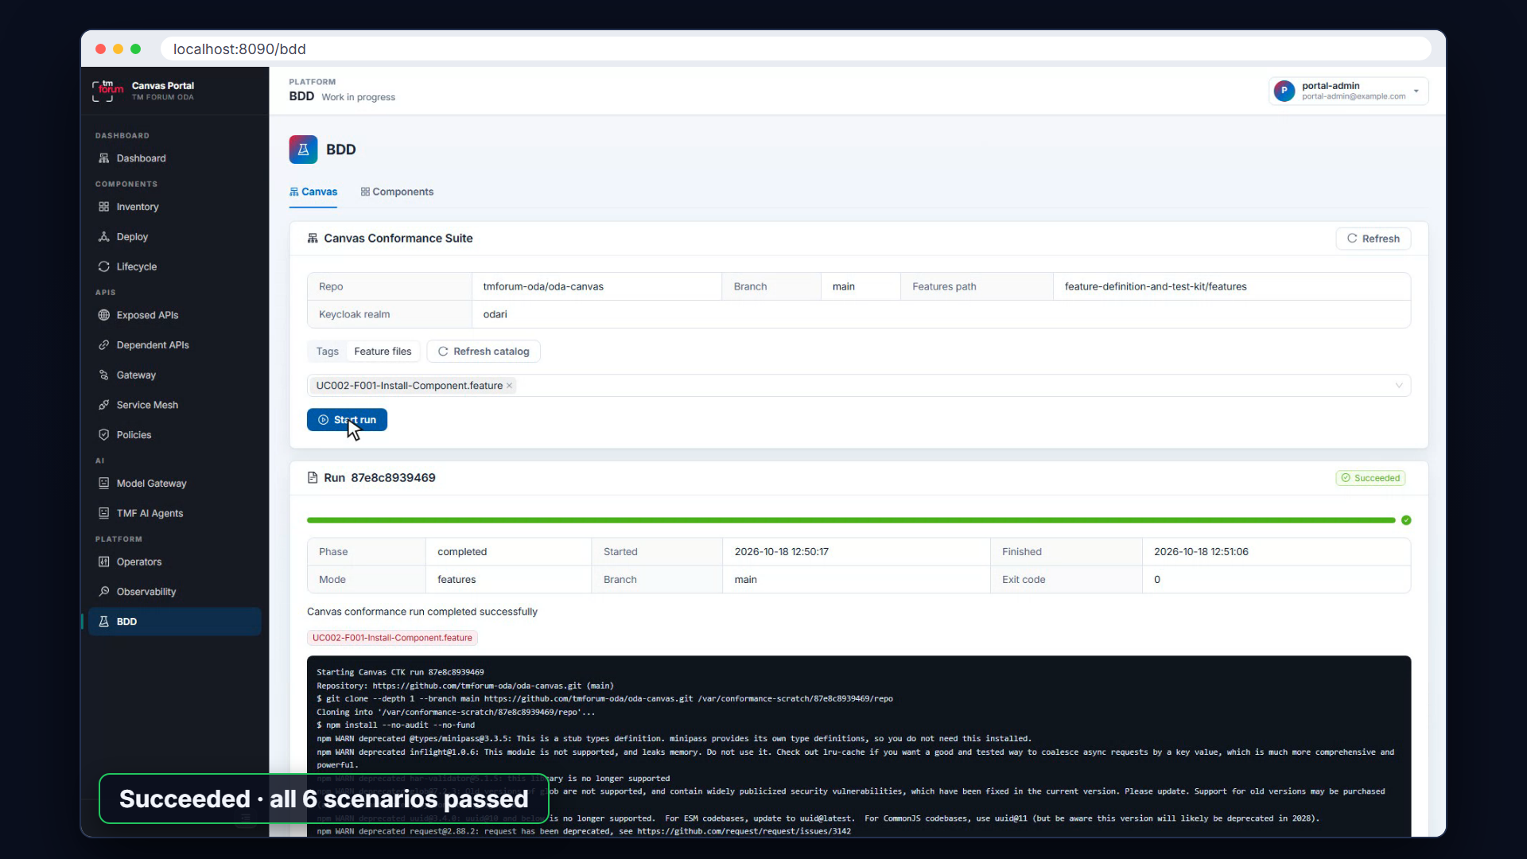
Live, the test kit in the Canvas Portal
Notes:
Here is the test kit in the Canvas Portal. The catalogue loads the feature files straight from the GitHub repository. Each one is named after the use case it tests, such as installing components, exposing APIs, or configuring roles. You can pick features and run them against this Canvas. Every change to the reference implementation is checked this way too.

Slide 7
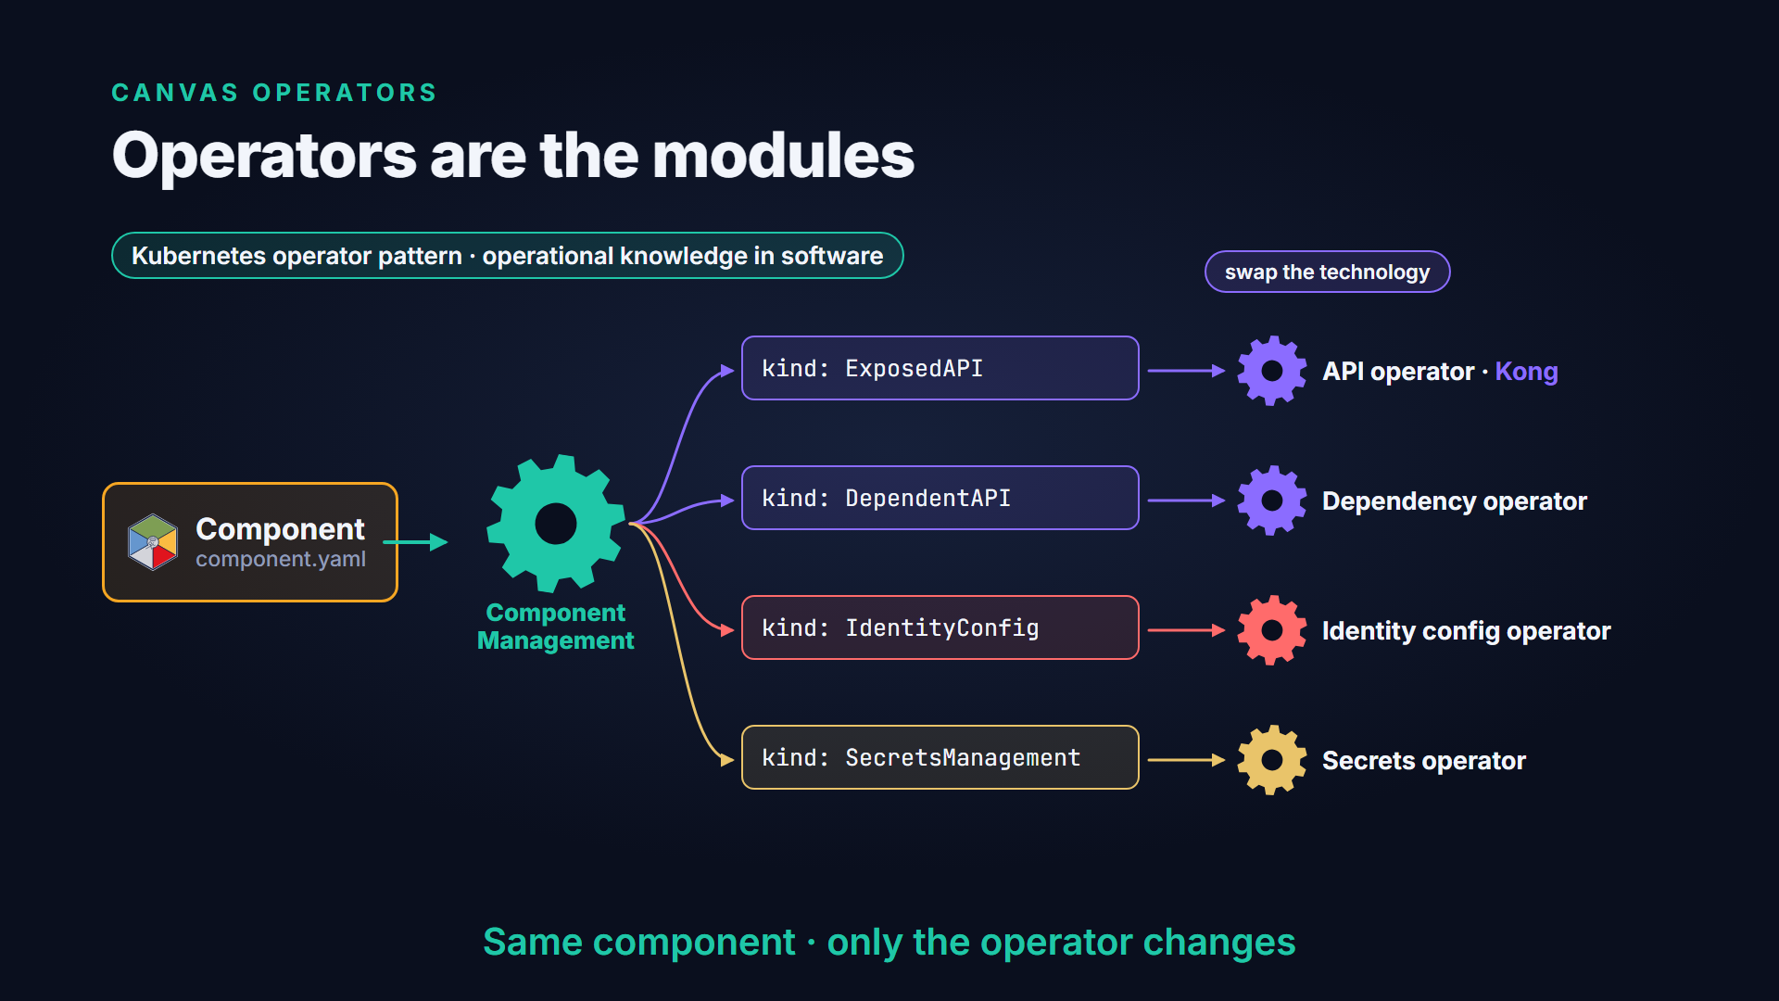
Operators are the modules
Notes:
The modules of a Canvas are called Canvas operators. They follow the Kubernetes operator pattern, software that holds the operational knowledge for one job. The Component Management operator splits each component into parts, such as exposed APIs, dependent APIs and identity. A separate operator handles each part. So you can swap one technology for another without changing the component.

Slide 8



The operator catalogue
CANVAS OPERATORS
The operator catalogue
Available now
Experimental
Planned
001 Component Management
009 Model-as-a-Service
006 Event Management
002 API Management
Data Product
Cost Control
003 Identity Config
011 Carbon-aware
Database Management
004 Credentials Management
005 Dependency Management
007 Secrets Management
Not a fixed list. New operator types are added as the Canvas matures.
010 Disruption Budget
008 OAuth2 Config
prototype
Notes:
These are the operator types today. Seven are available now. They cover components, APIs, identity, credentials, dependencies, secrets and disruption budgets. A prototype operator handles authentication between components. Three operators are experimental. One provides model as a service. One manages data products. And one scales workloads to cut carbon. Event management, cost control and database services are planned. The list isn't fixed. New types will be added as the Canvas matures.

Slide 9
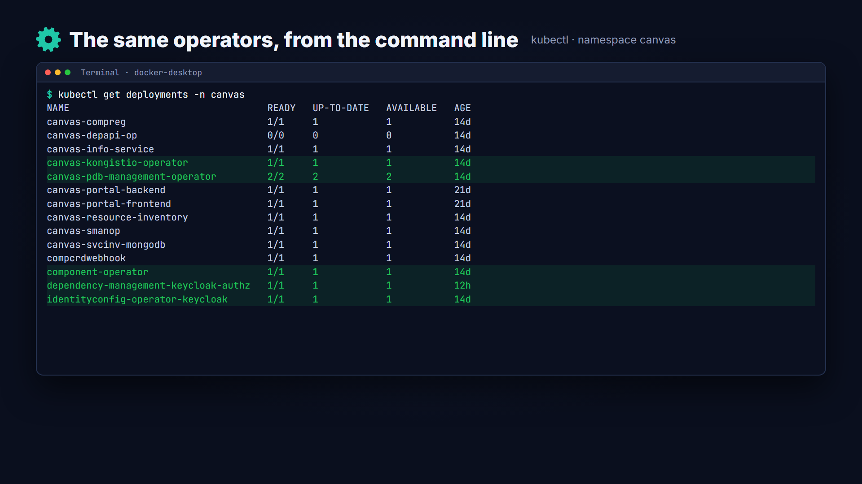
Live, the operators in this Canvas
Notes:
Here are the operators in a running Canvas, in the Canvas Portal. Each one shows its catalogue number, its image and its pods. This Canvas uses the Kong API operator, the Keycloak identity operator, and the Vault secrets operator. The same list is visible from the command line, as ordinary Kubernetes deployments.

Slide 10
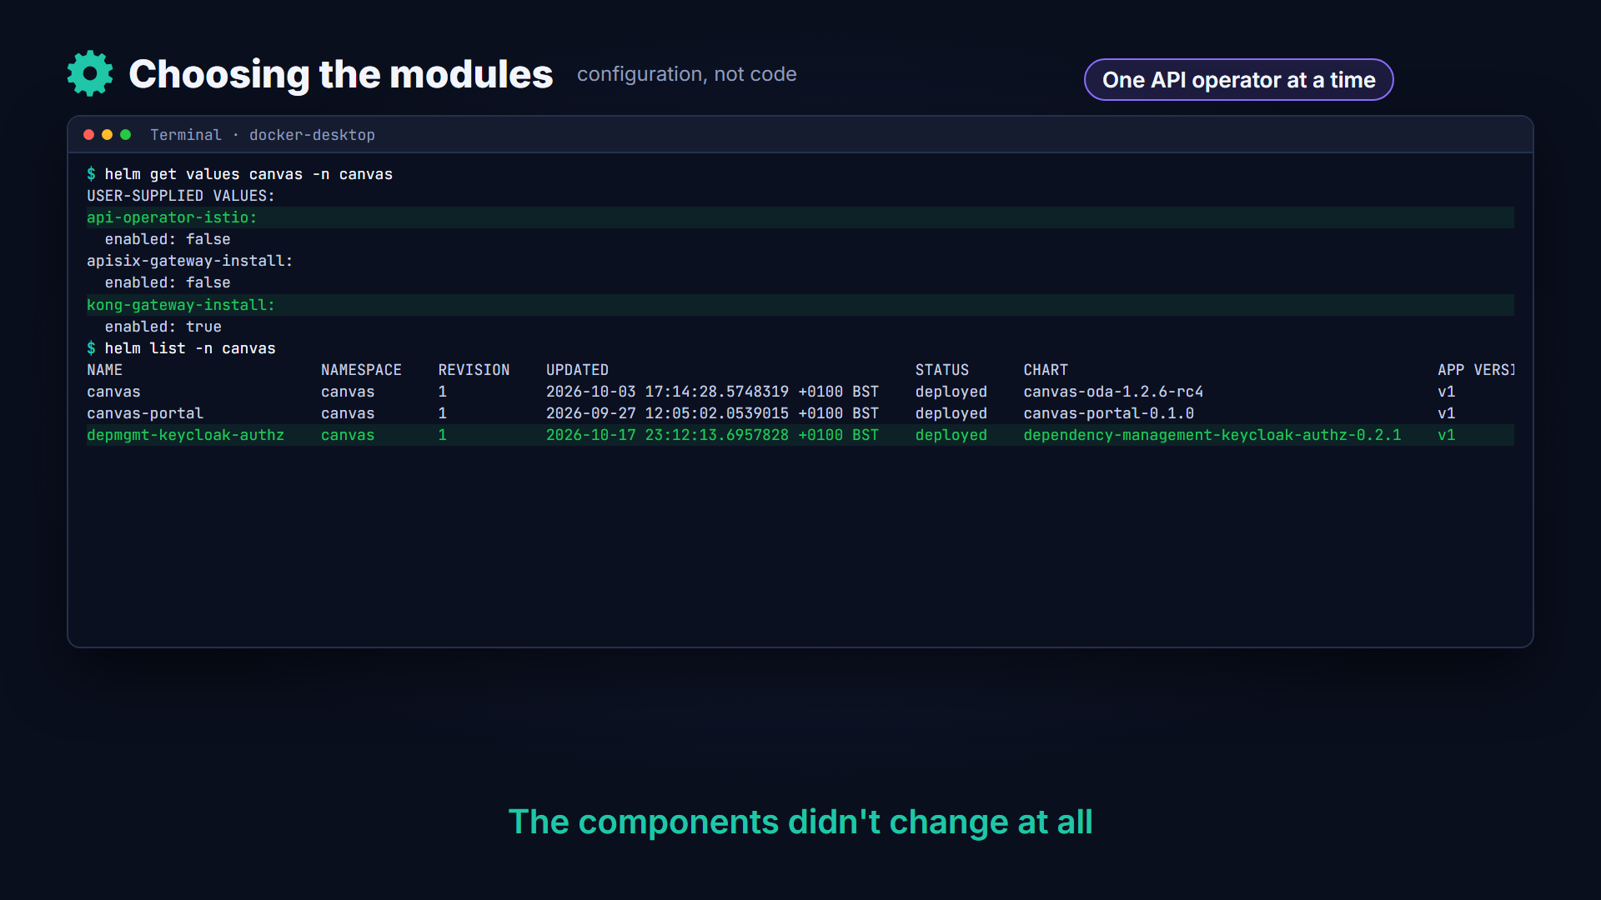
Live, choosing the modules
Notes:
Choosing the modules is configuration, not code. When this Canvas was installed, the Istio API operator was switched off and Kong switched on. Only one API operator runs at a time. Later, the simple dependency operator was replaced with one that waits for an access grant in Keycloak. The components didn't change at all.

Slide 11
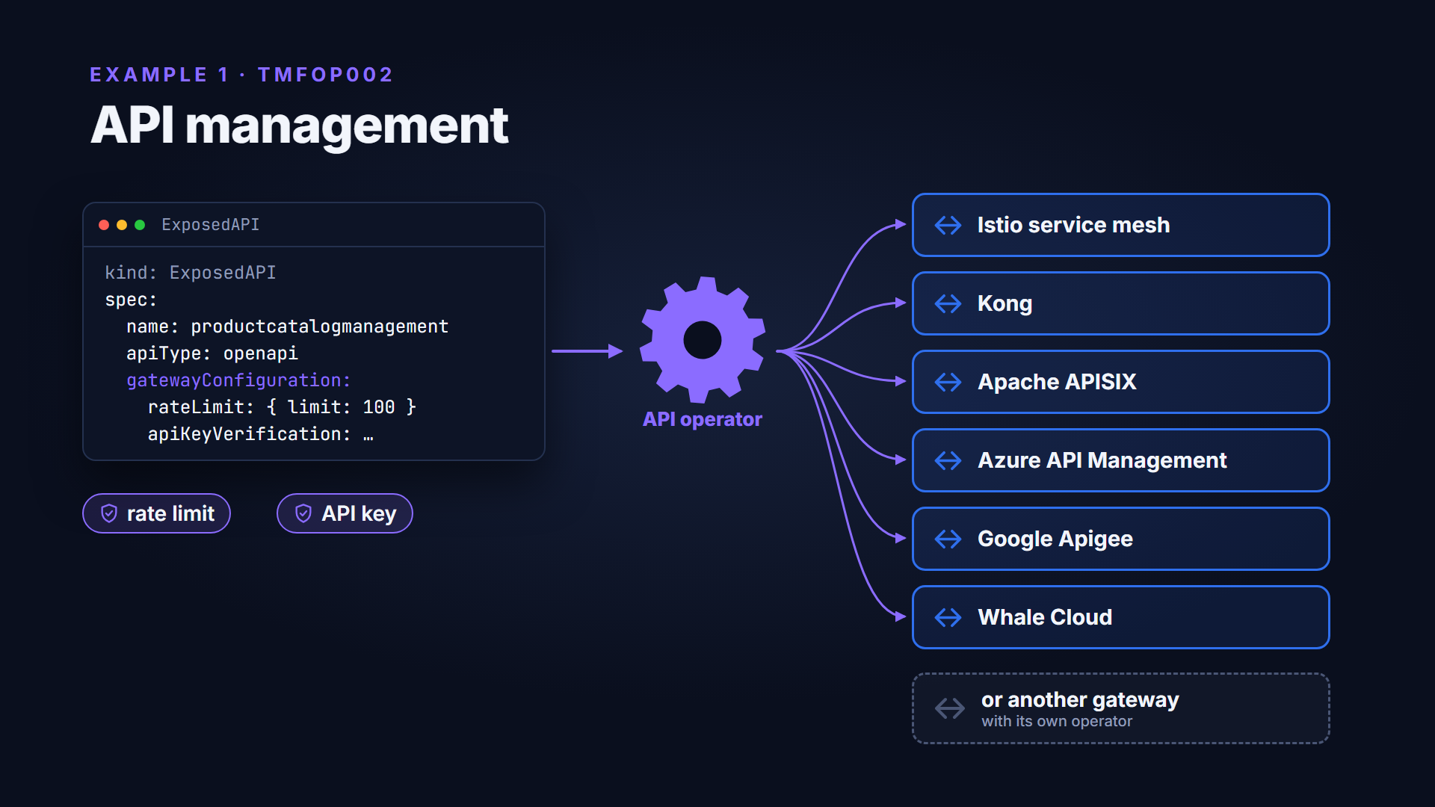
Example 1, API management
Notes:
First, API management. Every component declares the APIs it exposes, with policies such as rate limits or API-key checks. A Canvas can use any API gateway or service mesh, and an API operator configures it. There are operators for Istio, Kong and Apache APISIX. There are also operators for Azure API Management, Google Apigee and Whale Cloud. Any other gateway can be added with its own operator.

Slide 12
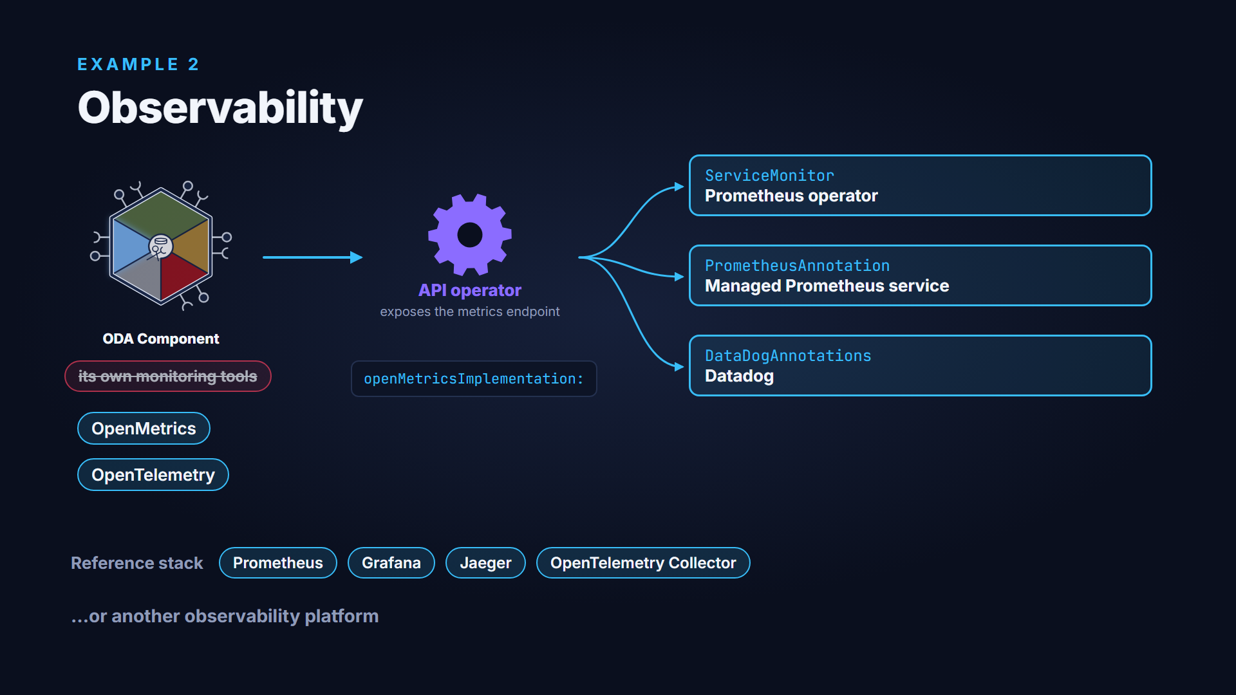
Example 2, observability
Notes:
Second, observability. A component doesn't bring its own monitoring tools. It publishes metrics and traces using the OpenMetrics and OpenTelemetry standards. When the API operator exposes the metrics endpoint, it also sets up how it is collected. That could be a Prometheus operator, a managed Prometheus service, or Datadog. The reference implementation includes a ready-made stack, and any other observability platform can be used.

Slide 13
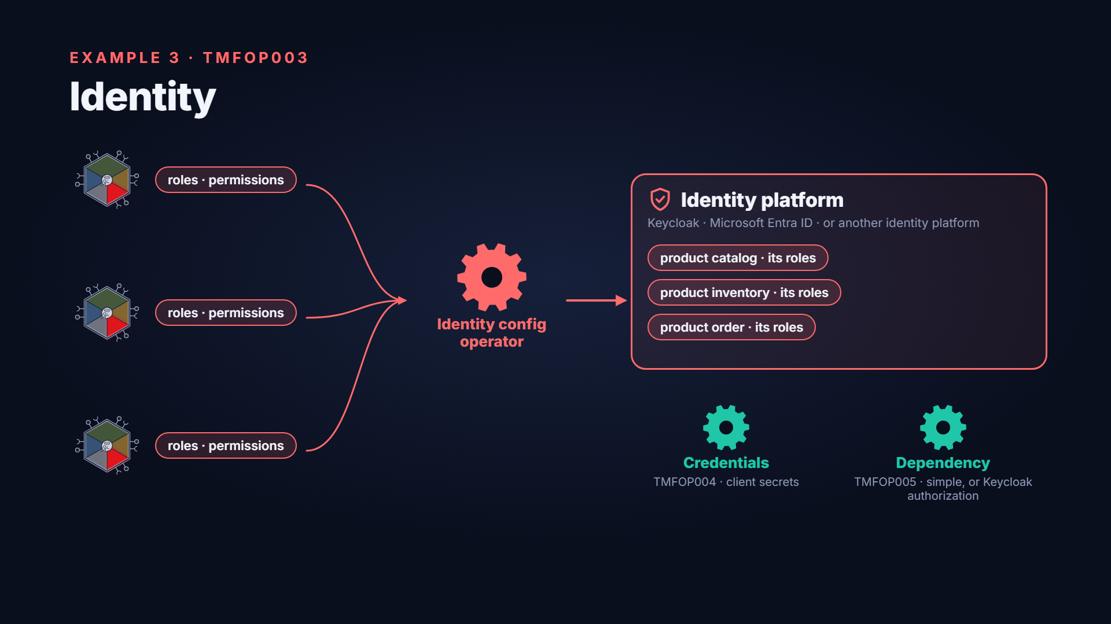
Example 3, identity
Notes:
Third, identity. Most applications today bring their own identity management. Each one has to be integrated with the company's central system. In the ODA model, a component holds only its roles and permissions, and declares them. Identity config operators register them in Keycloak, Microsoft Entra ID, or another identity platform. Companion operators manage each component's credentials and connect its dependencies once access is granted.

Slide 14


Example 4, secrets
EXAMPLE 4 · TMFOP007
Secrets
Secrets management operator
HashiCorp Vault
provides the store for the component
or another secrets platform
ODA Component
declares: a secrets store
Signs in with its own Kubernetes identity
No bootstrap passwords · JWT/OIDC based (UC014)
Notes:
Fourth, secrets. A component declares that it needs a secrets store, and the secrets management operator provides one. The reference implementation uses HashiCorp Vault, and another secrets platform can be used. The component signs in with its own Kubernetes identity, so no bootstrap passwords are needed.

Slide 15
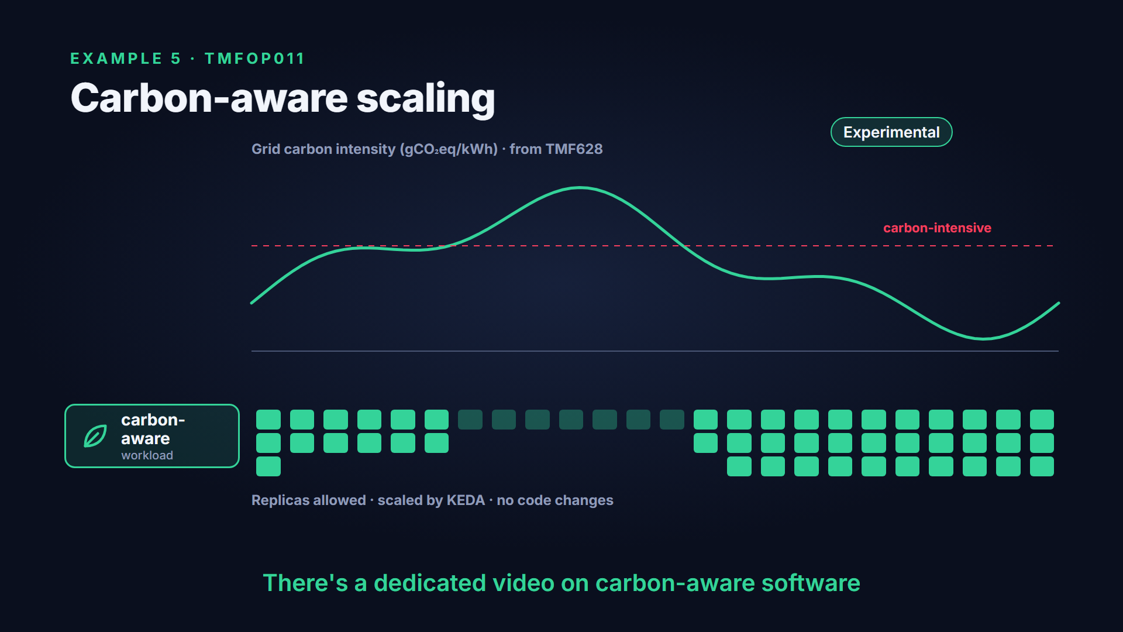
Example 5, carbon-aware scaling
Notes:
Carbon management was only a plan in the original version of this video. Now there is an experimental operator. A component marks some workloads as carbon-aware. The operator reads real-time grid carbon intensity, and limits how far those workloads scale when electricity is carbon-intensive. There's a dedicated video on this.

Slide 16



Build your own operator
BUILDING YOUR OWN
Build your own operator
Any language
Same custom resources
Help to start
Follows the Kubernetes operator pattern. The reference operators use Python with KOPF, and Go.
Component · ExposedAPI · DependentAPI · IdentityConfig · SecretsManagement
The create-oda-operator AI coding-assistant skill, and the BDD test kit to check it.
github.com/tmforum-oda/oda-canvas › source/operators · skills/create-oda-operator
Notes:
You can also build your own operators. They can be written in any language that follows the Kubernetes operator pattern. The reference operators use Python with the KOPF framework, and Go. To work with the rest of the Canvas, an operator uses the same standard custom resources. The repository includes an AI coding-assistant skill for creating operators, and the test kit to check them.

Slide 17

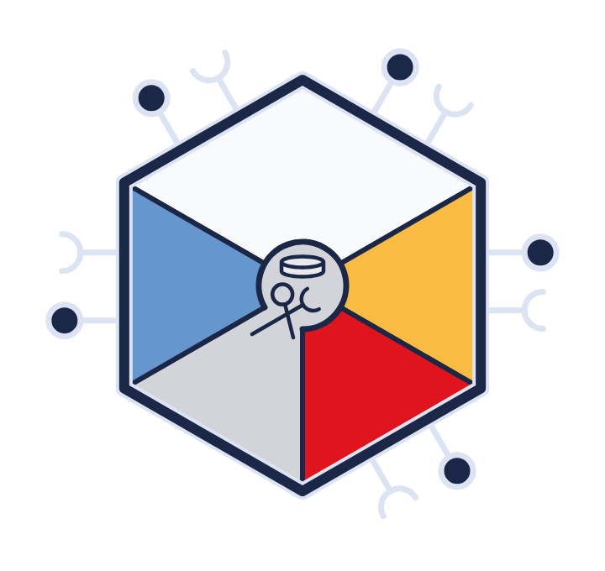

What's next
LOOKING AHEAD
What's next
Planned
The AI-Native Canvas
Event Management
Experimental · its own video
Components declare the AI models they need
Cost Control
Governed access through a model gateway
Database Management
Model-as-a-Service operator · TMFOP009 · experimental
Guardrails and usage records
MCP tools and agentic components
Notes:
The biggest area of new work is the AI-Native Canvas. Components will declare which AI models they need. The experimental Model-as-a-Service operator grants governed access through a model gateway. The gateway applies guardrails and records usage. The AI-Native Canvas has its own video. Operators for events, cost control and database services are also on the roadmap.

Slide 18
Recap
RECAP
How do I buy or build an ODA Canvas?
Buy, build, or mix and match
Operators are the modules, chosen by configuration
The test kit checks any Canvas
Notes:
To recap. You can buy a Canvas, build one, or mix and match. Operators are the modules, and you choose them through configuration. Whatever you choose, the test kit checks that it behaves like a Canvas.

Slide 19
Find out more
FIND OUT MORE
Docs, components and code
Open Digital Architecture
tmforum.org/oda
ODA Component Directory
tmforum.org/oda/directory
ODA Canvas reference implementation
github.com/tmforum-oda/oda-canvas › Canvas-design.md · source/operators
Notes:
To find out more, see the Open Digital Architecture pages on the TM Forum website. Browse the ODA Component Directory. And explore the reference implementation on GitHub, at TM Forum dash ODA slash ODA Canvas.

