Slide 1

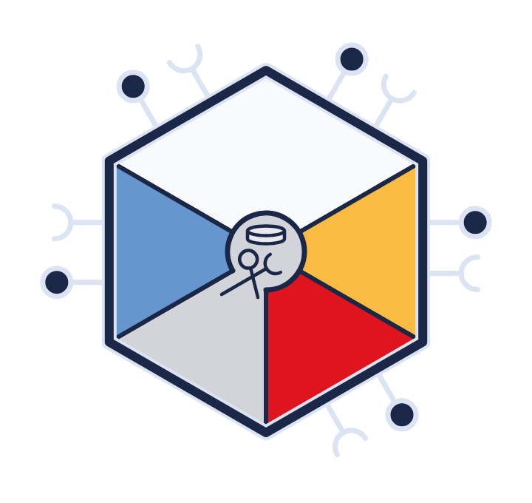

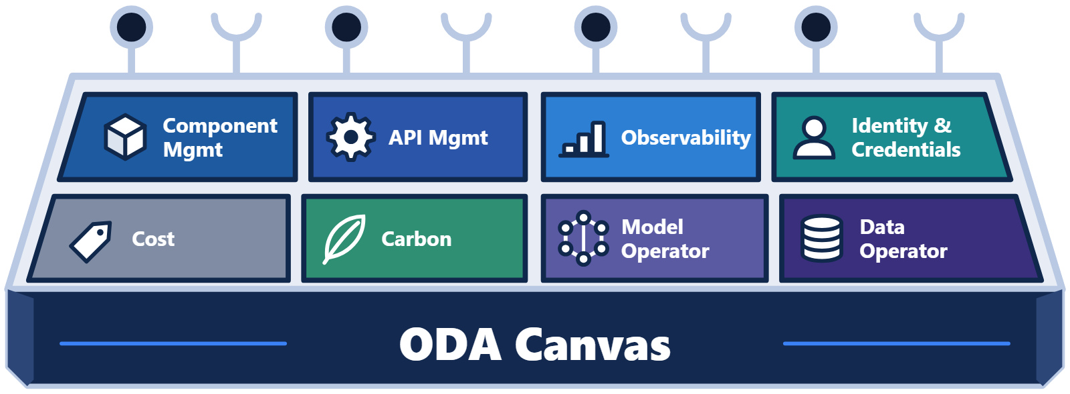
The AI-Native ODA Canvas (presenter introduction)
Training series · Part 4
The AI-Native
ODA Canvas
Agents · models · governance · AI-assisted development
Notes:
AI agents are quickly becoming the way service providers deliver intelligent, autonomous services.
Most organisations started with a few pilots. Each team wired its agents directly to its favourite model provider. That works for a demo. At enterprise scale it brings lock-in, hidden costs and inconsistent guardrails. The AI-Native Canvas takes a different approach. Agents are packaged as ODA Components. They declare the tools and models they need, and the Canvas grants governed access.
In this video, we look at how components become tools for agents, and how agents become components. We cover model as a service and the model gateway. We look at the services needed to run AI at scale. And we finish with how AI is helping us build the Canvas itself.

Slide 2



Four questions
THE AI-NATIVE CANVAS
Four questions
How do we expose components as tools for agents?
How do we deploy agents themselves as components?
MCP
Agentic components
How do we operate many agents, from many vendors?
How can AI help us build the Canvas?
Governance at scale
AI-assisted development
Questions 1–3 · AI-Native Canvas design Question 4 · new in this video
Notes:
The AI-Native Canvas work started from three questions. How do we expose ODA Components as tools for AI agents? How do we deploy the agents themselves as components? And how do we operate many agents, from many vendors, with proper governance? This video adds a fourth question. How can AI help us build the Canvas?

Slide 3
What the 2026 Catalysts show
TM FORUM CATALYSTS
What the 2026 Catalysts show
Use AI
59
53 of 59
Built from AI agents
29 of 59
Target autonomous networks
Catalyst projects at DTW 2026
37 of 59
Trust, security and governance for agents
13 of 59
Agent platform: registry, runtime, lifecycle, model gateway
5 of 59
Much of the AI-Native Canvas is lessons learned from these Catalysts
Source: tmforum.org/catalysts · projects C26.0 · read October 2026 · classified by topic and summary
Notes:
TM Forum's Catalyst projects show where the industry is heading. At DTW twenty twenty-six, there were fifty-nine Catalysts. Nine in ten used AI. About half were built from AI agents, often several agents working together. More than half targeted autonomous networks. About one in five tackled trust, security and governance for agents. And several built the platform that agents need, such as registries, runtimes and a model gateway. Much of the work in the AI-Native Canvas is lessons learned from these Catalyst projects.

Slide 4
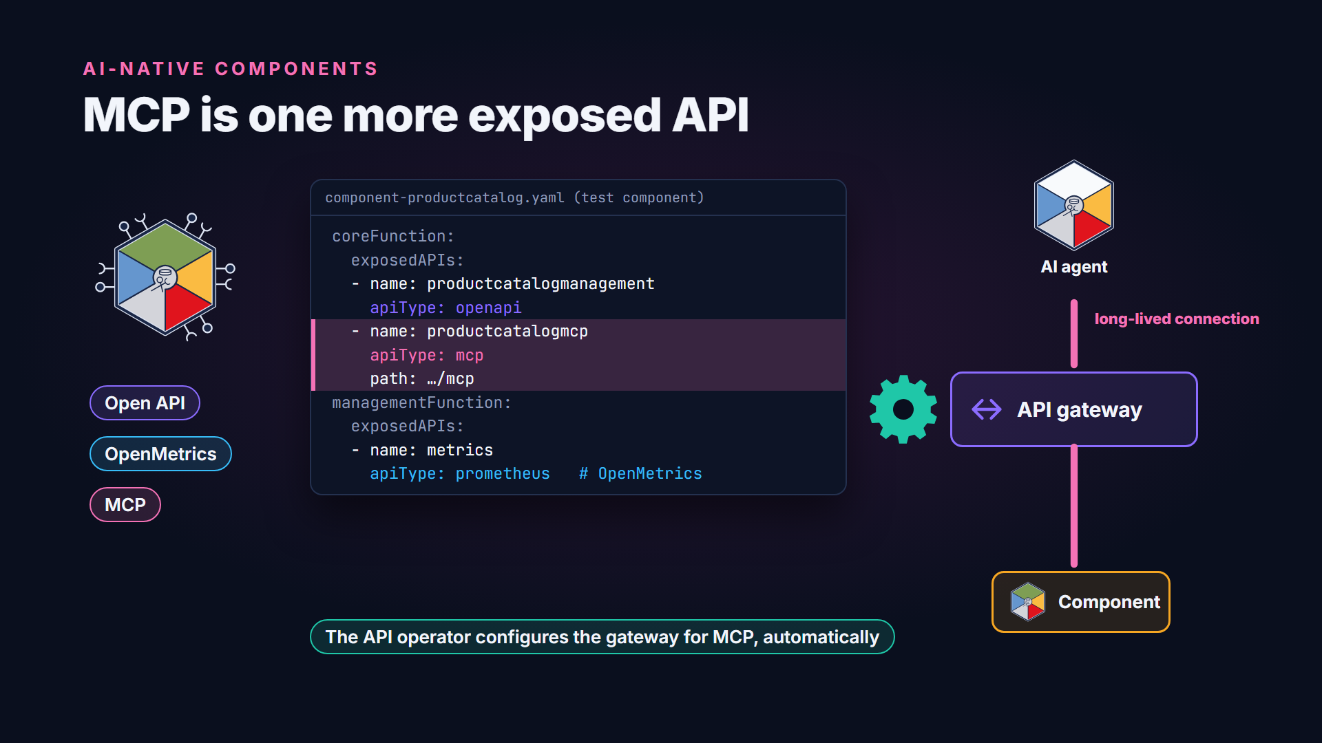
MCP is one more exposed API
Notes:
Components already declare the APIs they expose. That includes cross-industry APIs such as OpenMetrics. So adding MCP was simple. MCP became one more API type. The product catalog test component exposes an MCP server beside its Open APIs. MCP keeps long-lived connections open, unlike short REST calls. Because the component declares the type, the API operator configures the gateway for it automatically.

Slide 5
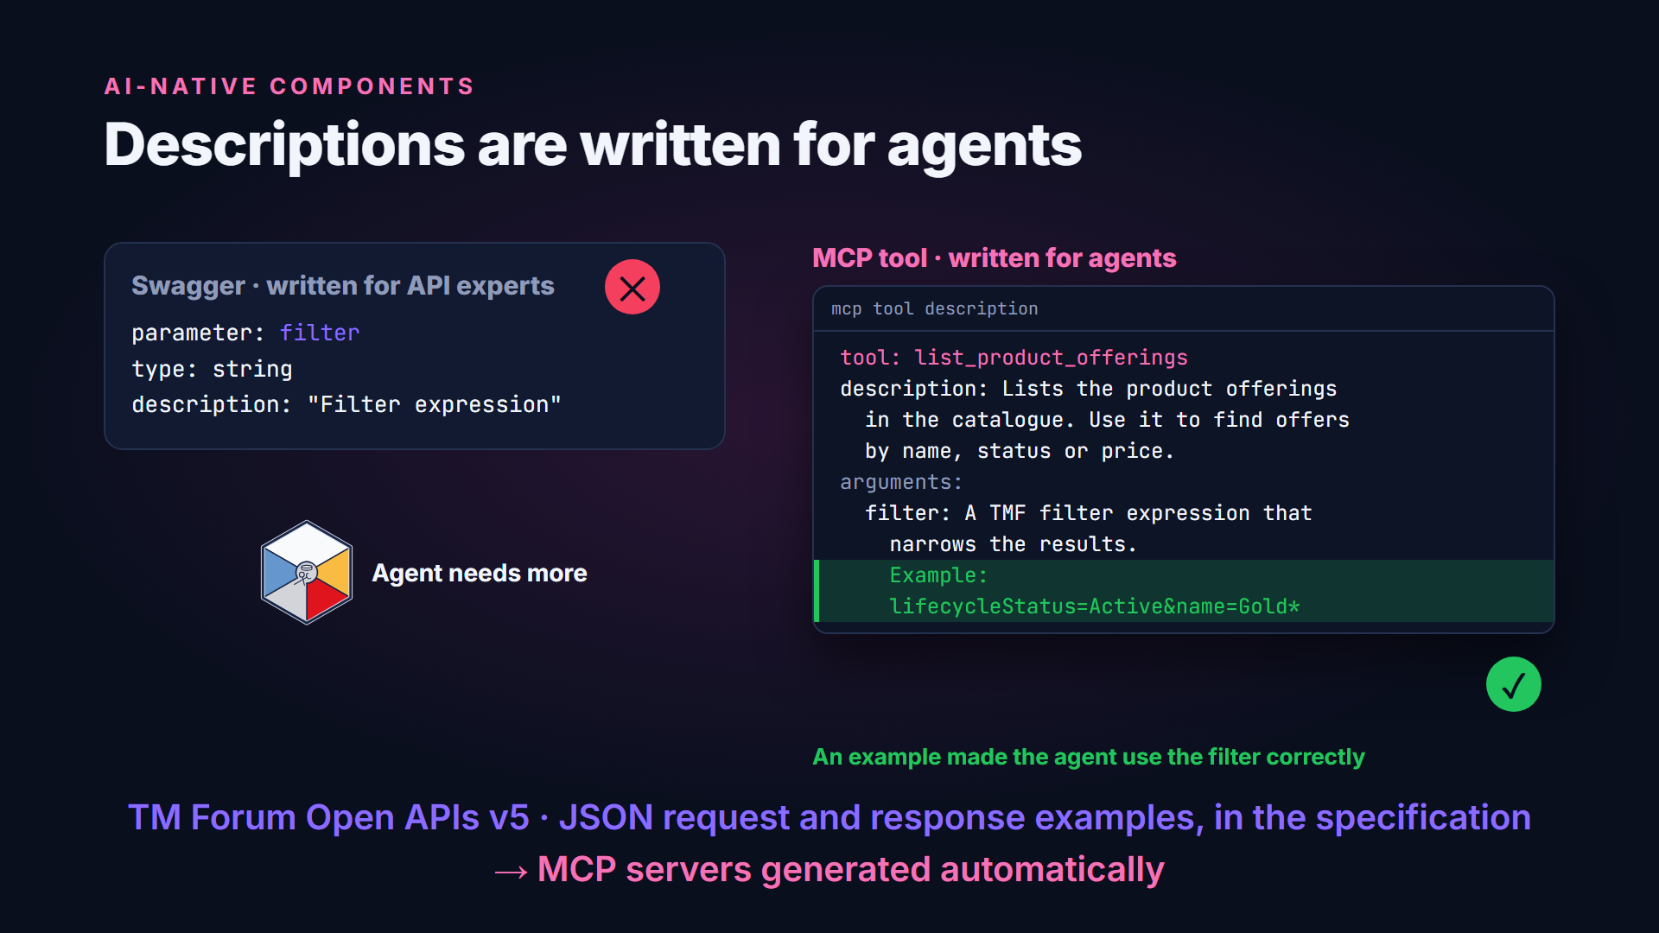
Descriptions are written for agents
Notes:
The heart of an MCP server is its plain-language description of each tool and argument. Swagger files were written for API experts. Agents need more. In testing, detailed explanations and concrete examples made the difference. One agent only used the filter argument correctly once an example was added. Version five of the TM Forum Open APIs includes JSON examples. They cover request and response payloads, embedded directly in the Open API specifications. That lets us generate MCP servers automatically.

Slide 6




Agents as components
AGENTIC COMPONENTS
Agents as components
Four assumptions
Models are services, reached by API
Approved model catalogues
Non-deterministic, so evaluate continuously
Agentic ODA Component
Extra services: vector databases, anonymisation, chunking
Notes:
The second question is about packaging agents as components. Four assumptions shape the design. Models run as services on the platform, and agents reach them through APIs. Service providers keep approved catalogues of models. Agents are non-deterministic, so they need continuous evaluation, not just fixed tests. And agents need extra services, such as vector databases and anonymisation, which the Canvas should provide.

Slide 7
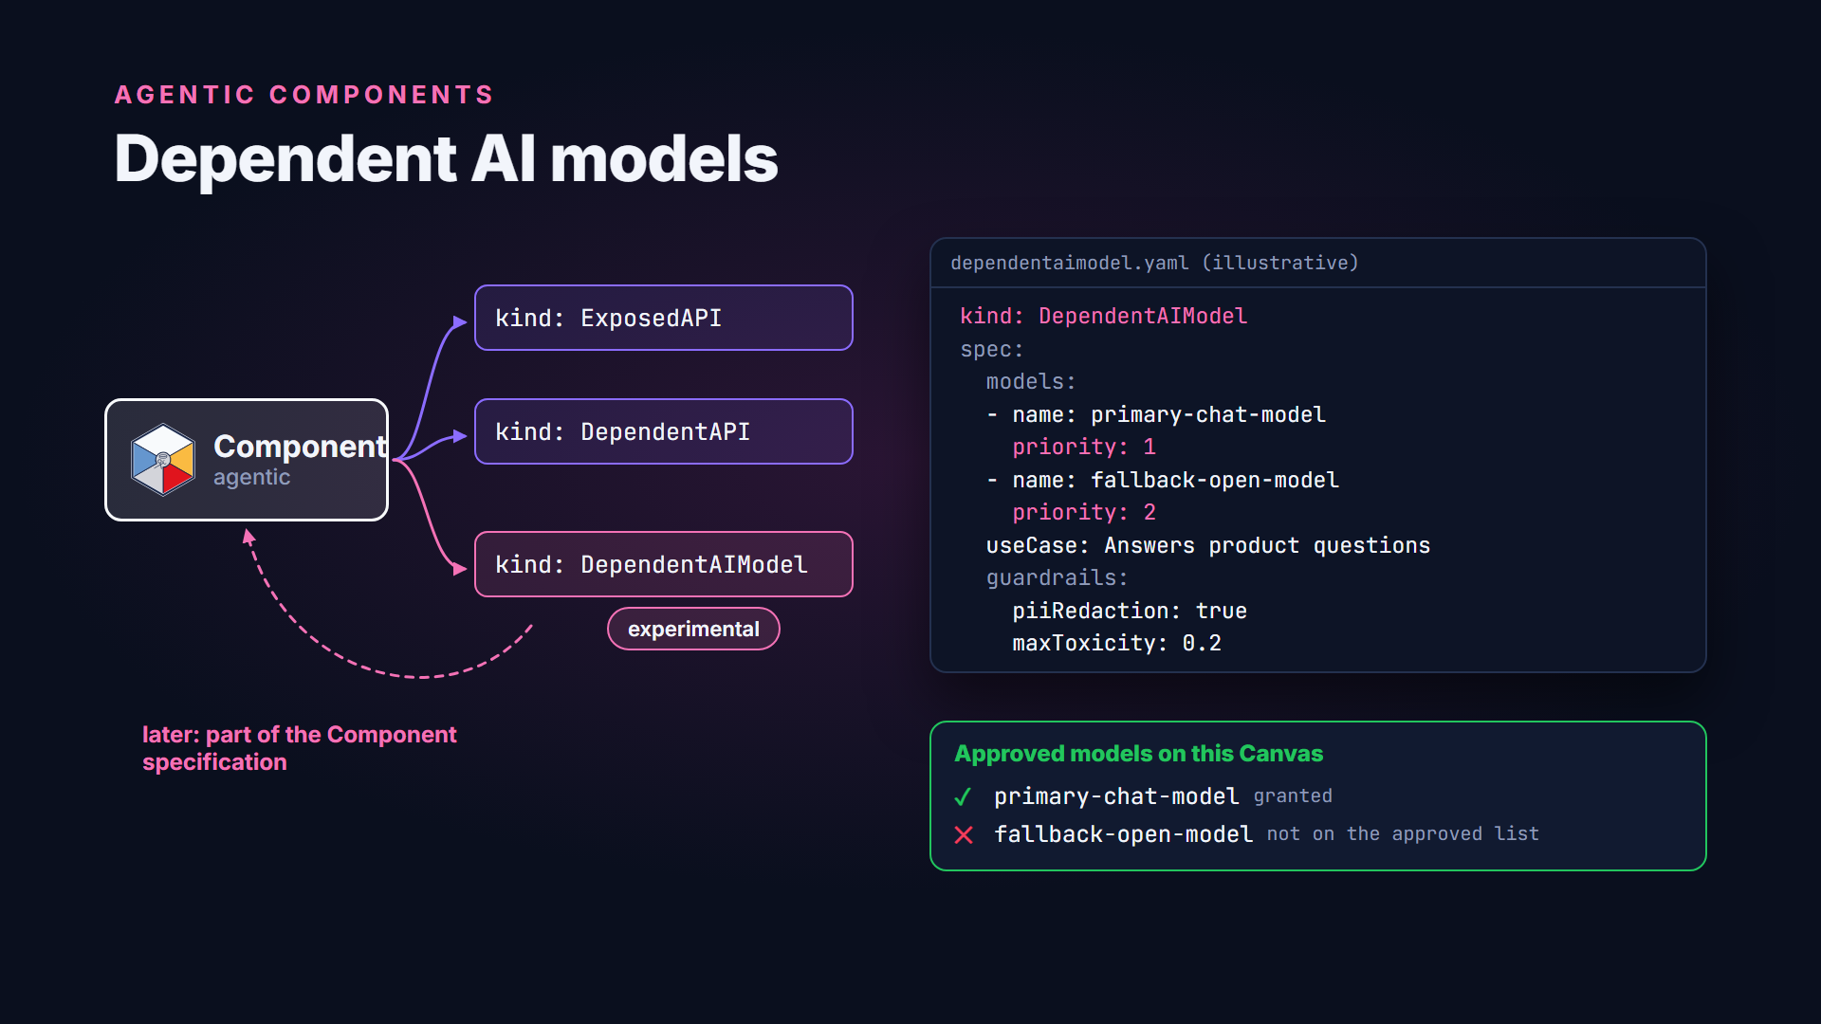
Dependent AI models
Notes:
With those assumptions, the component model extends naturally. A component already lists the APIs it depends on. Now it can list the AI models it depends on, in priority order. It describes its use case, and the guardrail thresholds it needs. The Canvas grants access to whichever models are on the approved list. This starts as an experimental resource of its own, called dependent AI model. Later it will join the main component specification.

Slide 8
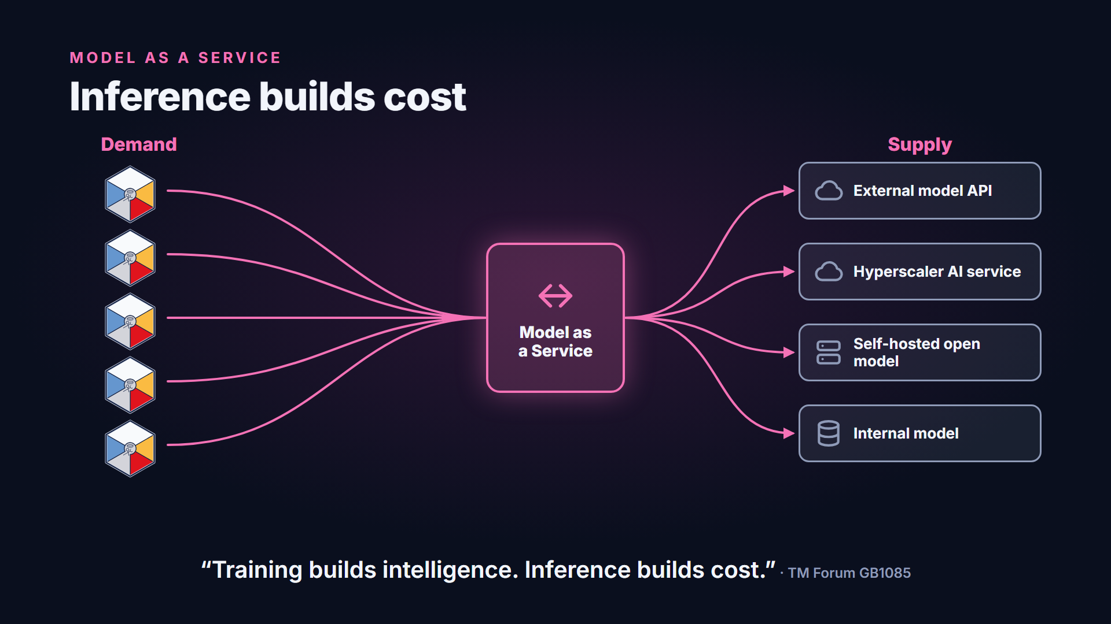
Training builds intelligence, inference builds cost
Notes:
TM Forum's Model as a Service guide starts with a simple observation. Training builds intelligence, but inference builds cost. Today, many teams wire their agents directly to model providers. That creates lock-in, hidden costs and inconsistent guardrails. Every team rebuilds the same plumbing. Model as a service puts a control plane between agents and models. It separates the demand for intelligence from its supply.

Slide 9


Three options
MODEL AS A SERVICE
Three options
One hyperscaler's AI service
Wait for an industry standard
Model as a Service
Rejected
Premature
Selected
Model lock-in becomes platform lock-in
The market is moving too fast
An internal standard layer, today
TM Forum GB1085 Model-as-a-Service (MODaaS) · Introductory Guide · alpha
Notes:
The guide weighed three options. Standardising on one hyperscaler's AI service was rejected. It just trades model lock-in for platform lock-in. Waiting for an industry-wide standard was judged premature, because the market moves too fast. Model as a service was selected. It gives a service provider its own standard layer today, without waiting for the market to settle.

Slide 10




What the control plane provides
MODEL AS A SERVICE
What the control plane provides
Model as a Service · control plane between agents and models
One API to every model
Model catalogue
Routing and failover
Quality checks
Internal or external
The most efficient model
When a provider goes down
Golden datasets catch drift
End-to-end tracing
Guardrails
Cost and budgets
Every request, every provider
Prompt attacks blocked · PII redacted
Stops a runaway agent
TM Forum GB1085 §2 · alpha
Notes:
The control plane offers a consistent set of services. One standard API reaches every model, internal or external. A catalogue helps developers pick the most efficient model that does the job. Routing fails over when a provider goes down. Golden datasets catch silent quality drift. Tracing follows every request end to end. Guardrails block prompt attacks and redact personal data. And cost tracking stops a runaway agent from blowing the budget.

Slide 11
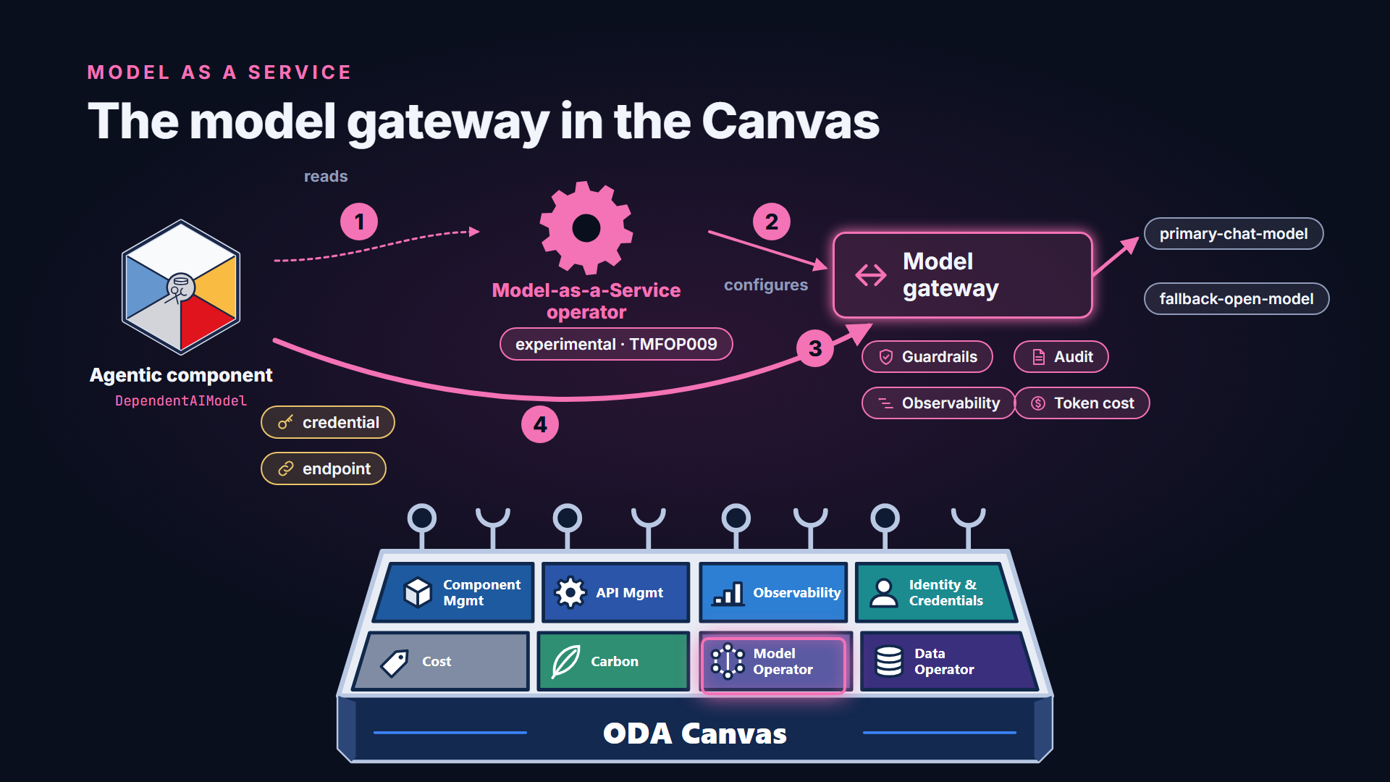
The model gateway in the Canvas
Notes:
On the Canvas, this is the job of the Model-as-a-Service operator. It's experimental today. The operator reads the models a component depends on. It configures the model gateway. Then it gives the component a credential and an endpoint. From then on, every model call goes through the gateway. Guardrails are enforced, and each call is recorded for audit, observability and cost.

Slide 12
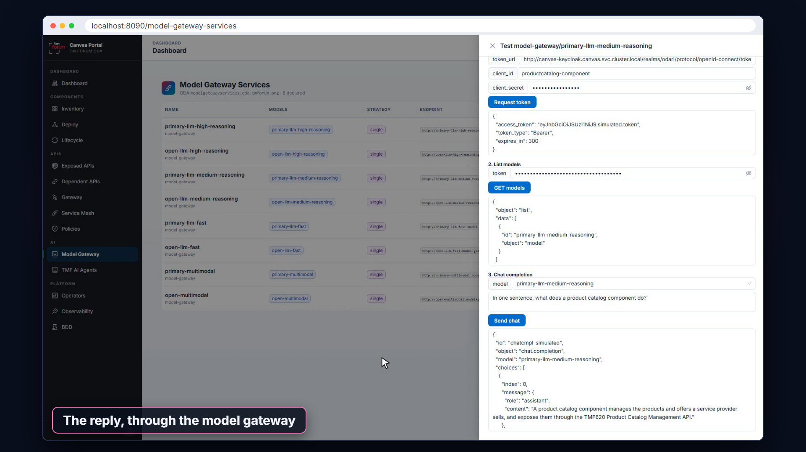
Simulated demo: Model Gateway in the Canvas Portal
Notes:
This is how the Model Gateway will appear in the Canvas Portal. The list shows the AI models available through the gateway. They cover high, medium and fast reasoning, and multimodal models. Each comes from a primary or an open provider, with its own gateway endpoint. The Portal can test the connection. It gets a token, lists the models, and sends a prompt through the gateway.

Slide 13



Six levers of inference cost
MODEL AS A SERVICE
Six levers of inference cost
Capability
Accuracy
Latency
Fit for the task
Is the last nine percent worth it?
Time to first token
Throughput
Context window
Token efficiency
Tokens per second
Memory is expensive
Verbose models cost more
Sufficient intelligence at optimal cost
Notes:
The guide also explains what drives the cost of each answer. It names six levers. The first three are capability, accuracy and latency. The next three are throughput, context window and token efficiency. A cheaper model is a false economy if it fails the task. But the most capable model is often more than a task needs. The aim is sufficient intelligence at the optimal cost.

Slide 14

Canvas services for AI
RUNNING AI AT SCALE
Canvas services for AI
Language, embedding and multimodal models
Classical ML with MLOps
Vector databases, anonymisation, chunking
AI observability: LangSmith, OpenLLMetry or another platform
Model gateway
Evaluation
Registry of agents, tools and use cases
Notes:
To run agents from many vendors, the Canvas needs a broader set of services. It needs access to language, embedding and multimodal models. It needs classical machine learning, with proper MLOps. It needs supporting services, such as vector databases. Observability must cover model calls, with LangSmith, OpenLLMetry or another platform. And it needs the model gateway, an evaluation framework, and a registry of agents, tools and use cases.

Slide 15
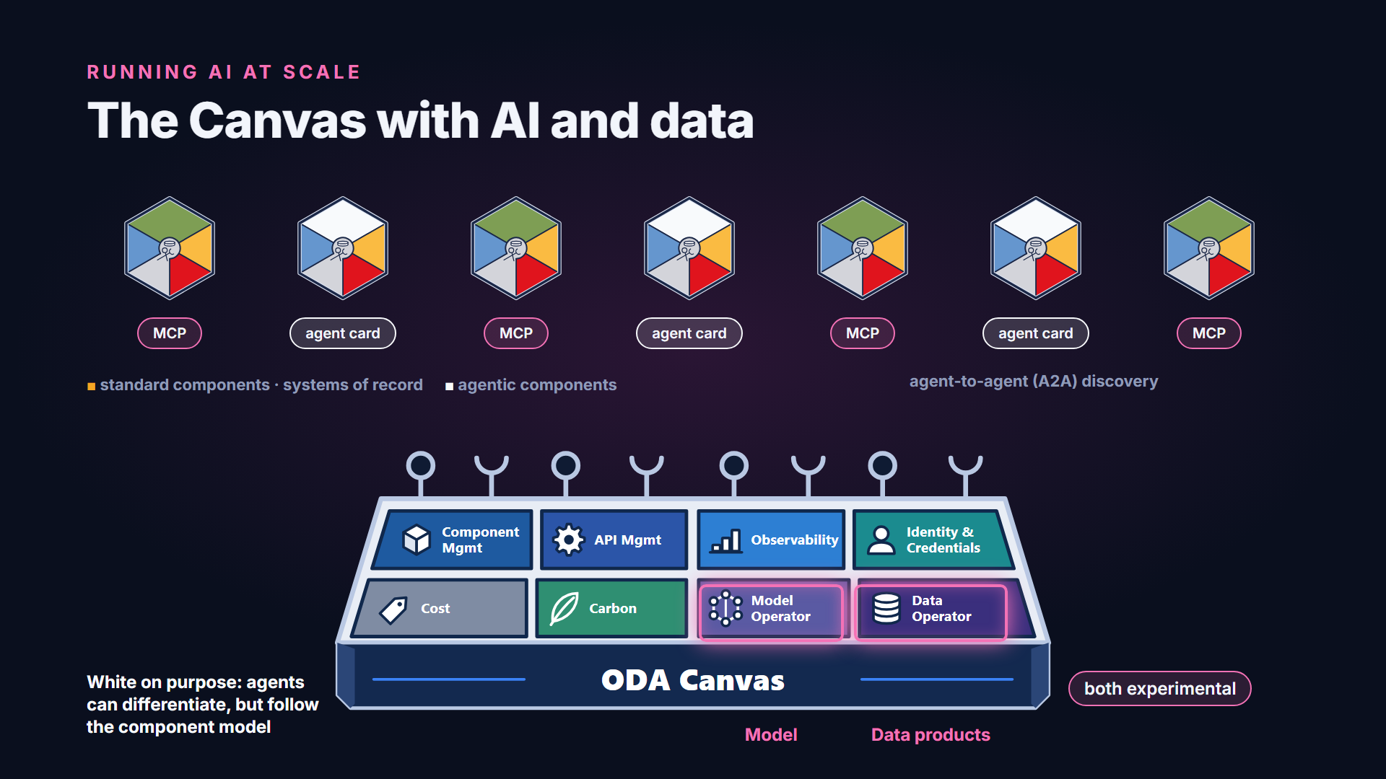
The Canvas with AI and data
Notes:
Here is how it fits together. Agentic components sit beside the standard components. Systems of record expose MCP, so agents can use them as tools. Agents publish agent cards, using agent-to-agent standards, so other agents can discover them. Agentic components are shown in white on purpose. Like engagement systems, agents can differentiate a service provider. They don't have to be standard, but they still follow the component model. The model and data operators, both experimental, extend the Canvas to models and data products.

Slide 16
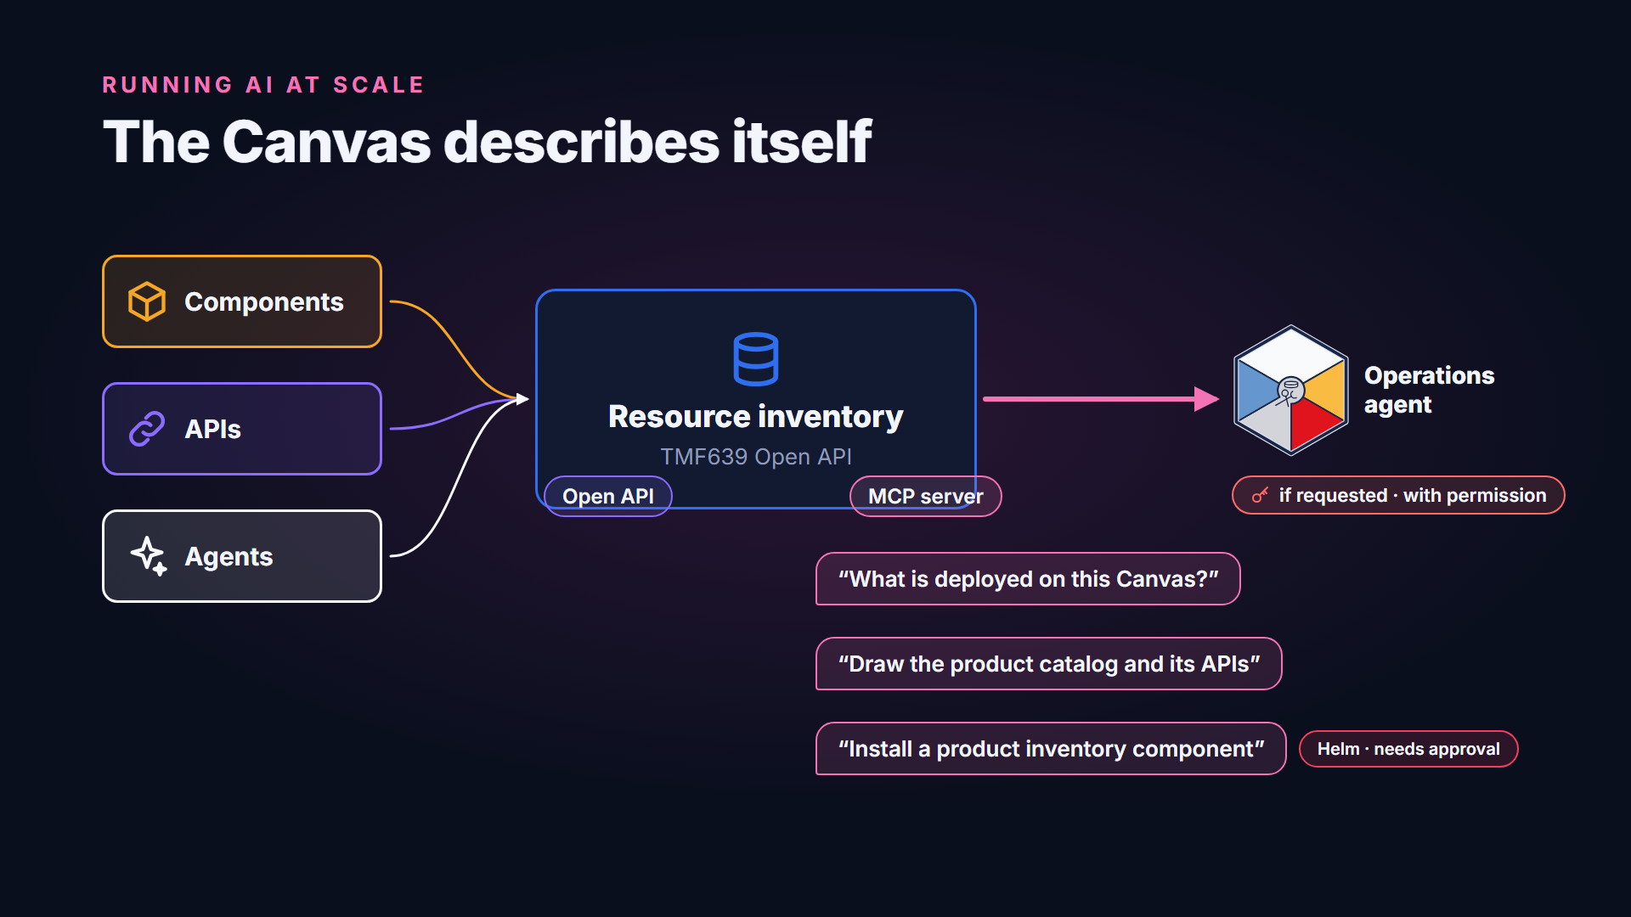
The Canvas describes itself
Notes:
Because everything on the Canvas is declared, the Canvas can describe itself. The reference implementation includes a resource inventory, based on the TMF six three nine Open API. It registers every component, API and agent. Like any TM Forum API, it is also offered as an MCP server. An operations agent, if requested and given the permissions, can ask what is deployed. It can also draw a component and its APIs. The MCP server also has Helm tools, so an agent can propose installing a component.

Slide 17
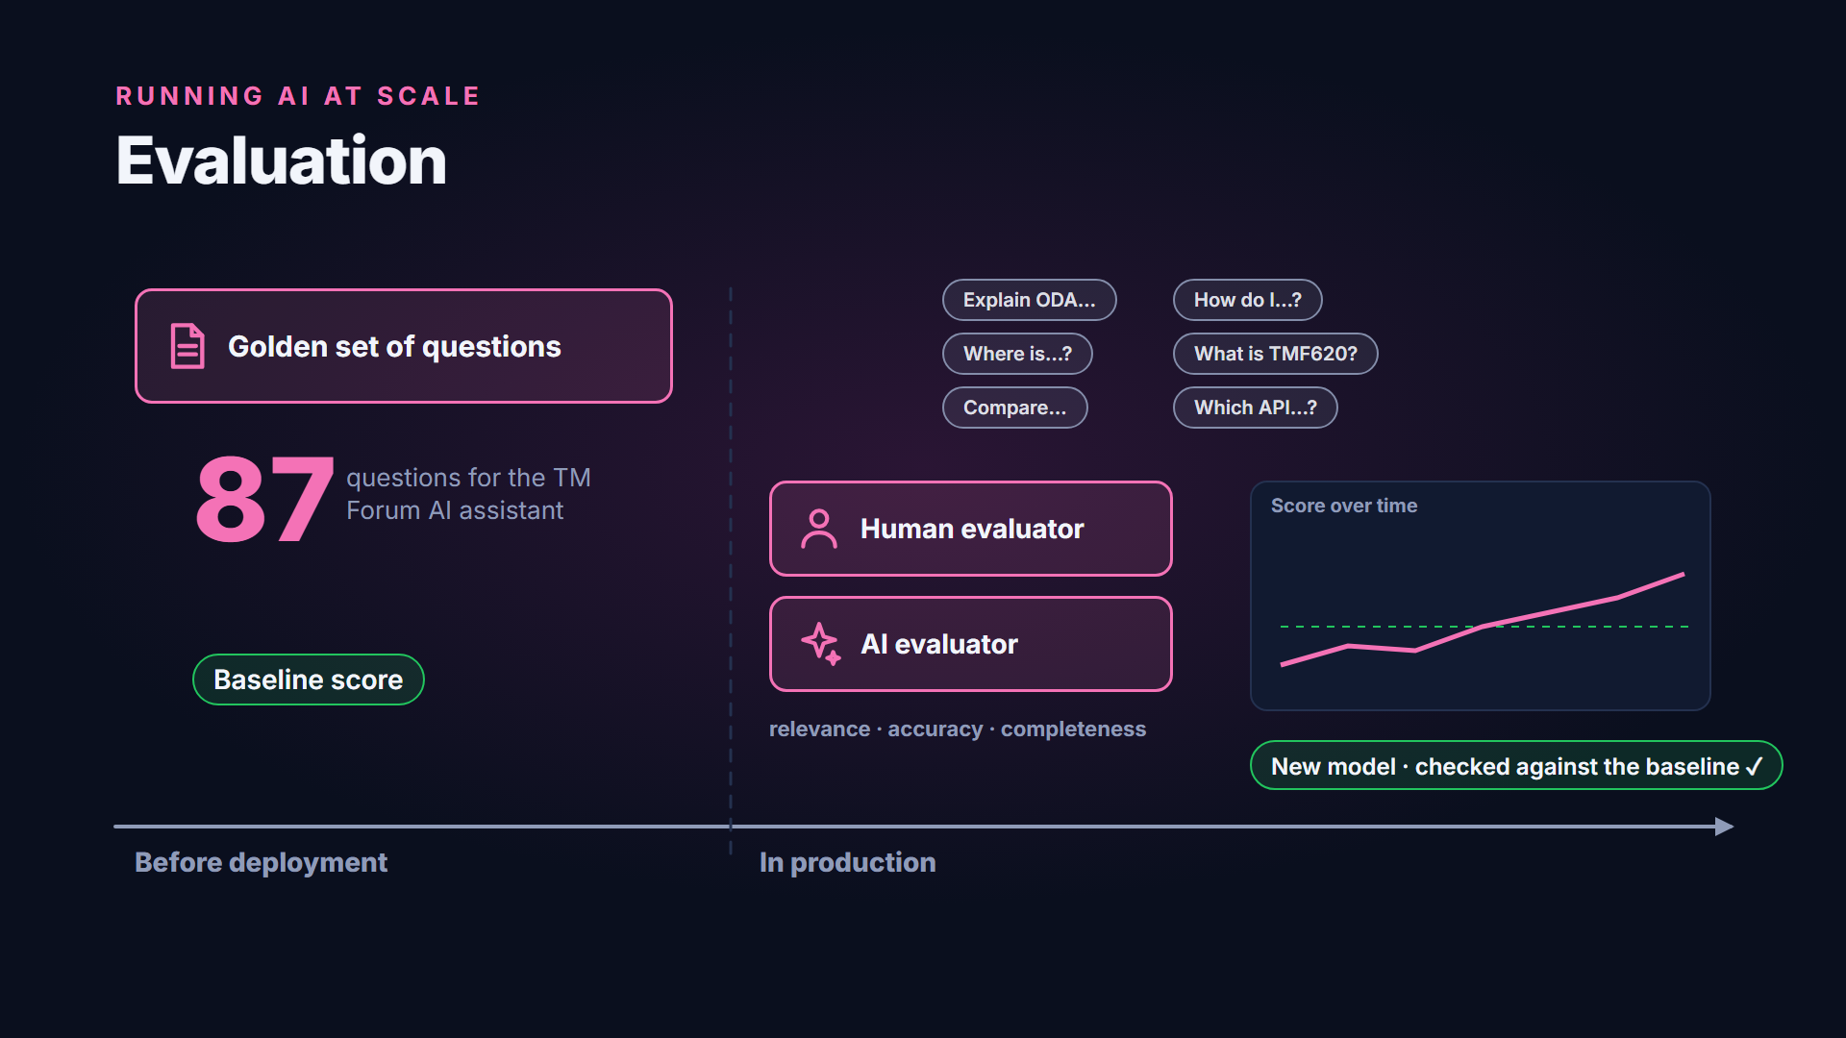
Evaluation
Notes:
Because agents are non-deterministic, they should ship with evaluation data. Before deployment, a golden set of questions sets a baseline. The TM Forum AI assistant used eighty-seven questions. In production, real questions and answers are logged and scored. People and AI evaluators rate them for relevance, accuracy and completeness. So a change, such as a new model, is checked against the baseline before it goes live.

Slide 18
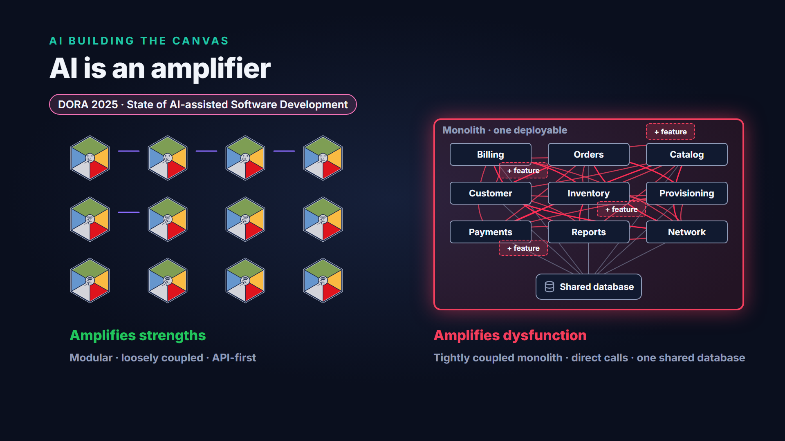
AI is an amplifier
Notes:
The AI tools we use to build the Canvas follow the same rule. Google's DORA report studied AI-assisted software development. It found that AI is an amplifier. It magnifies the strengths of high-performing teams. It also magnifies the dysfunctions of struggling ones. With a modular, loosely coupled, API-first architecture, AI amplifies that. With a tightly coupled monolith, AI amplifies the chaos.

Slide 19





Why ODA suits AI development
AI BUILDING THE CANVAS
Why ODA suits AI development
ODA gives…
…so a coding agent gets
Modular components
Small, well bounded tasks
Open APIs and data models
Clear contracts to code against
Component specification
Declarative, so results can be checked
Use cases and BDD tests
The agent verifies its own work
Notes:
The Open Digital Architecture is a good fit for AI development. Modular components give an agent small, well bounded tasks. Open APIs and shared data models give it clear contracts to code against. The component specification is declarative, so the result can be checked. And the use cases and BDD tests let an agent verify its own work.

Slide 20
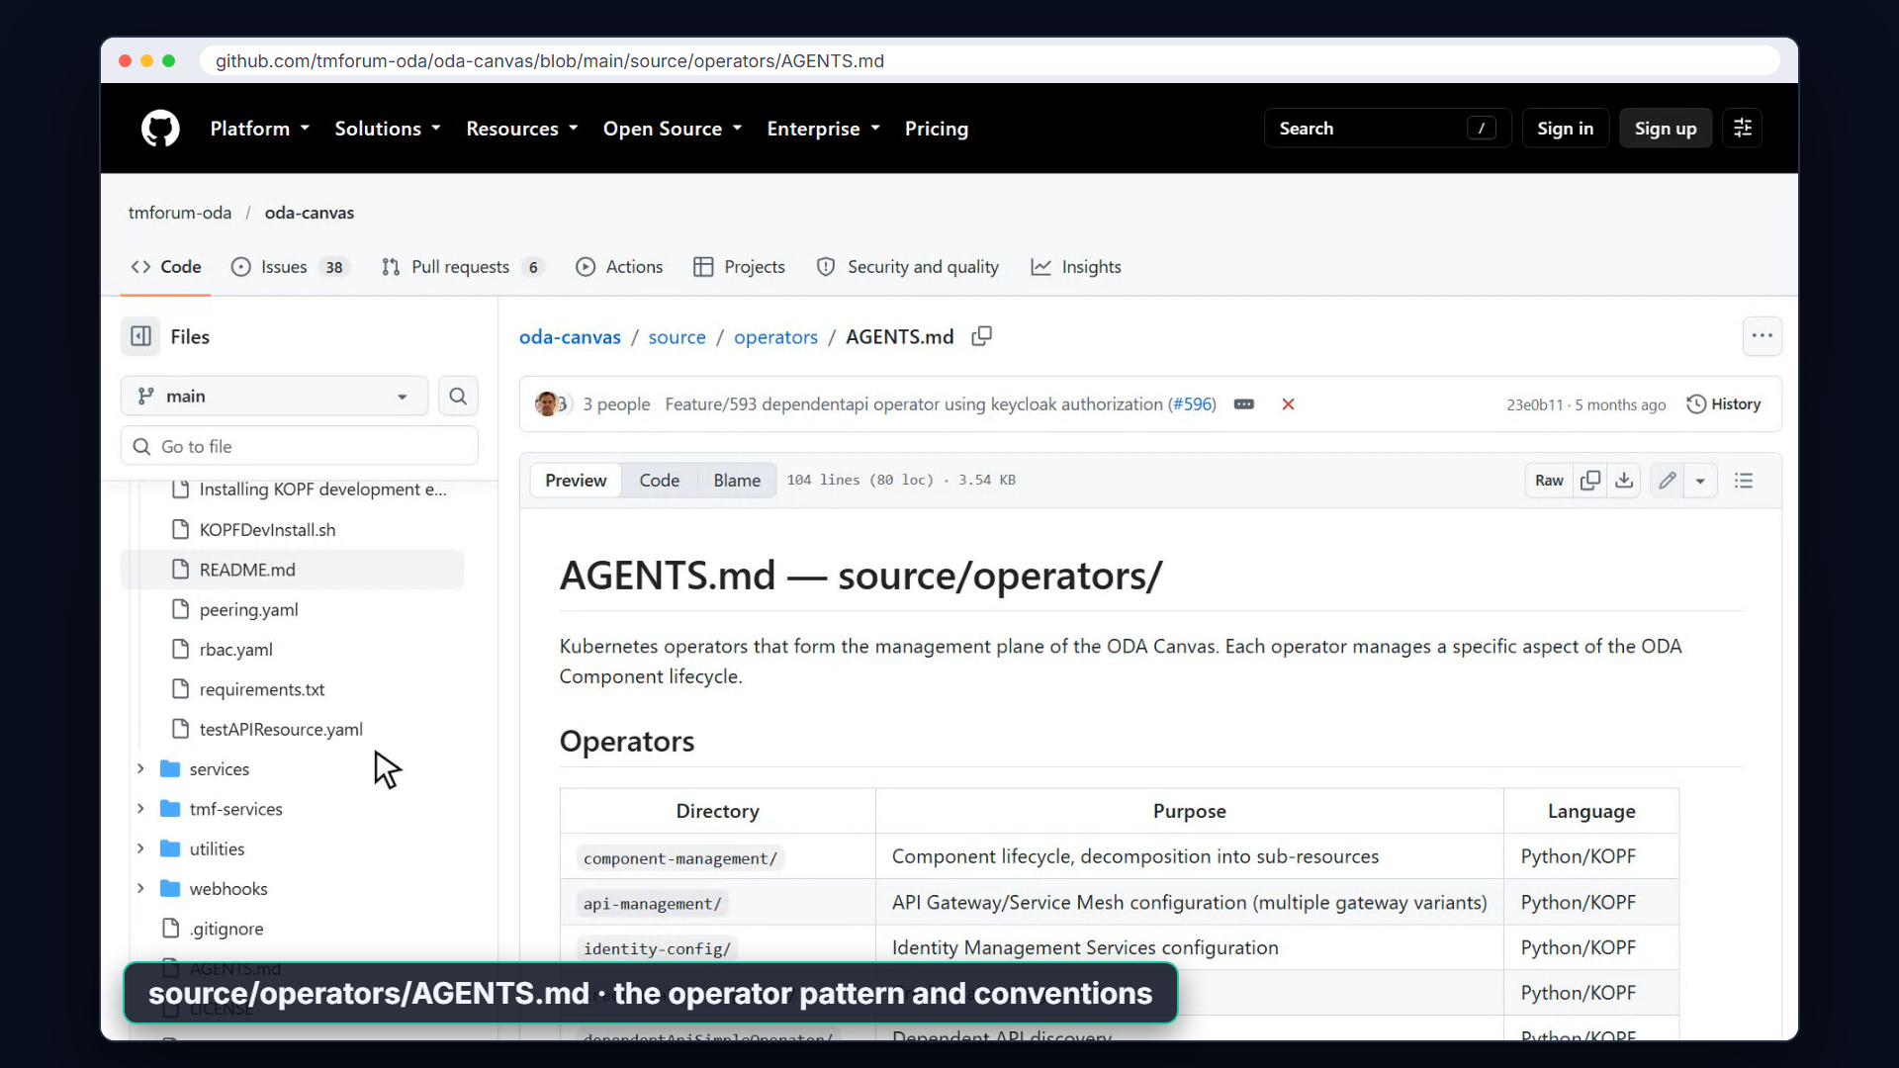
Live: AGENTS.md in the oda-canvas repository
Notes:
The Canvas repository documents itself for AI agents. There's an AGENTS dot M D file at the root, and in each main area of the repository. AGENTS dot M D is an open format that most coding agents read. It tells an agent what the project is, how it's structured, and the do's and don'ts. The operators folder, for example, explains the operator pattern and its code conventions.

Slide 21
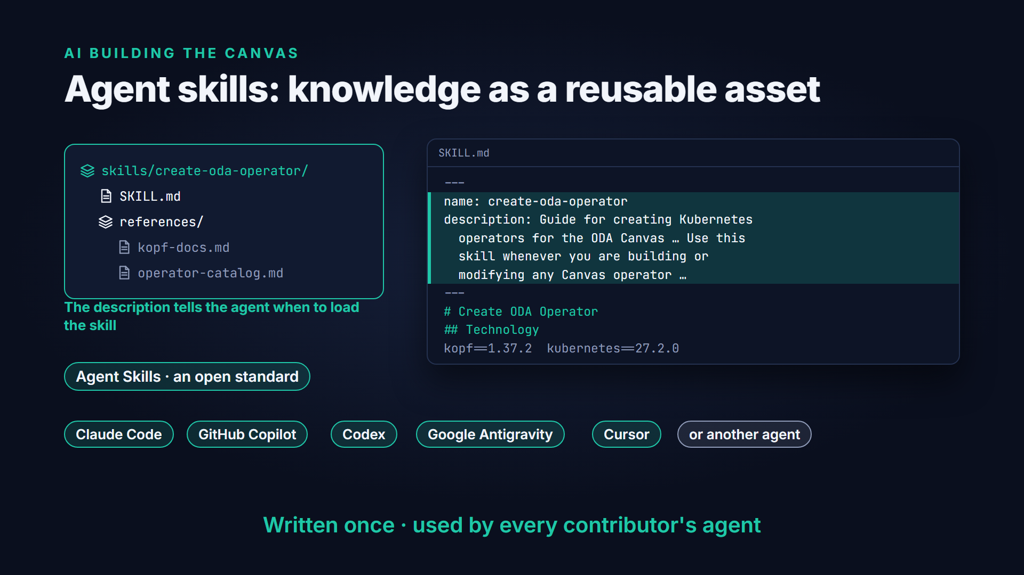
Agent skills: knowledge as a reusable asset
Notes:
Agent skills go a step further. A skill is a folder with a SKILL dot M D file, plus any scripts and references it needs. Its description tells the agent when to load it. Agent Skills is an open standard. The same skill works with Claude Code, GitHub Copilot and Codex. It works with Google Antigravity, Cursor or another agent too. That turns expert knowledge into a reusable asset. It's written once, and every contributor's agent can use it.

Slide 22
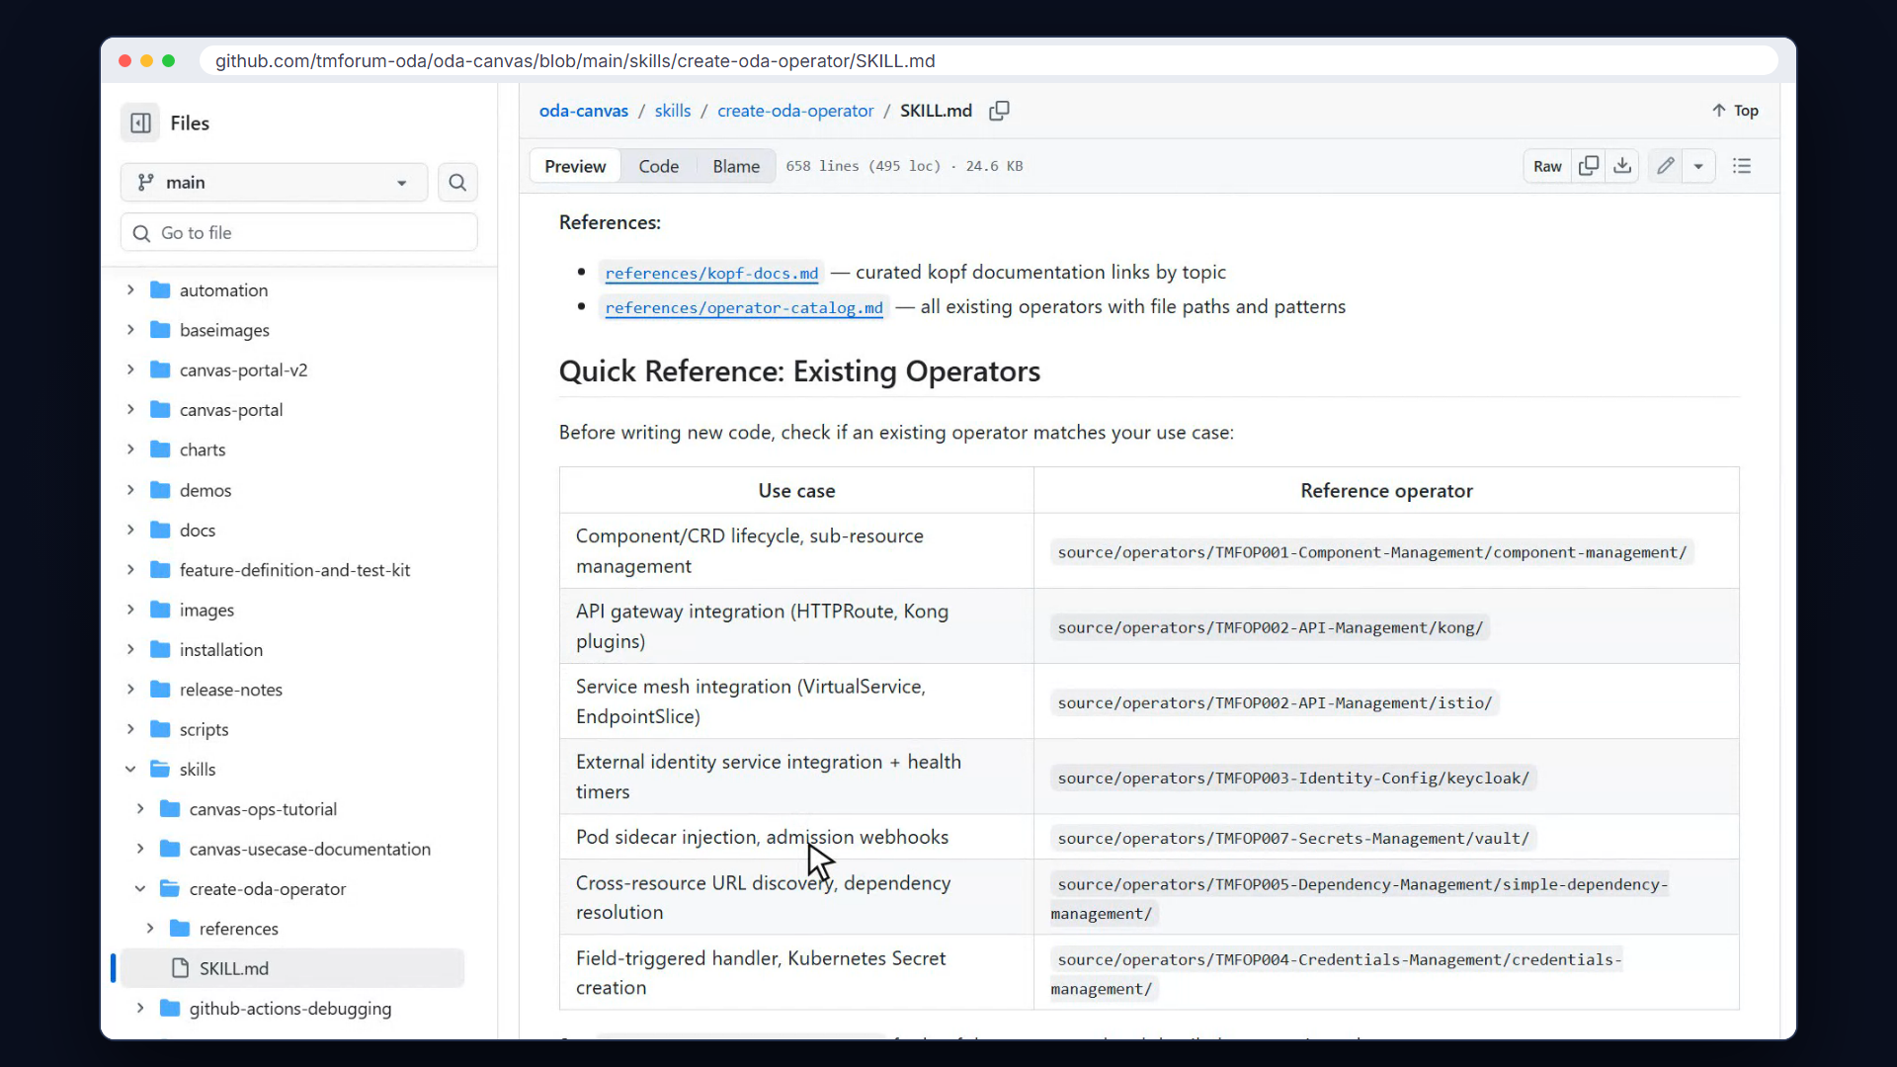
Live: the create-oda-operator skill
Notes:
The Canvas repository already has a set of skills. They cover operating the Canvas, writing use cases and BDD features, Helm charts and CI. The create-oda-operator skill helps anyone build a new Canvas operator with AI. It gives the agent the framework, the pinned versions, and a map of existing operators to copy from. A contributor's agent starts with the knowledge of the core team.

Slide 23
What's available today
STATUS
What's available today
MCP as an exposed API type
Available
Resource inventory MCP server, with Helm tools
Available
Model-as-a-Service operator and model gateway
Experimental
Data product operator
Experimental
DependentAIModel resource · joins the Component spec later
Experimental
Model manager for classical ML
Proposal
AGENTS.md files and agent skills
Available
Notes:
Here's where things stand. MCP as an exposed API type, and the resource inventory MCP server, are available today. The Model-as-a-Service operator, the model gateway and the data product operator are experimental. So is the dependent AI model resource, which will later join the component specification. A model manager for classical machine learning is still a proposal. And the AGENTS dot M D files and agent skills are ready to use now.

Slide 24

Find out more
FIND OUT MORE
Design, guide and code
AI-Native Canvas design
github.com/tmforum-oda/oda-canvas › AI-Native-Canvas-design.md
Model-as-a-Service guide
TM Forum GB1085 · Model-as-a-Service (MODaaS) Introductory Guide
Contribute with AI
github.com/tmforum-oda/oda-canvas › AGENTS.md · skills/
ODA agent skills marketplace
github.com/tmforum-oda/oda-agent-skills-marketplace · agent skills plugins for ODA
Developed in the open in the TM Forum Innovation Hub
Notes:
To find out more, read the AI-Native Canvas design in the oda-canvas repository. Then read TM Forum's Model as a Service guide. The work happens in the open, in the TM Forum Innovation Hub. If you'd like to contribute, point your coding agent at the repository. Its AGENTS dot M D files and skills will help it get started. The repository is on GitHub, at TM Forum dash ODA slash ODA Canvas.

