Slide 1

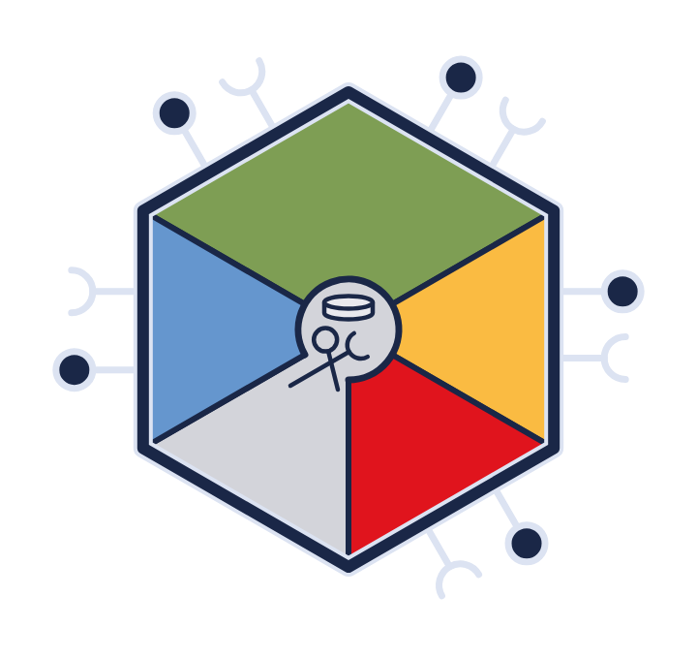
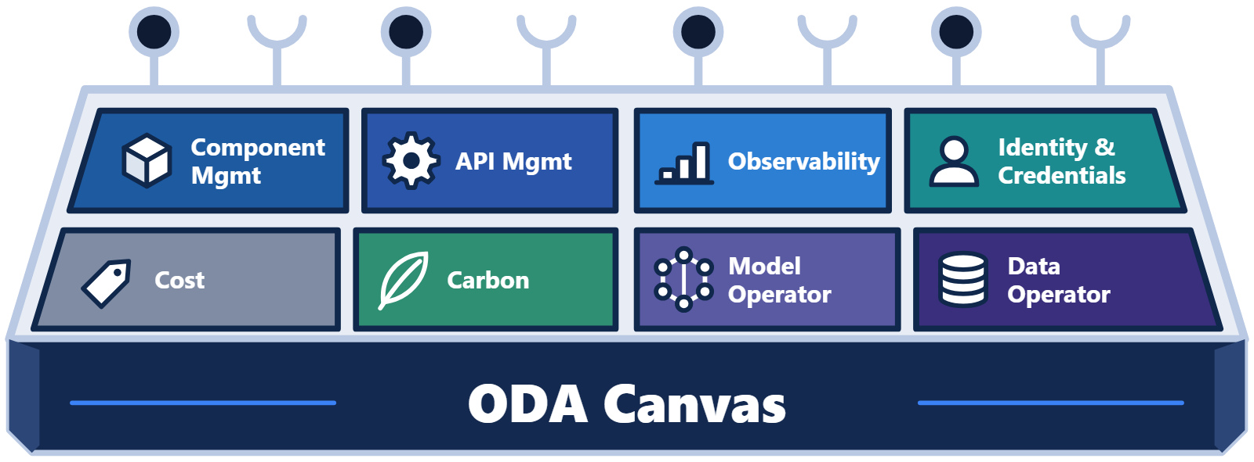
Title card
Introduction to the
ODA Canvas
Open Digital Architecture · TM Forum
Training series · Part 1
Notes:
Welcome to the first video in a series about the Open Digital Architecture Canvas. The Canvas is the execution platform for ODA Components. It also has an open-source reference implementation.

Slide 2



Who this is for
WHO THIS IS FOR
Two audiences, one platform
Component builders
Canvas builders & operators
Architects and software engineers building software components that meet the ODA standards
Site reliability engineers (SREs) building or operating a Canvas platform
CSP-run Canvas
Managed Canvas (cloud provider)
Notes:
This video is for two groups. The first group is the architects and software engineers who build functional software components. They want to know what it means to meet the ODA standards and run on the Canvas. The second group is site reliability engineers who build or operate a Canvas platform. That might be a communication service provider running its own Canvas. Or it might be a cloud provider offering a managed Canvas to others.

Slide 3





Roadmap
IN THIS VIDEO
Roadmap
1
History
2
Components and Canvas
3
Business benefits
4
A tour of the Canvas and its Portal
5
What's next
Deep dives on each area follow in later videos
Notes:
We'll start with a short history of how we got here. Then we'll explain what an ODA Component is and what the Canvas provides. After that we'll cover the business benefits. Next comes a quick tour of the Canvas, including the Canvas Portal. We'll finish with where the work is heading. Later videos in the series go deeper into each area.

Slide 4
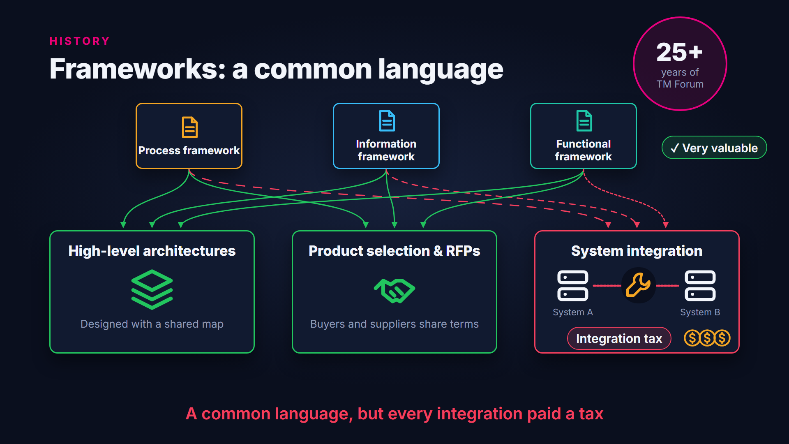
Frameworks and the problem of interpretation
Notes:
For more than twenty-five years, TM Forum has been a hub for collaboration on telecom IT. The early frameworks gave the industry a common language for processes, information and functions. Operators used them successfully to design high-level architectures. They also gave a common language for product selection and requests for proposal. But they were not detailed enough for systems to work together seamlessly. So every integration needed custom work. That integration tax was paid again and again.

Slide 5
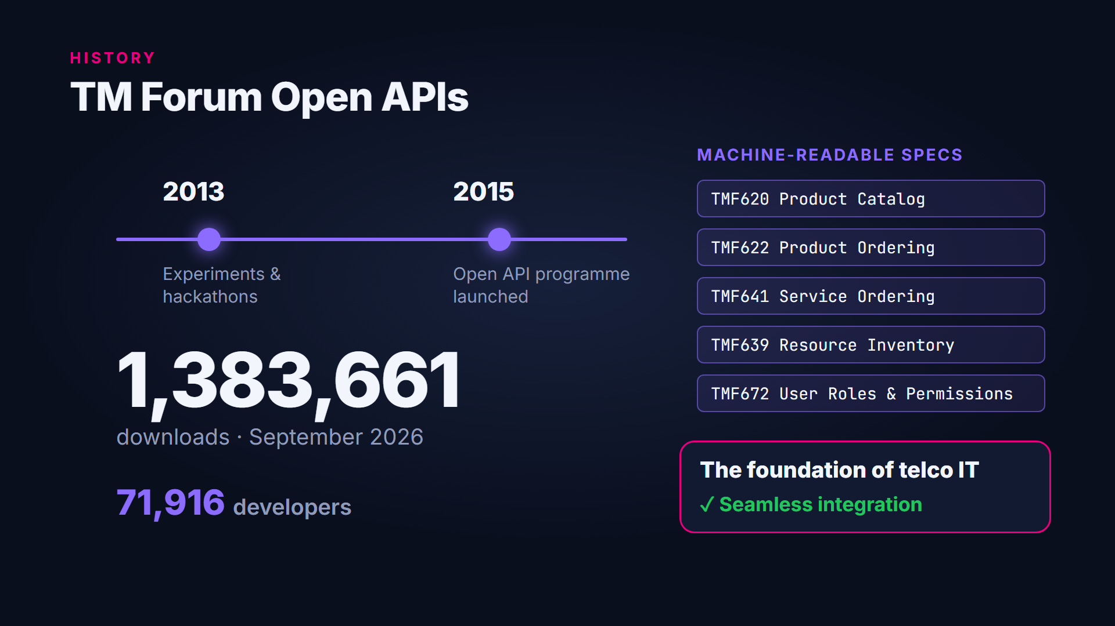
The Open API programme
Notes:
The next big step was TM Forum's Open API programme. It began with experiments and hackathons around 2013. It was formally launched in 2015. Open APIs are detailed, prescriptive, machine-readable specifications for standard services. Adoption has been huge. By September 2026, there had been almost one point four million downloads. They came from nearly seventy-two thousand developers. Today, TM Forum Open APIs are the foundation for many telcos' IT services. They have enabled seamless integration between systems.

Slide 6
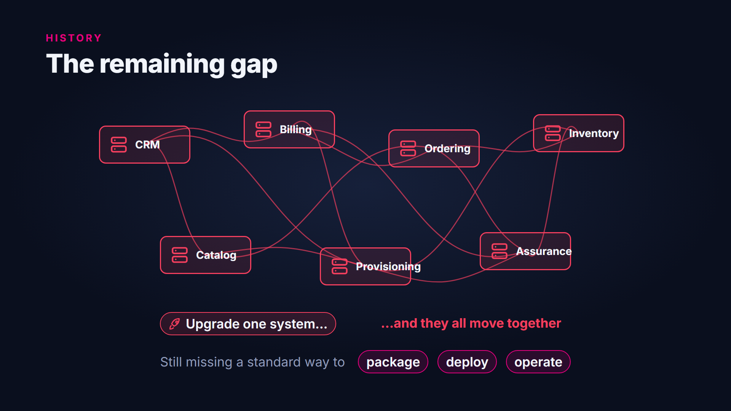
The remaining gap
Notes:
Standard APIs didn't solve everything. Telecom IT estates are still diverse and complex, and upgrading them is hard. Often several systems have to be upgraded together in one large transformation project. Standardising the interfaces wasn't enough. The industry also needed a standard way to package, deploy and operate the software behind them.

Slide 7
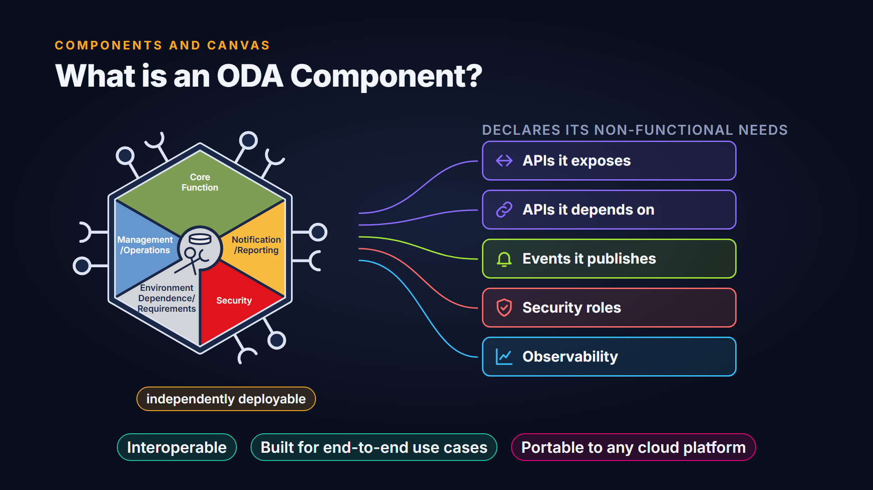
What is an ODA Component?
Notes:
That's where ODA Components come in. An ODA Component is an independently deployable unit of functionality. Alongside its business function, it declares its non-functional needs, such as the APIs it exposes and depends on, the events it publishes, its security roles and its observability. Components are interoperable, designed around end-to-end use cases. They are also portable and can run on any cloud platform that follows the standard.

Slide 8
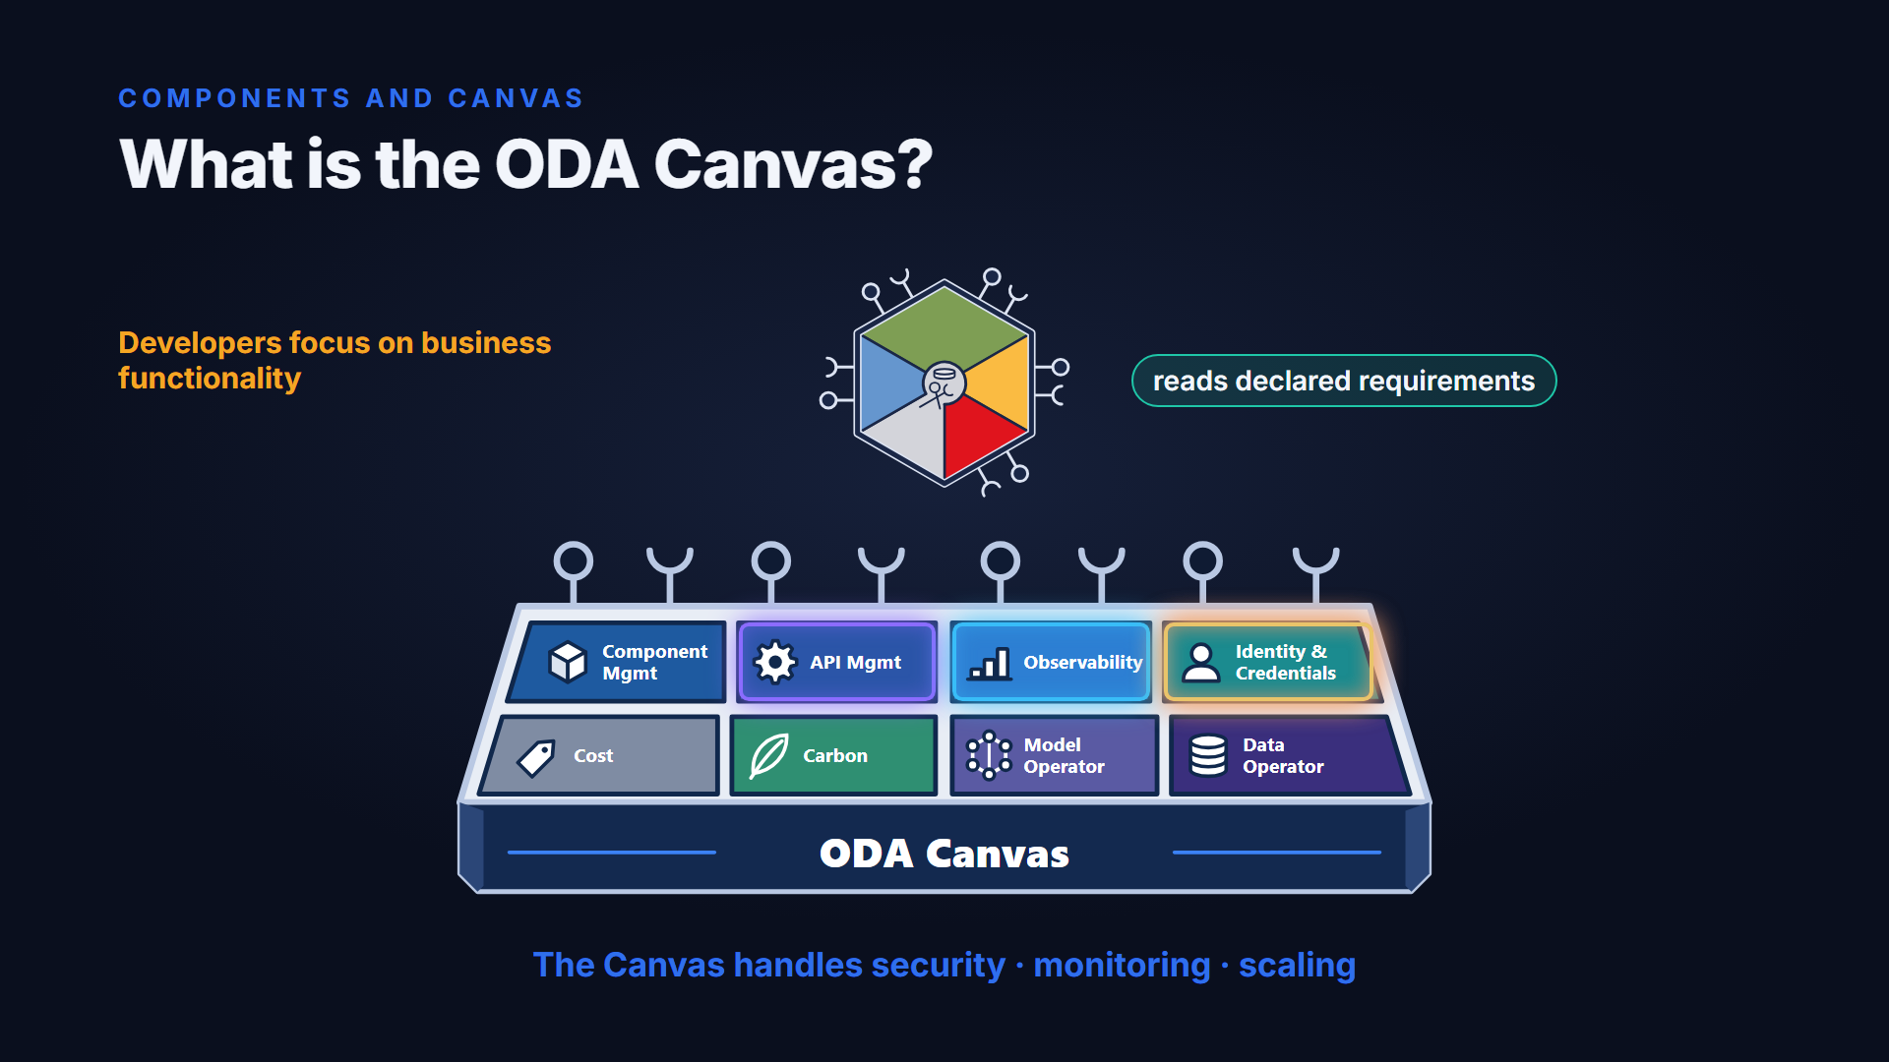
What is the ODA Canvas?
Notes:
The ODA Canvas is the cloud-native execution environment for those components. It reads each component's declared requirements and provides the shared operational services it needs, including API management, identity, observability and secrets. Component developers can focus on business functionality while the Canvas takes care of security, monitoring and scaling.

Slide 9
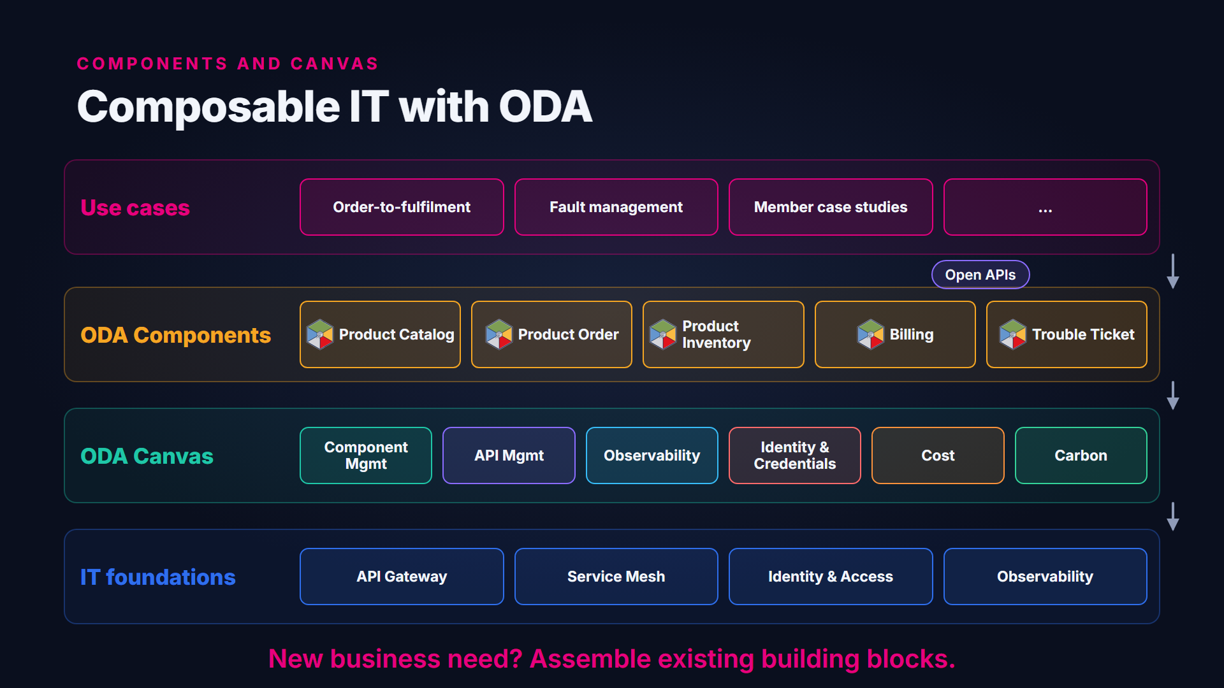
Composable IT with ODA
Notes:
Put the two together and you get composable IT. Use cases are assembled from standard components. Components are deployed onto a Canvas. Canvas operators configure the underlying platform services, such as API gateways, service meshes, identity and observability, whether those are open-source reference modules or commercial cloud services. When a new business need appears, you assemble existing building blocks instead of starting a new integration project.

Slide 10
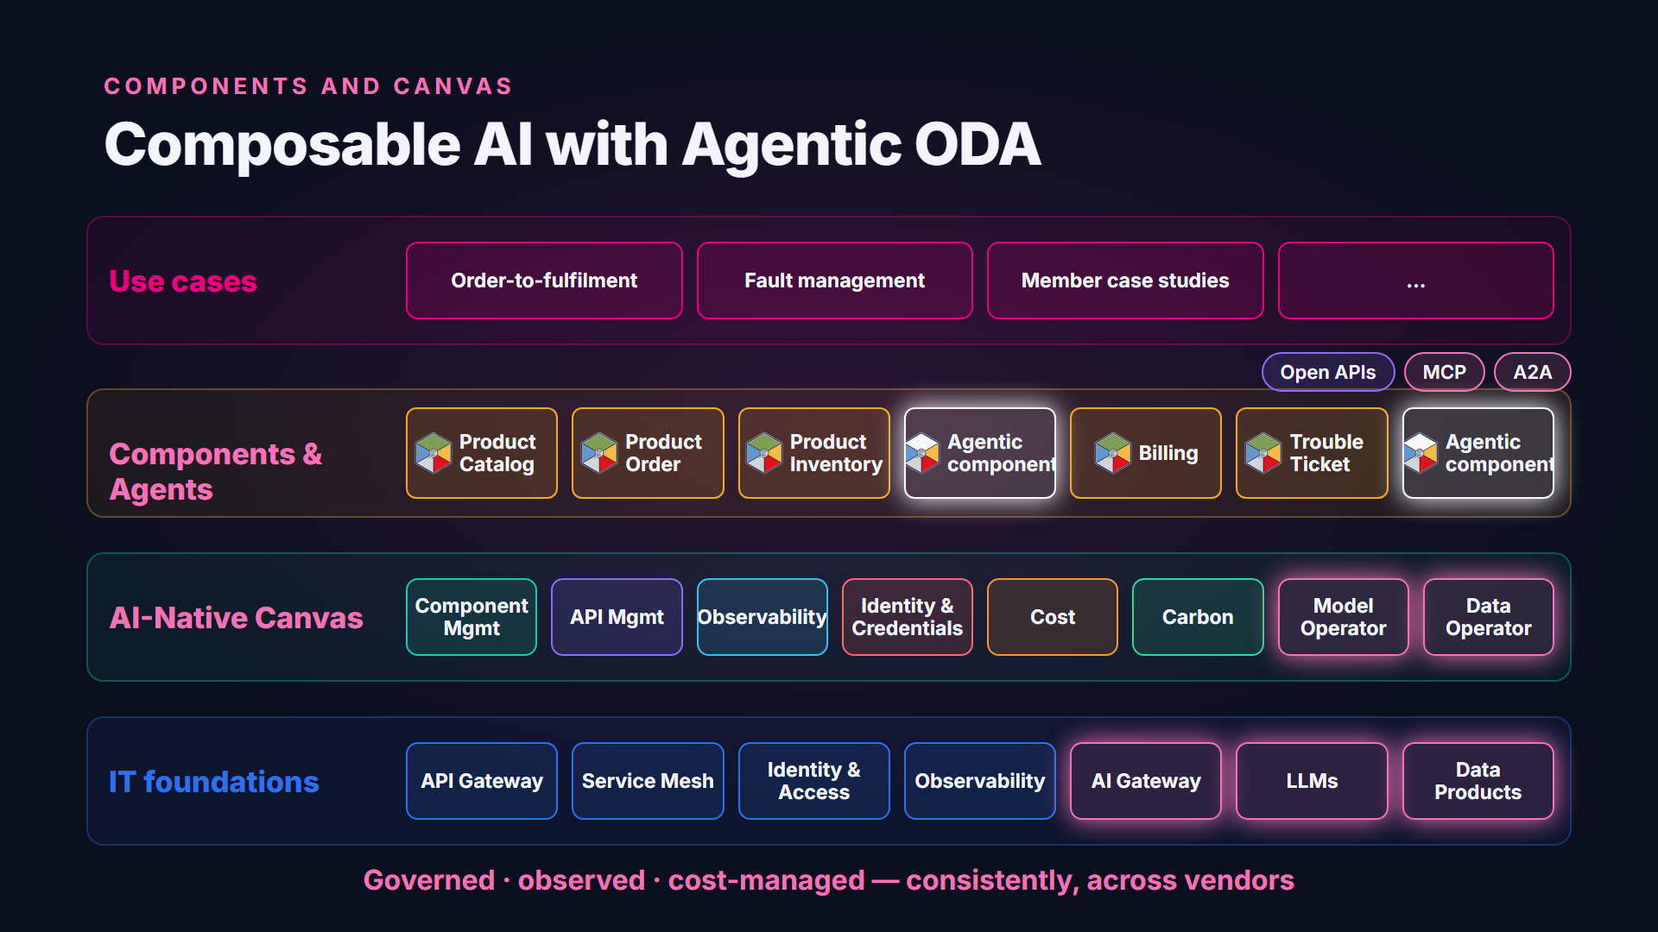
Composable AI with Agentic ODA
Notes:
The same model now extends to AI. In the AI-Native Canvas, AI agents can be packaged as agentic components that follow the same component standard. Standard components can expose their APIs as tools for agents using the Model Context Protocol. Agents can describe themselves to other agents through agent-to-agent standards. The Canvas adds AI and data services, such as an AI gateway in front of the approved language models, so that agents from many vendors can be governed, observed and cost-managed in one consistent way.

Slide 11
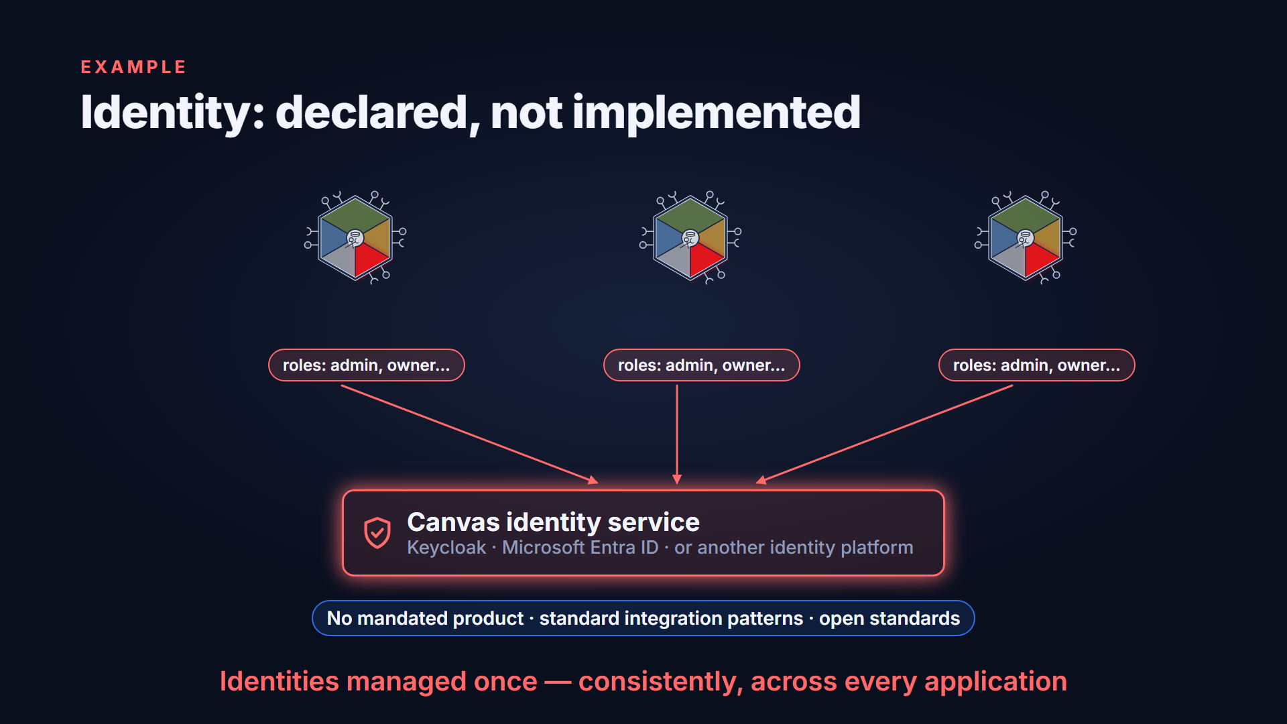
Example: identity is declared, not implemented
Notes:
Identity is a good example of why this matters. Traditionally, each application ships with its own identity management. Operations teams then have to integrate each one. In the ODA model, a component only declares the roles it supports. The Canvas configures those roles in one shared identity platform. That could be Keycloak, Microsoft Entra ID, or another identity management platform. The Canvas does not mandate a specific product. It provides standard integration patterns, built on open standards, for interoperability and portability. Identities are managed once, consistently, across every application.

Slide 12
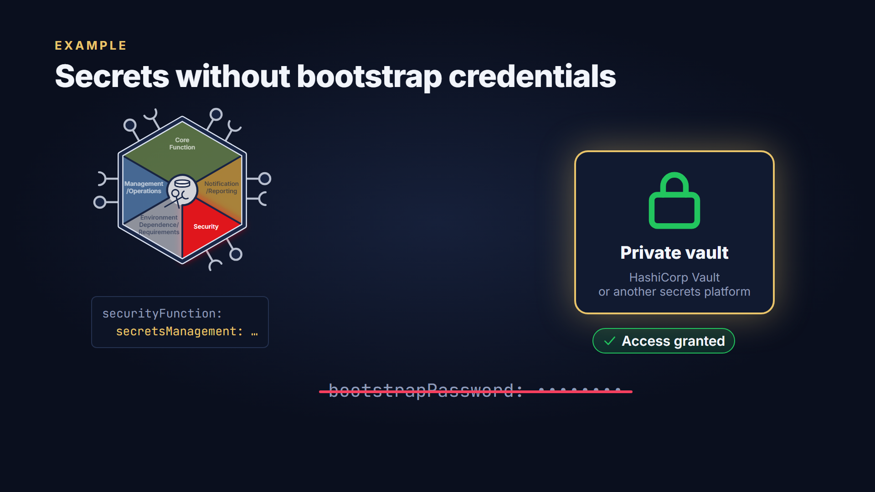
Example: secrets without bootstrap credentials
Notes:
Secrets work the same way. A component declares that it needs a secrets store, and the Canvas sets up a private vault for it. In the reference implementation that's HashiCorp Vault, but any secrets management platform can be used. The component authenticates with its own Kubernetes workload identity. So it never needs a bootstrap password just to reach the vault.

Slide 13






Six benefits
BENEFITS
Why ODA Components and Canvas?
Service providers
Software vendors
Systems integrators
Cloud providers
Customer experience
Simplicity
Innovation
Operational efficiency
Security
Technical debt
Zero touch, zero wait, zero trouble
Hundreds of ops teams → one SRE team
Agility, faster AI-native adoption
Integration fully automated
Zero trust, security as code
Continuous upgrade of every component
Notes:
Why do this? The benefits are shared by service providers, software vendors, integrators and cloud providers. Seamless integration supports zero-touch, zero-wait and zero-trouble customer experiences. Operations get simpler, moving from hundreds of teams running vertically integrated applications towards a single site reliability team running a Canvas. Agility drives innovation, including faster adoption of AI-native capabilities. Integration becomes automated instead of a manual project. Security is built in, with a zero-trust architecture and security as code. And modular contracts let every component be upgraded continuously, reducing technical debt.

Slide 14

An order-of-magnitude goal
BENEFITS
Not incremental — an order of magnitude
10×
efficiency
& agility
+30%
… and a faster transformation to an AI-native telco
Notes:
The ambition isn't an incremental gain. The goal is a step change, aiming for an order-of-magnitude improvement in efficiency and agility, and a faster transformation to an AI-native telco.

Slide 15
The component standard in two layers
A TOUR OF THE CANVAS
The component standard: two layers
LAYER 2 · STANDARD “GOLDEN” COMPONENTS
Product Catalog
Product Order
Product Inventory
Bill Calculation
Fault Management
TMFC001
TMFC002
TMFC005
TMFC031
TMFC043
LAYER 1 · DESIGN PATTERNS
Self-describing, modular software
Security as code
Management as code
tmforum.org/oda/directory
Notes:
The component standard has two layers. The lower layer is a set of design patterns for self-describing, modular software, with security and management defined as code. The upper layer is a set of standard golden components that represent industry best practice for breaking telecom IT into building blocks. You can browse them in the TM Forum ODA Component Directory.

Slide 16
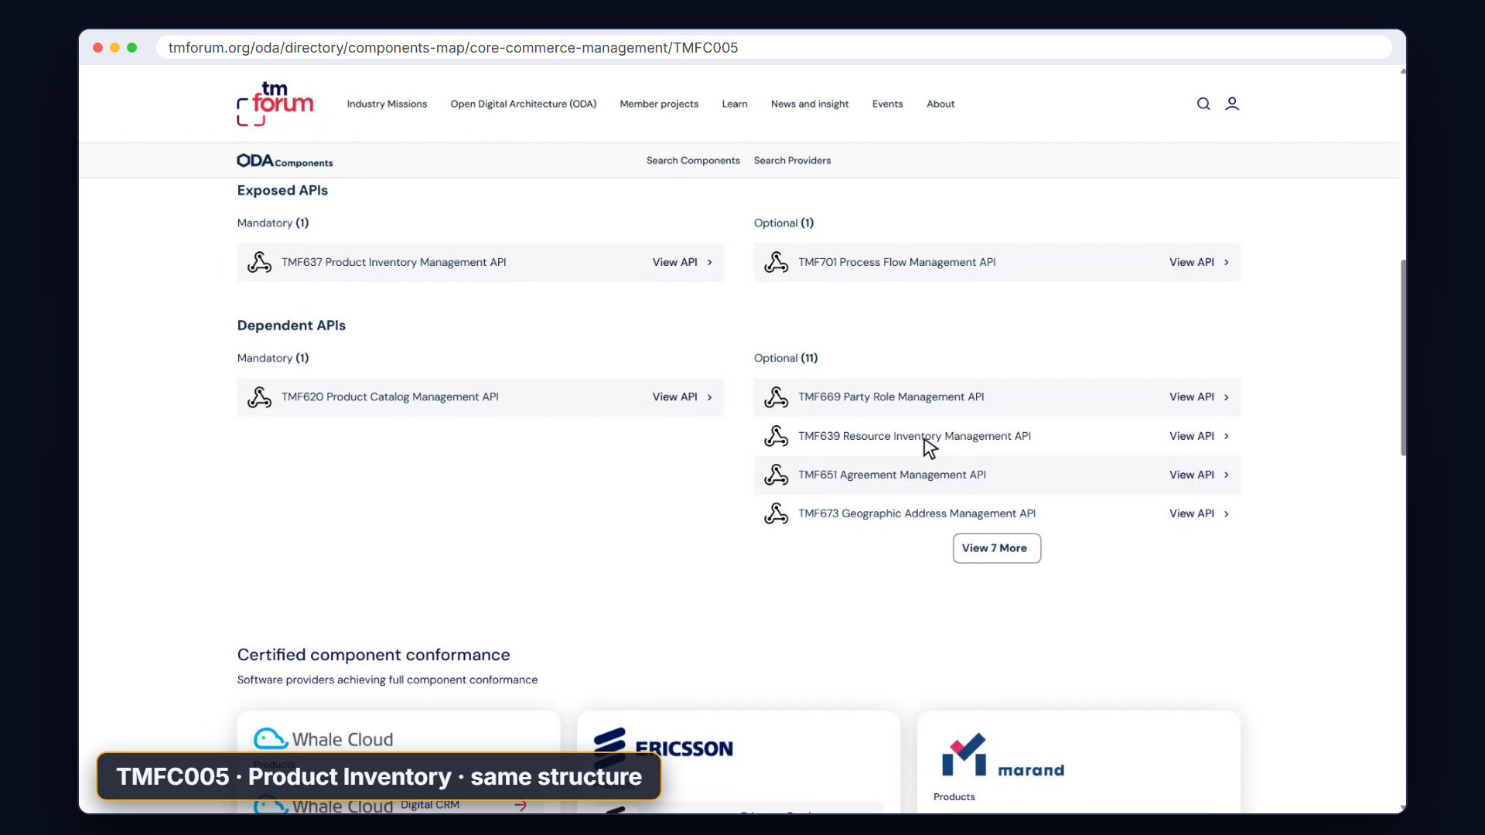
Live demo: the ODA Component Directory
Notes:
The standard components are published in the ODA Component Directory on the TM Forum website. Its components map groups them by business domain, alongside the Canvas operators. Opening Product Catalog Management shows its specification: the version and status, its YAML definition, conformance profile, test kit and reference implementation, the Open APIs it must expose and those it may depend on, and the products certified against it. Every standard component, such as Product Inventory, follows the same structure.

Slide 17
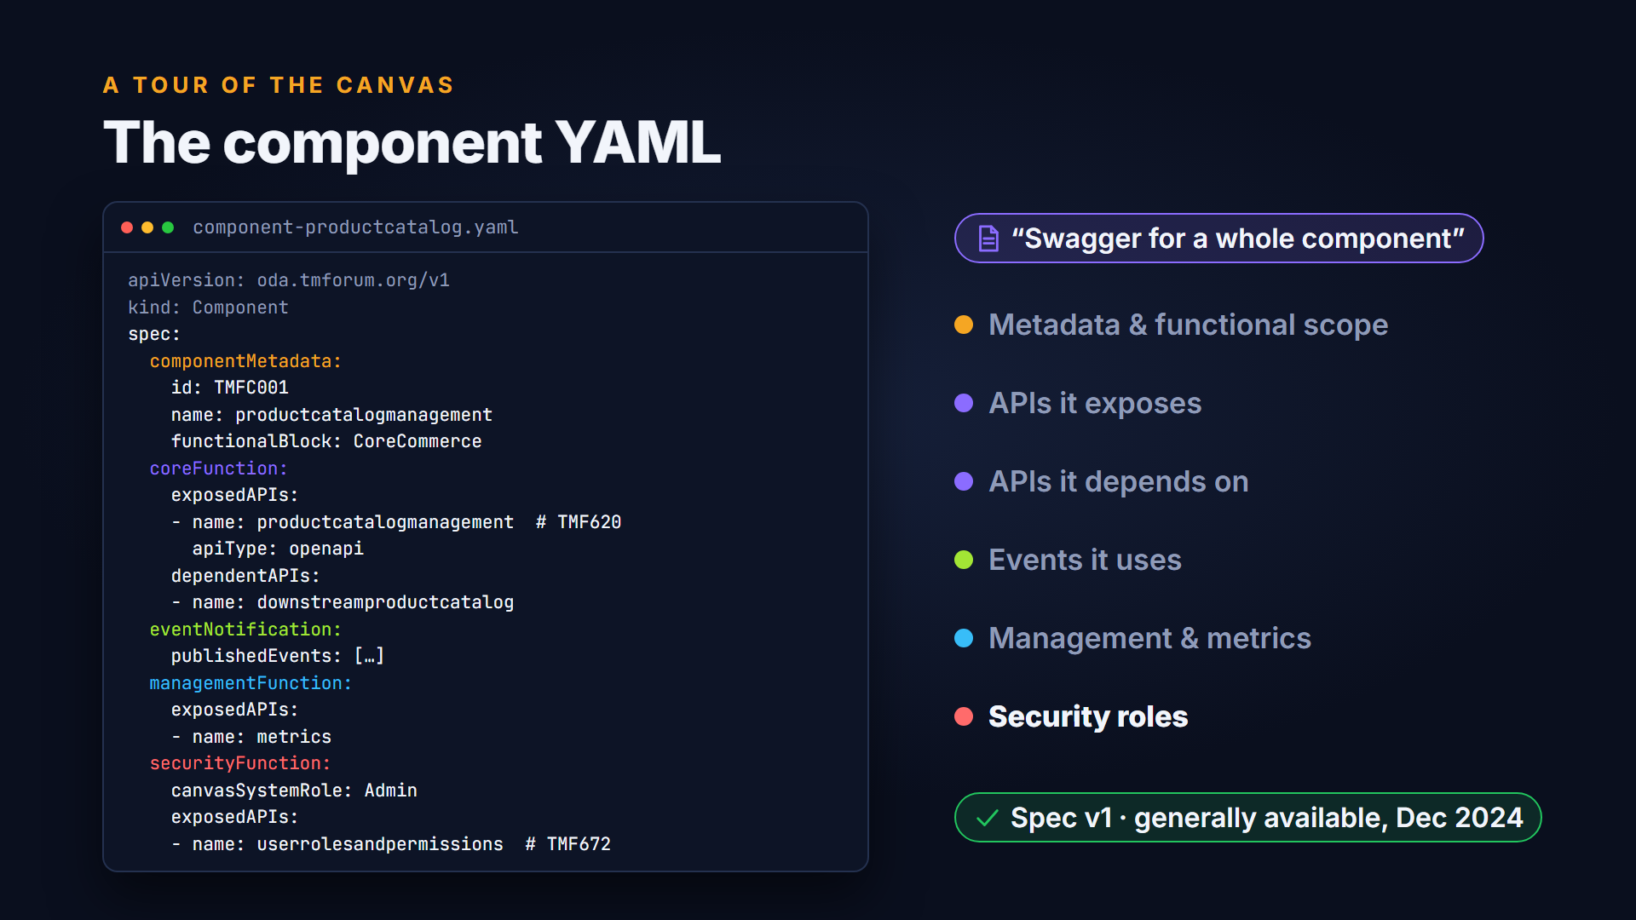
The component YAML
Notes:
Each component carries a YAML definition. Think of it as a Swagger file for a whole component. It describes the component's metadata and functional scope, and then, in its core, management and security functions, the APIs it exposes and depends on, the events it uses, and the roles it needs. The specification reached version one, its generally available release, at the end of 2024.

Slide 18
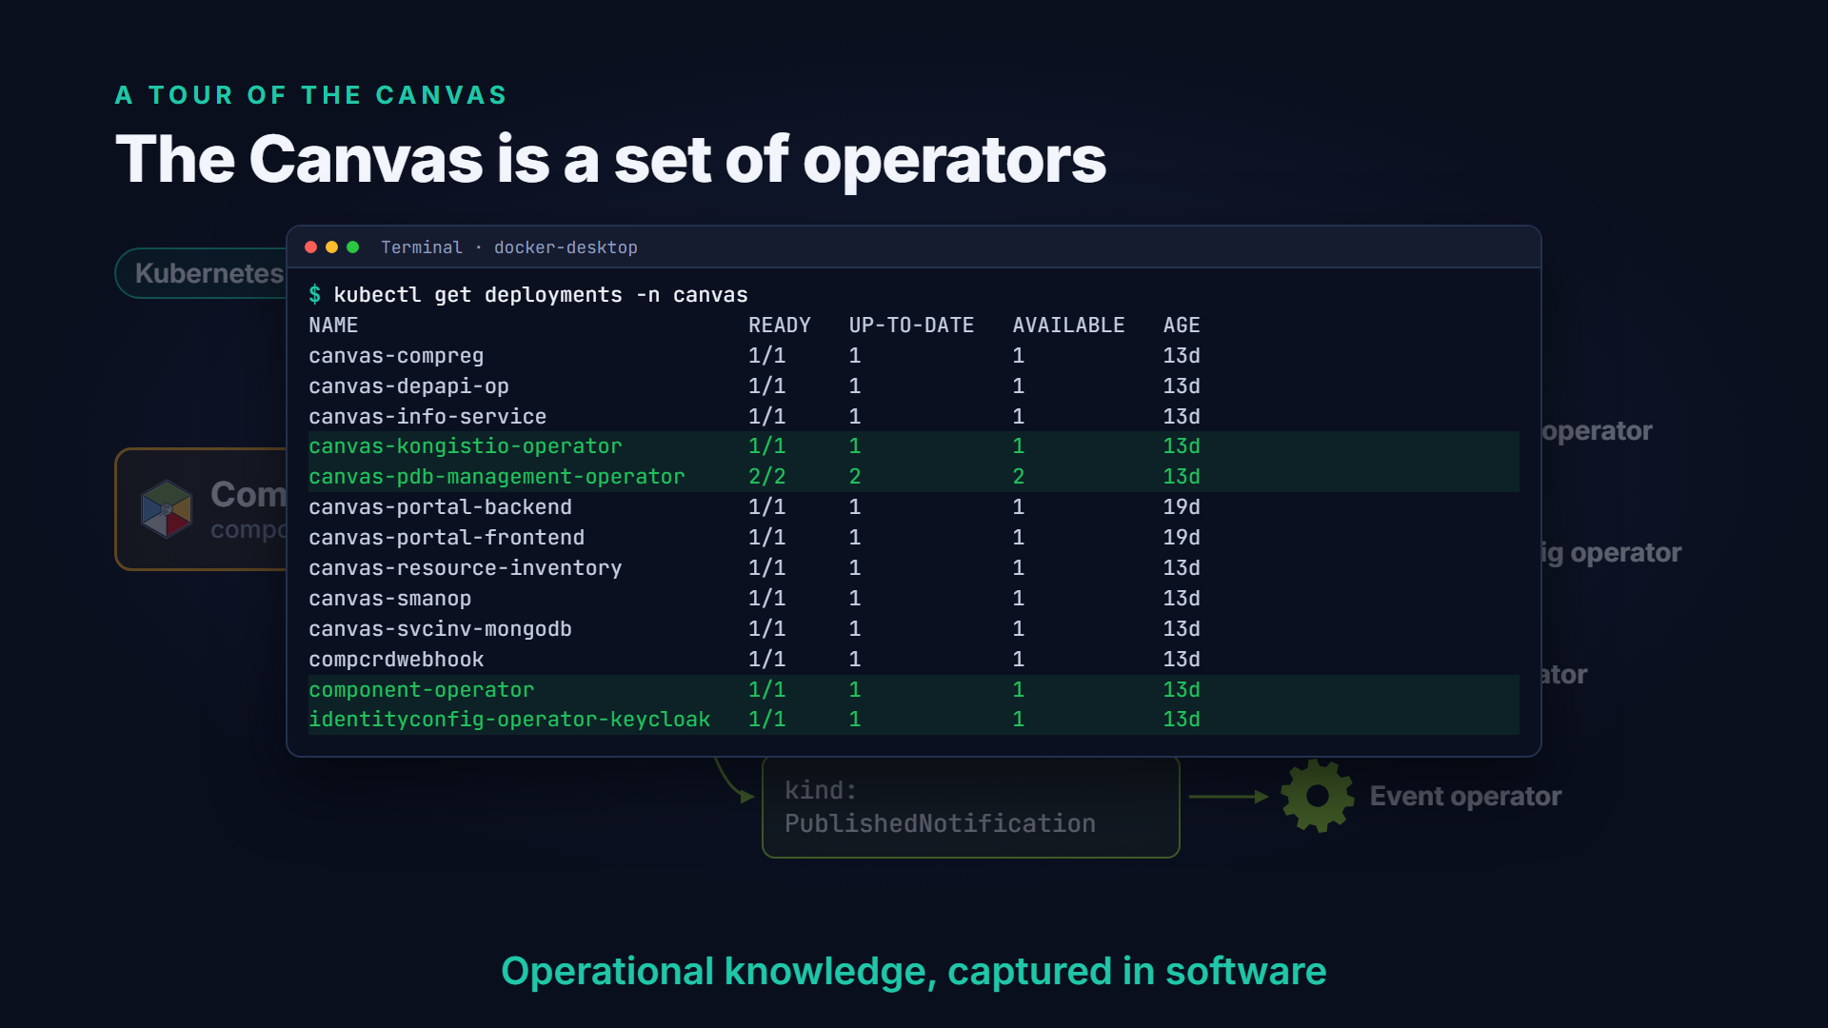
The Canvas as a set of operators
Notes:
The Canvas itself is modular. It is a set of software operators, following the Kubernetes operator pattern. The component management operator takes the component definition and breaks it into sub-resources, such as exposed APIs, dependent APIs, identity configuration and secrets management. Each sub-resource is handled by its own specialised operator. Each operator is a piece of software that holds the operational knowledge a human operator would otherwise apply by hand.

Slide 19
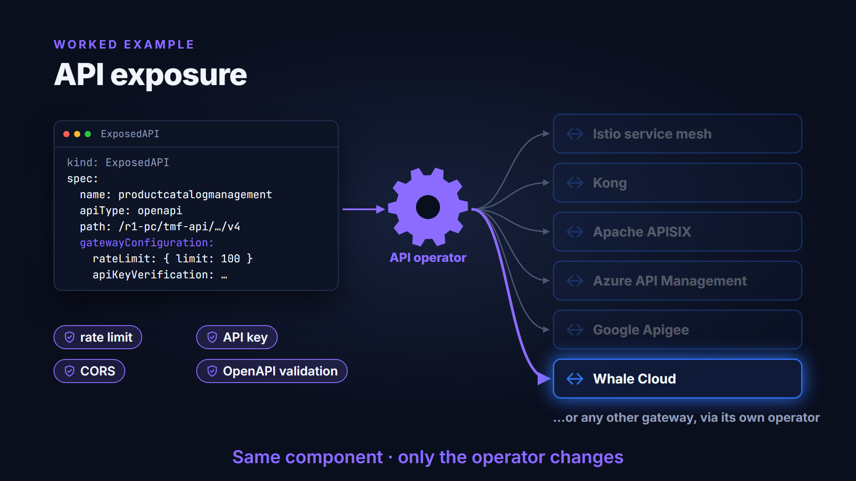
Worked example: API exposure
Notes:
API exposure shows the pattern. The component declares which APIs it wants to expose, and optionally policies such as rate limiting, API-key checks, cross-origin rules or request validation. An API operator reads that declaration and automatically configures whichever gateway or service mesh the Canvas uses. The reference implementation has six options. They are the Istio service mesh and the Kong and Apache APISIX gateways. There are also operators for Azure API Management, Google Apigee and Whale Cloud. Any other gateway can be added with its own operator. The component stays the same, and only the operator changes.

Slide 20
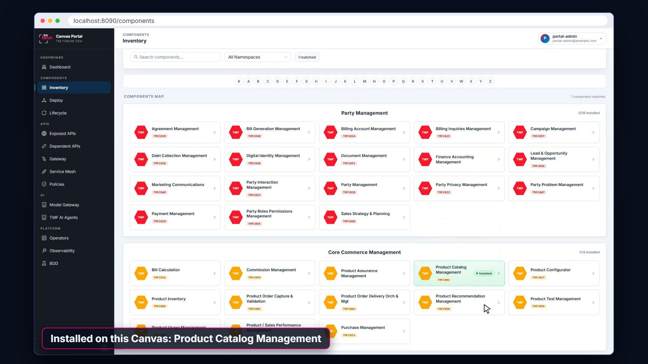
Live demo: the component inventory
Notes:
All of this is visible in the Canvas Portal. Here is the component inventory. It lists standard components grouped by business domain and shows which ones are installed on this Canvas.

Slide 21
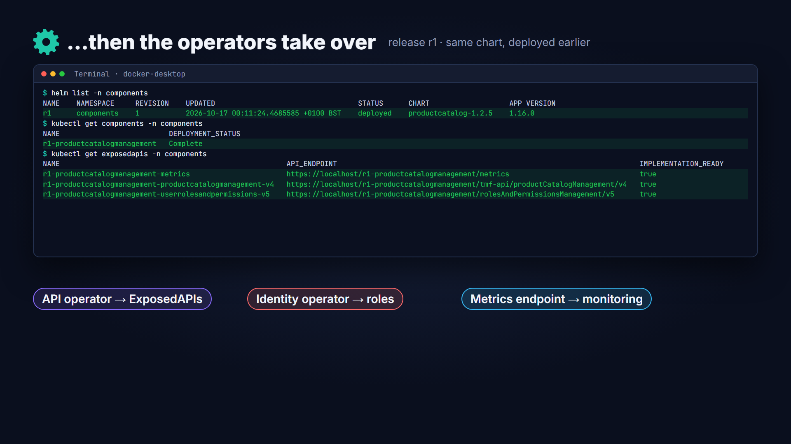
Live demo: deploying a component
Notes:
Components are packaged as Helm charts. Deploying one is just a matter of choosing the chart and giving the release a name. From there, the operators take over: they expose its APIs, register its roles and configure its monitoring. Later videos follow that process end to end.

Slide 22
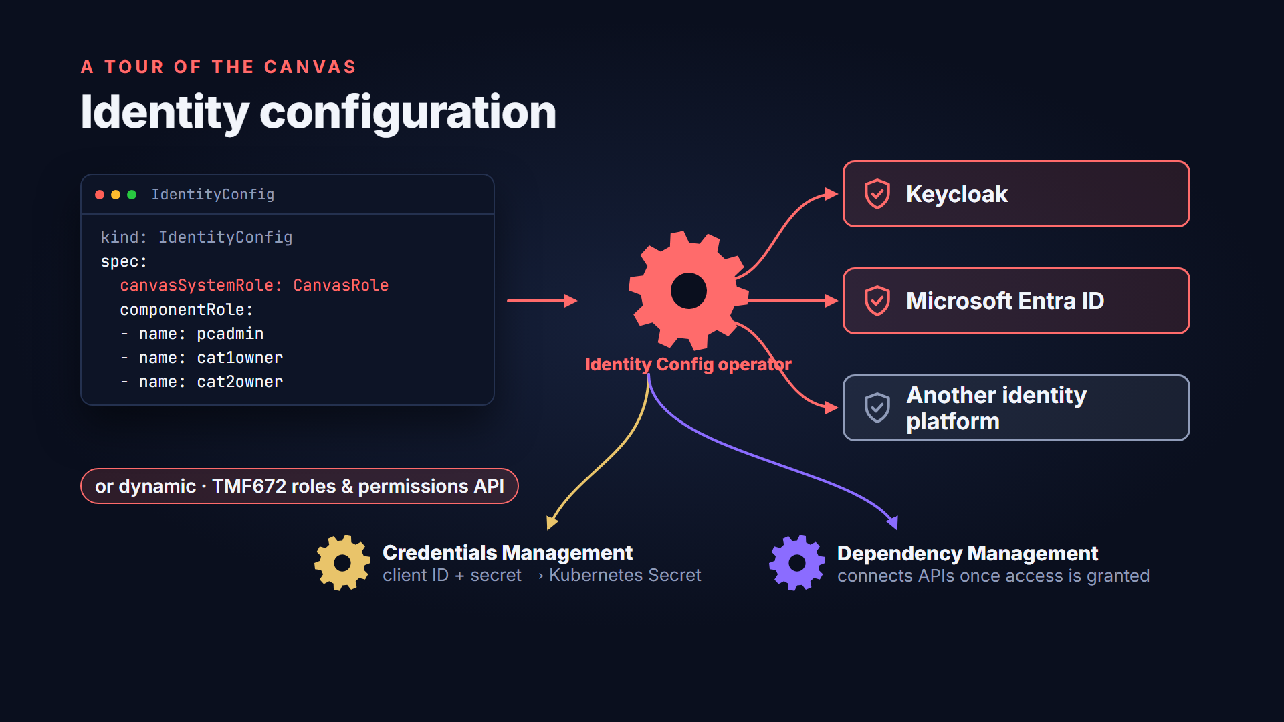
Identity configuration
Notes:
Identity follows the same pattern. A component declares its roles, either statically in its YAML or dynamically through a standard roles-and-permissions API. An identity config operator registers them in Keycloak, Microsoft Entra ID, or another identity management platform. Companion operators then create the component's client credentials and connect its API dependencies once access has been granted.

Slide 23
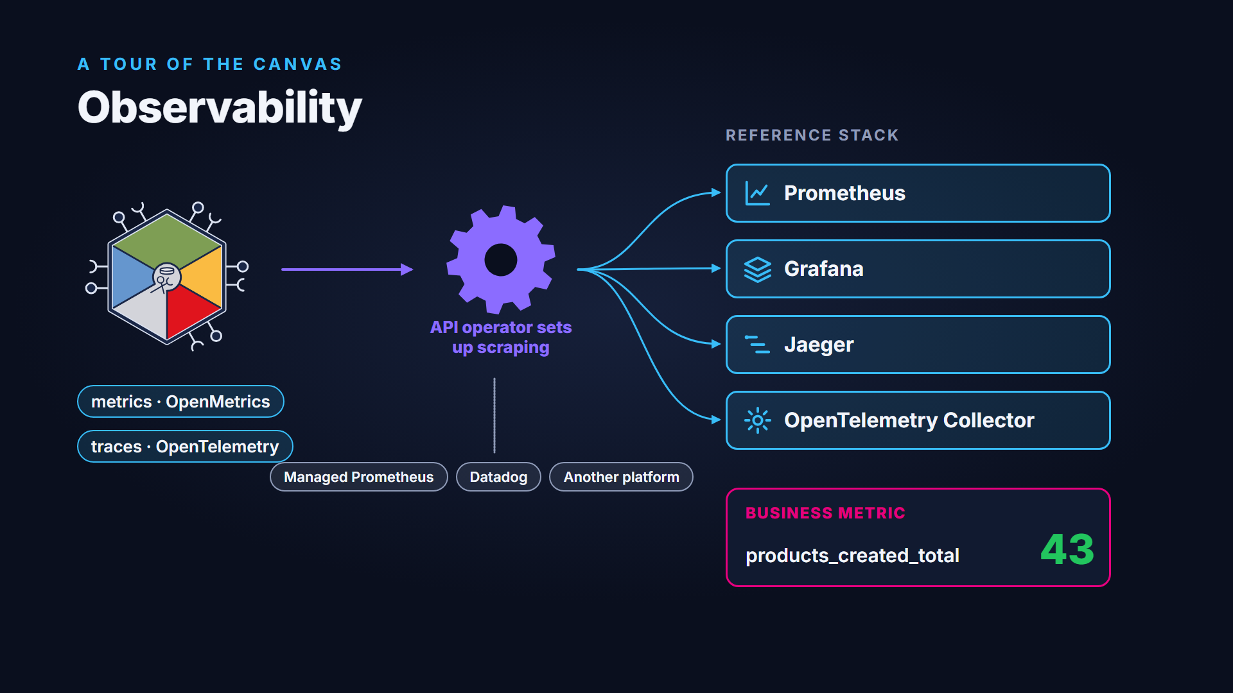
Observability
Notes:
For observability, components publish metrics using OpenMetrics and traces using OpenTelemetry, rather than shipping their own monitoring tools. When the API operator exposes a component's metrics endpoint, it also sets up scraping. In the reference implementation that means Prometheus, Grafana, Jaeger and an OpenTelemetry collector. The same declaration can target managed Prometheus services, Datadog, or another observability platform instead. Metrics can be business metrics as well as technical ones, for example a new product being added to a catalog.

Slide 24




Available today, experimental, planned
WHERE THINGS STAND
Available · experimental · planned
Available today
Experimental
Planned
Component Management
Model-as-a-Service
Event Management
API Management
Data Product
Cost Control
Identity Config
Carbon-aware
Database Management
Credentials Management
Dependency Management
Secrets Management
Generally available · regular releases
Disruption Budget
Every change tested by a BDD suite on a real Kubernetes cluster
OAuth2 Config
prototype
Notes:
Here's where things stand. Available in the reference implementation today are operators for component management, API management, identity, credentials, dependencies, secrets and disruption budgets. An OAuth2 configuration operator for authentication between components is available as a prototype. Experimental operators cover model-as-a-service, data products and carbon-aware scaling. Event management, cost control and database services are planned. The Canvas is generally available, with regular releases. Every change is checked by an automated behaviour-driven test suite, running against a real Kubernetes cluster.

Slide 25
Measuring Canvas adoption
A TOUR OF THE CANVAS
How do you measure Canvas adoption?
Outcome: automated component deployment & lifecycle management
API exposure
Observability
Identity
Secrets
Responsible AI
Cost
Carbon
…and future automations
Modular · deploy the Canvas incrementally
Notes:
How do you measure adoption? The outcome that matters is automated component deployment and lifecycle management. A service provider can turn on each light in turn as it automates API exposure, observability, identity, secrets and, increasingly, responsible AI, cost and carbon management. The Canvas itself is modular and can be deployed incrementally.

Slide 26
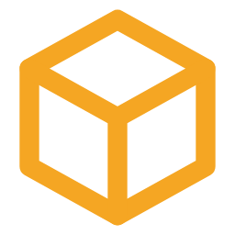

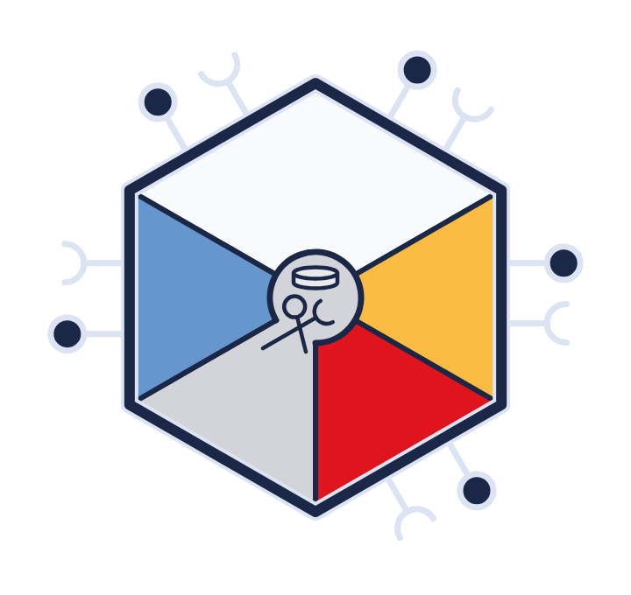


Built together
CONCLUSION
Built together
Software vendors
Systems integrators
Communication service providers
Cloud providers
ODA MANIFESTO
A standard execution environment for ODA Components
Adopting new capabilities — including AI — faster, together
Notes:
The ODA Components and Canvas are the result of collaboration between software vendors, systems integrators, communication service providers and cloud providers. Together they deliver what the ODA Manifesto set out: a standard execution environment for ODA Components. That shared foundation is what lets the industry adopt new capabilities, including AI, faster together than any one company could alone.

Slide 27


What's next
COMING UP IN THE SERIES
What's next
PART 2
PART 3
PART 4
PART 5
How do I buy or build an ODA Canvas?
Authentication & authorization
AI-Native ODA Canvas
Carbon-aware software
Reference implementation, docs and use-case library
github.com/tmforum-oda/oda-canvas
tmforum.org/oda/directory
Contributions welcome.
Notes:
This video was an overview. The next videos in the series go deeper into how to buy or build a Canvas, authentication and authorization, the AI-Native Canvas and carbon-aware software. The reference implementation, its documentation and its use-case library are all on GitHub at tmforum-oda slash oda-canvas, and contributions are welcome.

