Slide 1



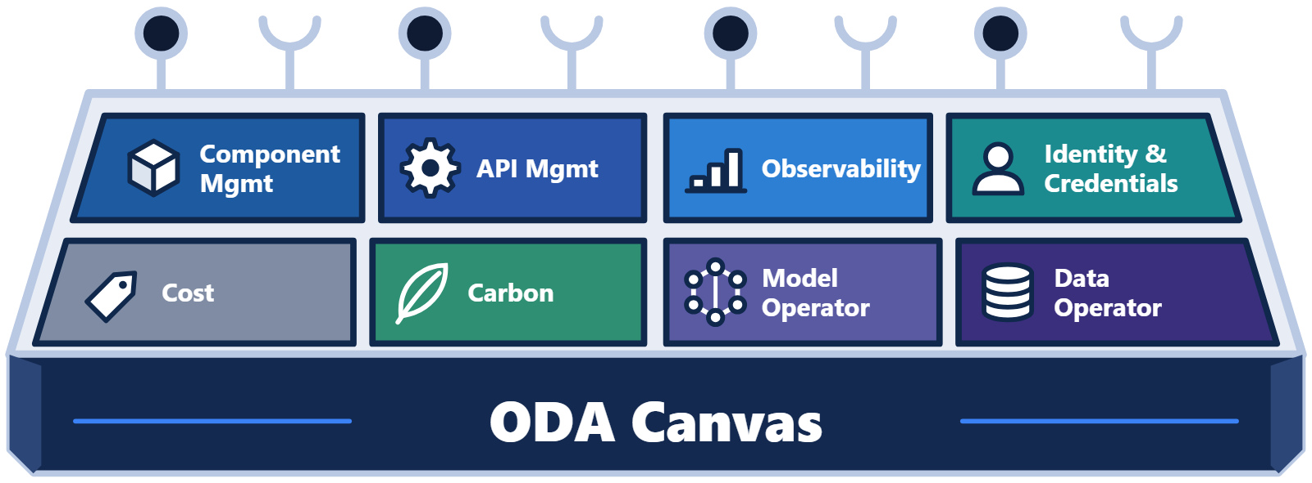
Title (presenter introduction)
Training series · Part 3
Authentication
and Authorization
in the ODA Canvas
With a live demo: three components and Keycloak
Notes:
Welcome to the third video in our series about the ODA Canvas. This one is about authentication and authorization. Traditionally, every application ships with its own identity management. Operations teams then have to integrate each one, and manage users and roles in many places. An ODA Component is different. It doesn't implement identity management at all. Instead, it declares the roles it supports. The Canvas configures those roles in one shared identity platform. That could be Keycloak, Microsoft Entra ID, or another identity platform.
In this video we'll look at how that works. We'll see how a component's YAML declares its security needs, and how the Canvas sets up its clients and roles. Then we'll run a complete example with three components. You'll see a role grant that also connects one component to another.

Slide 2





Four questions
IN THIS VIDEO
Four questions
Q1
Q2
Who does what?
How does the Canvas get in?
The job of the component, and the job of the Canvas
Permission to manage a component
Q3
Q4
How are roles defined?
How does a grant connect components?
Roles that others can be granted
From a role grant to a working dependency
Notes:
It answers four questions. First, what is the job of the component, and what is the job of the Canvas? Second, how does the Canvas get permission to manage a component? Third, how does a component define the roles that others can be granted? And fourth, how does granting one of those roles connect one component to another?

Slide 3
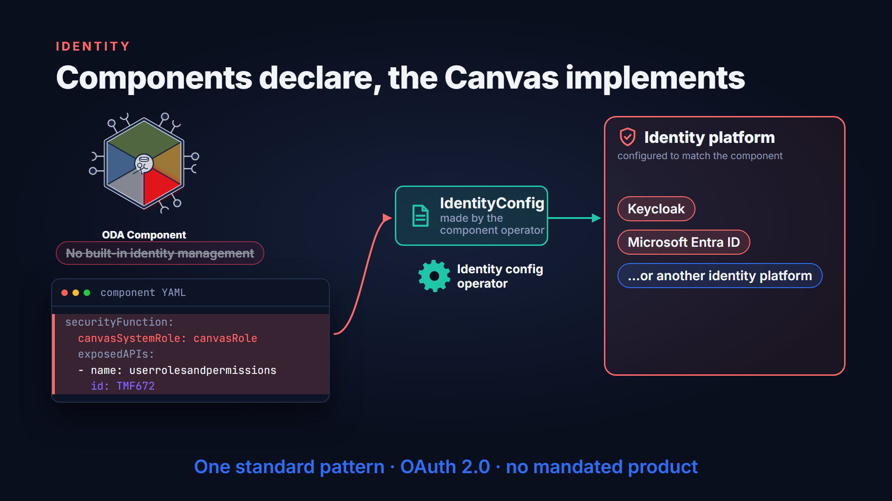
Components declare, the Canvas implements
Notes:
An ODA component does not bring its own identity management. Instead, its YAML specification declares what it needs, in the security function section. When the component is deployed, the component operator copies those requirements into an identity config resource. An identity config operator then configures the identity platform to match. The reference Canvas has operators for Keycloak and for Microsoft Entra ID. Another identity platform can be used, through the same standard pattern.

Slide 4
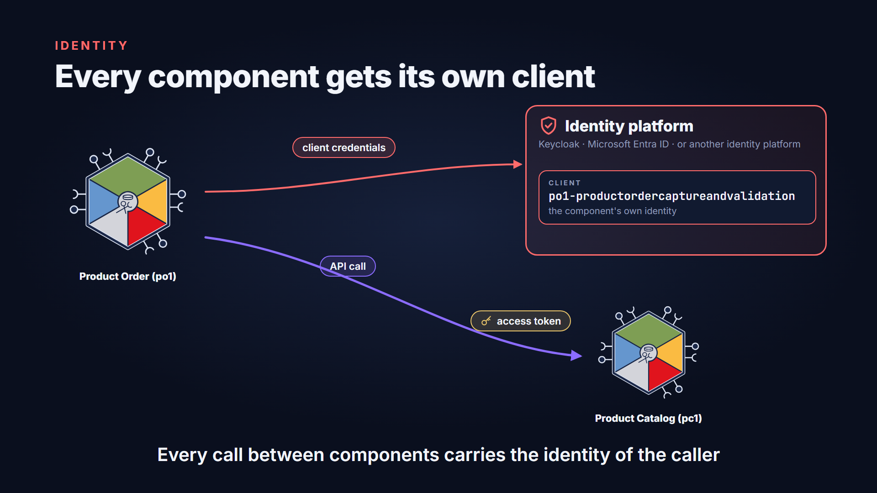
Every component gets its own client
Notes:
The operator first creates a client for the component. This client is the component's own identity. When the component calls another component's API, it uses this client to get an access token. So every call between components carries the identity of the caller.

Slide 5
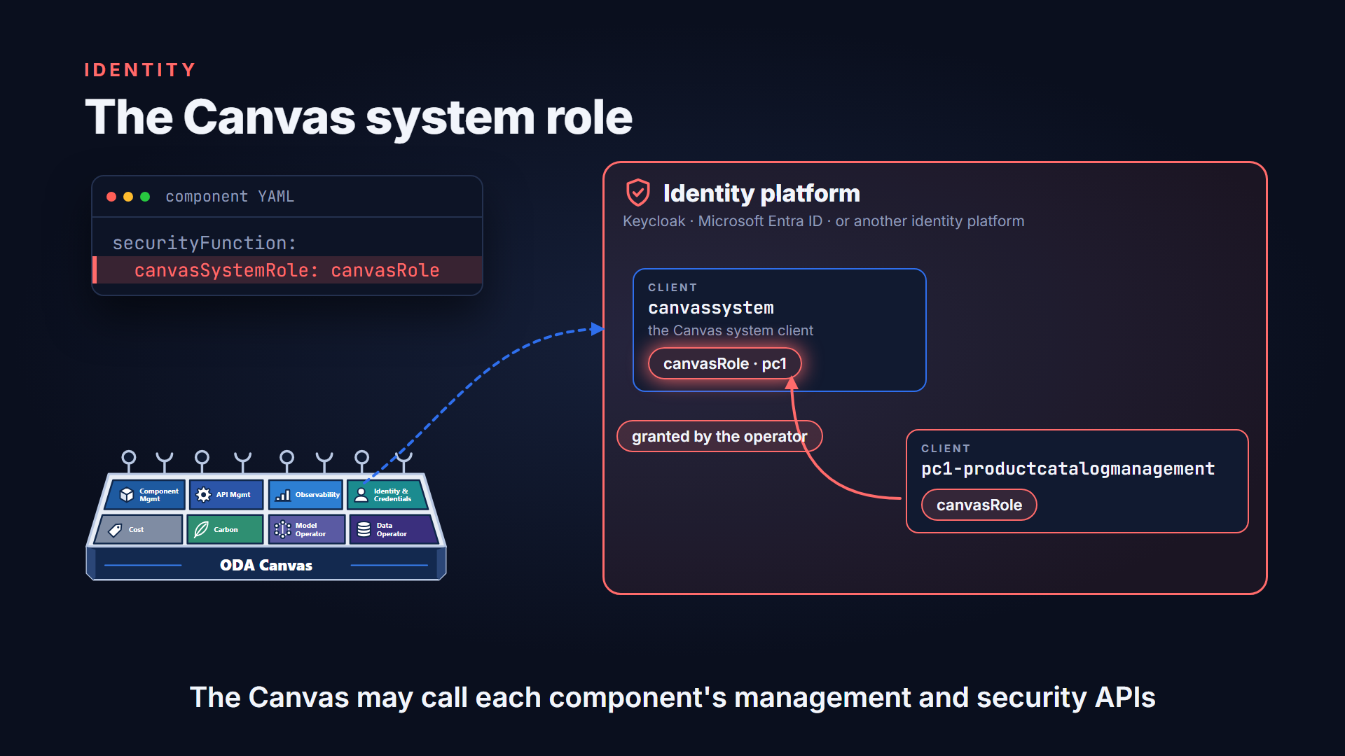
The Canvas system role
Notes:
The Canvas has its own identity too, called the Canvas system client. Every component must name one of its roles as its Canvas system role. When the component is deployed, the operator grants that role to the Canvas system client. That's how the Canvas earns permission to call the component's management and security APIs.

Slide 6
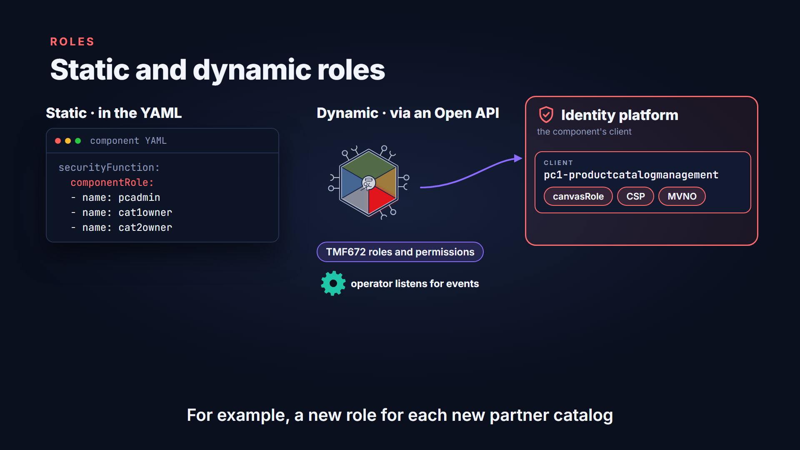
Static and dynamic roles
Notes:
A component can define its other roles in two ways. Static roles are listed directly in its YAML. Dynamic roles are published through a TM Forum Open API, the TMF672 roles and permissions API. The operator registers for events on that API. When the component adds a permission set, the matching role is added in the identity platform. When it removes one, the role is removed. A product catalog might add a role for each new partner catalog.

Slide 7
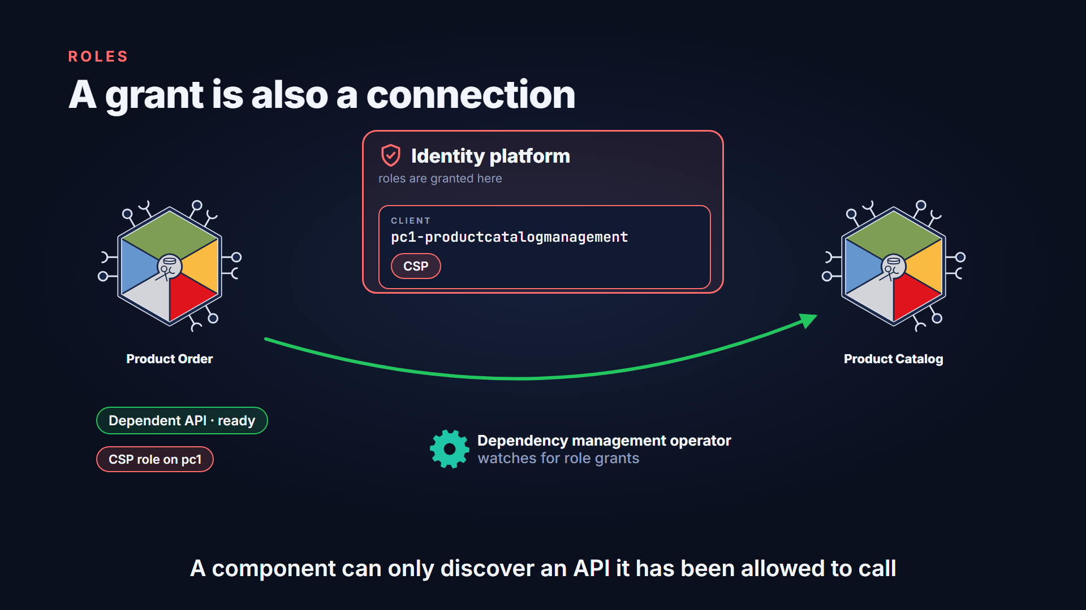
A grant is also a connection
Notes:
Roles are how access is granted. Other systems, or other components, are given roles on a component's client. The reference Canvas can go one step further. Its dependency management operator watches for role grants. Suppose a component is granted a role on another component. The operator then connects its dependent API to the matching exposed API. So a component can only discover an API it has been allowed to call.

Slide 8
The scenario
LIVE DEMO
The scenario
depends on TMF620 · catalog
Product Catalog · pc1
TMFC001
CSP · retail catalog
MVNO · wholesale catalog
Product Order Capture and Validation · po1
TMFC002
Product Inventory · pi1
depends on TMF637 · inventory
TMFC005
Notes:
Here's the scenario. A product catalog holds two catalogs. One is a communication service provider's retail catalog, and one is a wholesale catalog for MVNOs. A product order capture and validation component depends on the catalog, to check what is ordered. It also depends on a product inventory, where the ordered products are created.

Slide 9
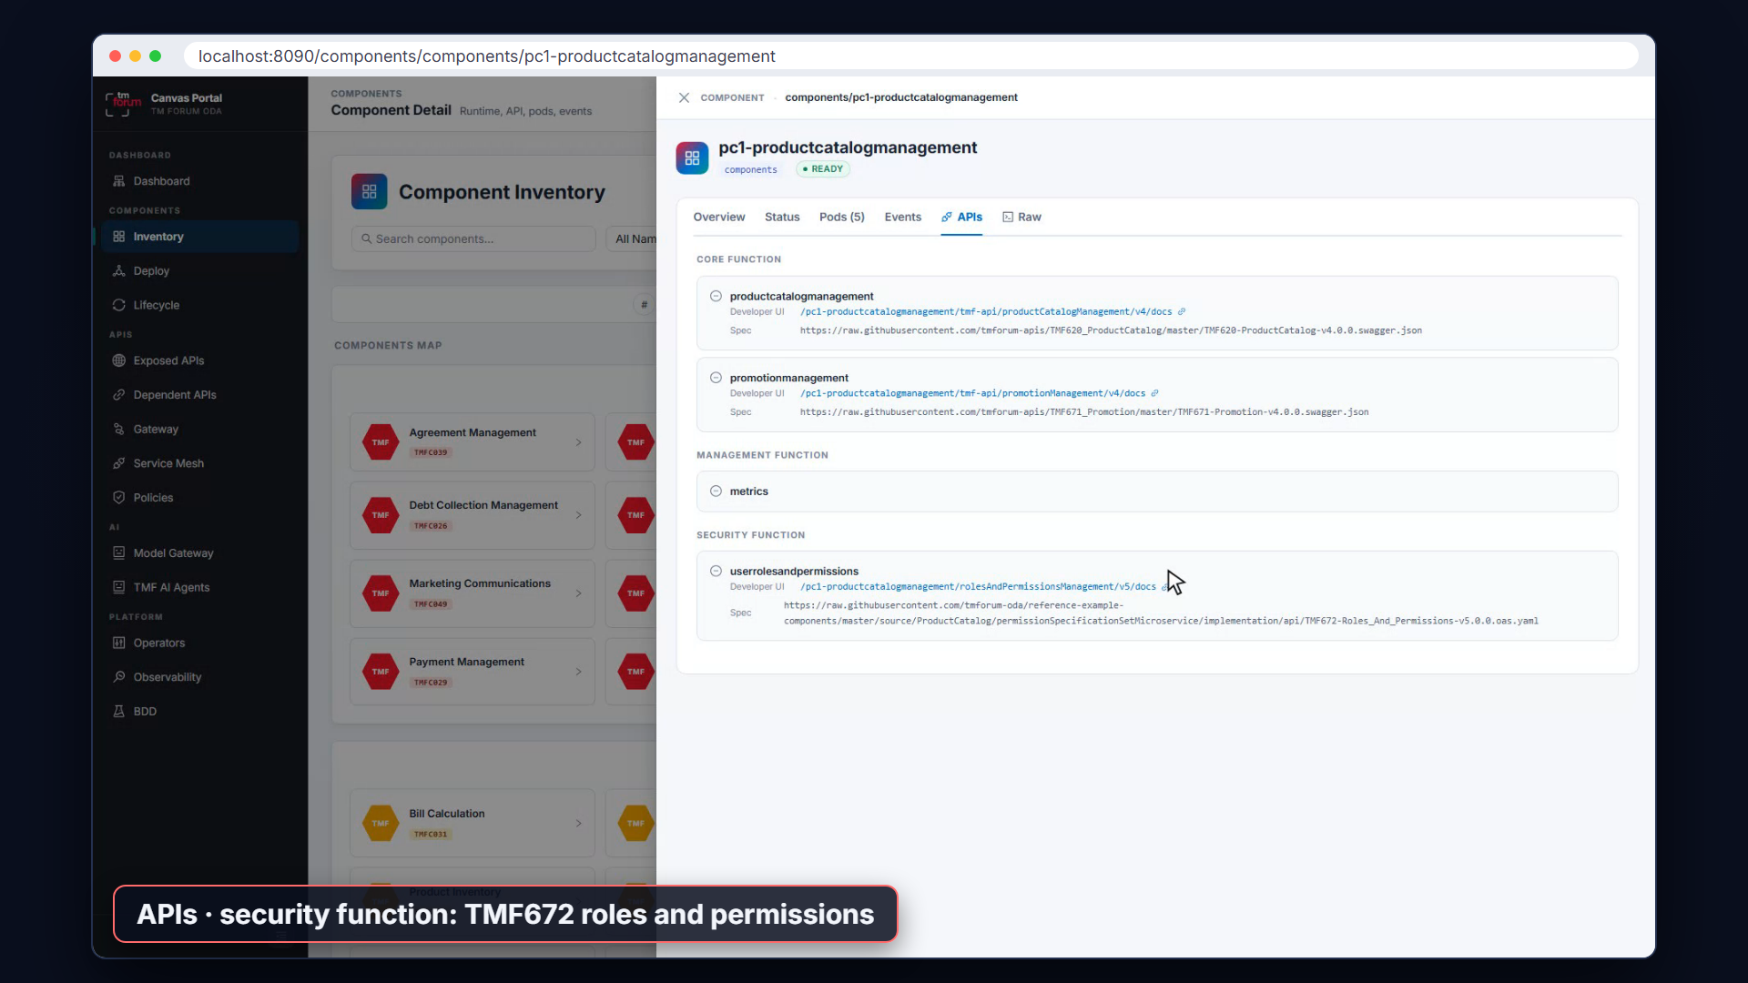
Deploy the product catalog
Notes:
We start by deploying the product catalog component. In the Canvas Portal we follow it until it is complete. Its security function names a Canvas system role, and exposes the TMF672 roles and permissions API for its other roles.

Slide 10
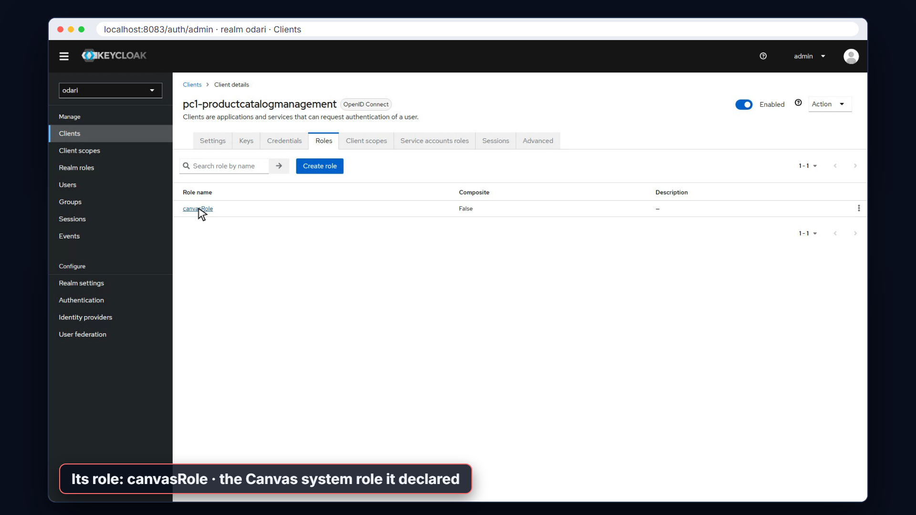
Its client appears in Keycloak
Notes:
In Keycloak, the identity config operator has created a client for the new component. It holds the Canvas system role that the component declared. This is the role the Canvas uses to manage the component. Nobody configured any of this by hand.

Slide 11
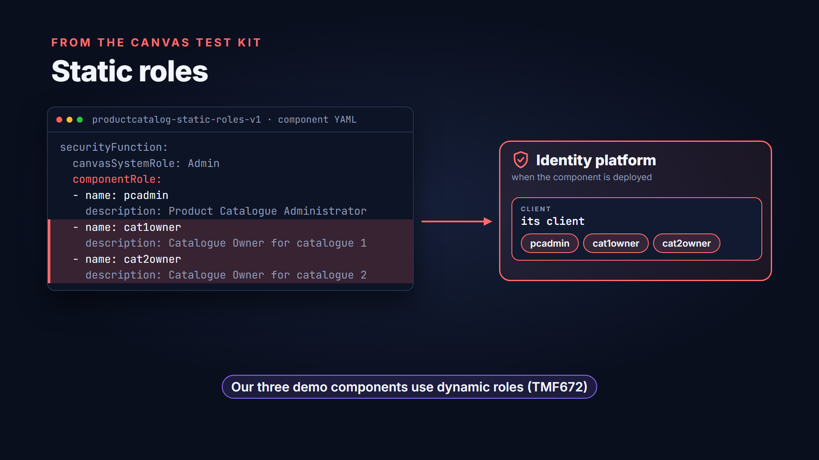
Static roles
Notes:
Before we go further, here is what static roles look like. This example from the Canvas test kit lists three roles in its YAML. There's an administrator and two catalog owners. When a component like this is deployed, the operator adds all three to its client. Our three components use dynamic roles instead.

Slide 12
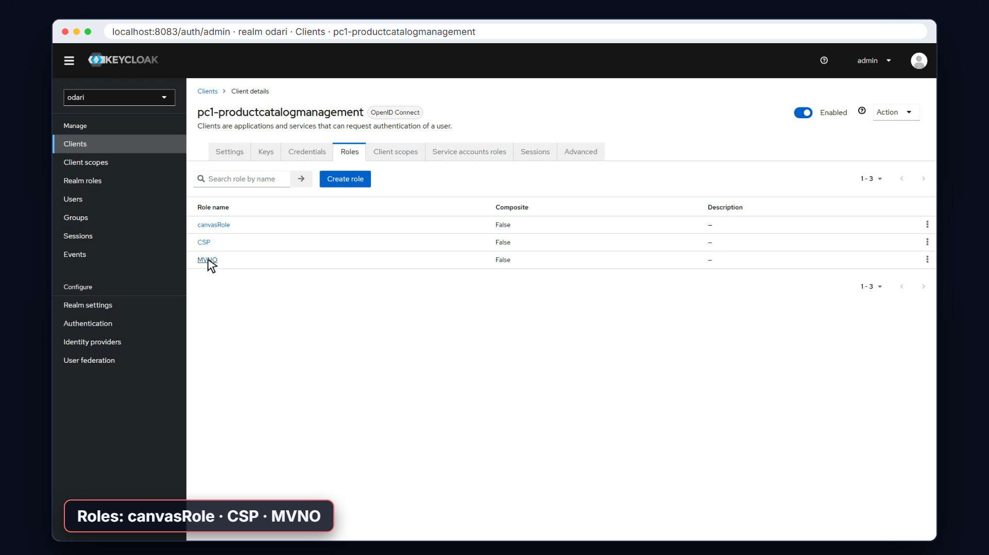
Dynamic roles through TMF672
Notes:
Now we load the catalog's test data. Along with the products, it creates two permission specification sets through the TMF672 API. One is for the CSP, and one is for MVNOs. The component publishes an event for each. The operator receives them, and the two new roles appear on the component's client in Keycloak.

Slide 13
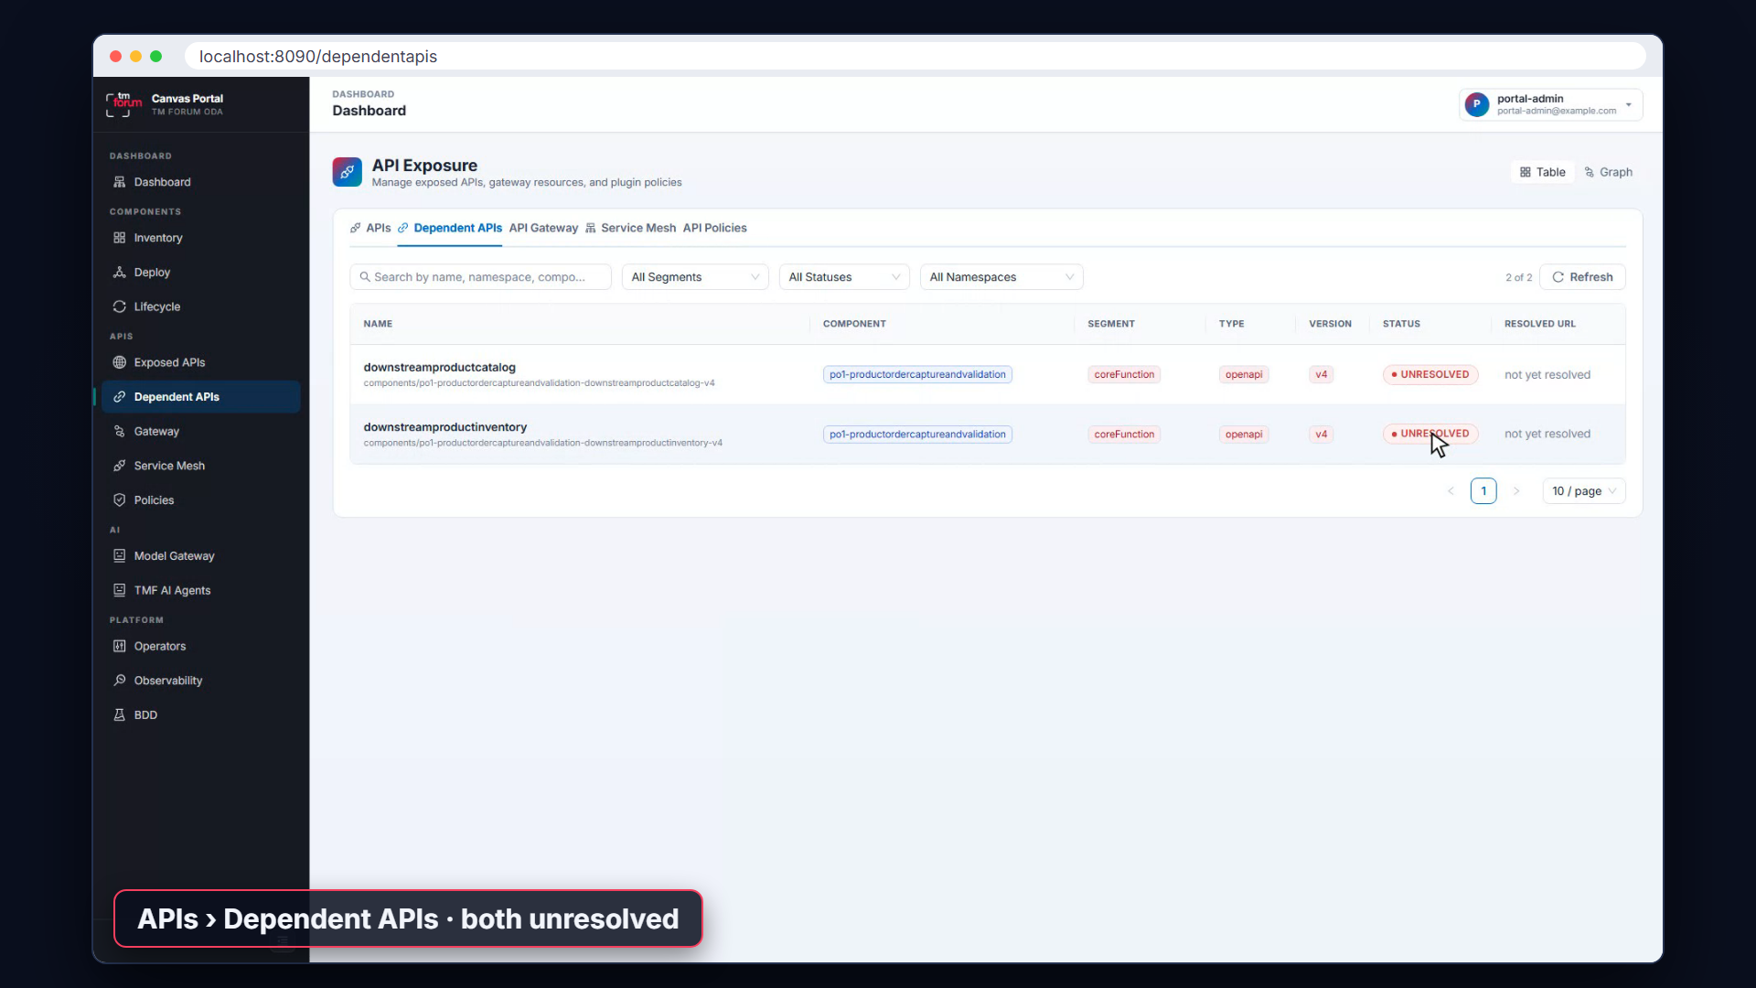
Deploy the order and inventory components
Notes:
Next we deploy the product inventory and the product order components. Both get their own clients in Keycloak. The order component declares two dependencies, on the product catalog API and the product inventory API. The Canvas Portal shows both dependencies as unmet. The APIs exist, but the order component hasn't been granted access to either of them.

Slide 14
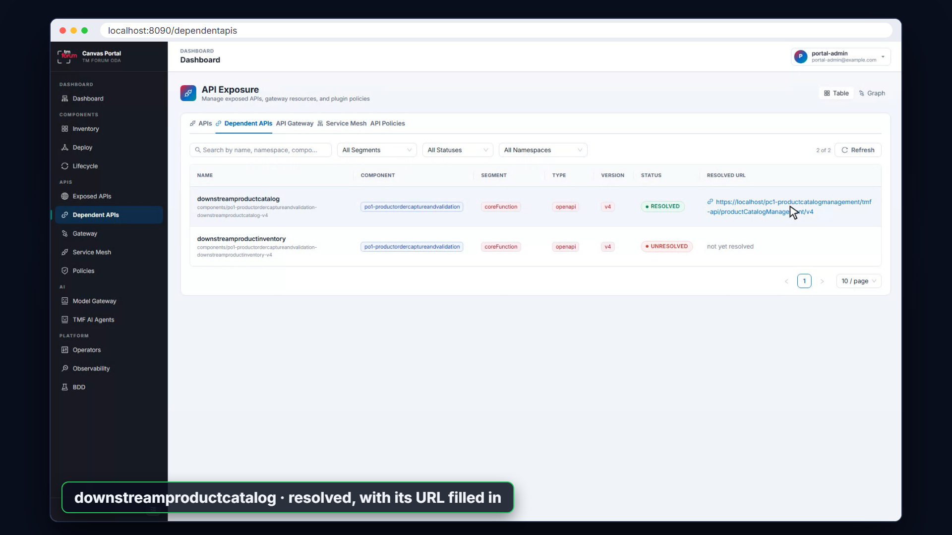
Grant a catalog role, and the dependency is met
Notes:
Now we act as the identity administrator. We open the order component's service account in Keycloak and assign it the CSP role on the product catalog. Within a few seconds, the Canvas Portal shows the catalog dependency as met, with the catalog's address filled in. One grant gave permission and made the connection.

Slide 15
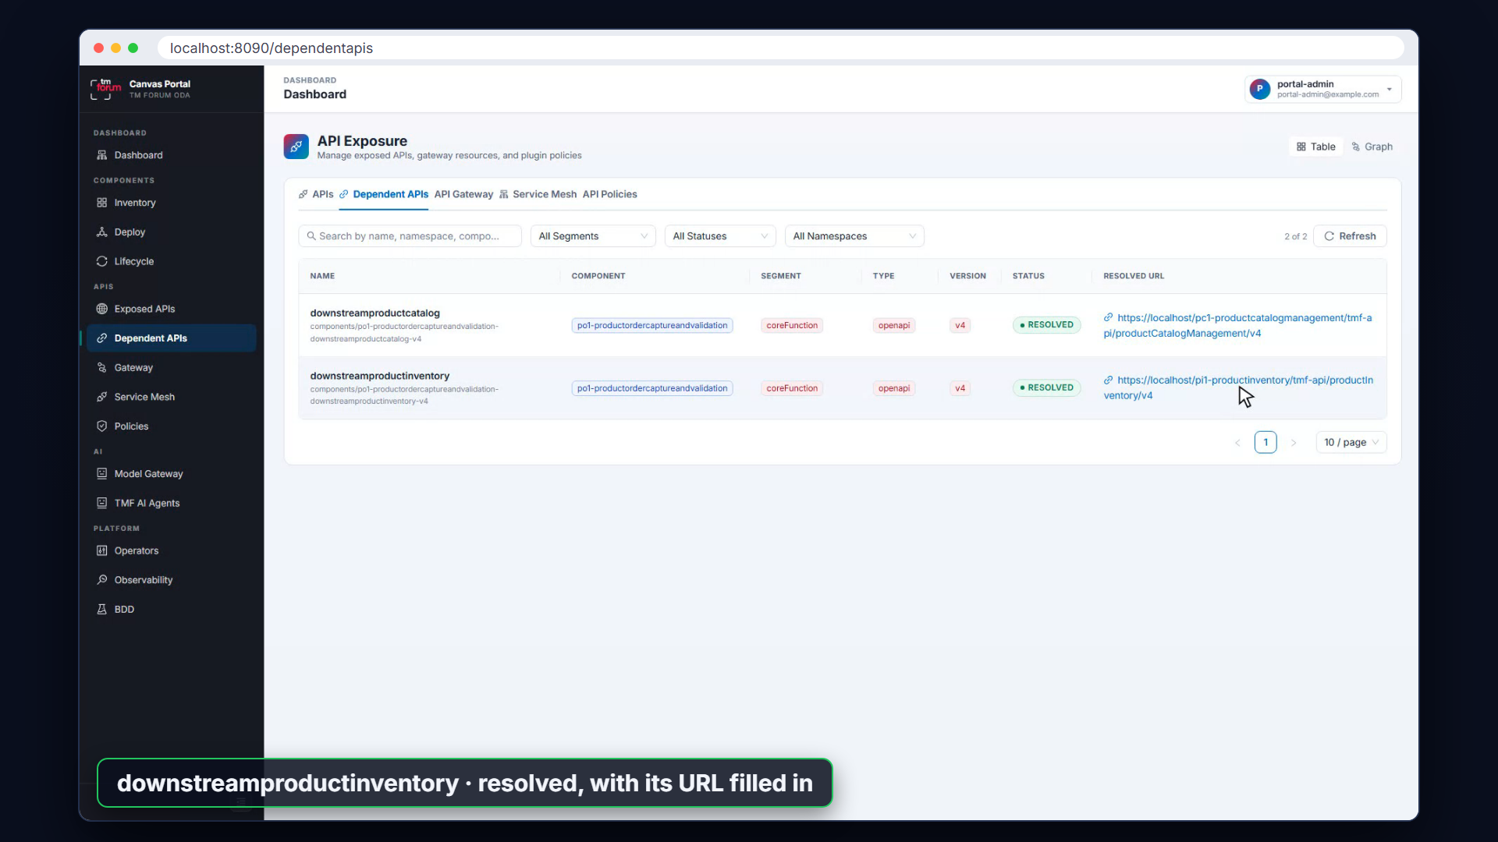
The same for the inventory
Notes:
We do the same for the product inventory, granting the order component the CSP role on the inventory's client. The second dependency is now met too. The order component is ready to do its job.

Slide 16
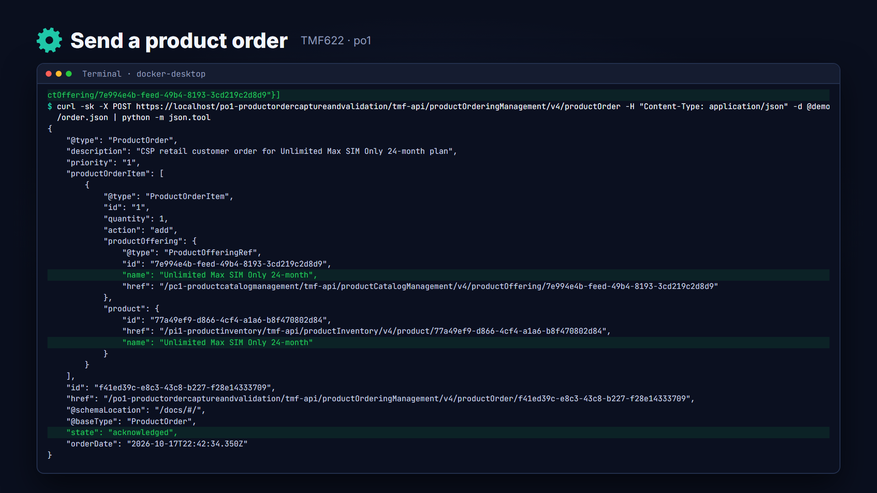
Send a product order
Notes:
Now we send a valid product order to the order component. It's a retail customer of the CSP, ordering an unlimited SIM-only plan. The order is accepted and acknowledged.

Slide 17
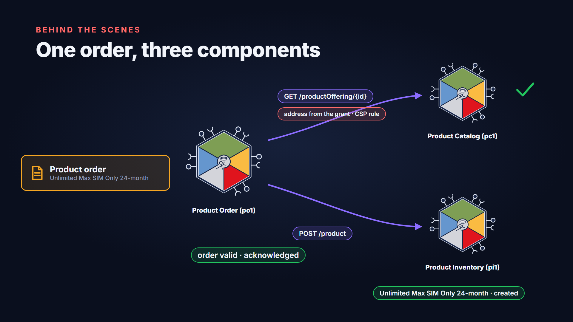
What happened behind the scenes
Notes:
Behind the scenes, the order component looked up each ordered offering in the product catalog. It used the address it was given when access was granted. The offering was found, so the order was valid. Then it created the product in the product inventory. The customer's new product is now in the inventory, ready to use.

Slide 18
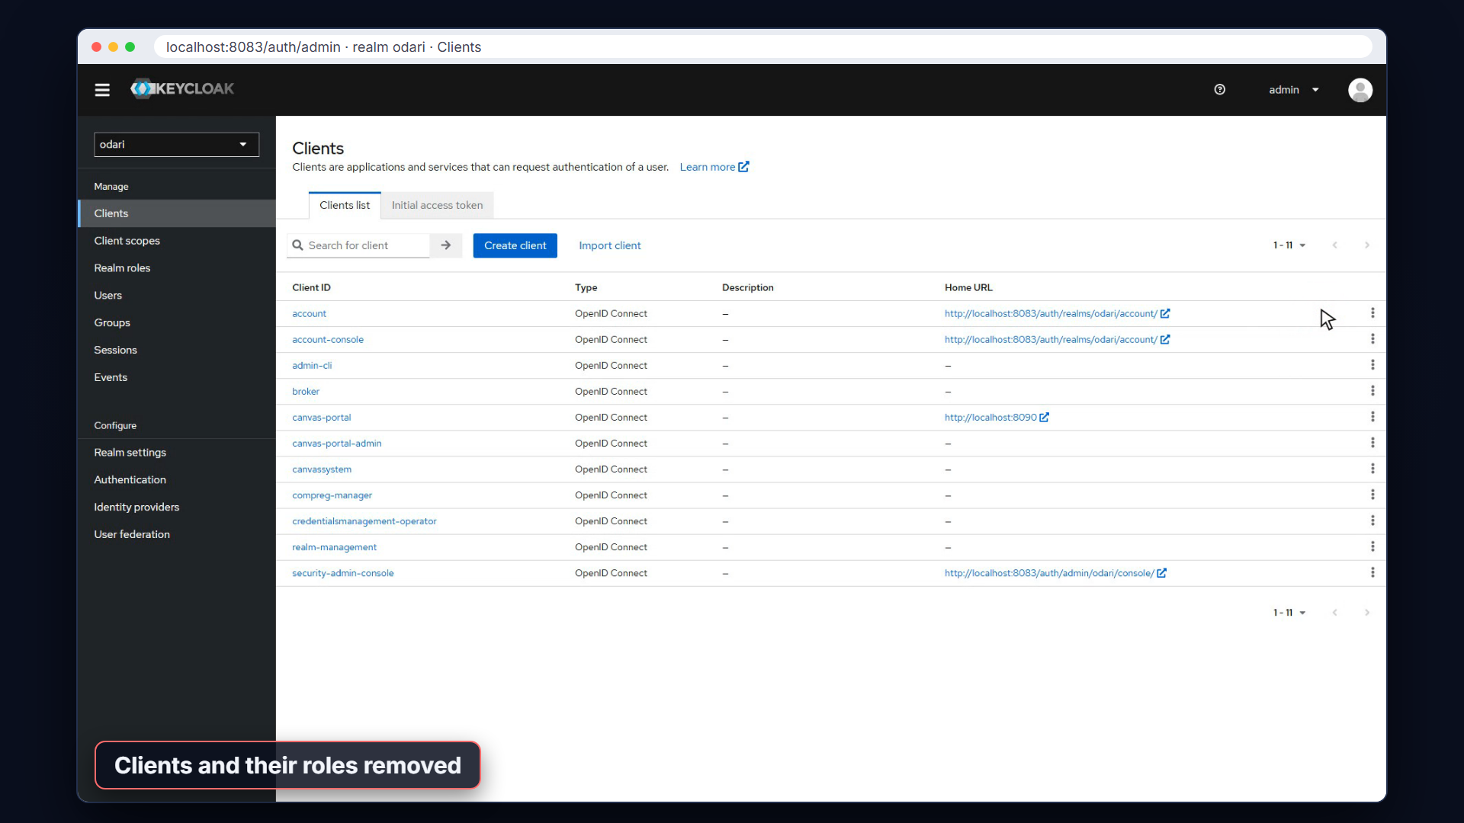
Automated cleanup
Notes:
Finally, the cleanup. As each component is uninstalled, the operator deletes its client from Keycloak, along with every role the component defined. The grants to the Canvas system client and to other components go with them. No orphaned identities or permissions are left behind.

Slide 19
Answers to the four questions
RECAP
Answers to the four questions
Q1
Q2
Who does what?
How does the Canvas get in?
Components declare their needs. The Canvas configures the identity platform, with a client per component.
Every component names a Canvas system role, which is granted to the Canvas system client.
Q3
Q4
How are roles defined?
How does a grant connect components?
Statically in the YAML, or dynamically through TMF672 roles and permissions.
Granting a component a role can also resolve its dependency on that API.
Notes:
So, the answers. Components declare their security needs, and the Canvas configures a shared identity platform. Each component gets a client, its own identity for outbound calls. The Canvas gets access through the Canvas system role. Components define other roles statically, or dynamically through TMF672. And granting a role can also resolve a dependency.

Slide 20
Find out more
FIND OUT MORE
Docs, use cases and examples
Authentication design
github.com/tmforum-oda/oda-canvas › Authentication-design.md
Use cases
UC005 Configure clients and roles · UC007 Configure dependent APIs
Operators
TMFOP003 Identity Config · TMFOP005 Dependency Management
Example components and test data
github.com/tmforum-oda/reference-example-components
Comments and contributions welcome.
Notes:
The authentication design, the use cases and the operator documentation are all in the oda-canvas repository on GitHub. The example components and their test data are in the reference example components repository. If you'd like to contribute, please get involved.

