Slide 1
20200327习题课

Slide 2
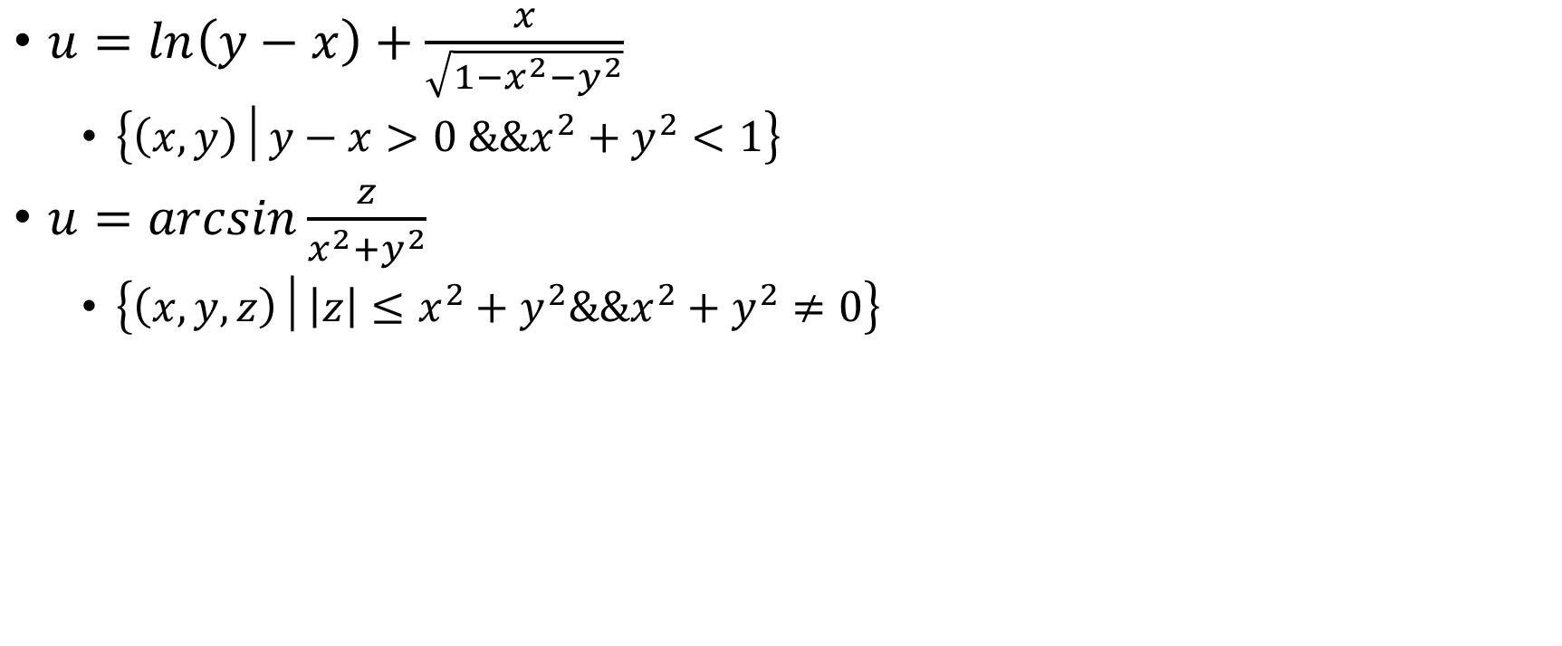
1.确定函数的自然定义域
$u=ln\left(y−x\right)+\frac{x}{\sqrt{1−x^{2}−y^{2}}}$
  $\left\{\left(x,y\right)│y−x>0 \&\&x^{2}+y^{2}<1\right\}$
$u=arcsin\frac{z}{x^{2}+y^{2}}$
  $\left\{\left(x,y,z\right)│\left|z\right|≤x^{2}+y^{2}\&\&x^{2}+y^{2}≠0\right\}$

Slide 3
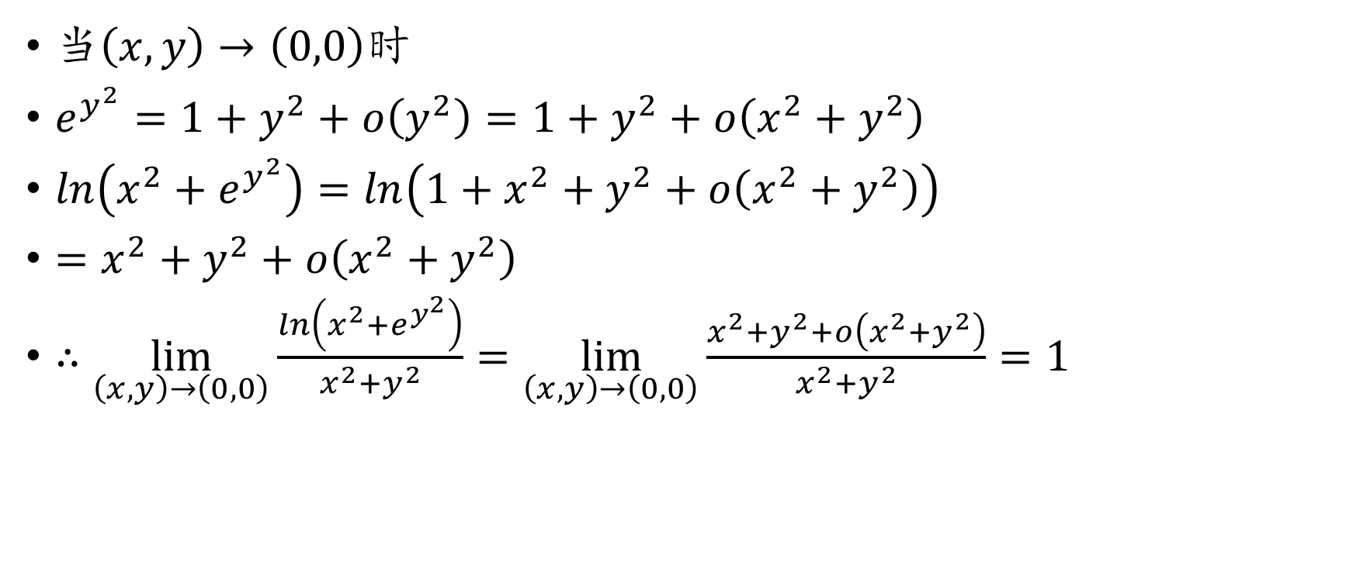
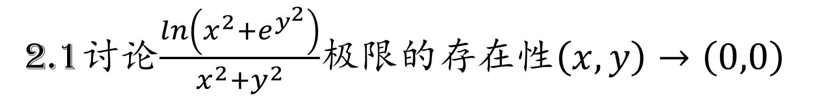
2.1讨论$\frac{\ln\left(x^{2}+e^{y^{2}}\right)}{x^{2}+y^{2}}$极限的存在性$\left(x,y\right)→\left(0,0\right)$
当$\left(x,y\right)→\left(0,0\right)$时
$e^{y^{2}}=1+y^{2}+o\left(y^{2}\right)=1+y^{2}+o\left(x^{2}+y^{2}\right)$
$\ln\left(x^{2}+e^{y^{2}}\right)=ln\left(1+x^{2}+y^{2}+o\left(x^{2}+y^{2}\right)\right)$
$=x^{2}+y^{2}+o\left(x^{2}+y^{2}\right)$
$∴\lim_{\left(x,y\right)→\left(0,0\right)}{\frac{\ln\left(x^{2}+e^{y^{2}}\right)}{x^{2}+y^{2}}}=\lim_{\left(x,y\right)→\left(0,0\right)}{\frac{x^{2}+y^{2}+o\left(x^{2}+y^{2}\right)}{x^{2}+y^{2}}}=1$

Slide 4
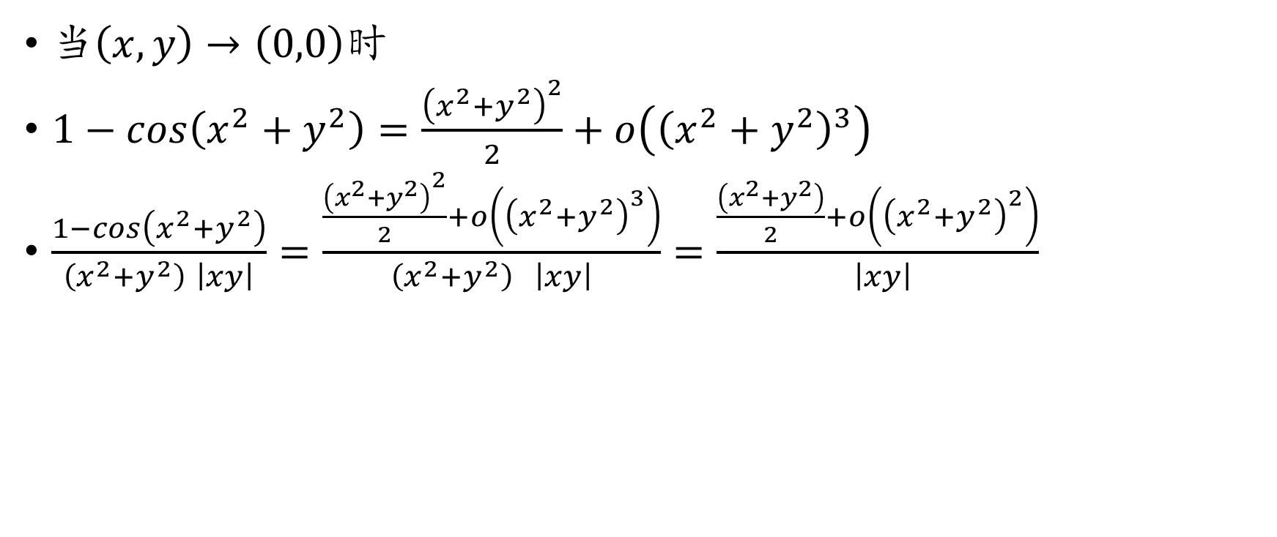
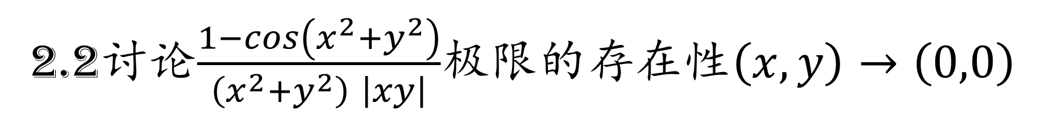
2.2讨论$\frac{1−\cos\left(x^{2}+y^{2}\right)}{\left(x^{2}+y^{2}\right) \left|xy\right|}$极限的存在性$\left(x,y\right)→\left(0,0\right)$
当$\left(x,y\right)→\left(0,0\right)$时
$1−\cos\left(x^{2}+y^{2}\right)=\frac{{\left(x^{2}+y^{2}\right)}^{2}}{2}+o\left({\left(x^{2}+y^{2}\right)}^{3}\right)$
$\frac{1−\cos\left(x^{2}+y^{2}\right)}{\left(x^{2}+y^{2}\right) \left|xy\right|}=\frac{\frac{{\left(x^{2}+y^{2}\right)}^{2}}{2}+o\left({\left(x^{2}+y^{2}\right)}^{3}\right)}{\left(x^{2}+y^{2}\right) \left|xy\right|}=\frac{\frac{\left(x^{2}+y^{2}\right)}{2}+o\left({\left(x^{2}+y^{2}\right)}^{2}\right)}{ \left|xy\right|}$

Slide 5
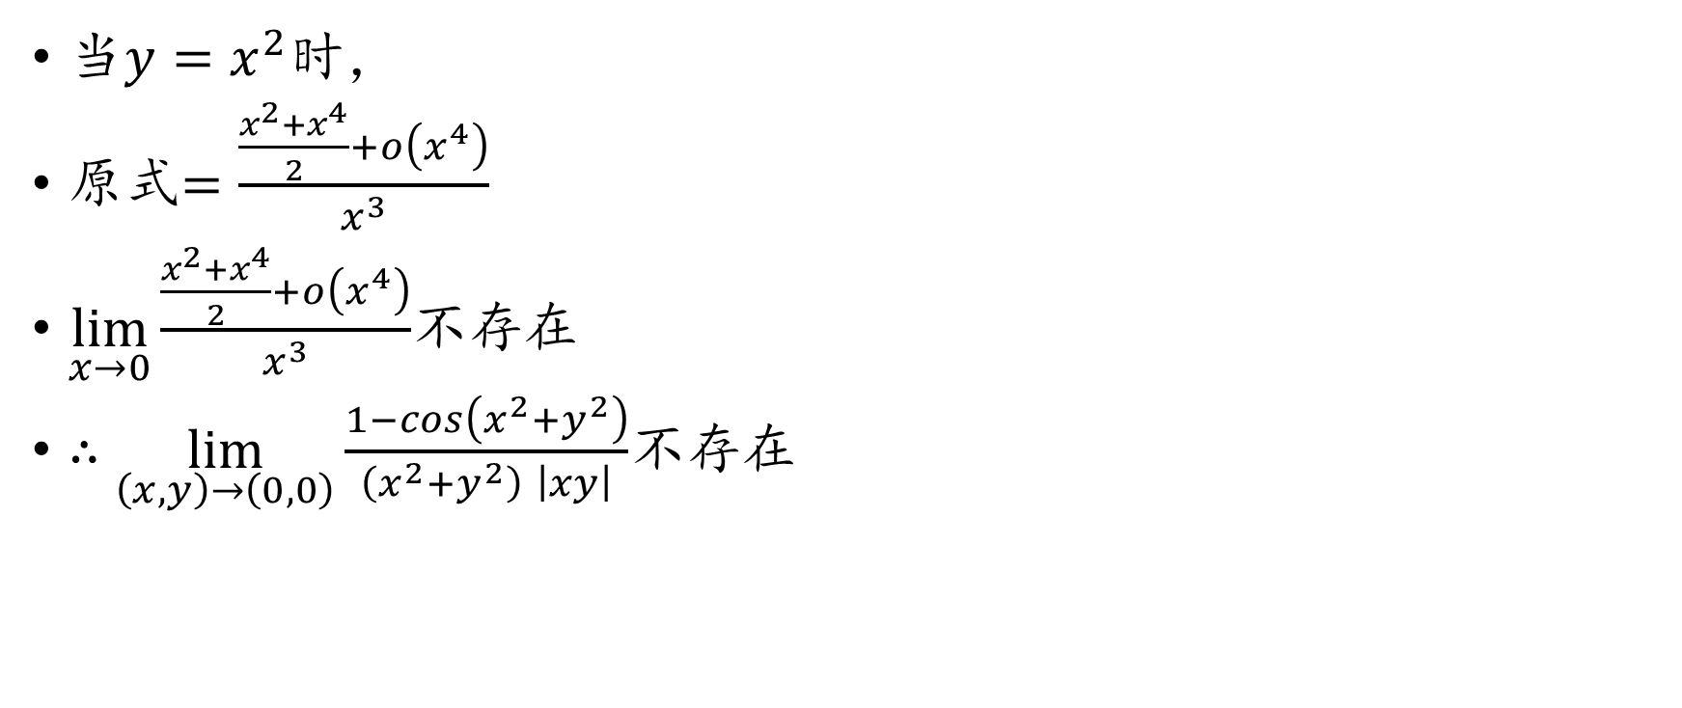
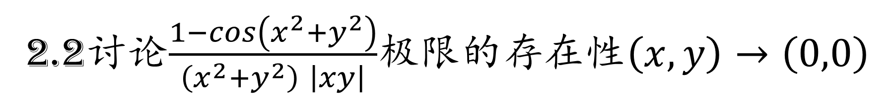
2.2讨论$\frac{1−\cos\left(x^{2}+y^{2}\right)}{\left(x^{2}+y^{2}\right) \left|xy\right|}$极限的存在性$\left(x,y\right)→\left(0,0\right)$
当$y=x^{2}$时，
原式$=\frac{\frac{x^{2}+x^{4}}{2}+o\left(x^{4}\right)}{x^{3}}$
$\lim_{x→0}{\frac{\frac{x^{2}+x^{4}}{2}+o\left(x^{4}\right)}{x^{3}}}$不存在
$∴\lim_{\left(x,y\right)→\left(0,0\right)}{\frac{1−\cos\left(x^{2}+y^{2}\right)}{\left(x^{2}+y^{2}\right) \left|xy\right|}}$不存在

Slide 6
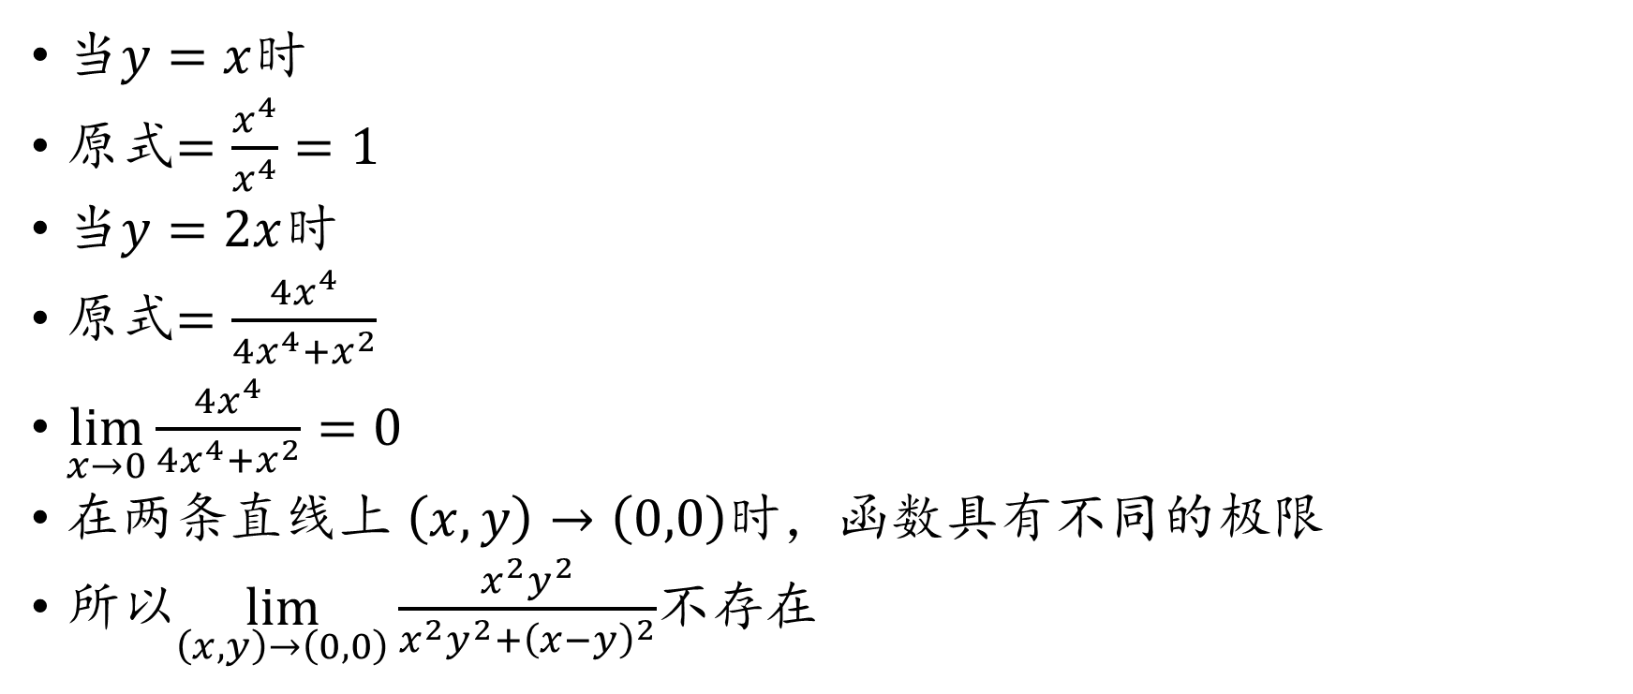
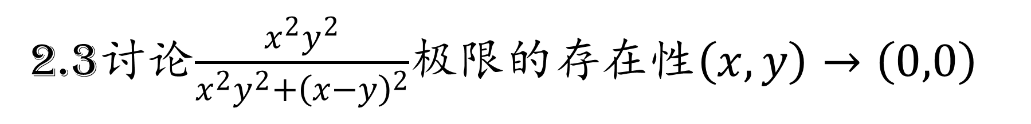
2.3讨论$\frac{x^{2}y^{2}}{x^{2}y^{2}+{\left(x−y\right)}^{2}}$极限的存在性$\left(x,y\right)→\left(0,0\right)$
当$y=x$时
原式$=\frac{x^{4}}{x^{4}}=1$
当$y=2x$时
原式$=\frac{4x^{4}}{4x^{4}+x^{2}}$
$\lim_{x→0}{\frac{4x^{4}}{4x^{4}+x^{2}}}=0$
在两条直线上 $\left(x,y\right)→\left(0,0\right)$时，函数具有不同的极限
所以$\lim_{\left(x,y\right)→\left(0,0\right)}{\frac{x^{2}y^{2}}{x^{2}y^{2}+{\left(x−y\right)}^{2}}}$不存在

Slide 7
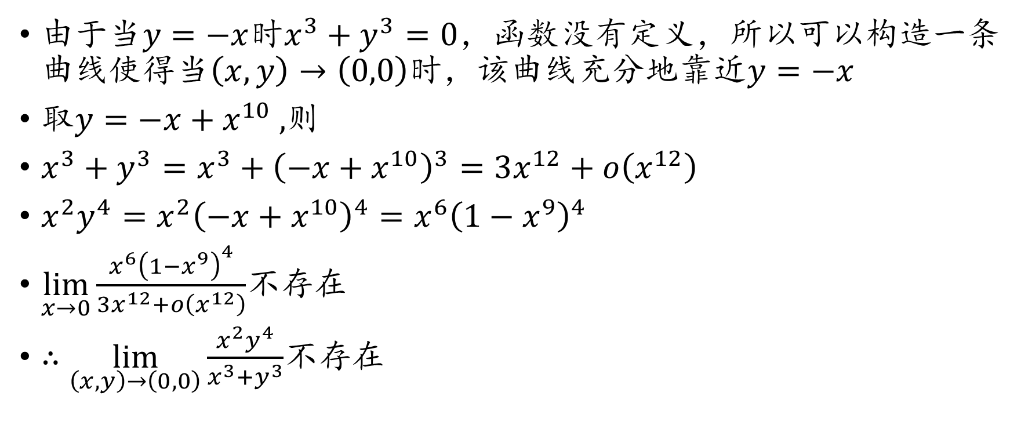
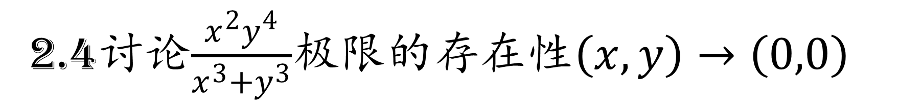
2.4讨论$\frac{x^{2}y^{4}}{x^{3}+y^{3}}$极限的存在性$\left(x,y\right)→\left(0,0\right)$
由于当$y=−x$时$x^{3}+y^{3}=0$，函数没有定义，所以可以构造一条曲线使得当$\left(x,y\right)→\left(0,0\right)$时，该曲线充分地靠近$y=−x$
取$y=−x+x^{10}$ ,则
$x^{3}+y^{3}=x^{3}+{\left(−x+x^{10}\right)}^{3}=3x^{12}+o\left(x^{12}\right)$
$x^{2}y^{4}=x^{2}{\left(−x+x^{10}\right)}^{4}=x^{6}{\left(1−x^{9}\right)}^{4}$
$\lim_{x→0}{\frac{x^{6}{\left(1−x^{9}\right)}^{4}}{3x^{12}+o\left(x^{12}\right)}}$不存在
$∴\lim_{\left(x,y\right)→\left(0,0\right)}{\frac{x^{2}y^{4}}{x^{3}+y^{3}}}$不存在

Slide 8
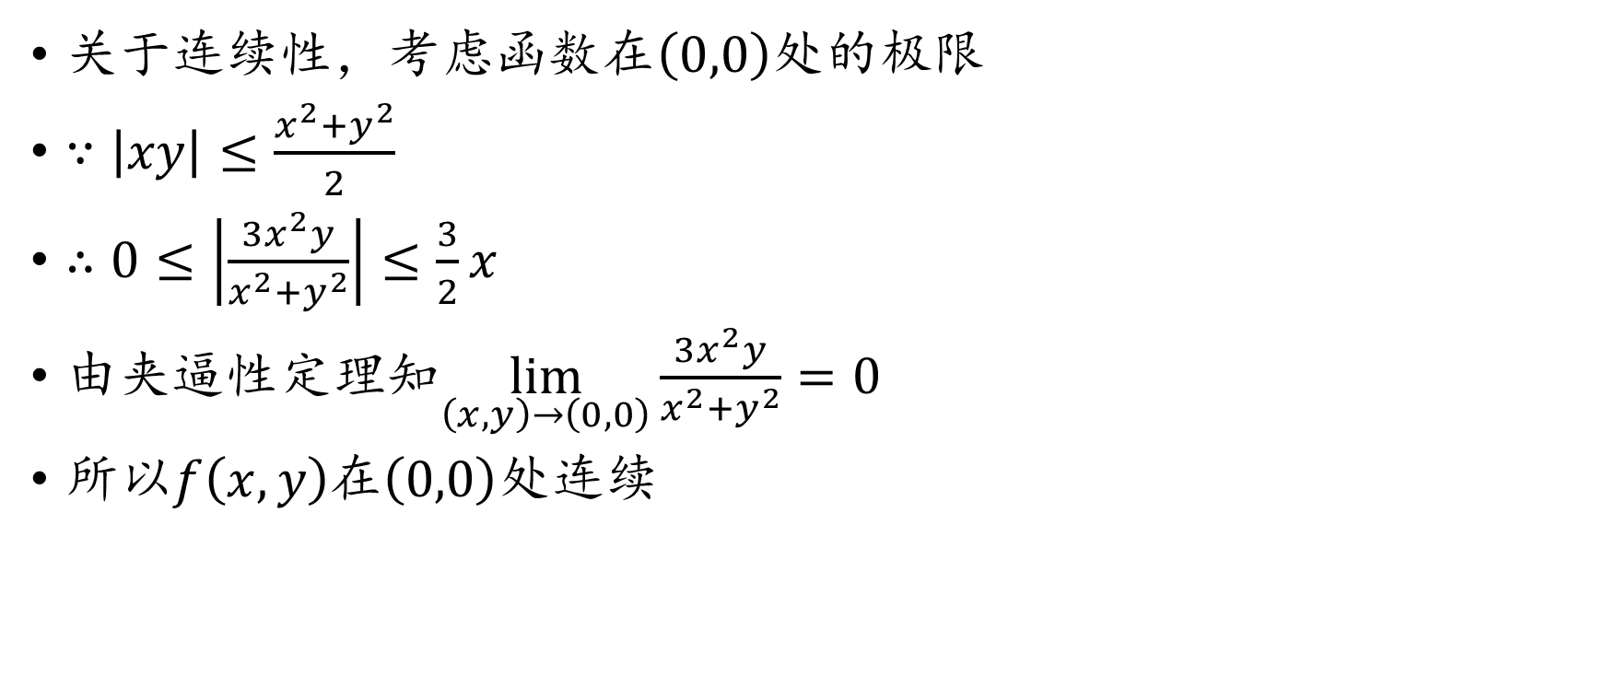
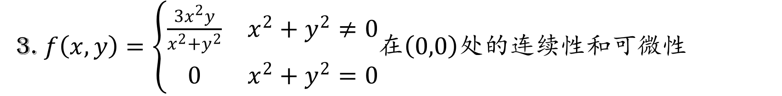
3. $f\left(x,y\right)=\left\{\begin{matrix}\frac{3x^{2}y}{x^{2}+y^{2}} & x^{2}+y^{2}≠0 \\ 0 & x^{2}+y^{2}=0\end{matrix}\right.$在$\left(0,0\right)$处的连续性和可微性
关于连续性，考虑函数在$\left(0,0\right)$处的极限
$∵\left|xy\right|≤\frac{x^{2}+y^{2}}{2}$
$∴0≤\left|\frac{3x^{2}y}{x^{2}+y^{2}}\right|≤\frac{3}{2}x$
由夹逼性定理知$\lim_{\left(x,y\right)→\left(0,0\right)}{\frac{3x^{2}y}{x^{2}+y^{2}}}=0$
所以$f\left(x,y\right)$在$\left(0,0\right)$处连续

Slide 9
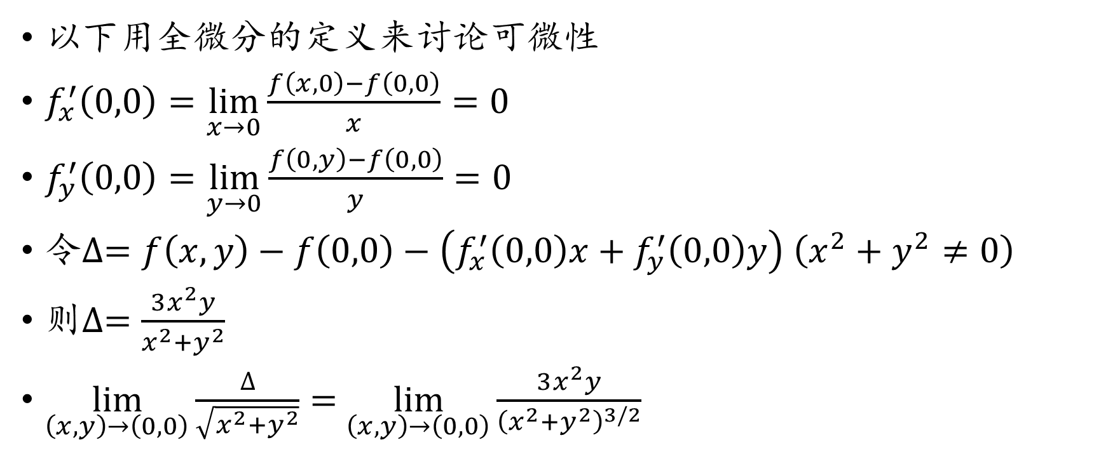
3. $f\left(x,y\right)=\left\{\begin{matrix}\frac{3x^{2}y}{x^{2}+y^{2}} & x^{2}+y^{2}≠0 \\ 0 & x^{2}+y^{2}=0\end{matrix}\right.$在$\left(0,0\right)$处的连续性和可微性
以下用全微分的定义来讨论可微性
$f_{x}^{′}\left(0,0\right)=\lim_{x→0}{\frac{f\left(x,0\right)−f\left(0,0\right)}{x}}=0$
$f_{y}^{′}\left(0,0\right)=\lim_{y→0}{\frac{f\left(0,y\right)−f\left(0,0\right)}{y}}=0$
令$∆=f\left(x,y\right)−f\left(0,0\right)−\left(f_{x}^{′}\left(0,0\right)x+f_{y}^{′}\left(0,0\right)y\right)$ $\left(x^{2}+y^{2}≠0\right)$
则$∆=\frac{3x^{2}y}{x^{2}+y^{2}}$
$\lim_{\left(x,y\right)→\left(0,0\right)}\frac{∆}{\sqrt{x^{2}+y^{2}}}=$ $\lim_{\left(x,y\right)→\left(0,0\right)}\frac{3x^{2}y}{{\left(x^{2}+y^{2}\right)}^{3/2}}$

Slide 10
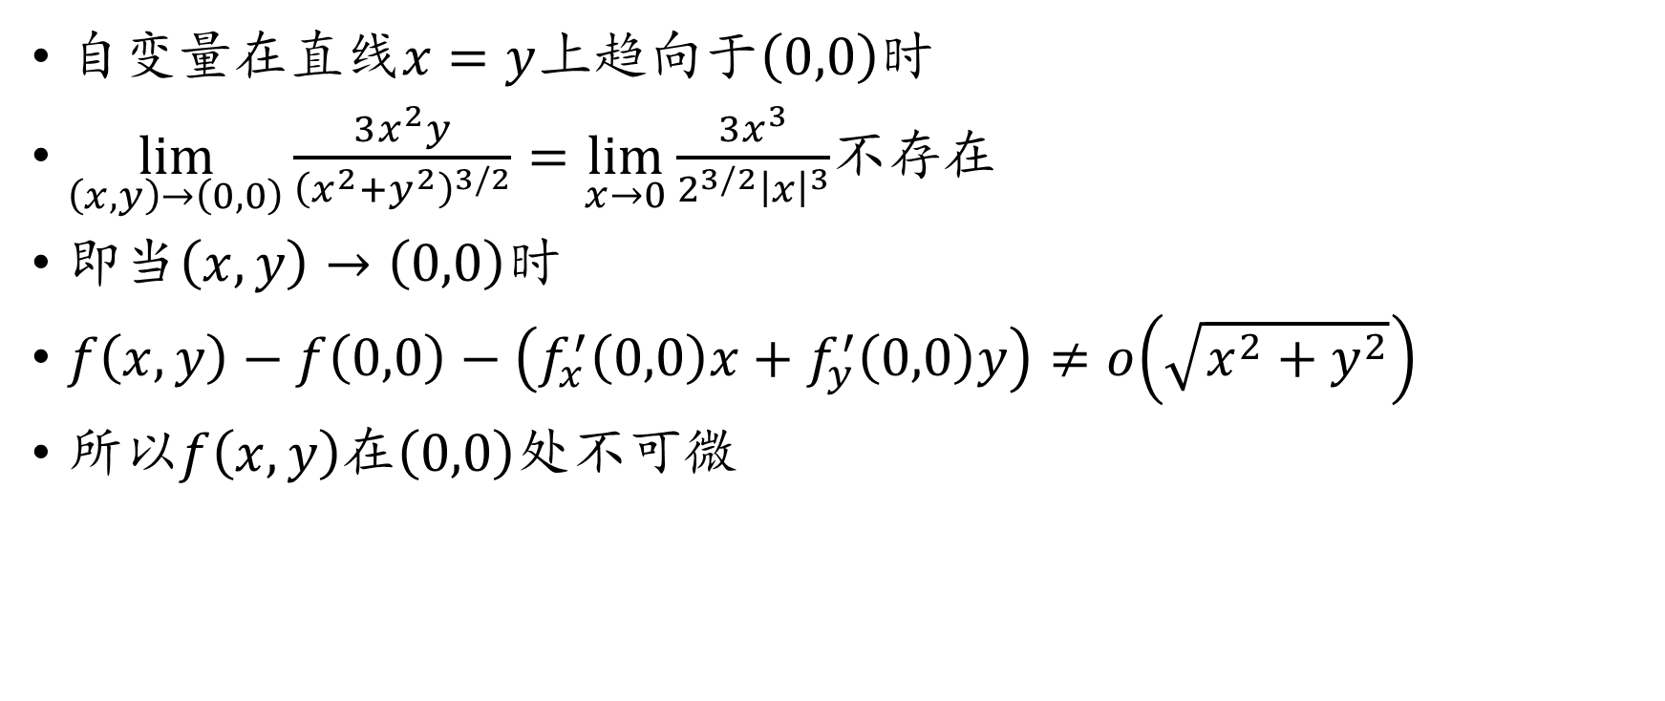
3. $f\left(x,y\right)=\left\{\begin{matrix}\frac{3x^{2}y}{x^{2}+y^{2}} & x^{2}+y^{2}≠0 \\ 0 & x^{2}+y^{2}=0\end{matrix}\right.$在$\left(0,0\right)$处的连续性和可微性
自变量在直线$x=y$上趋向于$\left(0,0\right)$时
$\lim_{\left(x,y\right)→\left(0,0\right)}\frac{3x^{2}y}{{\left(x^{2}+y^{2}\right)}^{3/2}}=\lim_{x→0}\frac{3x^{3}}{2^{3/2}{\left|x\right|}^{3}}$不存在
即当$\left(x,y\right)→\left(0,0\right)$时
$f\left(x,y\right)−f\left(0,0\right)−\left(f_{x}^{′}\left(0,0\right)x+f_{y}^{′}\left(0,0\right)y\right)≠o\left(\sqrt{x^{2}+y^{2}}\right)$
所以$f\left(x,y\right)$在$\left(0,0\right)$处不可微

Slide 11
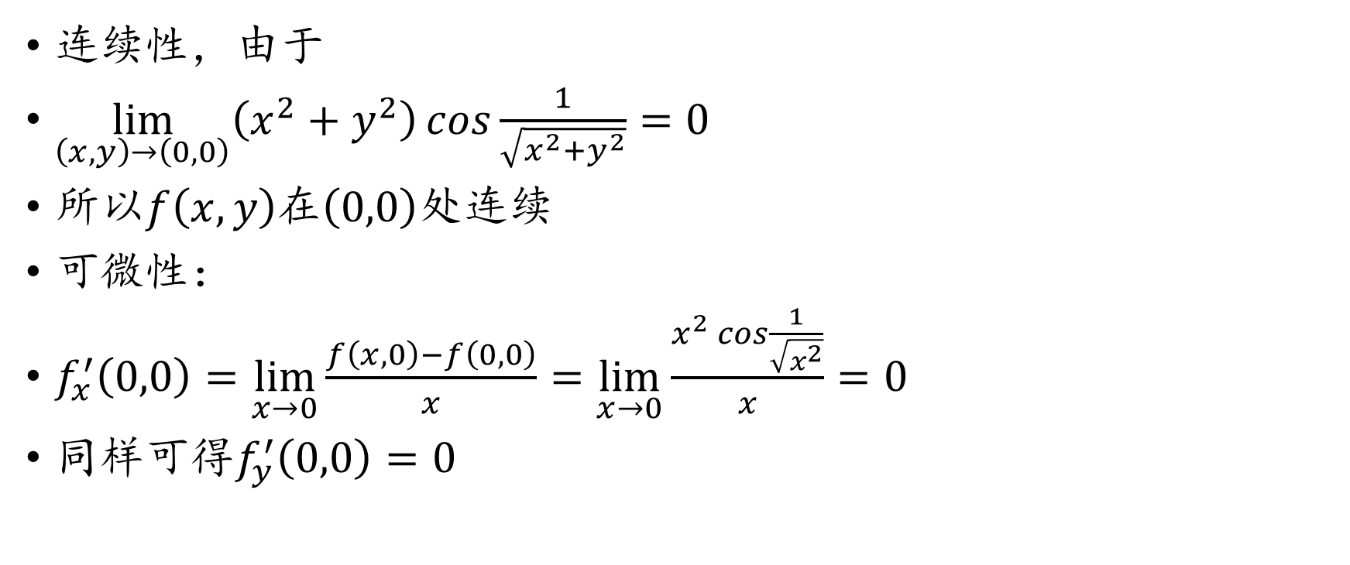
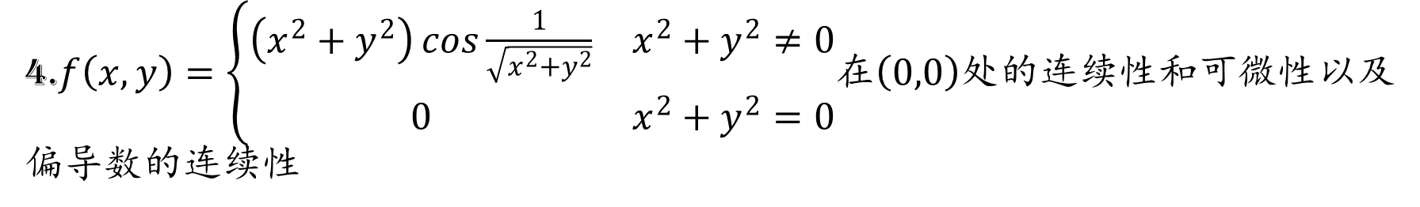
4.$f\left(x,y\right)=\left\{\begin{matrix}\left(x^{2}+y^{2}\right)\cos{\frac{1}{\sqrt{x^{2}+y^{2}}}} & x^{2}+y^{2}≠0 \\ 0 & x^{2}+y^{2}=0\end{matrix}\right.$在$\left(0,0\right)$处的连续性和可微性以及偏导数的连续性
连续性，由于
$\lim_{\left(x,y\right)→\left(0,0\right)}\left(x^{2}+y^{2}\right)\cos{\frac{1}{\sqrt{x^{2}+y^{2}}}}=0$
所以$f\left(x,y\right)$在$\left(0,0\right)$处连续
可微性：
$f_{x}^{′}\left(0,0\right)=\lim_{x→0}{\frac{f\left(x,0\right)−f\left(0,0\right)}{x}}=\lim_{x→0}{\frac{x^{2}\cos{\frac{1}{\sqrt{x^{2}}}}}{x}}=0$
同样可得$f_{y}^{′}\left(0,0\right)=0$

Slide 12
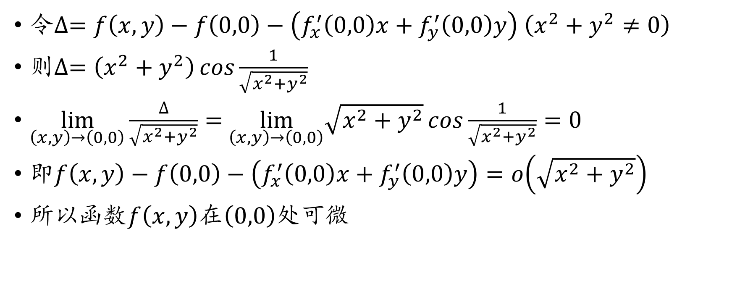
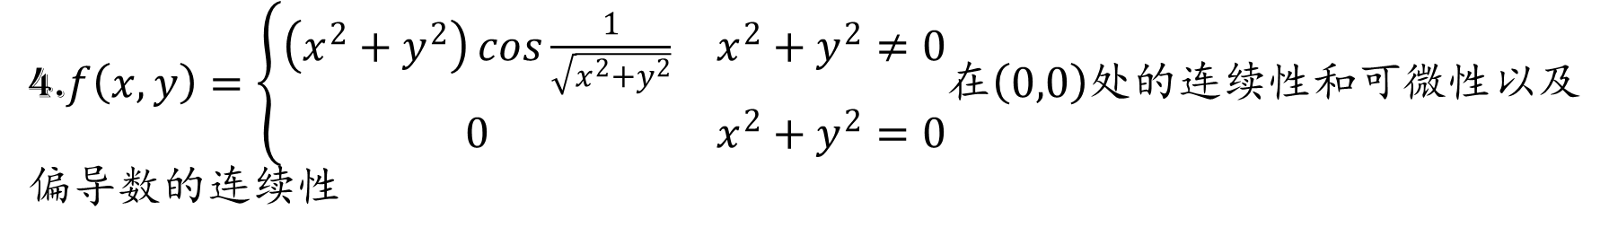
4.$f\left(x,y\right)=\left\{\begin{matrix}\left(x^{2}+y^{2}\right)\cos{\frac{1}{\sqrt{x^{2}+y^{2}}}} & x^{2}+y^{2}≠0 \\ 0 & x^{2}+y^{2}=0\end{matrix}\right.$在$\left(0,0\right)$处的连续性和可微性以及偏导数的连续性
令$∆=f\left(x,y\right)−f\left(0,0\right)−\left(f_{x}^{′}\left(0,0\right)x+f_{y}^{′}\left(0,0\right)y\right)$ $\left(x^{2}+y^{2}≠0\right)$
则$∆=\left(x^{2}+y^{2}\right)\cos{\frac{1}{\sqrt{x^{2}+y^{2}}}}$
$\lim_{\left(x,y\right)→\left(0,0\right)}\frac{∆}{\sqrt{x^{2}+y^{2}}}=$ $\lim_{\left(x,y\right)→\left(0,0\right)}\sqrt{x^{2}+y^{2}}\cos{\frac{1}{\sqrt{x^{2}+y^{2}}}}=0$
即$f\left(x,y\right)−f\left(0,0\right)−\left(f_{x}^{′}\left(0,0\right)x+f_{y}^{′}\left(0,0\right)y\right)=o\left(\sqrt{x^{2}+y^{2}}\right)$
所以函数$f\left(x,y\right)$在$\left(0,0\right)$处可微

Slide 13
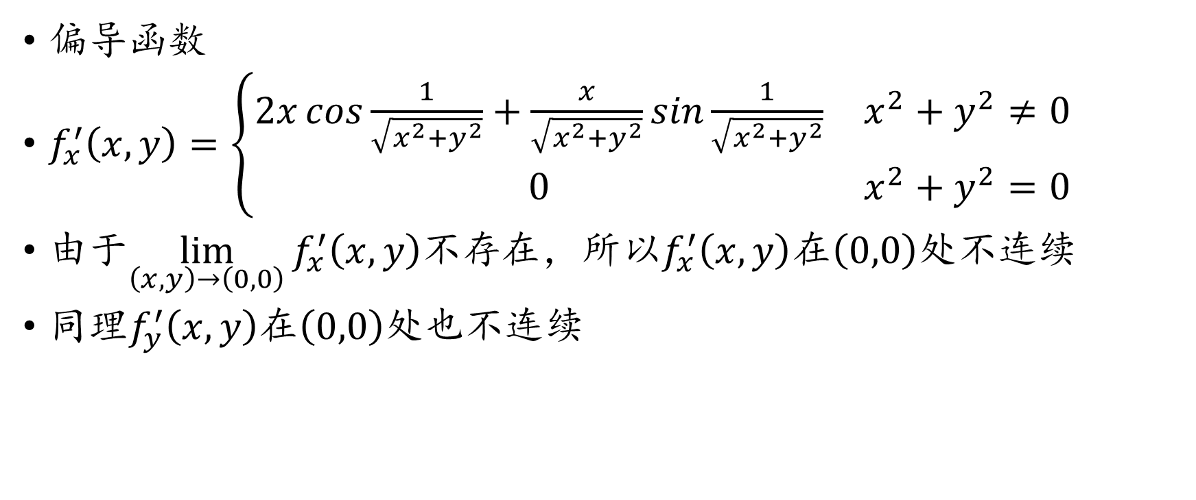
4.$f\left(x,y\right)=\left\{\begin{matrix}\left(x^{2}+y^{2}\right)\cos{\frac{1}{\sqrt{x^{2}+y^{2}}}} & x^{2}+y^{2}≠0 \\ 0 & x^{2}+y^{2}=0\end{matrix}\right.$在$\left(0,0\right)$处的连续性和可微性以及偏导数的连续性
偏导函数
$f_{x}^{′}\left(x,y\right)=\left\{\begin{matrix}2x\cos{\frac{1}{\sqrt{x^{2}+y^{2}}}}+\frac{x}{\sqrt{x^{2}+y^{2}}}sin\frac{1}{\sqrt{x^{2}+y^{2}}} & x^{2}+y^{2}≠0 \\ 0 & x^{2}+y^{2}=0\end{matrix}\right.$
由于$\lim_{\left(x,y\right)→\left(0,0\right)}{f_{x}^{′}\left(x,y\right)}$不存在，所以$f_{x}^{′}\left(x,y\right)$在$\left(0,0\right)$处不连续
同理$f_{y}^{′}\left(x,y\right)$在$\left(0,0\right)$处也不连续

Slide 14
4.$f\left(x,y\right)=\left\{\begin{matrix}\left(x^{2}+y^{2}\right)\cos{\frac{1}{\sqrt{x^{2}+y^{2}}}} & x^{2}+y^{2}≠0 \\ 0 & x^{2}+y^{2}=0\end{matrix}\right.$在$\left(0,0\right)$处的连续性和可微性以及偏导数的连续性
注：
教材的P18的定理7.2.3告诉我们当一个多元函数的各个偏导数在给定点处都连续时，函数在该点处必可微。
而这个例子告诉我们偏导数不连续时，函数也可能可微，即偏导数连续是可微的充分非必要条件。
所以往往用全微分的定义来判断一个多元函数在给定点处是否可微

Slide 15
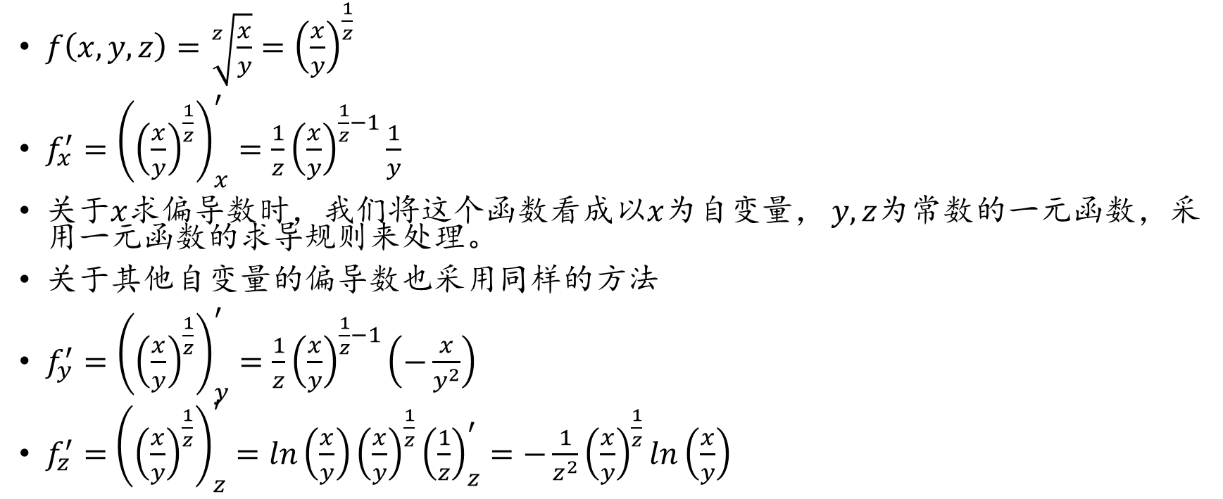
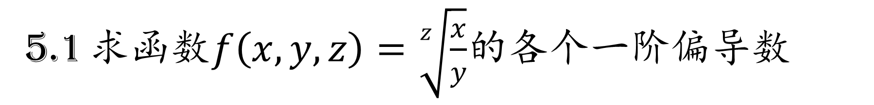
5.1 求函数$f\left(x,y,z\right)=\sqrt[z]{\frac{x}{y}}$的各个一阶偏导数
$f\left(x,y,z\right)=\sqrt[z]{\frac{x}{y}}={\left(\frac{x}{y}\right)}^{\frac{1}{z}}$
$f_{x}^{′}={\left({\left(\frac{x}{y}\right)}^{\frac{1}{z}}\right)}_{x}^{′}=\frac{1}{z}{\left(\frac{x}{y}\right)}^{\frac{1}{z}−1}\frac{1}{y}$
关于$x$求偏导数时，我们将这个函数看成以$x$为自变量， $y,z$为常数的一元函数，采用一元函数的求导规则来处理。
关于其他自变量的偏导数也采用同样的方法
$f_{y}^{′}={\left({\left(\frac{x}{y}\right)}^{\frac{1}{z}}\right)}_{y}^{′}=\frac{1}{z}{\left(\frac{x}{y}\right)}^{\frac{1}{z}−1}\left(−\frac{x}{y^{2}}\right)$
$f_{z}^{′}=$ ${\left({\left(\frac{x}{y}\right)}^{\frac{1}{z}}\right)}_{z}^{′}=ln\left(\frac{x}{y}\right){\left(\frac{x}{y}\right)}^{\frac{1}{z}}{\left(\frac{1}{z}\right)}_{z}^{′}=−\frac{1}{z^{2}}{\left(\frac{x}{y}\right)}^{\frac{1}{z}}ln\left(\frac{x}{y}\right)$

Slide 16
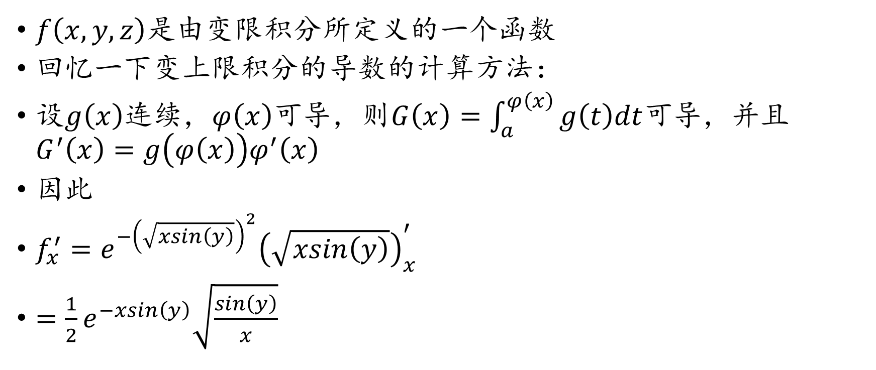
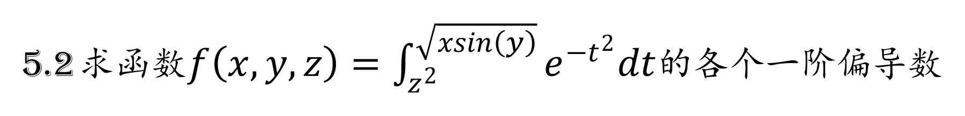
5.2 求函数$f\left(x,y,z\right)=\int_{z^{2}}^{\sqrt{xsin\left(y\right)}}{e^{−t^{2}}dt}$的各个一阶偏导数
$f\left(x,y,z\right)$是由变限积分所定义的一个函数
回忆一下变上限积分的导数的计算方法：
设$g\left(x\right)$连续，$φ\left(x\right)$可导，则$G\left(x\right)=\int_{a}^{φ\left(x\right)}{g\left(t\right)dt}$可导，并且$G^{′}\left(x\right)=g\left(φ\left(x\right)\right)φ^{′}\left(x\right)$
因此
$f_{x}^{′}=e^{−{\left(\sqrt{xsin\left(y\right)}\right)}^{2}}{\left(\sqrt{xsin\left(y\right)}\right)}_{x}^{′}$
$=\frac{1}{2}e^{−xsin\left(y\right)}\sqrt{\frac{sin\left(y\right)}{x}}$

Slide 17
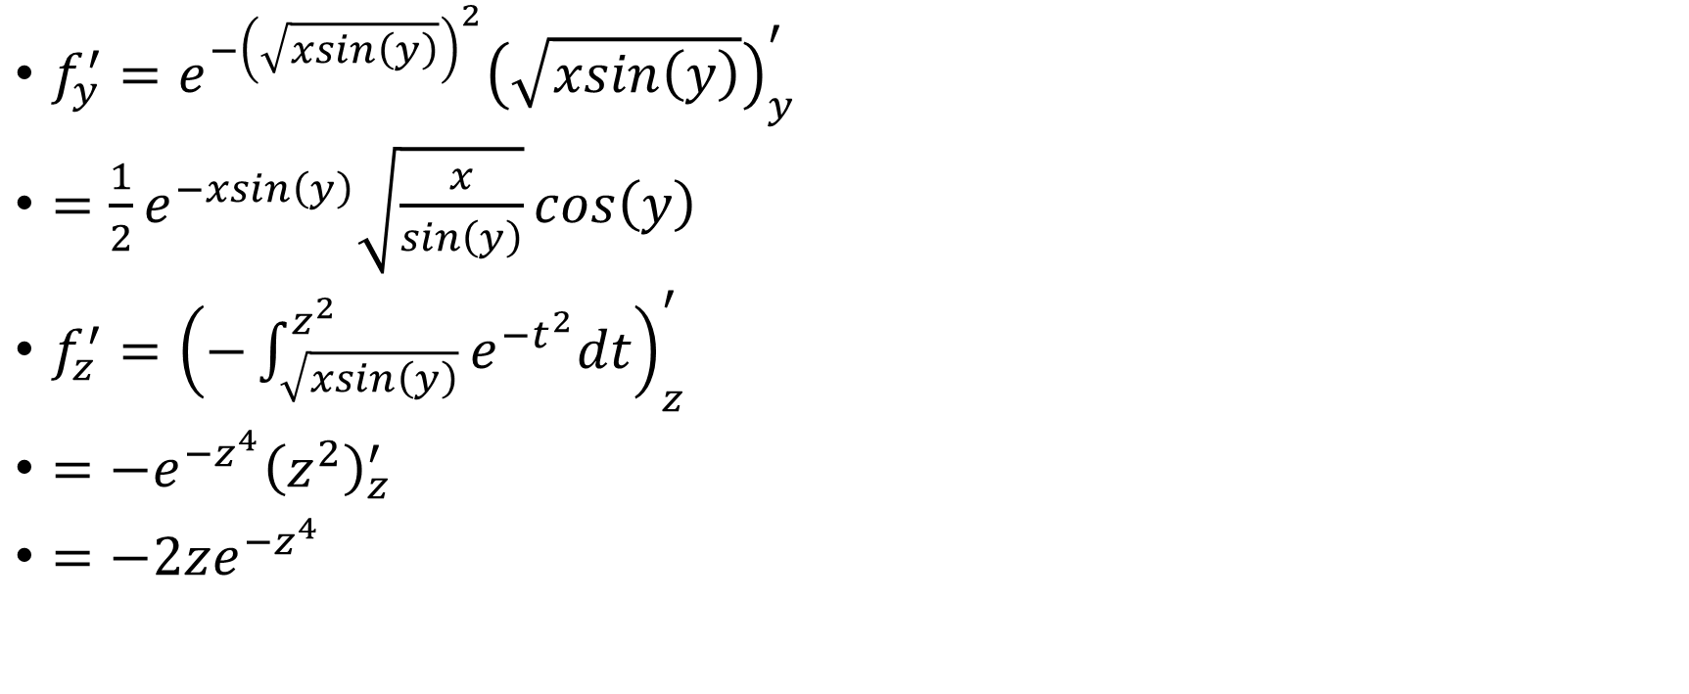
5.2 求函数$f\left(x,y,z\right)=\int_{z^{2}}^{\sqrt{xsin\left(y\right)}}{e^{−t^{2}}dt}$的各个一阶偏导数
$f_{y}^{′}=e^{−{\left(\sqrt{xsin\left(y\right)}\right)}^{2}}{\left(\sqrt{xsin\left(y\right)}\right)}_{y}^{′}$
$=\frac{1}{2}e^{−xsin\left(y\right)}\sqrt{\frac{x}{sin\left(y\right)}}cos\left(y\right)$
$f_{z}^{′}={\left(−\int_{\sqrt{xsin\left(y\right)}}^{z^{2}}{e^{−t^{2}}dt}\right)}_{z}^{′}$
$=−e^{−z^{4}}{\left(z^{2}\right)}_{z}^{′}$
$=−2ze^{−z^{4}}$

Slide 18
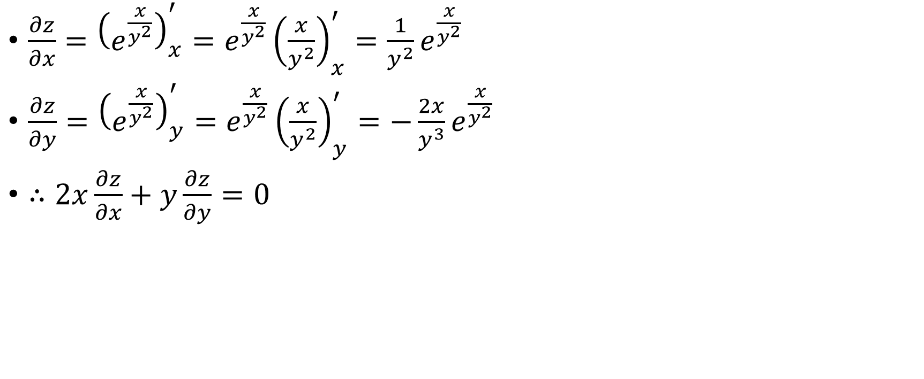
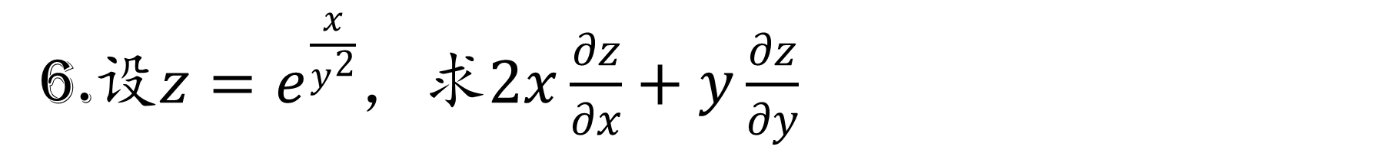
6.设$z=e^{\frac{x}{y^{2}}}$，求$2x\frac{∂z}{∂x}+y\frac{∂z}{∂y}$
$\frac{∂z}{∂x}={\left(e^{\frac{x}{y^{2}}}\right)}_{x}^{′}=e^{\frac{x}{y^{2}}}{\left(\frac{x}{y^{2}}\right)}_{x}^{′}=\frac{1}{y^{2}}e^{\frac{x}{y^{2}}}$
$\frac{∂z}{∂y}={\left(e^{\frac{x}{y^{2}}}\right)}_{y}^{′}=e^{\frac{x}{y^{2}}}{\left(\frac{x}{y^{2}}\right)}_{y}^{′}=−\frac{2x}{y^{3}}e^{\frac{x}{y^{2}}}$
$∴2x\frac{∂z}{∂x}+y\frac{∂z}{∂y}=0$

