Slide 1
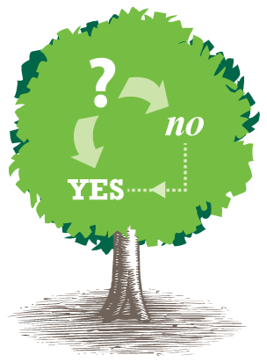
Data Science Camp
Decision Trees

Slide 2
This Lesson
Decision Trees
Random Forests
Gradient Boosting Decision Trees
Xgboost

Slide 3
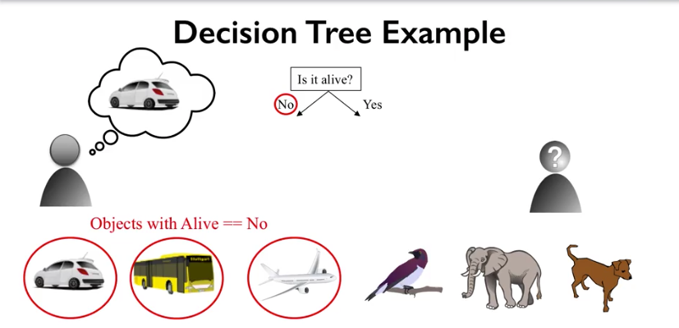
Decision Trees
Learns the series of explicit if-then rules on feature values that result in a decision that predicts the target value.

Slide 4
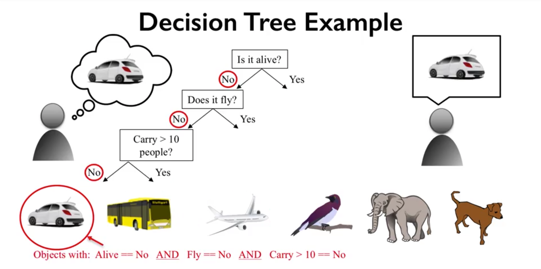
Decision Trees
Questions are prioritized by importance

Slide 5
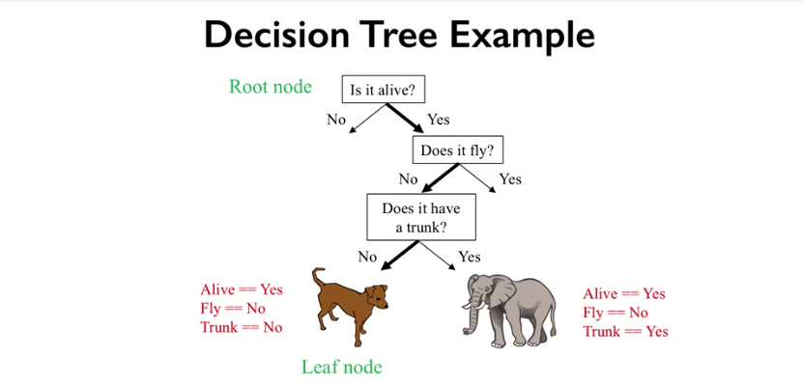
Decision Trees
Supervised algorithm allows to learn the rules automatically

Slide 6
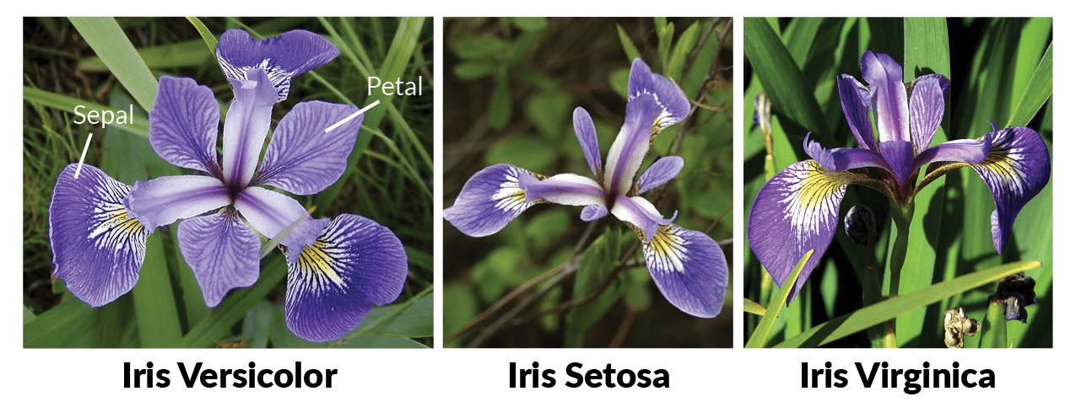
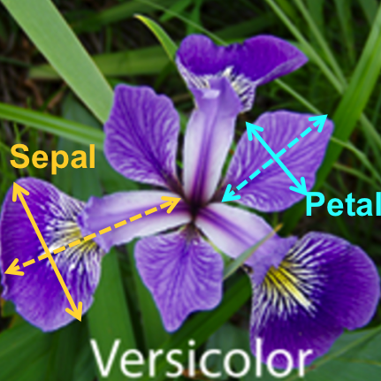
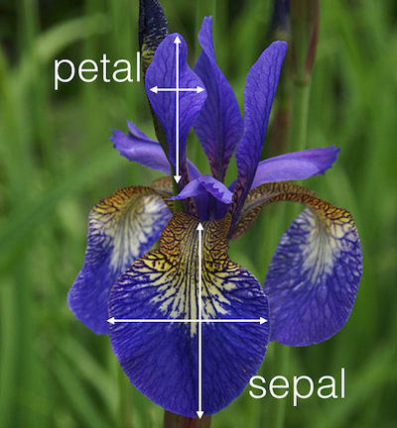
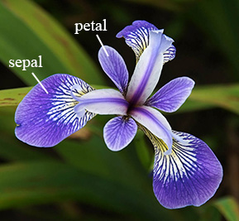
Iris Data Set
For linear regression:

Slide 7
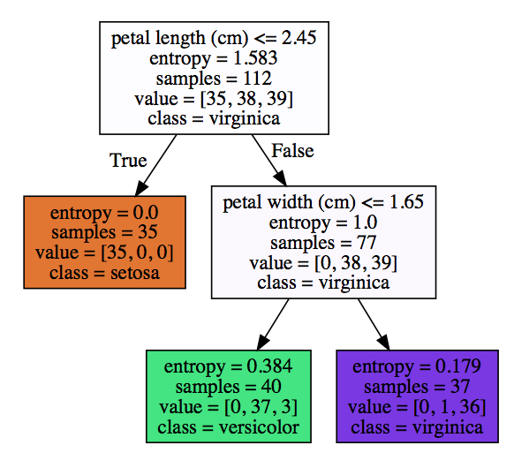
Decision Trees Splits

Slide 8
Informativeness Of Splits

Slide 9
Measure of uncertainty

Slide 10
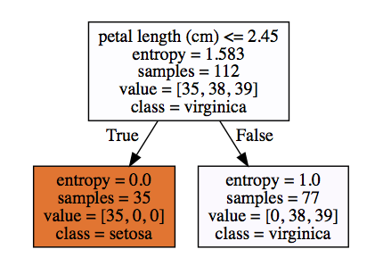
Pure and mixed nodes
Pure Node
Mixed Node

Slide 11
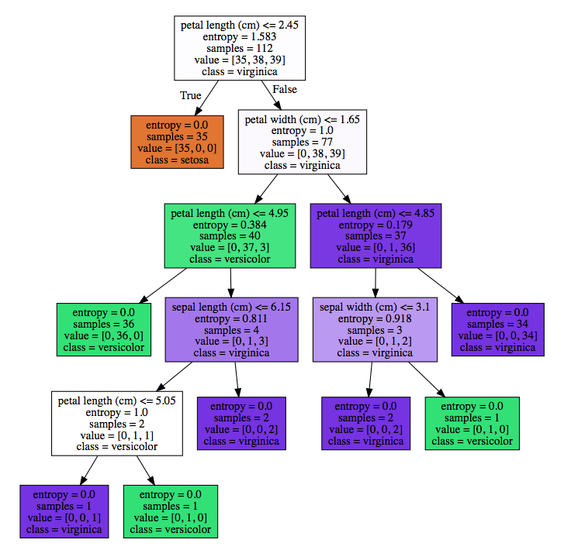
Unrestricted Learning:
Continue splitting until all nodes are pure

Slide 12
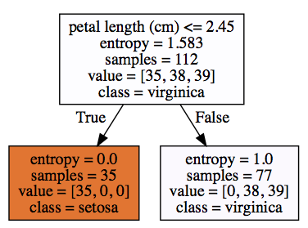
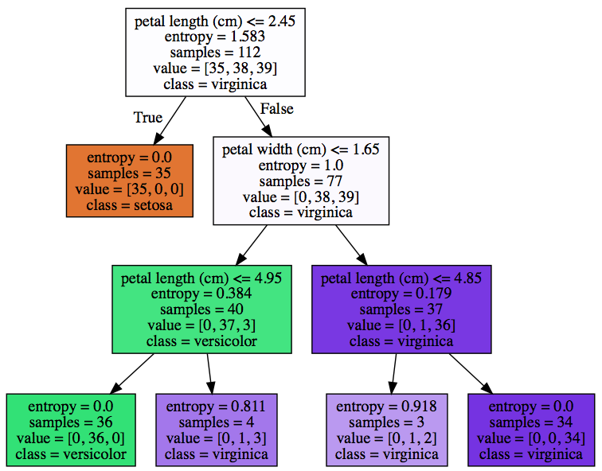
Decision Trees Overfitting
Pruning: Stop the splitting at configured max_depth
max_depth = 1 max_depth = 2 max_depth = 3
For linear regression:
max_depth = 1
train accuracy= 66.071%
test accuracy= 68.421%
max_depth = 2
train accuracy= 96.429%
test accuracy= 94.737%
max_depth = 3
train accuracy= 98.214% test accuracy= 97.368%
Unrestricted
train accuracy= 100.000%
test accuracy= 94.737%

Slide 13
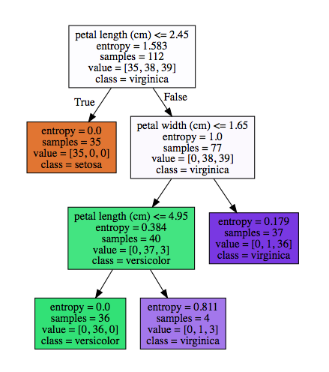
Decision Trees Overfitting
Limit the number of leaf
For linear regression:
max_leaf_nodes = 2 max_leaf_nodes = 3 max_leaf_nodes = 4
Unrestricted
train accuracy= 100.000%
test accuracy= 94.737%
max_leaf_nodes=4
train accuracy= 98.214%
test accuracy= 97.368%
Notes:
Other params to stop splitting :
min_samples_leaf
min_impurity_split

Slide 14
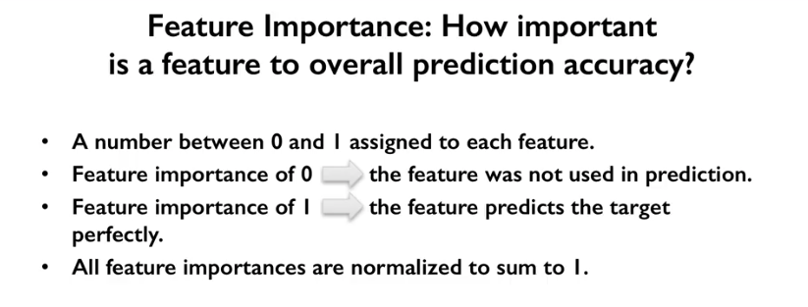

Slide 15
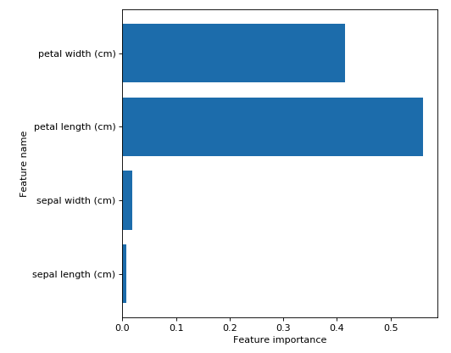
Feature Importance
Unrestricted model

Slide 16
Algorithms to build a decision tree
ID3
(Iterative Dichotomiser 3)
uses Entropy and Information Gain
as metrics.
CART
(Classification and Regression Trees)
uses Gini Index (Classification) as metric.
Other
Notes:
criterion : string, optional (default=”gini”)
The function to measure the quality of a split. Supported criteria are “gini” for the Gini impurity and “entropy” for the information gain.

Slide 17
outlook | humidity | wind | play
sunny | high | weak | no
sunny | high | strong | no
overcast | high | weak | yes
rainy | high | weak | yes
rainy | normal | weak | yes
rainy | normal | strong | no
overcast | normal | strong | yes
sunny | high | weak | no
sunny | normal | weak | yes
rainy | normal | weak | yes
sunny | normal | strong | yes
overcast | high | strong | yes
overcast | normal | weak | yes
rainy | high | strong | no
Training Set
New Sample
outlook | humidity | wind | play
rainy | high | weak | ?

Slide 18
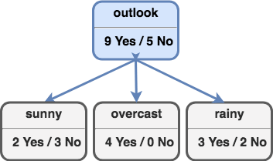
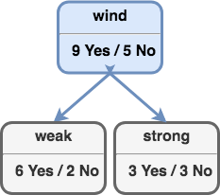
ID3 algorithm
Need to choose feature to split:
outlook | humidity | windy
Which one is the best ?
Need some measure of “purity” -> Certainty

Slide 19


Certainty
Completely certain => uncertainty (entropy) = 0
Completely uncertain => uncertainty (entropy) = 1
Expected symmetric measurement of uncertainty (entropy)
e.g. Value 0 for both “4 Yes/0 No” and “0 Yes/4 No”

Slide 20

Entropy for binary classification
S - set of examples

Slide 21

Information Gain
Information gain = loss of entropy

Slide 22

Gain calculation
Feature ‘outlook’ has the best information gain
Notes:
https://www.analyticsvidhya.com/blog/2020/06/4-ways-split-decision-tree/#:~:text=Steps%20to%20split%20a%20decision%20tree%20using%20Information%20Gain%3A,entropy%20or%20highest%20information%20gain

Slide 23
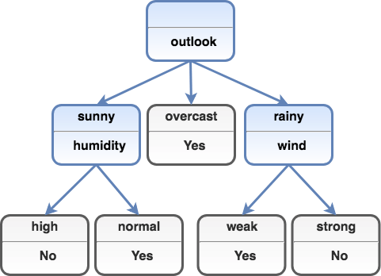
Full Decision Tree
New Sample
outlook | humidity | wind | play
rainy | high | weak | ?

Slide 24
Decision Trees Sklearn Implementation
from sklearn.tree import DecisionTreeClassifier
clf = DecisionTreeClassifier(
# criterion : ”gini”, “entropy” (default=”gini”)
random_state=0, # (default None) The best split may vary due to features are randomly permuted at each split.
# max_depth : int or None, (default=None)
# max_leaf_nodes : int or None, optional (default=None)
).fit(X_train, y_train)
print("train accuracy= {:.3%}".format(clf.score (X_train, y_train)))
print("test accuracy= {:.3%}".format(clf.score (X_test, y_test)))

Slide 25
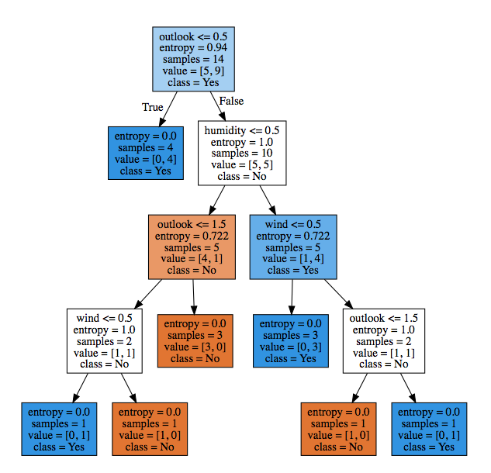
Tennis dataset

Slide 26
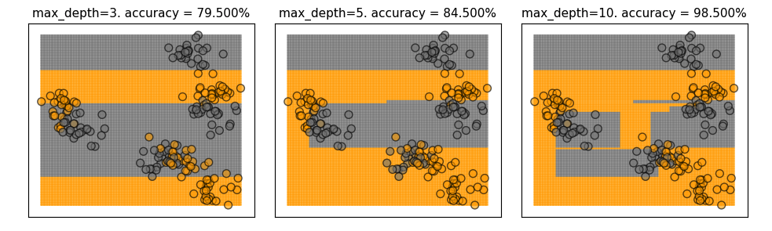
Synthetic dataset Decision Boundary
X_mk8, y_mk8 = make_blobs(n_samples = 200, n_features = 2, centers = 8,
cluster_std = 1.3, random_state = 4)
y_train = y_mk8 % 2

Slide 27
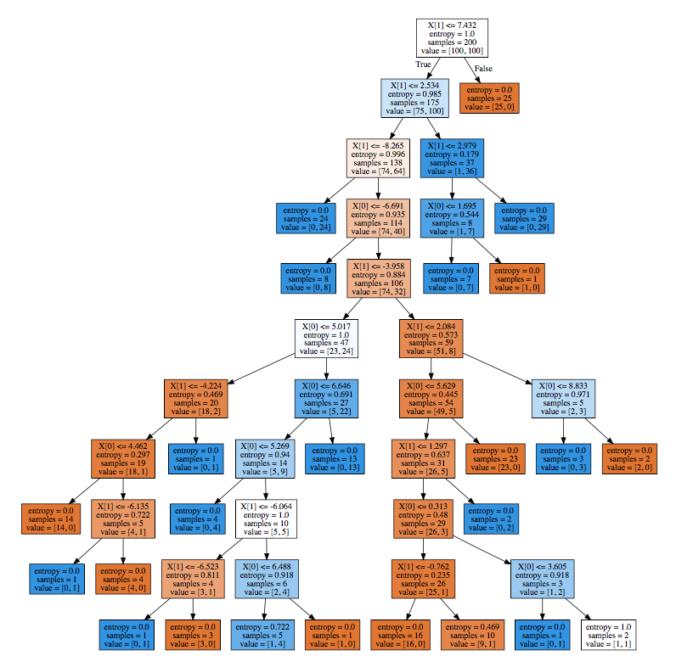
Synthetic dataset Decision Tree

Slide 28
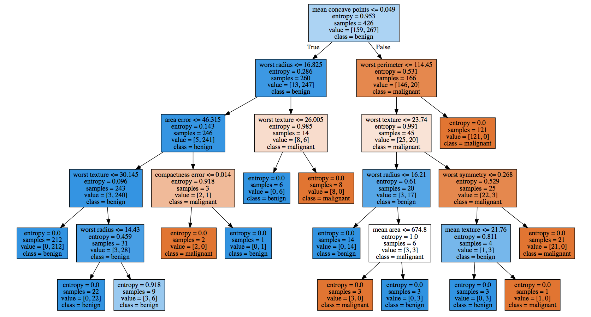
Load_breast_cancer -> Home Task

Slide 29
Decision Trees Pros And Cons
Pros
Easily Visualized and interpreted
No feature normalization needed
Works well for mixture feature types
Cons
Cannot capture complex relation between features
Not good choice for high-dimensional data
Comparing with linear models

Slide 30
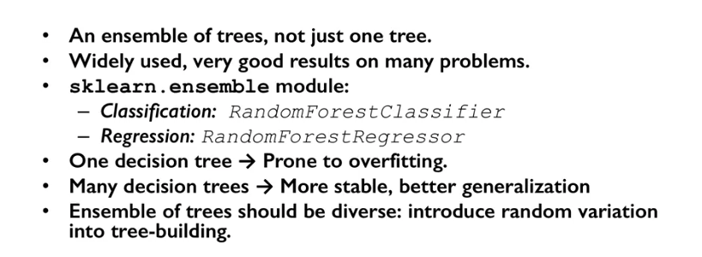
Random Forests
For linear regression:

Slide 31
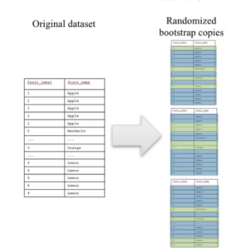
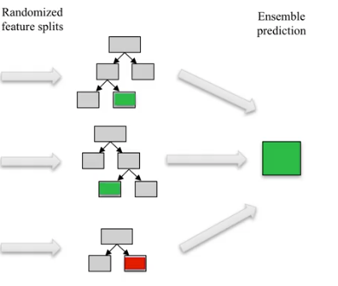
Random Forest Process
Smaller max_features => more diverse trees => more complex random forest Larger Larger max_features => more similar trees => more simple random forest
For linear regression:
max_features
n_estimators

Slide 32
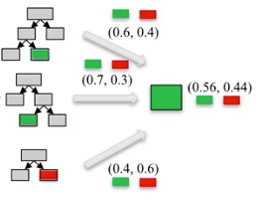
Prediction by Random Forest
STEP 1
STEP 2
STEP 3
Compute prediction by every tree
Compute average
Select the highest probability class

Slide 33
Random Forest Sklearn Implementation
from sklearn.ensemble import RandomForestClassifier
clf = RandomForestClassifier(
# n_estimators: default = 10
# max_features: default “auto” => sqrt(n_features), None => n_features
# max_depth: default = None,
# n_jobs=None,
random_state= 0
).fit(X_train, y_train)
n_estimators
max_features
n_jobs

Slide 34
Random Forests Pros and Cons
Pros
Great performance
No feature normalization needed
Works well for mixture feature types
Cons
Difficult to interpret
Not good choice for high-dimensional data comparing with linear models

Slide 35
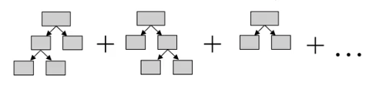
Gradient Boosting Decision Trees
Iterative process to build series of shallow (week ) trees
learning_rate
clf = GradientBoostingClassifier(
learning_rate=0.01, # (default=0.1) larger value -> more complex trees
max_depth=3, # (default=3)
# n_estimators= 10, (default=100)
).fit(X_train, y_train)

Slide 36
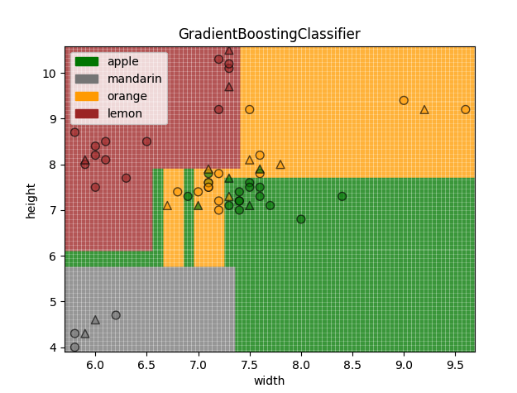
Fruits dataset 2D
train accuracy= 95.455%
test accuracy= 80.000%

Slide 37
XGBoost
Extremely fast gradient boosting modifications that allows to apply L1 and L2 regularizations
reg_alpha : L1 regularization
reg_lambda : L2 regularization
from xgboost import XGBClassifier
clf = XGBClassifier() .fit(X_train, y_train)

Slide 38
Home Task
Use load_breast_cancer
and classify with:
Decision Trees
Random Forest
GBDT
XGBoost

Slide 39
Learn more
Applied Machine Learning in Python
https://www.coursera.org/learn/python-machine-learning
Chapter 4: Decision Trees Algorithms
https://medium.com/deep-math-machine-learning-ai/chapter-4-decision-trees-algorithms-b93975f7a1f1
Decision Tree (video tutorial)
https://www.youtube.com/playlist?list=PLBv09BD7ez_4temBw7vLA19p3tdQH6FYO
sklearn.tree.DecisionTreeClassifier
https://scikit-learn.org/stable/modules/generated/sklearn.tree.DecisionTreeClassifier.html#sklearn.tree.DecisionTreeClassifier
sklearn.ensemble.GradientBoostingClassifier
https://scikit-learn.org/stable/modules/generated/sklearn.ensemble.GradientBoostingClassifier.html
xgboost
https://xgboost.readthedocs.io/en/latest/
Notes:
All home task text is provided in handouts

Slide 40
THANKS!
Any questions?

