Slide 1
House Renting System

Slide 2
House Renting Project
Introduction:
The House Renting Project aims to create an efficient platform for house owners and potential tenants to interact, manage, and facilitate rental transactions seamlessly.
The platform allows property owners to list their available properties, while customers can search for, browse, and rent houses based on their preferences.

Slide 3
Object-Oriented Programming (OOP) principles to design and implement the solution. These principles help make the system modular, scalable, and maintainable.
Here’s a breakdown of the key OOP principles we used:
Encapsulation
Encapsulation is the bundling of data (variables) and methods that operate on the data within one unit (class). It also restricts direct access to some of an object's components.
Abstraction
Abstraction involves hiding the complex implementation details and providing only essential features or interfaces.

Slide 4
cont...
Inheritance
Inheritance allows a class to inherit methods and properties from another class. It helps in creating a hierarchical relationship between classes.
Polymorphism
Polymorphism allows objects to be treated as instances of their parent class.
It provides the ability to call the same method on different objects, and each one responds differently.

Slide 5
Project Overview
Create a platform for house owners to list their properties:
Allow customers to search, rent, and manage house rentals
Key Features:
Admin Control for Managing Houses and Users:
The admin has full control over the system, including approving or rejecting house listings, managing customer accounts, and ensuring that the system functions smoothly. Admins can also view reports and analytics on rented houses and user activity.

Slide 6
cont...
Customer Registration and Login:
Customers can create an account by registering with a name, email, password, and role. The system will securely store passwords Once registered, customers can log in to manage their accounts and interact with the platform.
Property Listing and House Rental:
Owners or admins can list properties on the platform by providing details such as location, rent price, type, and status. Customers can search through available listings, and upon finding a suitable property, they can rent it. Once rented, the house status is updated, and customers can view the rental details.

Slide 7
Key Elements in the House Renting
Admin, Owner, Customer: These represent the users of the system, each interacting with the system via a user interface.
User Interface: The interface through which users interact with the application.
Application Logic : Handles the core functions like registration, house listing, rental operations, and user management.

Slide 8
Database Schema
The structure of the three main tables in the database that support the core functionalities of the House Rental System: Houses, Customers, and Rentals. Each table contains relevant columns that store data for houses, users, and rental transactions.

Slide 9
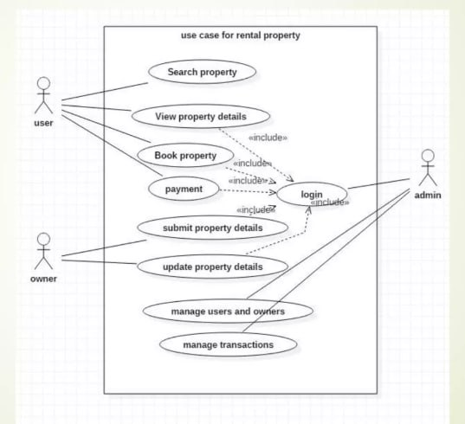
Usecase diagram

Slide 10
Design Patterns: Singleton, Factory, Observer
Design patterns are proven solutions to common problems in software design. an explanation of the Singleton, Factory, and Observer design patterns and how they can be applied to the House Rental System project.

Slide 11
Factory Pattern
The Factory design pattern defines an interface for creating objects, but it allows subclasses or other classes to decide which class to instantiate. This pattern is used to create objects without specifying the exact class of object that will be created.
Use Case in House Rental System:
In the House Rental System, a House Factory can be used to create different types of houses (e.g., Apartment, Villa, Townhouse). Each type of house can have its own set of properties, but they all share a common interface. The HouseFactory will decide which type of house to create based on input parameters (like house type).

Slide 12
Observer Pattern
The Observer design pattern is used when an object (known as the subject) changes its state, and it needs to notify all dependent objects (known as observers) about the change. This is particularly useful in event-driven systems where multiple parts of the system need to react to state changes.
Use Case in House Rental System:
In the House Rental System, an Email Notification System could be implemented using the Observer pattern. For example, when a house is rented, the system can notify relevant users (admin, owner, customer) about the rental status. Each user is an observer of the rental status changes.

Slide 13
Singleton Pattern
The Singleton design pattern ensures that a class has only one instance and provides a global point of access to that instance. This is particularly useful when you want to restrict the instantiation of a class to a single object (e.g., a configuration manager or a database connection).
Use Case in House Rental System:
In the House Rental System, the Database Connection Manager can be implemented as a Singleton. Since there should only be one instance of the database connection to manage connections and queries, the Singleton pattern ensures that no additional instances of the connection manager are created.

Slide 14
conclusion
The House Rental System is designed to streamline the process of house rentals by facilitating the following:
House Listing: Owners can easily list their properties with essential details like location, rent price, and type.
Search and Rent: Customers can search for houses based on location, price range, and type, and rent them easily.
Admin Control: Admins manage house listings and user activities to ensure smooth operation of the platform.
Security and Authentication: The system provides secure login for users, ensuring that only authorized individuals can access the platform.

