Slide 1
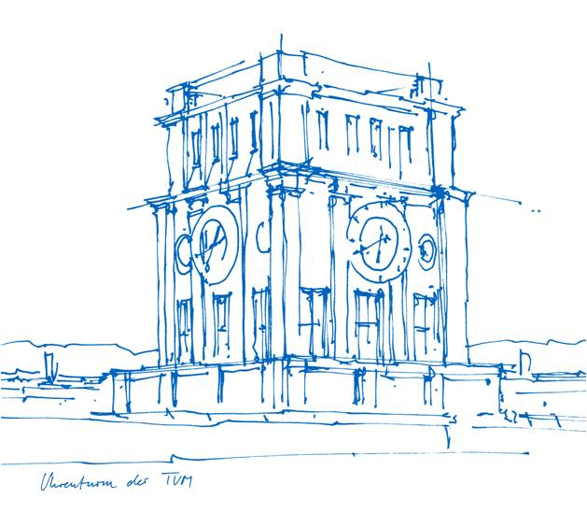
Maze Walker
Nicolas Otremba, Sahin Er, Viola Stumpf, Jay Kapadia
Technische Universität München
Fakultät für Informatik
Lehrstuhl für Mustertechnik
München, 08. Februar 2019

Slide 2
Outline
Portals
Snow
Footprints
Falling snow
Fog
Particle system
Dissolve

Slide 3
Portals
Two cameras per direction
    Distance rendering
    Portal view rendering
Position calculation in C#

Slide 4
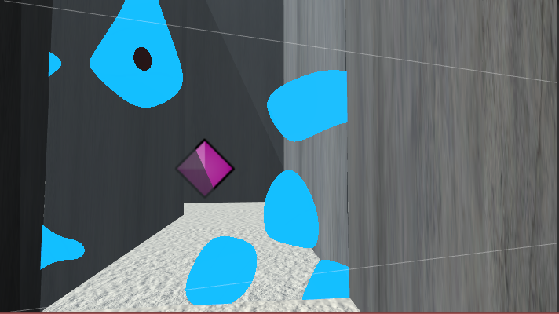
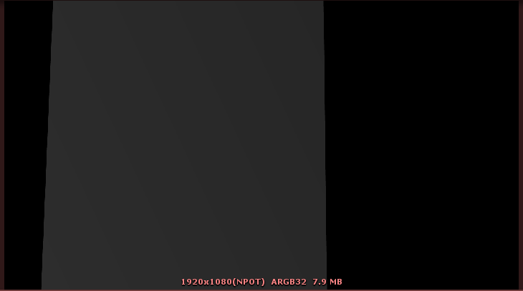
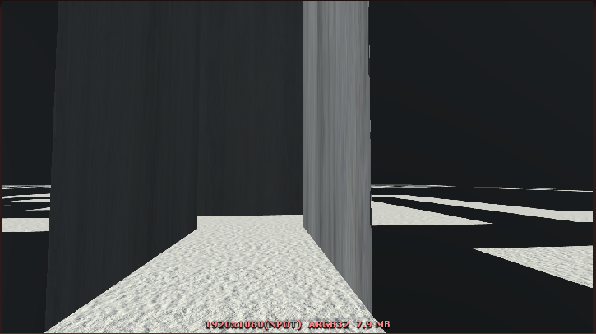
Main Camera
Depth Camera
Portal Camera

Slide 5
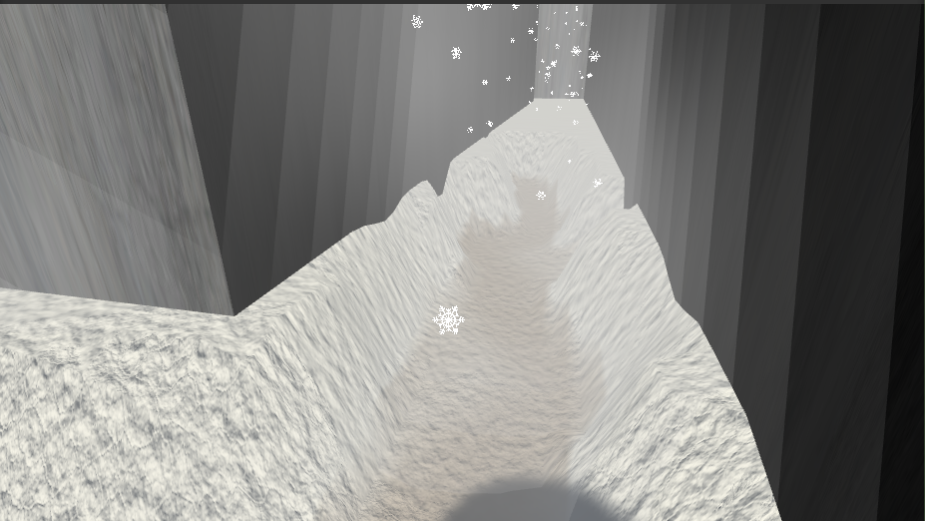
Snow
Surface Shader with Vertex Shader
Vertices displaced depending on the
Texture
Colored after hitting a threshold
Interpolated color at height differences

Slide 6
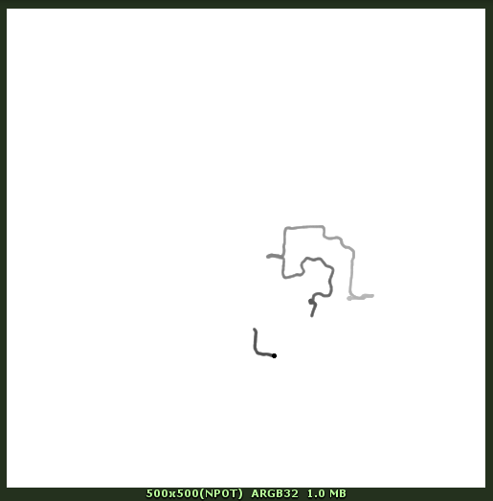
Snow - Footsteps
Texture generated with cs script
Values (1,0)
Shader updates Texture every 0,2 seconds
Snow increases with Time
Another shader sets Value to 0 at player Pos

Slide 7
Falling Snow
Particle system
Compute shader
    Velocity and position update
    Boundary conditions
Width radius

Slide 8
Falling Snow
(1,0)
(1,1)
Geometry shader
    Quad directing towards the camera
    Map texture coordinates
Fragment shader
    Map transparent texture
(0,0)
(0,1)

Slide 9
Fog
Last in render queue
Noise to vary fog density
Alpha value is influenced by a predetermined float in the material

Slide 10
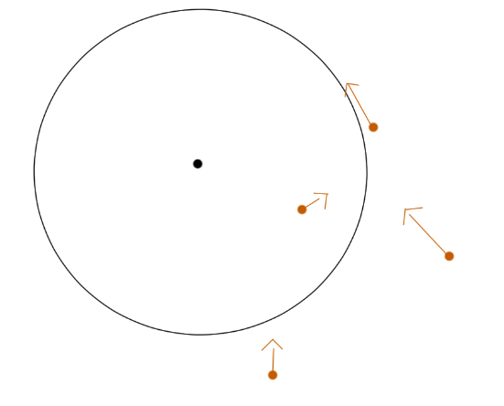
Particle System
Compute Shader
    Particle movement depending on center
    Steering to reach target velocity
Particle rendering
    Interpolation between two colors
    Line drawing

Slide 11
Dissolve
Calculate distance from player to portal
Player position as threshold for dissolving
Glowing border near dissolve

