Slide 1

Cybersecurity Chatbot – TrustBot Your Trusted Bot for Safe Searching

Slide 2
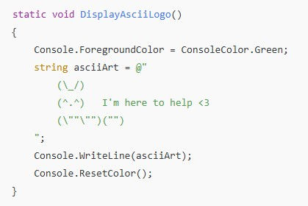
Key Features of TrustBot
Let’s examine its attributes and the process of its construction: 1. Voice Greeting: Greets users with a pre-recorded announcement. 2. ASCII Art Presentation: Displays an awesome ASCII logo during startup. 3. User Engagement: Users have the ability to inquire about cybersecurity topics. 4. Input Verification: Confirms significant input prior to replying. 5. Improved UI Effects: Typing animation to make replies more captivating. 6. Security Principles: Responds to inquiries regarding subjects such as malware, firewalls, encryption, and others.

Slide 3
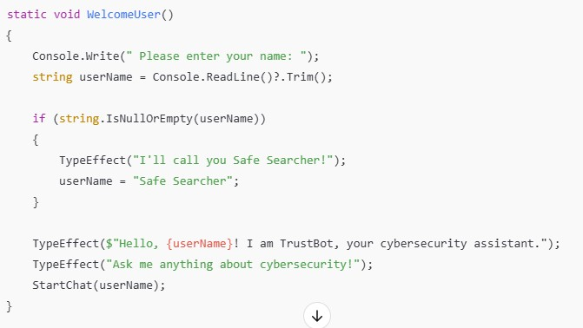
How TrustBot Works:
TrustBot begins with an ASCII logo and a welcome message for the user.
It subsequently requests the user's name and customizes replies.
The chatbot consistently engages with users and offers cybersecurity guidance based on identified keywords.
Users can enter keywords such as “firewall,” “malware,” or “password” to receive security advice.
If the input is not identified, TrustBot urges the user to inquire about something different.

Slide 4
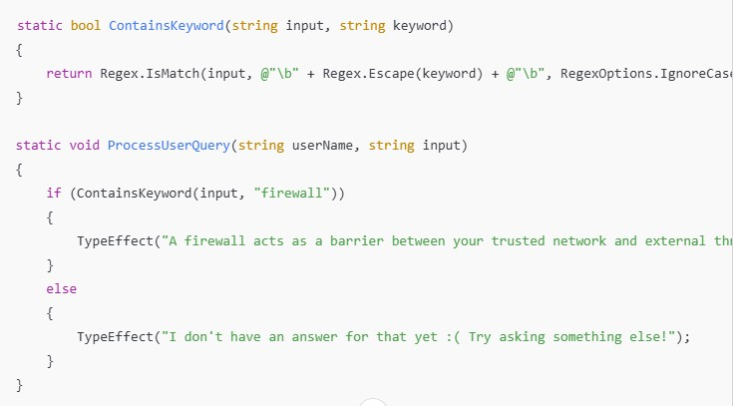
Handling User Queries
TrustBot monitors for particular keywords and replies with pre-set cybersecurity descriptions
.Employs Regular Expressions (Regex) to identify keywords in user input.
Delivers instructional material on cybersecurity topics such as phishing, malware, and encryption.
If an unrecognized keyword is typed in, TrustBot prompts the user to ask a different question

Slide 5
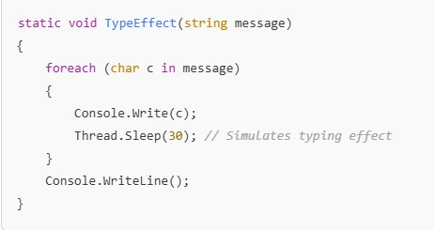
Special Effects – Speech & Typing
TrustBot has a voice synthesis function that plays a welcoming audio file.
It includes a typing effect to mimic a chatbot experience that feels human-like.
These impacts boost user involvement and create more organic interactions.

Slide 6
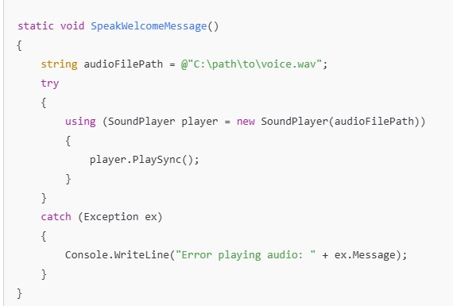
Voice Greeting Feature
TrustBot greets users by playing an audio file.
It employs the System.Media.SoundPlayer class to play a .wav file
If a mistake happens, the bot notifies the user.

Slide 7
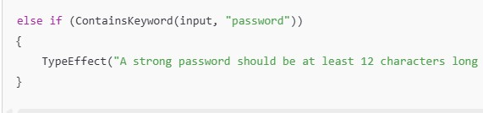
Security Topics Covered
TrustBot offers guidance on a range of security issues, such as: 🔹 Phishing – Recognizing and steering clear of fraudulent emails. 🔹 Firewalls – Safeguarding devices against unauthorized entry.
🔹 Encryption – Safeguarding personal information. 🔹 Malware & Ransomware – Stopping and addressing outbreaks. 🔹 Two-Step Verification (2SV) – Introducing an additional level of protection.

Slide 8
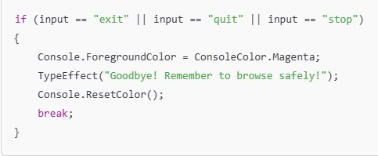
Error Handling and Exit Option
TrustBot addresses invalid entries by asking the user to submit a correct query again.
The chatbot enables users to leave by entering “exit,” “quit,” or “stop.”
If a command that is not recognized is input, TrustBot replies courteously.

