Slide 1
ReadUs
February 18 2020

Slide 2
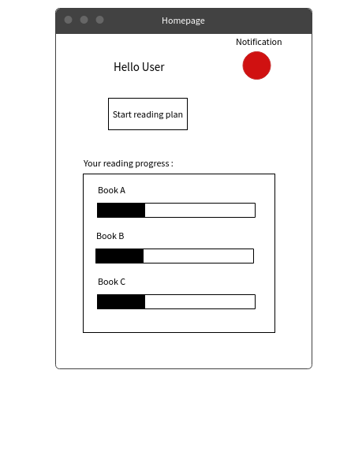

Slide 3
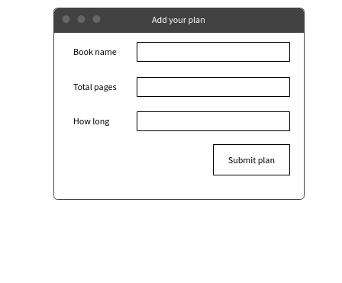

Slide 4
