Slide 1
Kitsune: An Ensemble of Autoencoders for Online Network Intrusion Detection
Group Members：Yuan Xiaojian、Yang Zizhen、Yang Wei

Slide 2
Existing Problems of NIDS based on ANN ??
Traditional NIDS：deployed at a single point in the gateway. (problems?)
=>However, Distributed NIDS are typically deployed directly on simple routers for better scalability.
This is not feasible in NIDS based ANN：
Offline Processing: To train the model, all tagged instances must be available locally, and an hour's traffic can contain millions of packets.
Supervised Learning: It takes a lot of manpower and resources to label. And in the face of constantly shifting attacks, it may be impractical to maintain a malicious attack traffic repository on a continuous basis
High Complexity: A simple router cannot provide enough memory or processing power to train a complex ANN.

Slide 3
What did the author do??
（1）Offline Processing → Online Processing
Online processing is done in a manner similar to stream clustering.
The instances are discarded immediately after the training or executing the model.
Author designed a framework to extract features quickly from dynamic data streams, and the complexity of the sliding window model is high, so the damped incremental statistics is adopted.
(In the damped window model, the weight of the old value decreases at any time.)

Slide 4
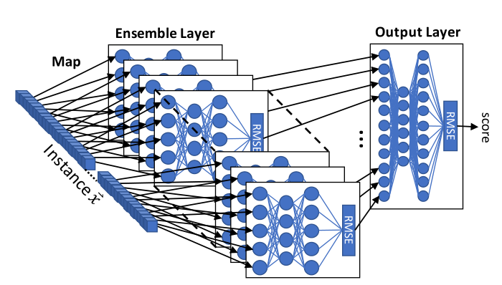
What did the author do??
（2） Supervised Learning → Unsupervised Learning
The author proposes an unsupervised anomaly detection algorithm based on integrated autoencoder called KitNET.
Parameter m: The maximum number of inputs per autoencoder in the integration.(used to balance the detection speed and performance)

Slide 5
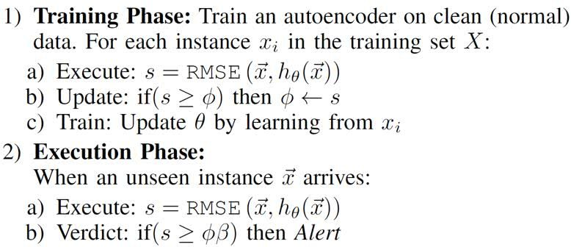
The training data only contains normal network packets.
The goal of the training is that the RMSE of input and output is less than the set threshold.
For the new sample, if the RMSE is greater than the set threshold, it will be judged as an abnormal sample, and the system will issue a warning

Slide 6
What did the author do??
（3）High Complexity → Low Complexity
The packet processing rate must exceed the expected maximum packet arrival rate,
to ensure that there is no waiting packet queue.
Kitsune can increase the packet processing rate by up to five times and provide detection performance comparable to offline (batch) anomaly detectors

Slide 7
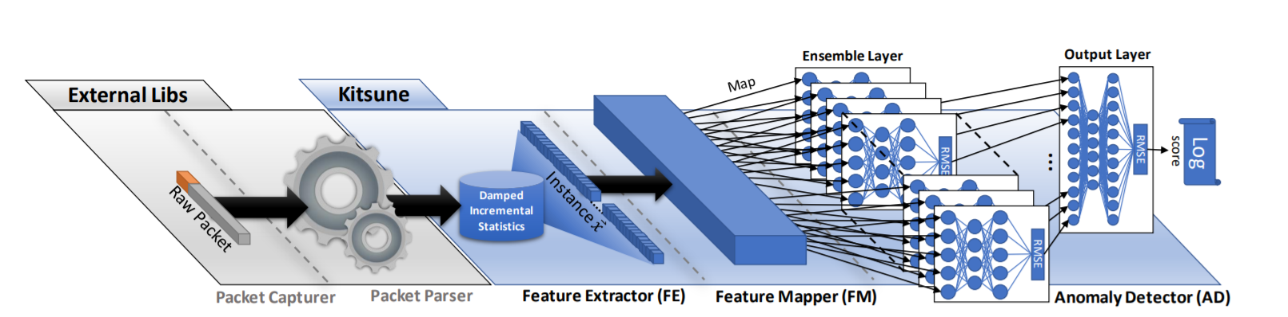
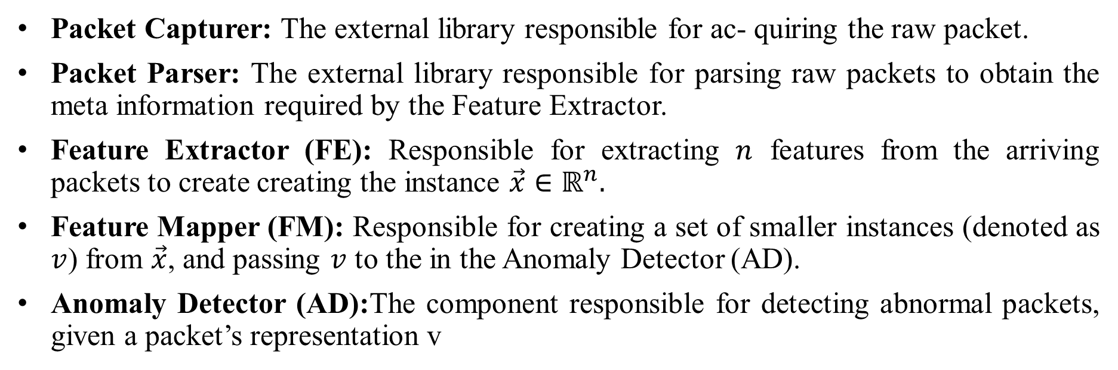
What is Kitsune??
Packet Capturer: The external library responsible for ac- quiring the raw packet.
Packet Parser: The external library responsible for parsing raw packets to obtain the meta information required by the Feature Extractor.
Feature Extractor (FE): Responsible for extracting $n$ features from the arriving packets to create creating the instance $\vec{x}∈ℝ^{n}.$
Feature Mapper (FM): Responsible for creating a set of smaller instances (denoted as $v$) from $\vec{x}$, and passing $v$ to the in the Anomaly Detector (AD).
Anomaly Detector (AD):The component responsible for detecting abnormal packets, given a packet’s representation v

Slide 8
The working process of Kitsune
(1) The Packet Capturer first needs to capture the binary network packet and pass it to the Packet Parser.
(2) The Packet Parser parses the packet's basic information, such as packet arrival time, packet size, and network address, and passes this information to the FE module.
(3)The FE extracts the statistical information of network packets (a total of 115 dimensional features) to represent network packets.
(4) The FM groups the features. Each group of features reflects a class of characteristics of network packets, and trains a separate AutoEncoder for each group of features.
(5) Finally, integrates the output of each AutoEncoder as a new input for AD, and trains another AutoEncoder as the final exception detector

Slide 9
What are the problems that still exist??
When first installed, Kitsune assumes that all traffic is benign while in train-mode.
→A pre-existing opponent may be able to escape the detection of kitsune.
(2) Another threat to Kitsune is a DoS attack launched against the FE.
→ An attacker sends a large number of packets with random IP addresses, causing FE to create many incremental statistics and thus consume a large amount of memory.

Slide 10
What are we going to do??
Continue to collect relevant information, learn the theoretical basis of ANN, in-depth understanding of the article.
According to the author's thinking, we try to code and simulate the core anomaly detection algorithm KitNET.
Simplify the Kitsune implementation process and try to apply KitNET to abnormal traffic detection.
Think about the problems that still exist and see if we can come up with a solution.

Slide 11
Thanks For Listening

