Slide 1
Context & Objective
Sales Perfomance Analysis – Superstore Dataset
Dataset: Superstore Sales
Period: 2015-2018
Goal: Analyze revenue performance, customer behavior and sales trends (2015-2018)
Leticia Gomes Silva e Silva • 2026 Tools: SLQ • Power Bi

Slide 2
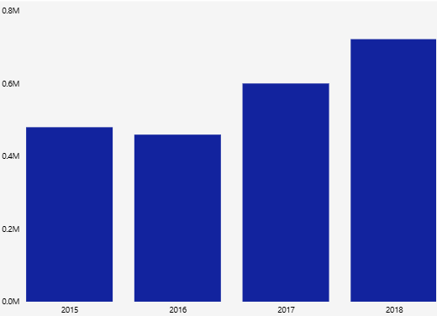
Revenue & Performance
Key Questions
How much revenue does the company generate?
Which categories drive the most revenue?
How has revenue evolved over time?
Key Findings
Total Revenue (2015-2018): 2.26M
Revenue showed overall growth, peaking in 2018
Technology is the top revenue category
Average order value slightly decreased over the period

Slide 3
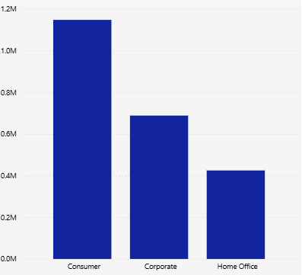
Customer Behavior
Key Questions
How are the main customers?
Which segments and regions drive revenue?
Key Findings
Total of 793 unique customers
Consumer segment dominates revenue
West region is the strongest market
Average spend per customer: 2,851.87

Slide 4
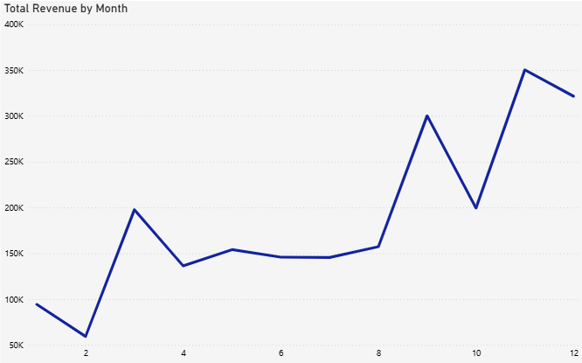
Sales Trends & Seasonality
Key Questions
How do sales evolve over time?
Is there seasonality?
Key Findings
Strong concentration of sales in Q4 (Oct-Dec)
December is the best month
Clear seasonal pattern observed
Revenue growth accelerated after 2016

Slide 5
Business Insights & Recommendations
Revenue Growth
Focus marketing efforts during Q4 peak season
Explore revenue growth opportunities in the South region
Customer Strategy
Strengthen retention strategies in the Consumer segment
Operational Efficiency
Optimize inventory planning based on seasonal demand
Reevaluate low-performing products

Slide 6
Project Summary
End-to-end sales analysis using SQL
Data cleaning, validation and transformation performed
Business analysis structured into Revenue, Customers and Time
Insights prepared for visualization and business decision-making
Dashboard developed in Power BI for visualization
Dataset: Superstores Sales | Tools: MySQL Full SLQ queries available upon request

Slide 7
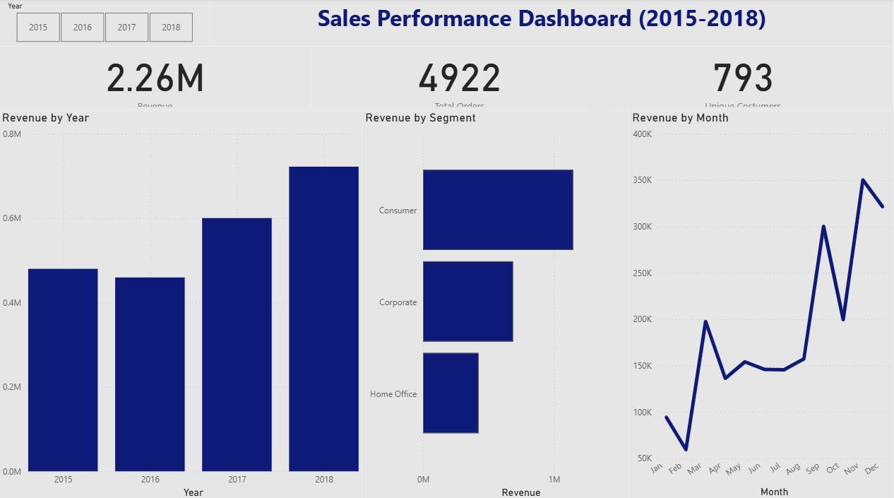
Interactive dashboard developed in Power BI to support dynamic business analysis

