Slide 1

ShockMarket - AI-Powered Virtual Power Plant
Intelligent Battery Energy Storage for Grid Optimization

Slide 2

MARKET CHALLENGE
India's Grid Volatility Crisis
Growing Renewable Integration
The Opportunity
Market volatility = profit potential while supporting grid reliability
Solar and wind capacity expansion creates unprecedented price volatility in power markets
Demand-supply imbalance arbitrage
Ancillary services revenue
Day-Ahead Market (DAM) price swings
Grid stabilization support
Real-Time Market (RTM) fluctuations
Grid stability challenges

Slide 3






OUR SOLUTION
Intelligent Energy Storage Arbitrage
100 MWh BESS
Large-scale battery energy storage system for market participation
IEX Market Trading
Dual participation in DAM & RTM markets
ML Price Forecasting
Advanced algorithms predict optimal trading windows
Smart Dispatch
Buy low, sell high while maintaining grid reserves
Revenue generation through intelligent arbitrage + ancillary grid services

Slide 4




SYSTEM ARCHITECTURE
Data-Driven Trading Pipeline
IEX Market Data
ML Models
Real-time price feeds
Price & demand forecasting
Trading Signals
Battery Dispatch
Buy/sell decisions
Charge/discharge control
Core Components
Price Forecasting Engine
Dispatch Optimizer
Python, XGBoost
Demand Prediction System
RESTful API Layer
Flask, React Dashboard

Slide 5

Battery System Specifications
100
25
95%
20%
MWh Capacity
MW Power
Efficiency
Min SOC
Total energy storage
Max charge/discharge rate
Round-trip energy retention
Grid stability reserve
80
MWh Usable
Per trading cycle
Grid Reserve Protocol: 20% minimum State of Charge maintained at all times for emergency grid stabilization services

Slide 6


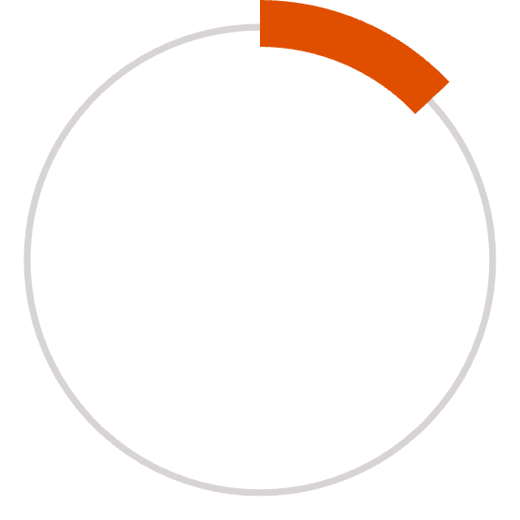
FORECASTING ACCURACY
ML-Powered Price Prediction
XGBoost Models
Separate regression models for each market segment
Key Features
22%
Time of day patterns
Day of week seasonality
Historical price lags
Demand forecasts
DAM MAPE
Prediction Scope
Day-Ahead Market prediction error
96 time blocks (15-min intervals) forecast daily
13%
RTM MAPE
Real-Time Market accuracy

Slide 7
MARKET STRATEGY
Dependency Flow: DAM Price Forecasting Pipeline
01
02
03
Input Data Sources
Demand Forecasting Model
Solar Forecasting Model
Weather Data • Calendar Data • Historical Demand • Historical Solar Generation • Historical Wind Generation • IEX DAM Market Data
Inputs: Weather + Calendar + Demand Lags → Output: Demand Forecast (15-min blocks, next day)
Inputs: Weather + Solar Lags → Output: Solar Generation Forecast (15-min blocks)
04
05
06
Wind Forecasting Model
Total Generation Calculation
Net Load Calculation
Inputs: Weather + Wind Lags → Output: Wind Generation Forecast (15-min blocks)
Formula: Solar Forecast + Wind Forecast
Formula: Demand Forecast − Total Generation Forecast
07
DAM Price Forecasting Model
Inputs: Net Load • Time Block • Hour • Historical DAM Prices (Lag-96, Lag-672) • Final Scheduled Volume → Output: DAM Price Forecast (₹/MWh)

Slide 8


