Slide 1
Regular Expressions (2) Optimization & SMS Speak
Letitia Etsebeth 15597601

Slide 2
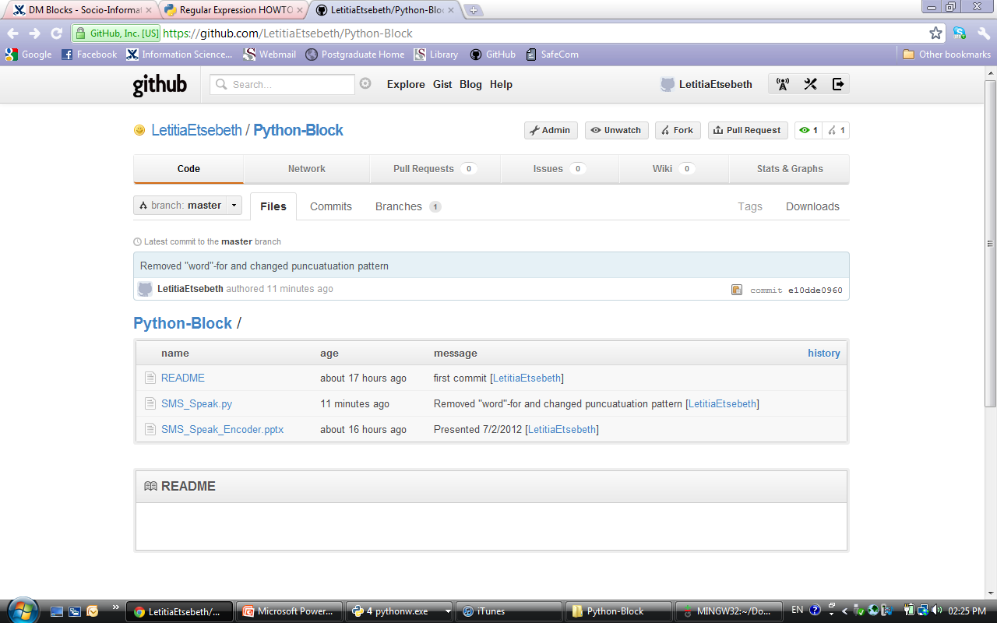
Source Control

Slide 3
Optimizing Code
Changes:
Added a single re for removing Punctuation & Vowels
Refrained from splitting the words and the resulting for-loop
Removed the doubles search and if statement
Add the time
Import time module
time.clock()

Slide 4
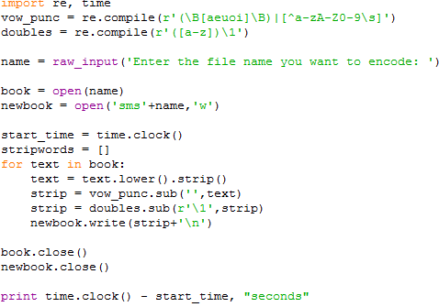
Code…

Slide 5
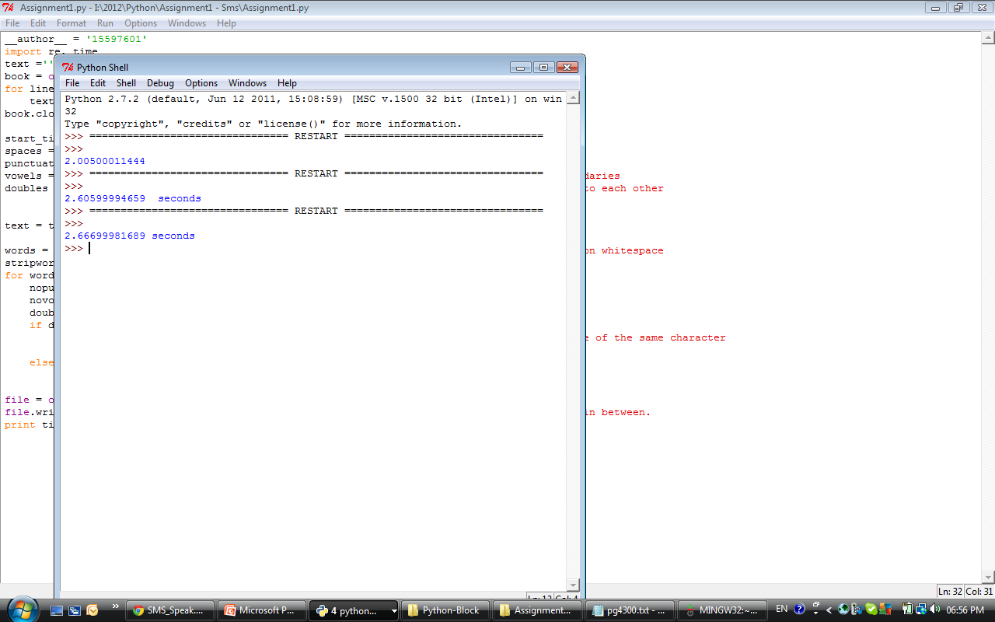
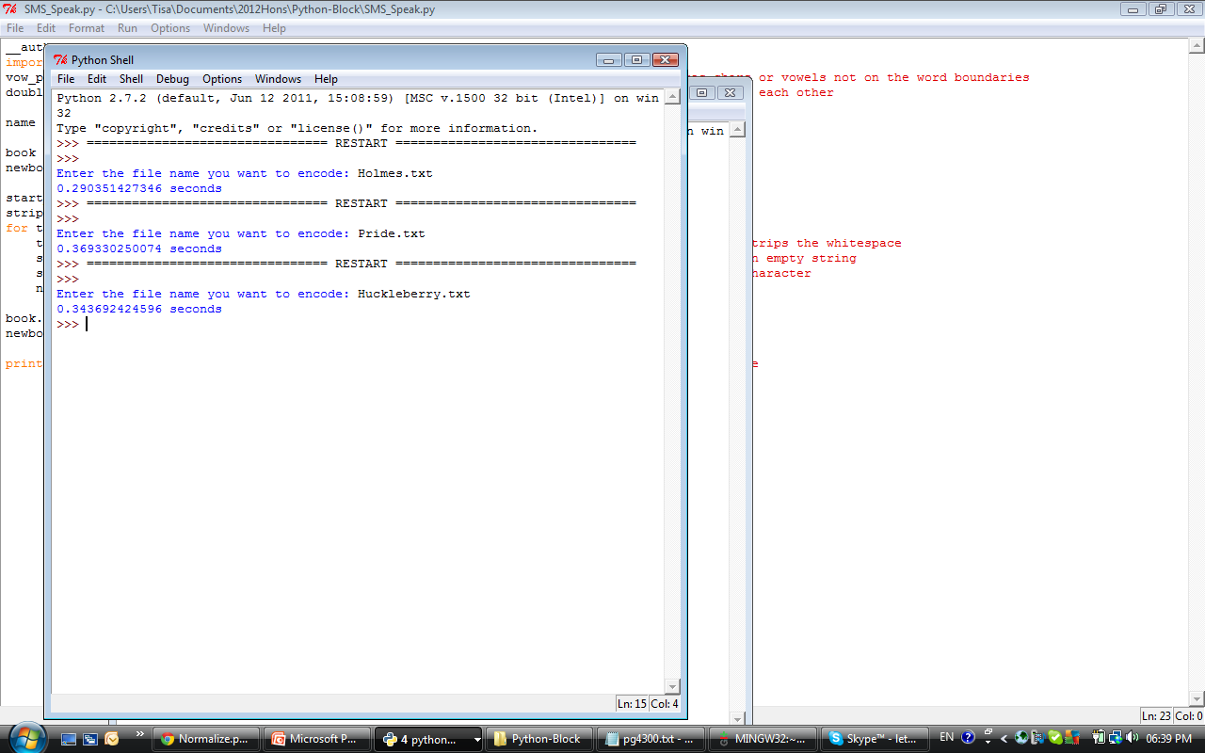
Time Improvement:
The Adventures of Huckleberry Finn
Old:
New:
Improvement: 87.11 %

Slide 6
SMS Speak is (not) English
Step 1 – Normalize all files
Step 2 – Create a dictionary
Step 3 – Decode SMS into English
Step 4 – Accuracy Test

Slide 7
Step 1 – Normalize all files
Lowercase the files
Remove all extra spaces and indents
Remove punctuation

Slide 8
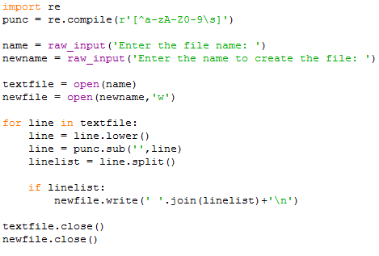
Code…

Slide 9
Step 2 – Create a dictionary
Read every word from a normalized file
Translate that word to sms speak.
Update the dictionary. SMSWord: Word
‘Save’ the dictionary.

Slide 10
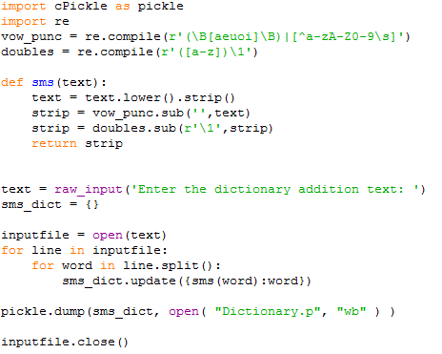
Code…

Slide 11
Step 3 – Decode SMS speak
Import the saved dictionary
For every word in the file, look up the English in the dictionary
Write each line to the new file

Slide 12
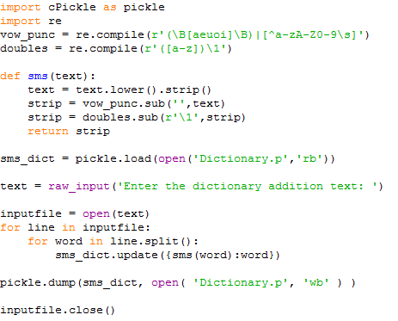
Code…

Slide 13
Step 4 – Accuracy Test
Create lists of the original lines & the translated lines.
Note: Newlines in text files
file.readlines()
Create list of the original words & translated words.
Note: Need to use integer indexes.
Compare the two lists item by item.
Count
Word Count
Correct Words
Calculate accuracy
Correct Words/Word Count * 100

Slide 14
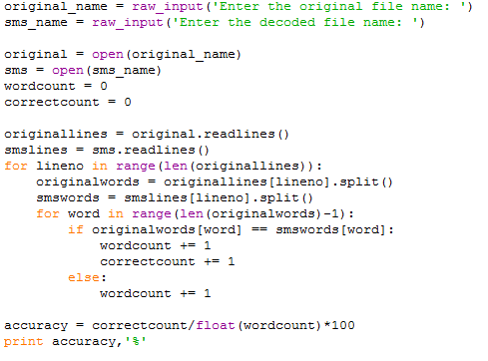
Code…

Slide 15
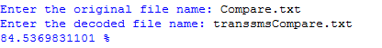
Accuracy
On all the text:

Slide 16
Questions???

Slide 17
The End…

