Slide 1
UAT Automation Framework
By SSTZ-UAT

Slide 2
Agenda
Traditional Automated Testing.
UAT Automation Framework introduction.
Advantage.
Demo.
Q&A

Slide 3
The traditional way to do automated testing.
Write test case
Test case designer
(Finacial backgroud)
Write test scripts
Execute automation scripts
Automation tester
(Computer background)
Tester

Slide 4
What’s the problem?
We need someone who is strong in programing skills to write test scripts, it’s very hard for the most of UAT members.
Commercial test tools are very expensive.
Maintain test scripts is not an easy job.
What is the solution?
UAT Automation Framework

Slide 5
UAT Automation Framework
Keyword driven test automation framework.
Just write excel test case, NO code.
Developed by SSTC-UAT team, FREE.
Very SMALL, smaller than a word document.
XDETester: 700MB word: 1MB Framework: 0.5MB
Maintenance: just modify the excel test case.
Keyword: Some predefined words.

Slide 6
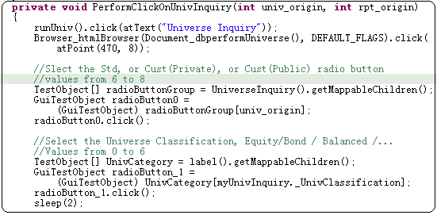
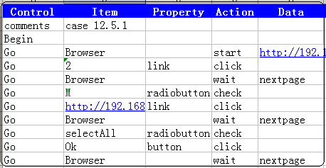
UAT Automation Framework
Traditional(XDETester) Automation Framework

Slide 7
UAT Automation Framework
Customize for StateStreet UAT testing.
Advanced architecture, easy to enhance.
Will support Flex and SilverLight in future release.
Onsite support.

Slide 8
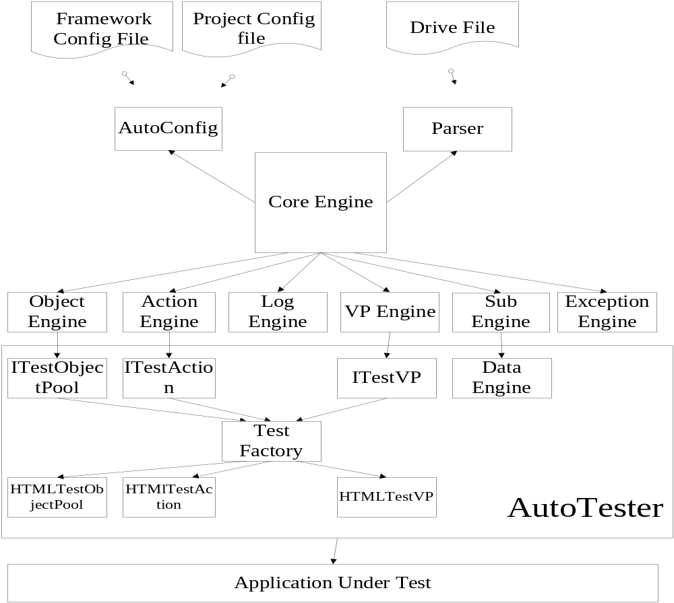
UAT Automation Framework

Slide 9
DEMO
UAT Automation Framework

Slide 10
Q&A

Slide 11
Thank you!

