Slide 1
AutoTester
&
UAT Automation Framework
By SSTZ-UAT

Slide 2
Agenda
UAT Automation Framework.
Demo
AutoTester
Advantage.
Demo
Q&A

Slide 3
UAT Automation Framework
Keyword driven test automation framework.
Just write excel test case, NO code.
Developed by SSTC-UAT team, FREE.
Very SMALL, smaller than a word document.
XDETester: 700MB word: 1MB Framework: 0.5MB
Maintenance: just modify the excel test case.
Keyword: Some predefined words.

Slide 4
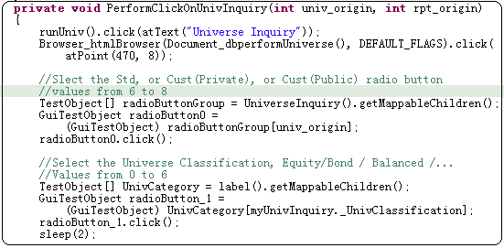
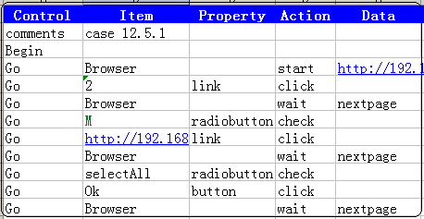
UAT Automation Framework
Traditional(XDETester) Automation Framework

Slide 5
UAT Automation Framework
Customize for StateStreet UAT testing.
Advanced architecture, easy to enhance.
Will support Flex and SilverLight in future release.
Onsite support.

Slide 6
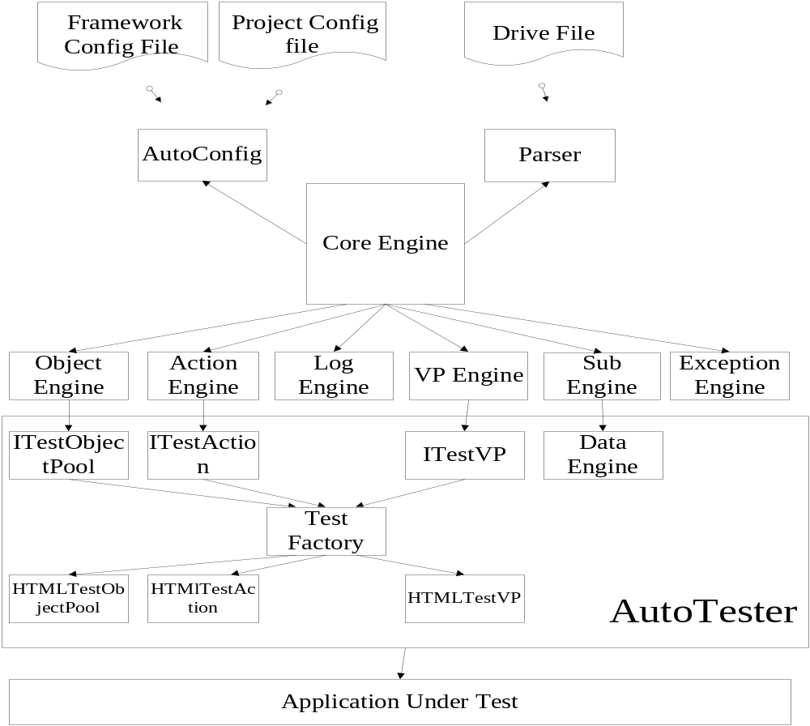
UAT Automation Framework

Slide 7
DEMO
UAT Automation Framework

Slide 8
AutoTester
AutoTester is a Web GUI Test Automation tools.
Simulate end user actions.
Developed by SSTZ-UAT team.
Programing by C++/C#.

Slide 9
Advantage
Free/OpenSource to StateStreet.
Compile to a single file, NO other tools needed.
AutoTester is very small , easy to distribute.
XDETester > 700MB, AutoTester < 10MB.
Support Window 2000/XP/Vista, IE 6.0/7.0
Support different languages : Keyword, C#/C++.

Slide 10
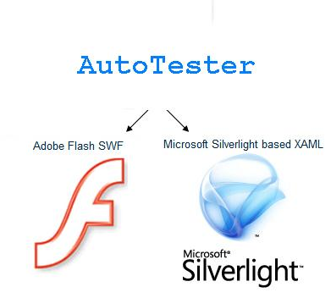
Advantage
Support Flex/Silverlight Testing in future release.

Slide 11
AutoTester
Demo

Slide 12
Q&A

Slide 13
Thank you!

