Slide 1



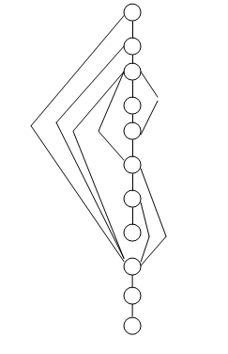
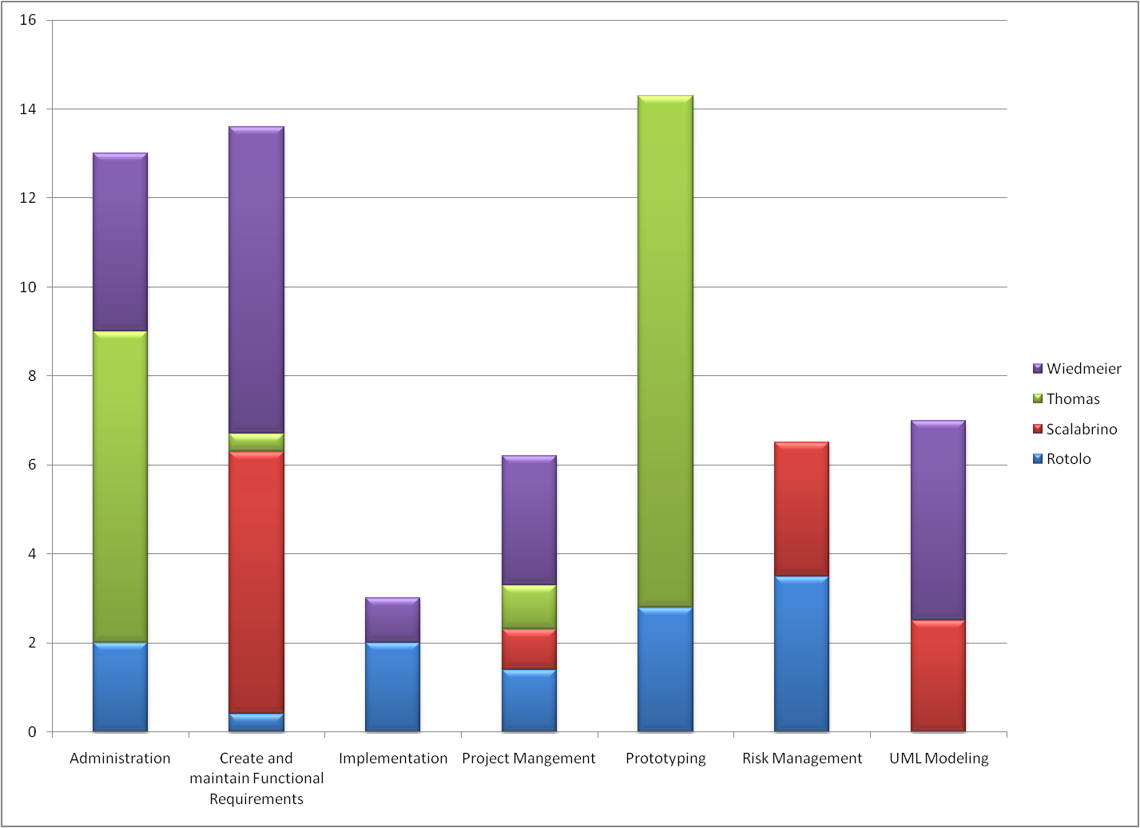
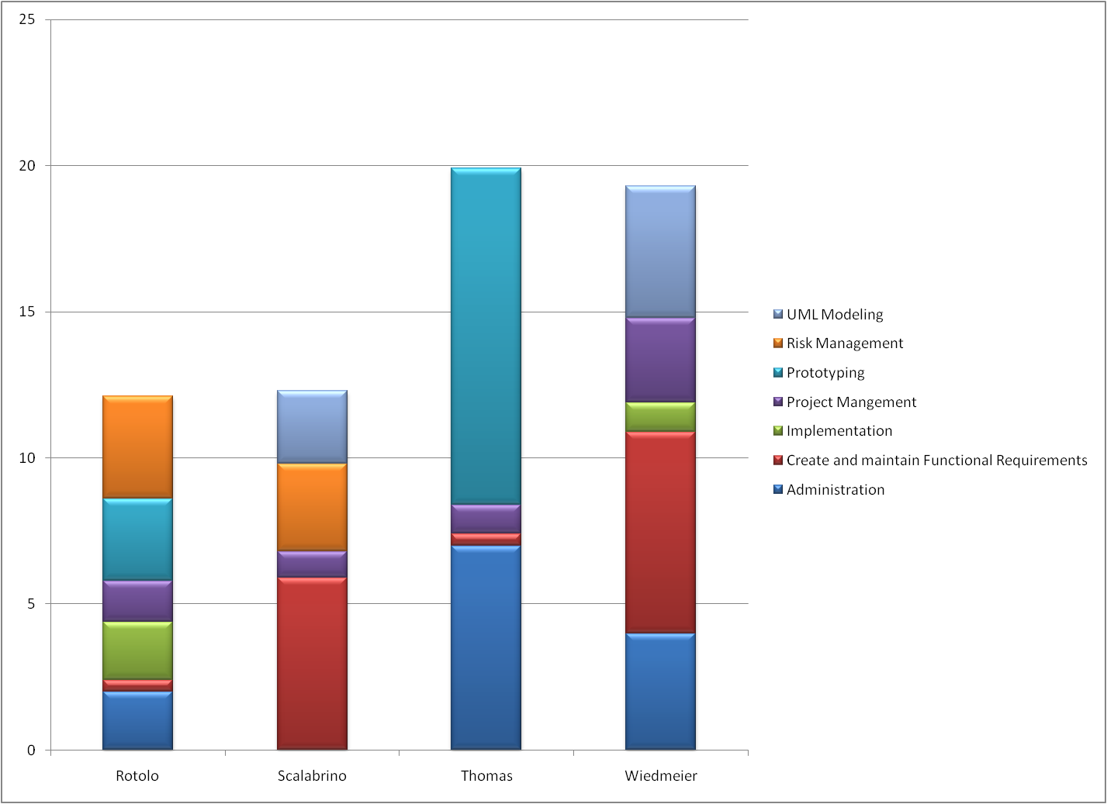
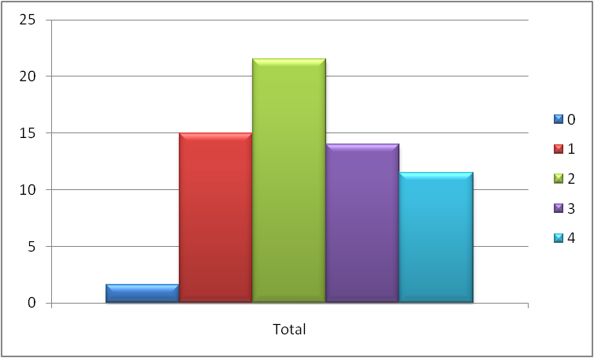
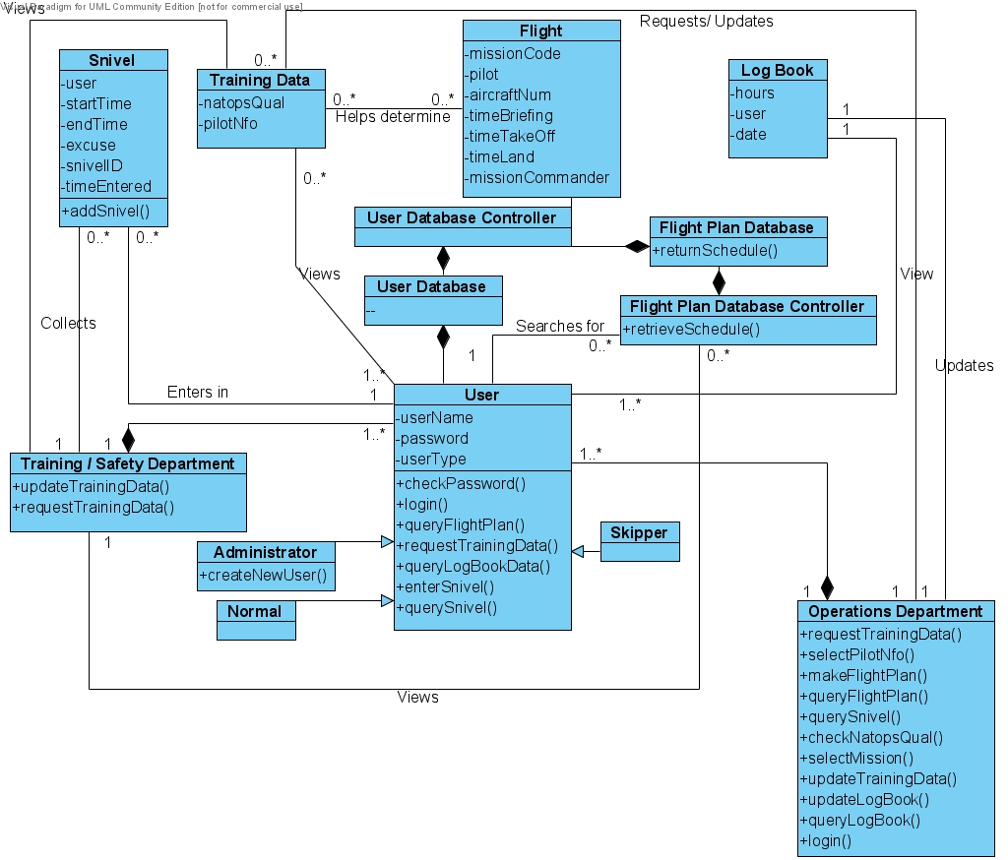
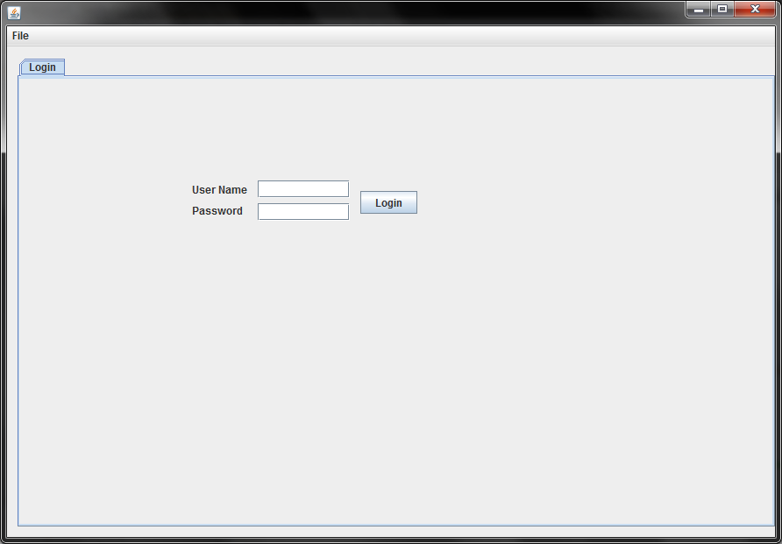
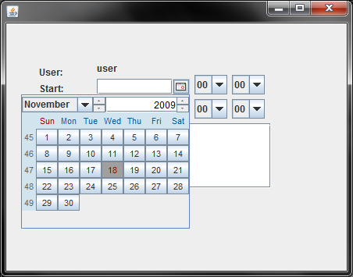
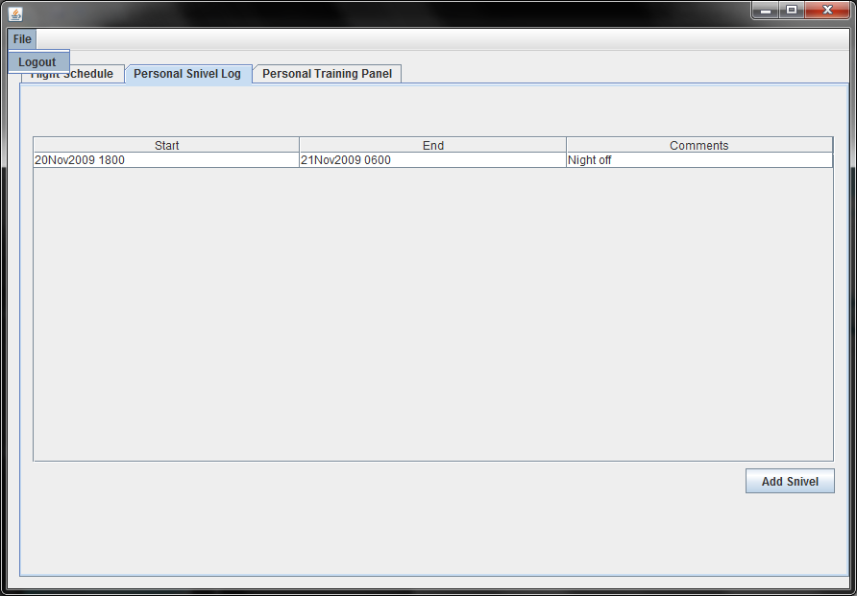
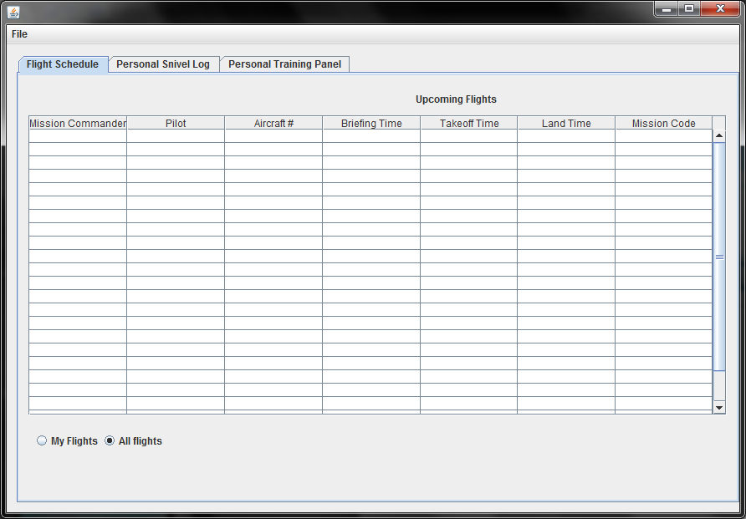
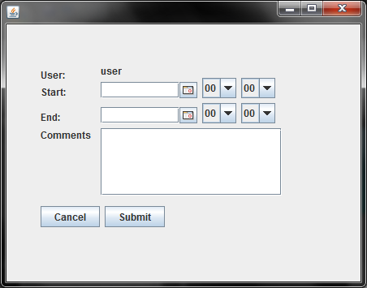
Flight Scheduler Assistant
Team Name: Code Maulers
Patrick Rotolo
Alec Thomas
Anthony Scalabrino
Tori Wiedmeier
Overview
McCabe Metric for makeFlightPlan()
Workload Distribution
The Aviation Scheduler uses a database to keep track of flight information for pilots and NFOs to include their flights, training data, log books, and snivels. Access to certain features are restricted based on the role of the user.
Cumulative Task Oriented
Cumulative Member Oriented
M= e-2+2 = 16-11+2 = 7 a reasonable M value
UML Diagram
Time Per Milestone
Avg ManHours Per Team Member: 16 hrs
GUI

