Slide 1
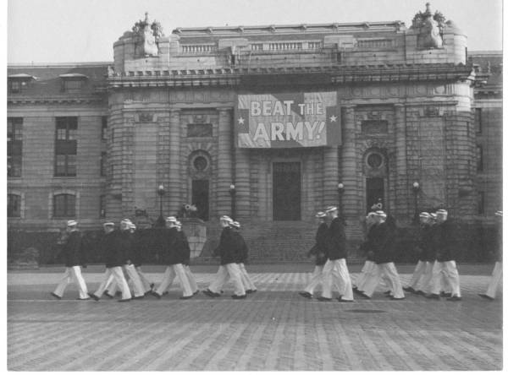


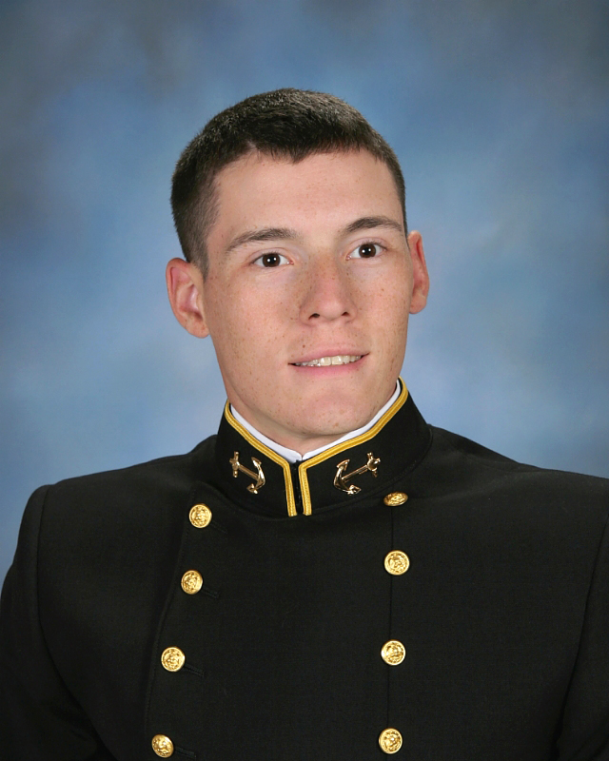
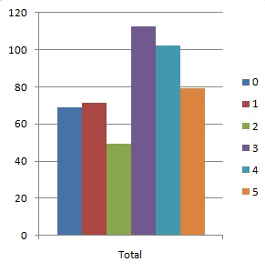
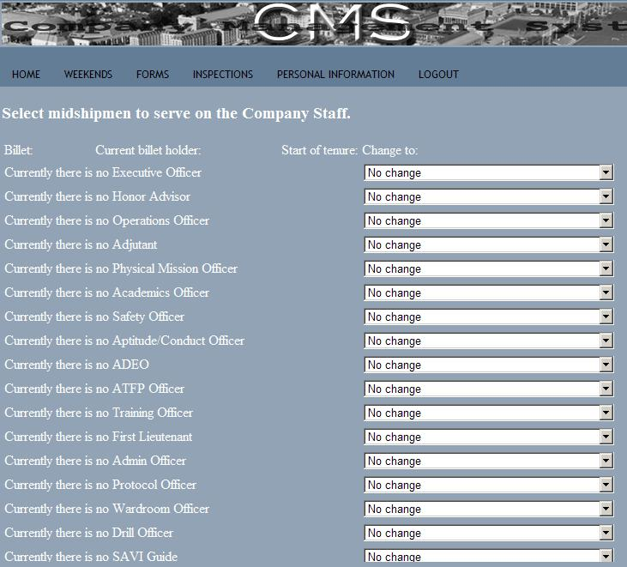
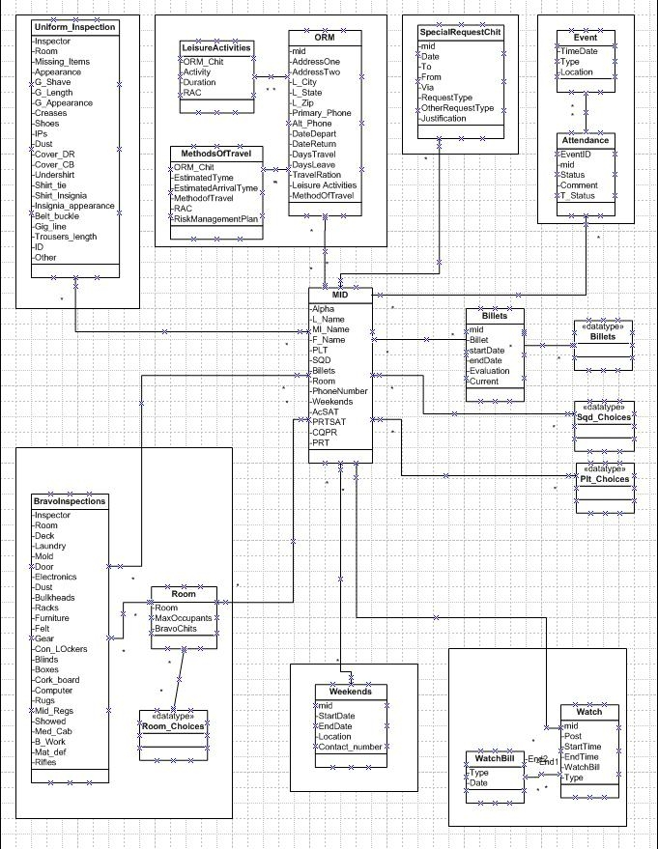
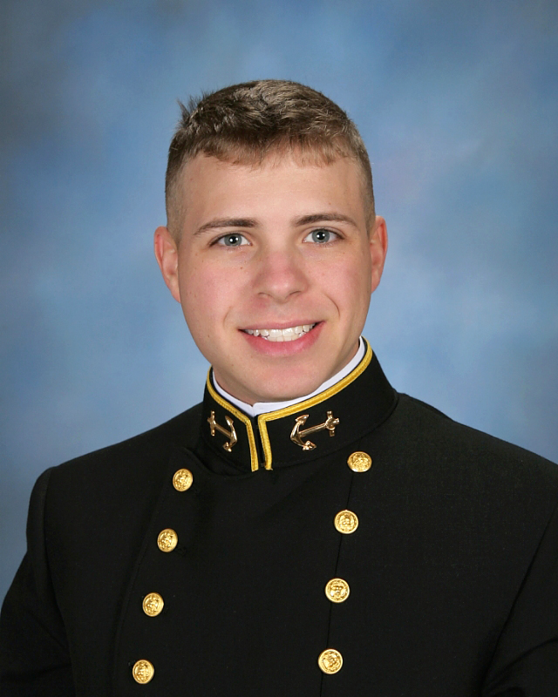
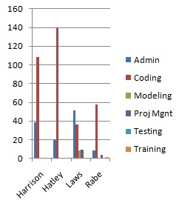
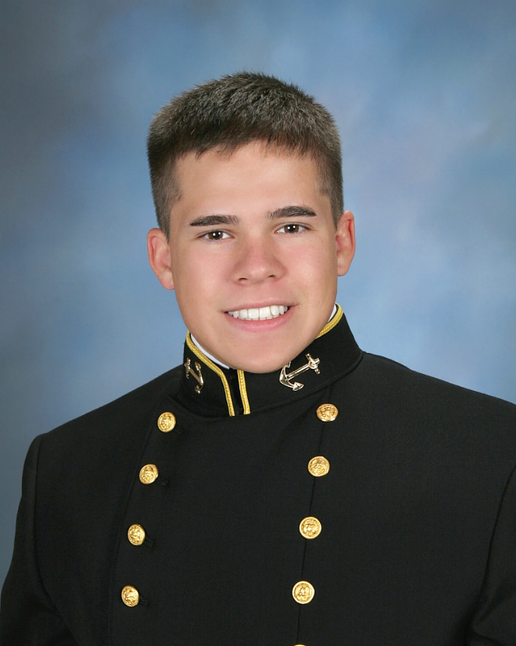
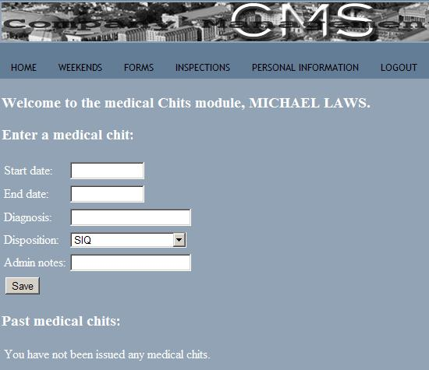
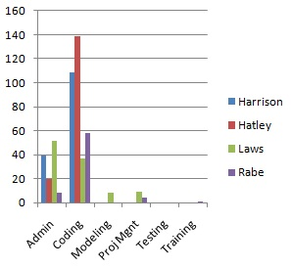
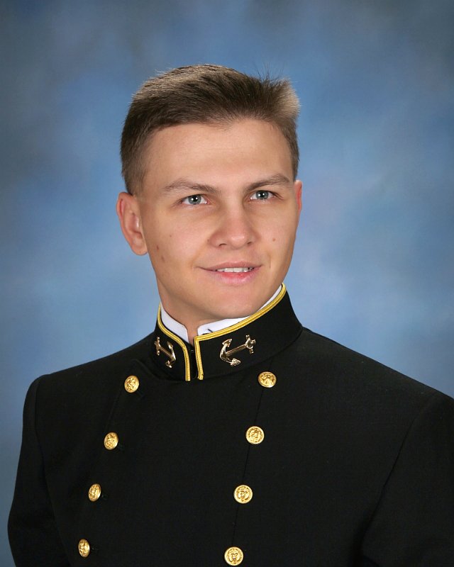
Company Management System
OVERVIEW
Through programming with a web framework we have never heard of before (Django), in a language we have never used before (Python), we created a user role based, dynamically generated, highly extensible system to handle the paperwork the midshipmen of a company process on a daily basis.
Mcabe’s Metric
E = 8
N = 7
P = 1
Therefore,
M = 3
MIDN Laws
Figure02: Time per Milestone
midn Harrison
Figure05: Staff List
Figure03: Member Distribution
Workload Distribution
Average man hours
per person: 120+
MIDN Rabe
MIDN Hatley
Figure04: Time per Milestone
Figure01: UML Diagram
Figure06: MedChit Page

