Slide 1
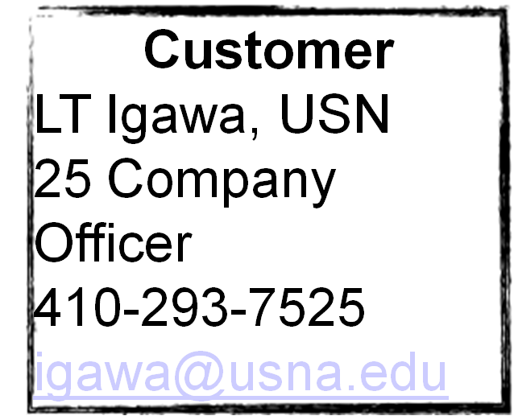

Company Management System
(CMS)

Slide 2
Overview
Expanded Acceptance-Testing-Focused Functional Requirements Trace Table
Risk Management.
Meetings
Workload Matrices
Gantt Chart
Modeling
Coding
Testing

Slide 3
Expanded Acceptance-Testing-Focused Functional Requirements Trace Table
Expanded Acceptance-Testing-Focused Functional Requirements Trace Table Overall Percentage of Functional Requirements Complete => 43/67= 64% Customer Initials will be placed next to the status of the testing or requirements.
Functional Requirement / Applications Each functional requirement will be developed by the following people in the following roles: Models (database): Midn Harrison Views (individual page functionality): Midn Hatley Templates/CSS/AJAX (page usability): Midn Rabe Backup/Admin/coordination: Midn Laws | Requirement Status – Used to signify completion of Functional Requirements KEY: C – Complete MS – Milestone 1, 2,etc... | Set of Acceptance Test Plan test cases - in total, these test cases must demonstrate that the Functional Requirement in question has been met, and must include both normal and abnormal uses of the system. | Testing Status – note that each test case has its own status field.
Database Integration and Storage The system will handle all required data types in an object oriented manner. The system will also protect sensitive data using encryption. The functional requirements contained herein include: Storage of all applicable objects and their relevant information Include all relevant pieces of information in the models Encryption of passwords and other sensitive information | 1. C – MS 1 ________ 2. C – MS 1 ________ 3. C – MS 2 ________ | 1. Test relational database model 2. Ensure that the database tables relate and interact properly 3. Show that the database uses means to protect sensitive information. | 1. In progress ________ 2. In progress ________ 3. In progress ________

Slide 4
Risk Management Plan
Priority | Risk | Risk Management Technique | Status
1 | Unauthorized page access due to different hacking techniques | This will be mitigated through development of the software from the foundation with security at the forefront of the design. | All code will be written and analyzed with an emphasis on security
Probability
Low
Severity:
High
2 | Faulty writing of mySQL queries | Write queries that are syntactically correct and ensure that all queries are checked for errors | All code will be checked by tests to ensure correct syntax
Probability
Low
Severity:
High
3 | Browser Incompatibilities with interface code. | Test interface in multiple browsers. Write a catch statement that will catch and deny acces to unsupported browsers | Appropriate code will be added to appropriate pages
Probability
Low
Severity:
Low
4 | Ward Hall updating their system to something other than LDAP for authentication | Transfer to ward hall. | Appropriate error messages will be written in to facilitate.
Probability
Low
Severity:
Low
5 | User Error when entering data | Accept and write an intuitive interface to mitigate this from happening | Interface code will be intuitive and ergonomic
Probability
High
Severity:
Low

Slide 5
Meetings
Demonstrated 25 of the 67 functional requirements to the customer that were not already completed.
Met with our technical advisor to go over what has been done so far.

Slide 6
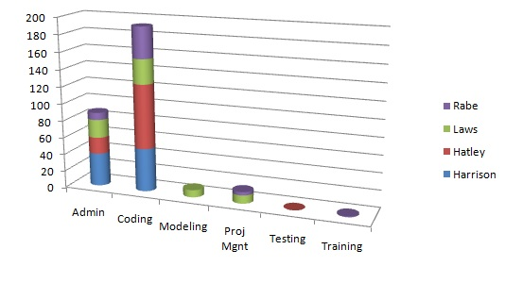
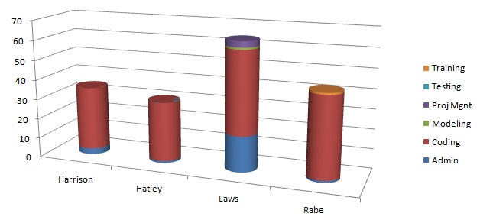
Workload – Milestone 3

Slide 7
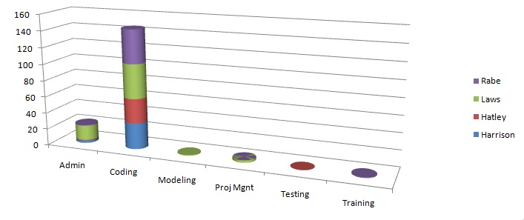
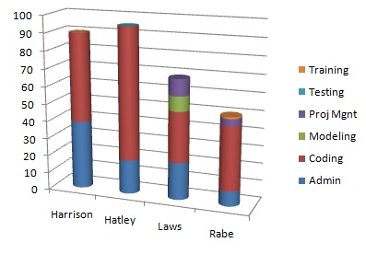
Workload – Total time

Slide 8
Gantt Chart
Progress

Slide 9
Coding – McCabe’s Complexity Metric of 3
This project is very flat.
There is no deep or
complicated code.
M = E − N + 2P
E = 8
N = 7
P = 1
Therefore,
M = 3

Slide 10
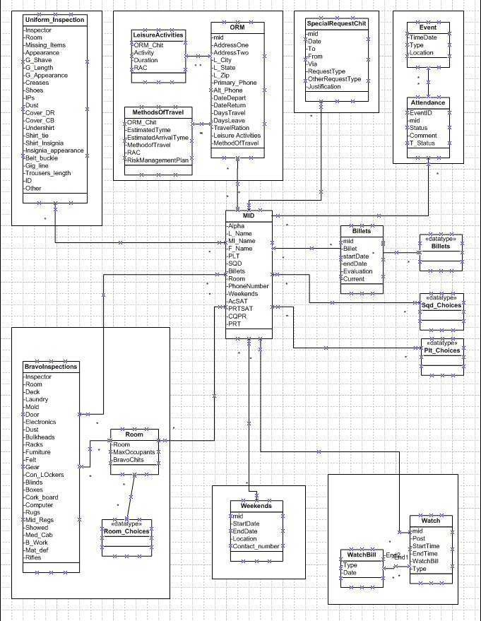
UML Diagram

Slide 11
Testing
Time spent clicking everything
    Not unreasonable because of the relatively linear nature of the project

Slide 12
Questions?

