Slide 1



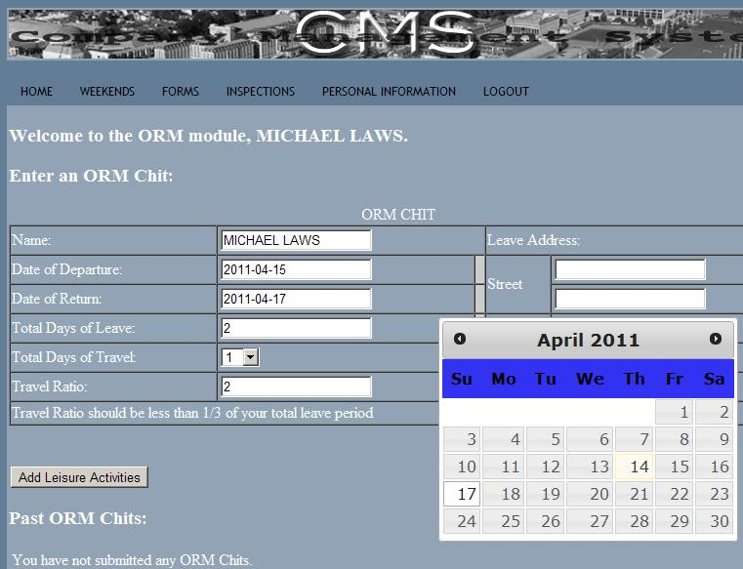
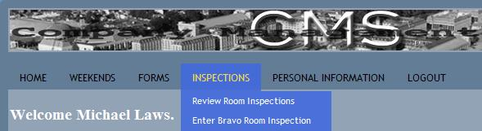
Company Management System
Team Name: Team1
Michael Laws
Michael Harrison
Ryan Rabe
Dimitri Hatley
Topical Areas: Web, Database, Middleware, OOP, Frameworks
OVERVIEW: CMS is a web interfaced, database back ended, modularly designed, system to manage the daily paperwork that a Company of Midshipmen deals with on a daily basis.
CONCLUSIONS:
Lessons Learned:
Simple problems may have complicated solutions.
Good team communication is as important as good code.
A framework to aid development may or may not be a good idea depending on the application.
Top 3 challenges:
Complexity Management
Many MIDN data points to keep track of and reference
SOLUTION: Use the Django framework to aid in design and development
Team coordination and cohesion
Dynamic projects require active communication
SOLUTION: External server based solutions for code storage and execution
Learning a new framework and language
We had to learn the language python and the framework Django
SOLUTION: Time and effort.
Mistakes Made:
Did not fully solidify requirements before coding
Did not fully learn the potential or quirks of Django before coding
Suggestions for the Future:
Spend time fully learning the languages and frameworks and their internal systems before using them
Ex1: screen capture of the dynamic navigation bar
Ex2: screen capture of the dynamic ORM chit with popup calendar

