Slide 1
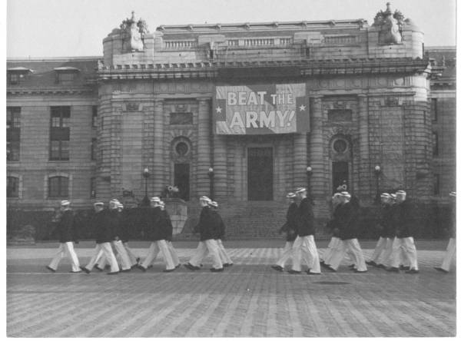


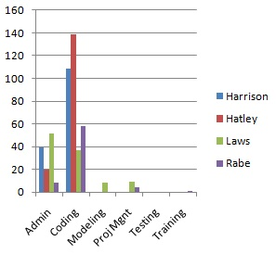
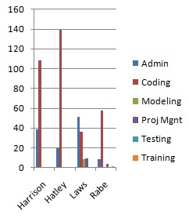
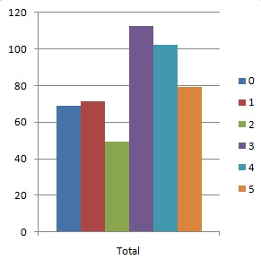
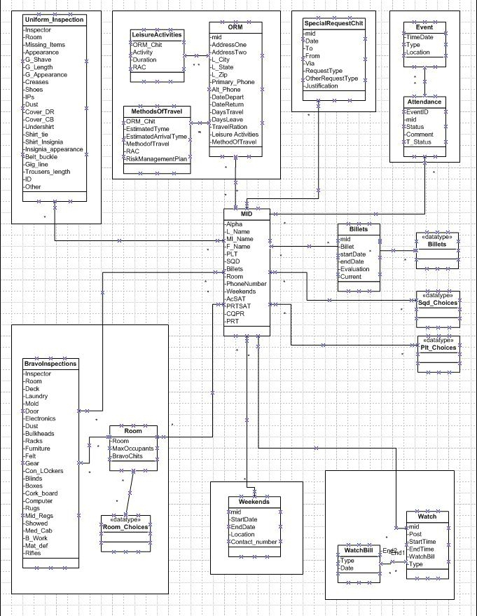
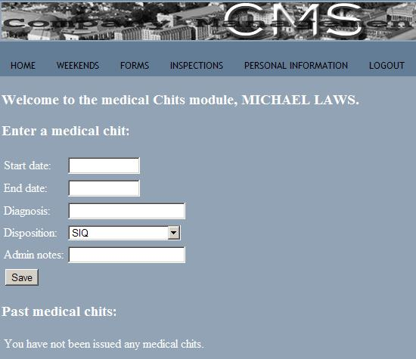
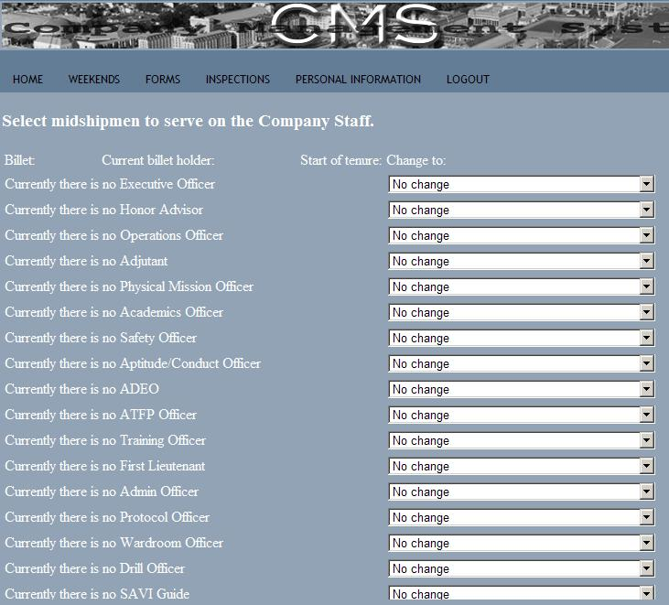
Company Management System
Team Name: Team1
Michael Laws, Michael Harrison
Ryan Rabe, Dimitri Hatley
Cumulative Task Oriented
OVERVIEW
Through programming with a web framework we have never heard of before (Django), in a language we have never used before (Python), we created a user role based, dynamically generated, highly extensible system to handle the paperwork the midshipmen of a company process on a daily basis.
Cumulative Member Oriented
Workload Distribution
Avg man hours per person: 120+
Time Per Milestone
UML Diagram
Mcabe’s Metric
E = 8
N = 7
P = 1
Therefore,
M = 3
GUI

