Slide 1
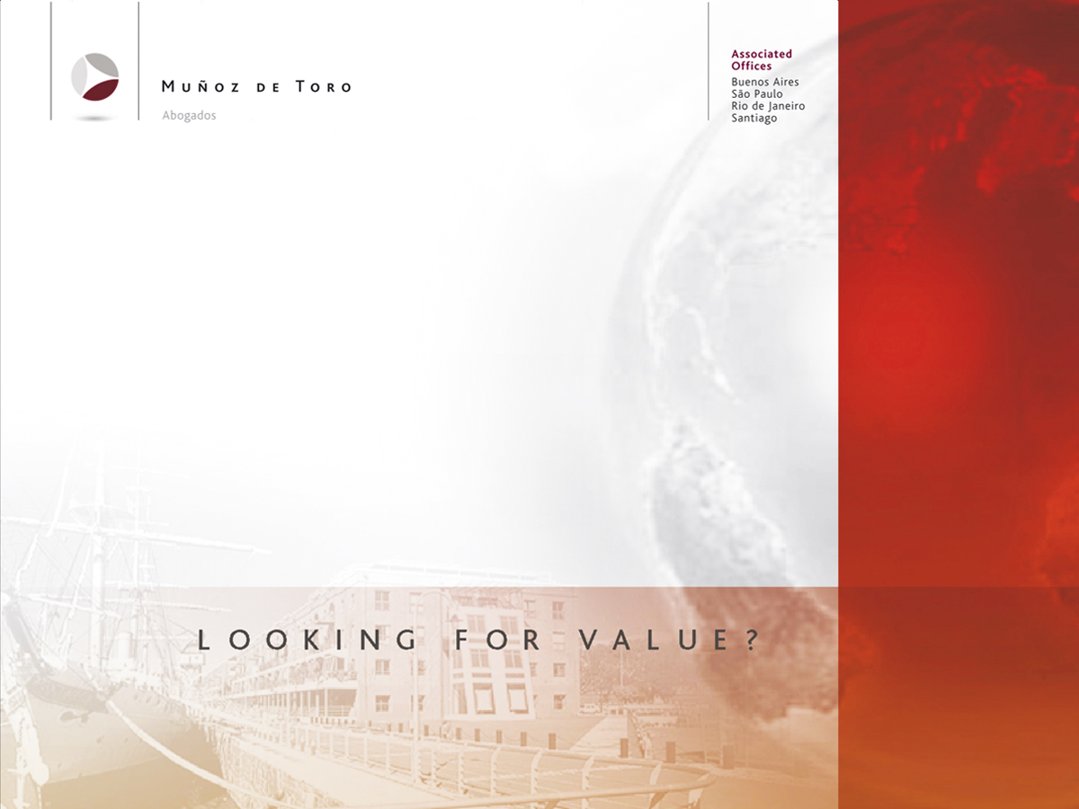
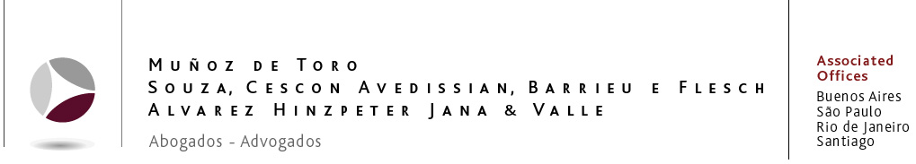
TELECOM ARGENTINA S.A.

Slide 2
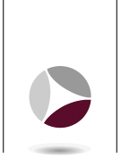
TELECOM CURRENT STRUCTURE
The Werthein Group has an option (exercisable from January 31, 2008 through December 31, 2013) to acquire the France Telecom Group’s remaining 2% equity interest in Sofora.
Telecom Italia Group has two call options for US$ 60 millions against W de Argentina Inversiones S.L. equity interest in Sofora: (i) a call option for a 2% interest excersible from December 31, 2008 through December 31, 2013; and (ii) a call option for a 48% interest that can be exercised 15 business days after December 31, 2008.
Telecom France Group
Telecom Italia Group
100%
100%
Atlas Services Belgium S.A.
France Cables et Radio S.A.
W de Argentina Inversiones S.L.
Telecom Italia S.P.A.
Telecom Italia Internacional N.V.
0,7%
1,3%
48%
32,5%
17,5%
SOFORA TELECOMUNICACIONES S.A.
Preferred Stock
A and B
Listed in New York, Luxemburg and Buenos Aires’ Stock Exchange. In 2002, they acquire voting rights.
Common Stock
A, B and C
67,78%
32,22%
P.P.P
Nortel Inversora
Public Offering
4,68 %
54,74%
100% Class A (51%)
40,58%
8,5% Class B (3,74%)
Telecom Argentina S.A.
This chart was prepared pursuant to the information provided from the Form 20-F filed with the U.S. Securities and Exchange Commission on June 30, 2005.

