Slide 1


A Slice of
Raspberry Pi
Original By Spencer Martin
Revised By Thomas “Tweeks” Weeks

Slide 2
About Me

Slide 3
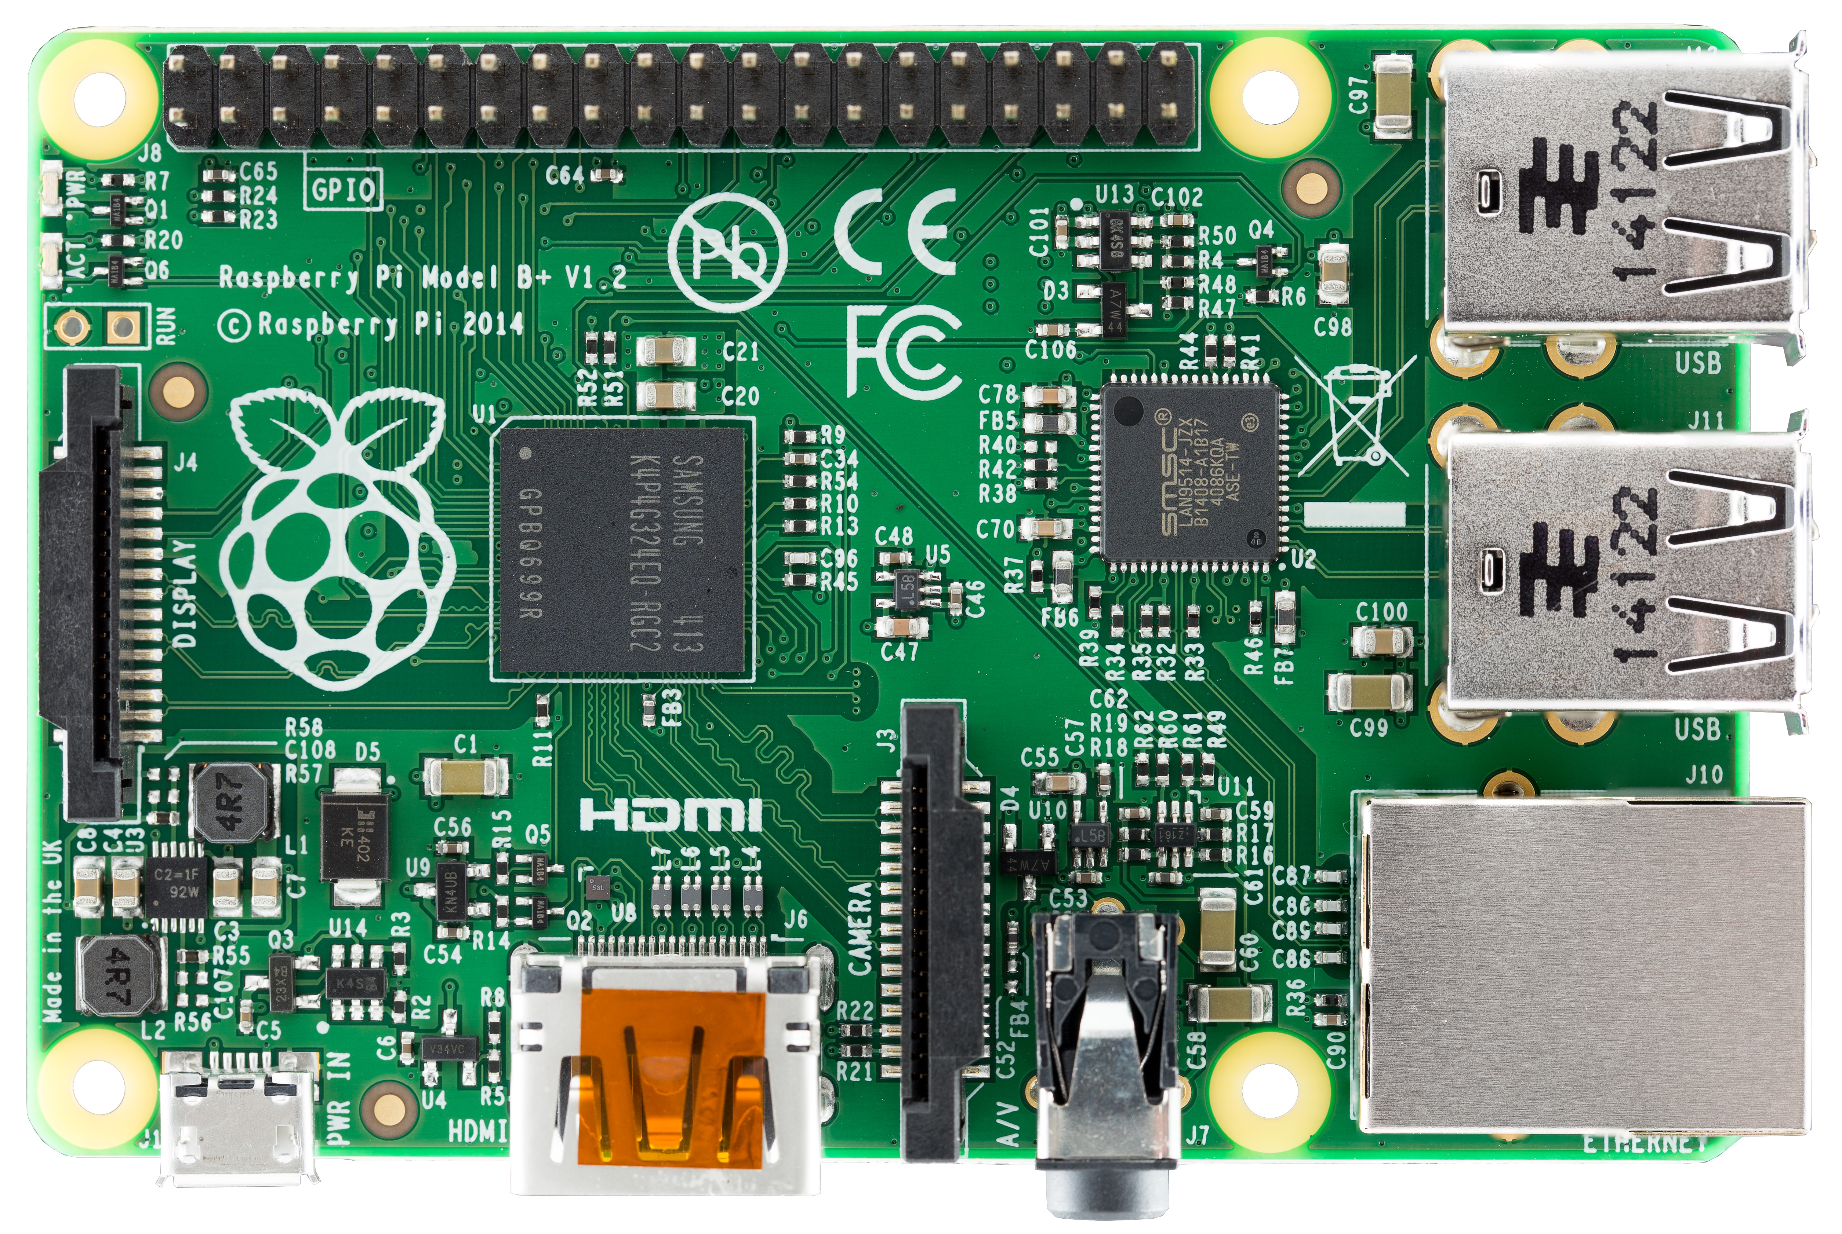
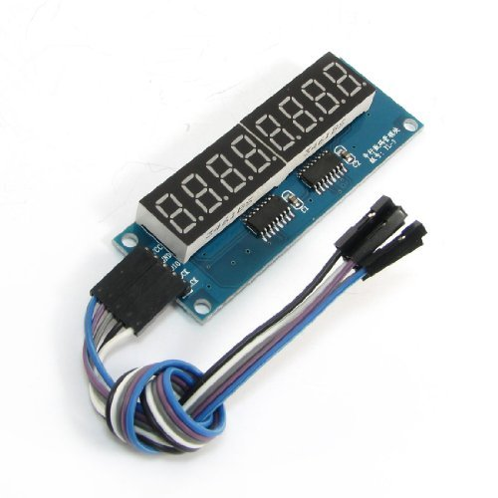
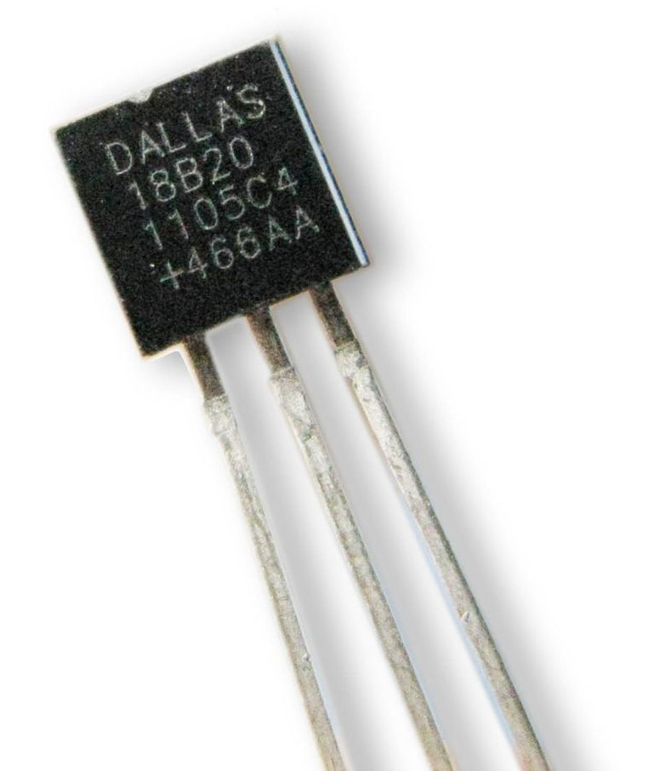
Class goals
Learning a bit about the python language
Write a final program called piTempLogger.py that:
Measures things and outputs results to a blinking LED
Output to a 7 segment LED display to show more data.
Read temp from a sensor
Research how to email the temperature to yourself in python

Slide 4
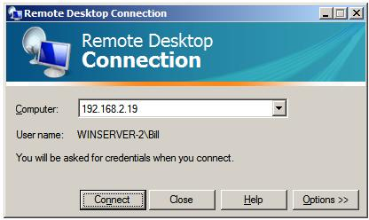
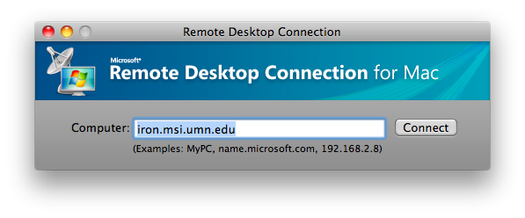
Connecting To Your Pi
From a Laptop
Connect to the Pi using
“Remote Desktop” clients:
For Windows type:
mstsc /v:ip-address
For Mac OSX install/use:
10.6 http://tinyurl.com/mac-rdp-10-6
10.7 http://tinyurl.com/mac-rdp-10-7
For Linux type
rdesktop -u pi -g 1024x768 ip-address
192.168.11.X
pi
192.168.11.X
* -In the IP 192.168.11.X where X is your Pi number if on wifi

Slide 5

1) Getting Familiar with the Python Language

Slide 6

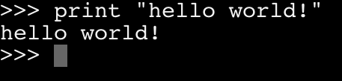
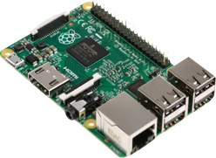
Hello world!
Your first program
Open terminal or command prompt and type in python
At the “>>>” python prompt, type in:
print "hello world"
Hello World!

Slide 7
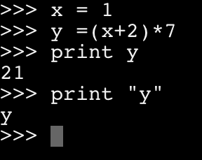
Math and Variables
Try setting a variable by typing in:
x = 1
You multiply, divide, add, subtract using operators:
* / + -
Print variables by omitting quotes
print x

Slide 8
Math and Variables
Try setting a variable by typing in:
x = 1
You multiply, divide, add, subtract using operators:
* / + -
Print variables by omitting quotes
print x
WARNING: Standard mathematical “order of operations” applies.
Remember PEMDAS ?

Slide 9
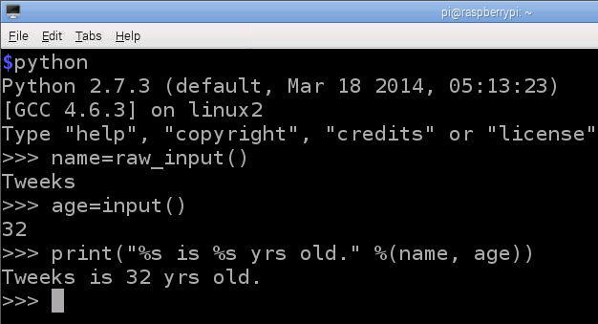
Input
Taking input from users
The command input() is good for taking numbers as input from users and raw_input() is good for taking text (without needing quotes).
Either quietly prompts the user to enter data.
Here's how you might use each:
name = raw_input()
age = input()
And what it would look like using them:

Slide 10
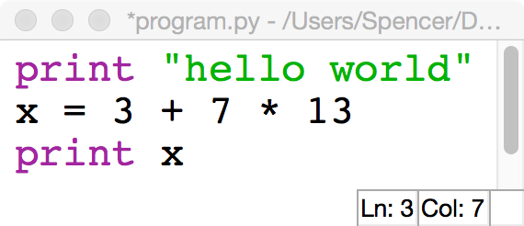

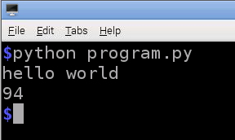
Writing Multi line programs
Open the programming interface called idle.sh and select File / New Window
Type your python commands into the idle programming window
Save-As your program to “program.py”
Close all idle windows
Run your program from the terminal, by typing in
python program.py
In Idle, save your program
to a file called “program.py”

Slide 11
For loops
Doing things against a list
Start
In Idle, save to a file
called ‘for-loop.py’
For loops step through lists (in this case a range of numbers).
A for loop condition ends with a colon, and the code block within a for loop is all indented by spaces.
for x in range(0, 10):
print x
print “goodbye”
For x=
0,1,2,3...10
Is X
done?
no
print x
yes
print “goodbye”
Stop

Slide 12
Ifs
Conditionals.
If this, then do that.
If checks a condition and executes code if the condition is true.
If conditions end with a colon, and the code block within an if is indented with spaces.
for x in range(0, 10):
if x == 2:
print(“x is now two”)
elif x == 3:
print(“x is now three”)
else:
print(x)
print “goodbye”
In idle, save this program
as “for-if-loop.py”
For loop
If
elif
else
Is x
= 2 ?
no
Is x
= 3 ?
no
print
x
yes
yes
print
x is now two
print
x is now three
Exit for
print
goodbye

Slide 13
While loops
Do things while
something is true.
While loops repeat code while a condition is true.
Code in while loops are indented by spaces, and conditions are ended with colons.
x = 0
while x < 10:
if x == 2:
print(“Hello World”)
elif x == 3:
print(“Hallo Weld”)
else:
print(“Hola Mundo”)
x = x + 1
print “goodbye”
Saving this as “while-if.py”
While
Is x < 10?
no
Exit while
yes
Do stuff in
while block
print
goobye

Slide 14
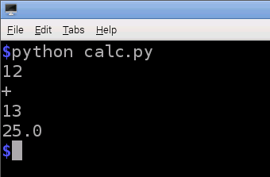
Challenge
Write a 4 function calculator in python that takes as input, a number, then an operation
(+ - * / ), the another number and prints the answer.
For example: If you input
‘12’ <enter>, then
‘+’ <enter>, and finally
‘13’ <enter>,
then it should print
25 as the answer.
Save into a new
file called “calc.py”

Slide 15
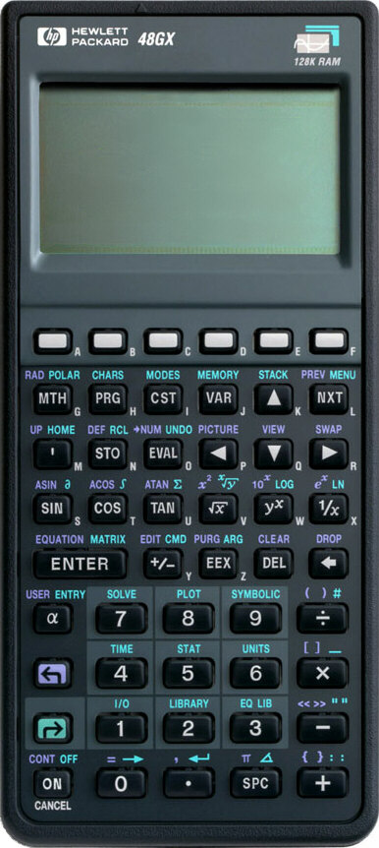
Calculator solution
x = input()
op = raw_input()
y = input()
if op == '+':
n = x + y
elif op == '-':
n = x - y
elif op == '*':
n = x * y
elif op == ‘/‘:
n = x / y
print(n)

Slide 16

2) Writing piTemoLogger.py
The goal of this class is to learn how to write a python logger.py program on the RaspberryPi we will eventually build up to a program called piTempLogger.py that will:
measure the room temperature,
displays it on a seven segment LED,
If we finish everything else, email the data to ourselves.

Slide 17

2) Writing piTemoLogger.py
But to do all this, we must first learn how to:
Talk to the outside world using the Pis GPIO port
Output data to a 7 segment “595 driver” LED display
Write nested loops and conditionals
Read the temperature from a DS18B20 temp probe
Send email to Gmail over SMTP using python

Slide 18
2) Writing piTemoLogger.py
But to do all this, we must first learn how to:
Talk to the outside world using the Pis GPIO port
Output data to a 7 segment “595 driver” LED display
Write nested loops and conditionals
Read the temperature from a DS18B20 temp probe
Send email to Gmail over SMTP using python
Let's get Started!!

Slide 19
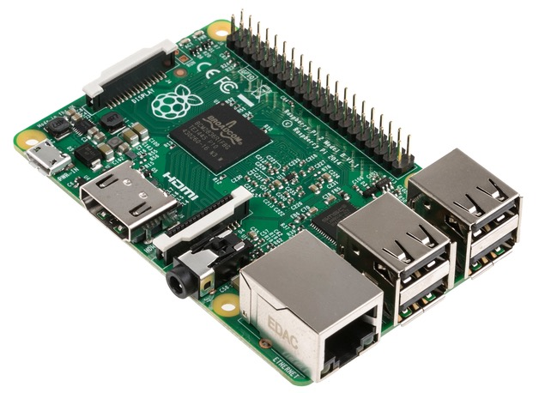
GPIO Port Support
Start saving
into “logger.py”
The RaspberryPi's GPIO, or General Purpose
Input/Output port, is your Pi's gate to the outside world. It can be used to read values for sensors, or activate LEDs or motors.
It is used in python by importing (or loading) the GPIO module like this.
import RPi.GPIO as GPIO
GPIO Port
Hardware
GPIO Port
Software

Slide 20
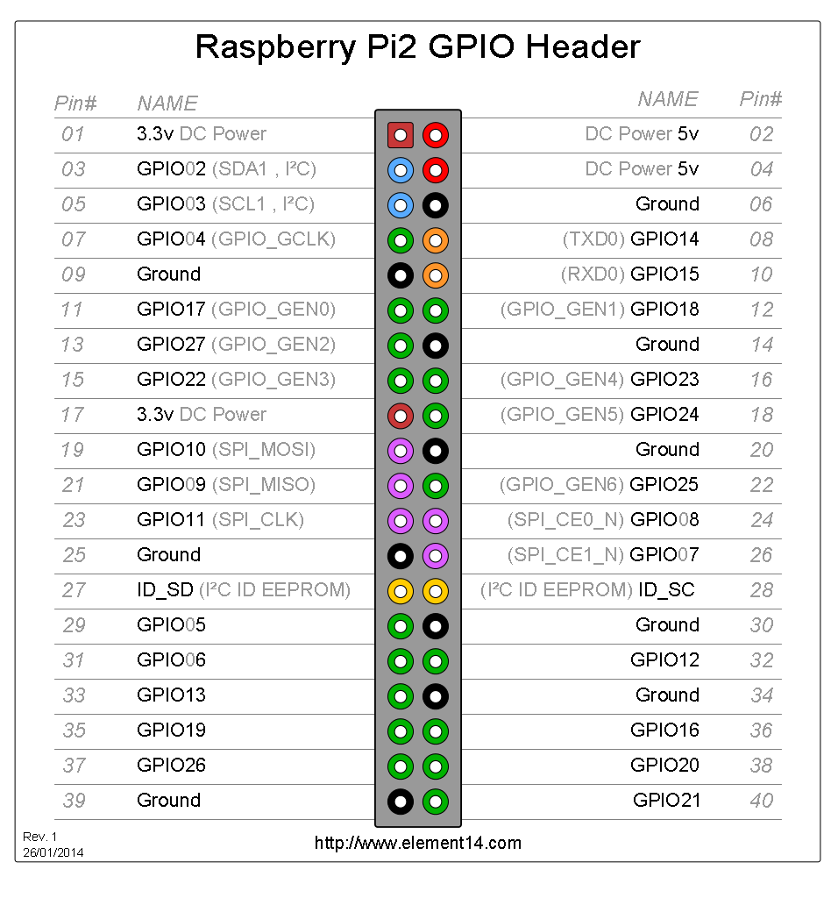
GPIO Pin Secret Decoder Ring
(keep this handy)

Slide 21
Blinking an LED
NOTE: before hooking this up
POWER OFF! After it's hooked up
as seen below, get TA write off
before powering up. Not doing
so can let the magic smoke out
and (cost you $40).
GPIO 22
(pin15 in code)
3v3
GND
Here's how to hook up the Pi (GPIO22=pin15) to your breadboard and LED. Note that your kit may have a big rainbow ribbon cable and “T” shaped board connecting your Pi to the breadboard. Do not go beyond this section until you have it working.
TA Initials

Slide 22

Blinking an LED
Continue saving
into “logger.py”
#This imports the GPIO module
import RPi.GPIO as GPIO
#This imports time for sleep function
import time
#initialize GPIO to use Raspberry Pi pinouts
GPIO.setmode(GPIO.BOARD)
#set pin 15 to output mode
GPIO.setup(15, GPIO.OUT)
while True:
#Turn on LED and wait 1 second
GPIO.output(15,True)
time.sleep(1)
#turn off LED and wait 1 second
GPIO.output(15,False)
time.sleep(1)
After importing the GPIO module (software) and connecting up the previous circuit (hardware), here's how we program the GPIO pinouts (pin 15 below = GPIO22 on the Pi's GPIO pins). After running this program, if your hardware is all correct, your program should slowly turn the LED on, wait, and turn it off. Get TA sign-off below.
TA Initials

Slide 23
Input from buttons
After you have the LED
blinking, we're going to hook
up a push button switch, read it,
And output the state to the LED.
GPIO 22
3v3
GND
GPIO 23
Note that the push button switch connects GPIO23(pin 14) to the + (3v) row when the button is pushed. This puts a logical “1” (True or High) on pin 14, which we will read in and output to pin 15(GPIO22). Get this working and signed off before continuing.
TA Initials

Slide 24
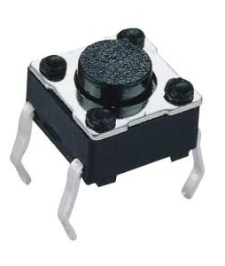
Input from buttons
Continue saving
into “logger.py”
After connecting the push button switch to the Pi's GPIO23 (pin 14, in the code below), add the new lines of code from the program below. The button program will watch the button state, and if pressed (True), it will output that logic “True” state (on) to the LED output pin, turning on the LED. Be sure to get TA sign-off (below).
#get access to GPIO module
import RPi.GPIO as GPIO
#set up pins
GPIO.setmode(GPIO.BOARD)
GPIO.setup(14, GPIO.IN)
GPIO.setup(15, GPIO.OUT)
#check whether button is pressed and
#change LED accordingly
while True:
button = GPIO.input(14)
GPIO.output(15,button)
TA Initials

Slide 25
Blinker
Challenge
Save-As to a new program
called “blinker.py”
Using your logger.py code as a starting place (saving it to blinker.py) modifying the code so that the Pi blinks the LED while the button is released, and stops blinking when the button is pressed.

Slide 26
Blinker
Solution
Save to “blinker.py”
#import GPIO module
import RPi.GPIO as GPIO
#import time for sleep function
import time
#initialize GPIO to use
#Raspberry Pi pinouts
GPIO.setmode(GPIO.BOARD)
#set pin 15 to output,14 as input`
GPIO.setup(15, GPIO.OUT)
GPIO.setup(14, GPIO.IN)
while True:
button = GPIO.input(14)
while button == True:
print 'waiting'
#turn on LED and wait 1 second
GPIO.output(15,True)
time.sleep(1)
#turn off LED and wait 1 second
GPIO.output(15,False)
time.sleep(1)

Slide 27
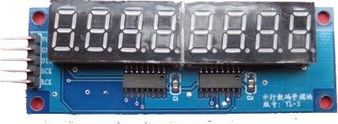
Using 7-segment LED display modules
The seven-segment LED module “shifts” in the display number data into those two small “74LS595” TTL driver chips. As a result, this module only needs to be hooked up to ground, power (3.3v), a DATAinput, and two clock lines. If you hooked up eight 7-segment LEDs directly, it would take over 64 wire connections plus a bunch of electrical resistors!
If interested in how these chips work
(or digital logic), then see the spec
sheet for this common “TTL chips”*.
* - http://www.ti.com/product/SN74LS595/technicaldocuments

Slide 28
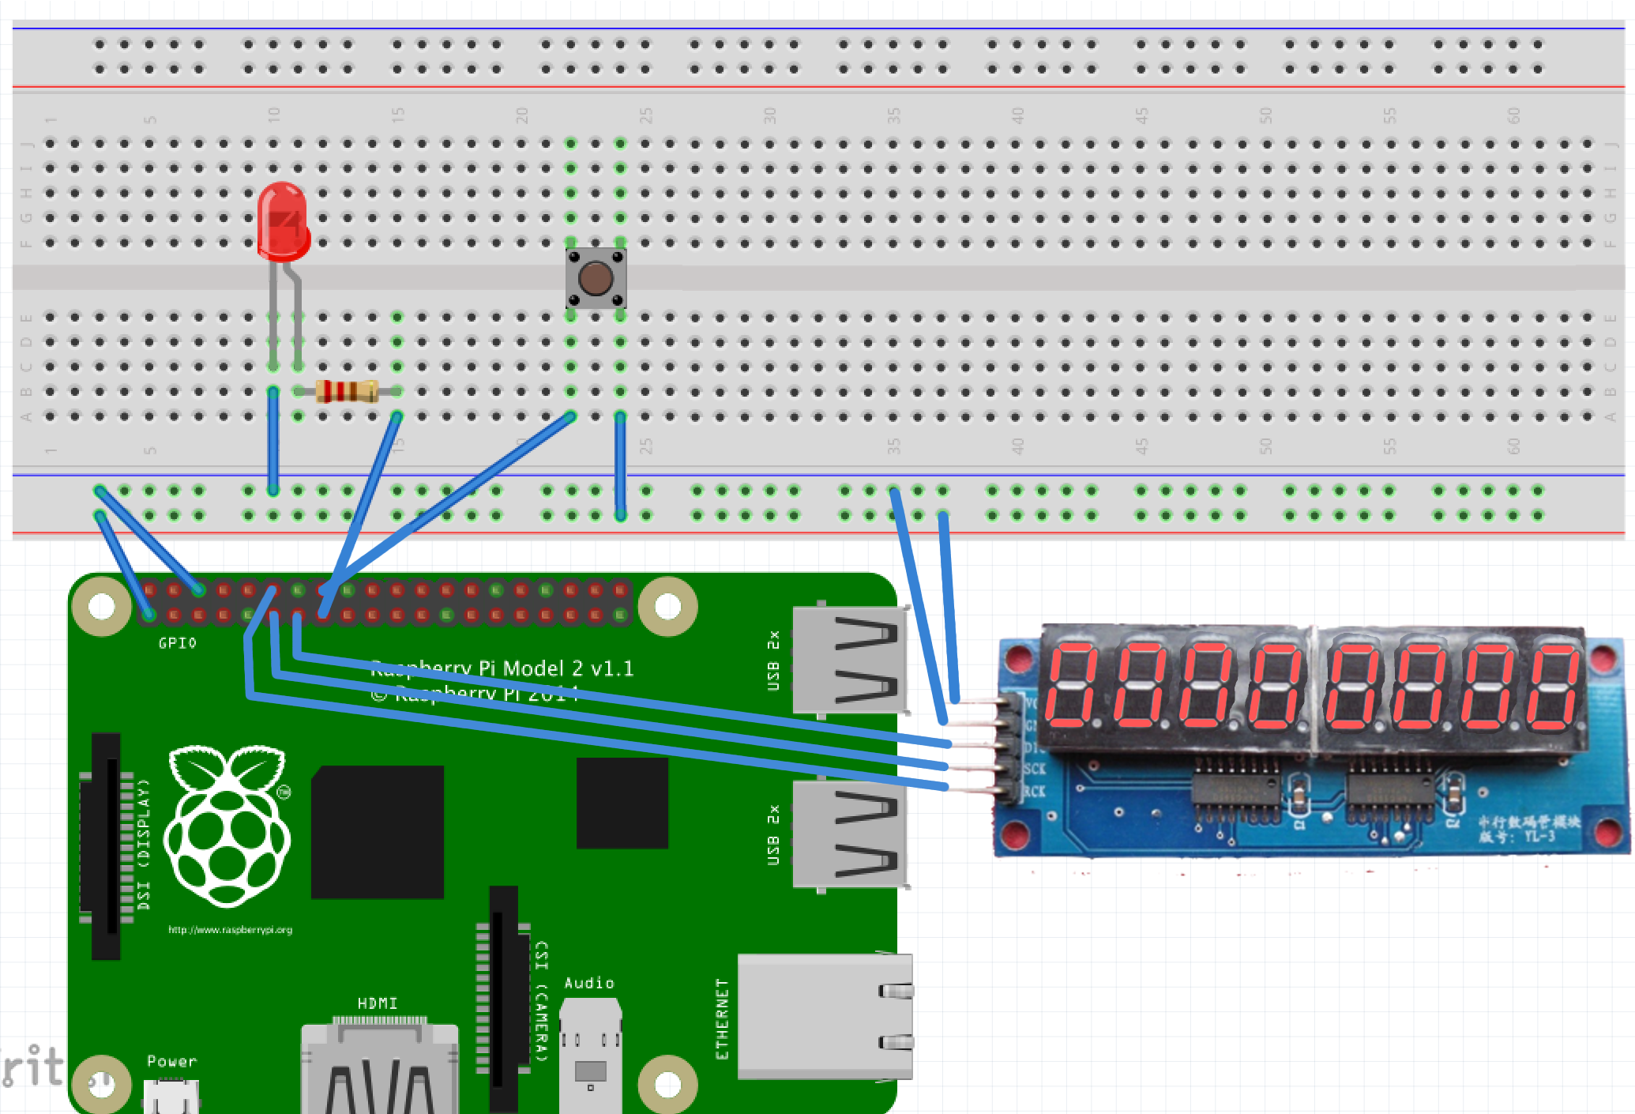
Connecting 7-segment module
NOTE: before hooking this up
POWER OFF! After it's hooked up
as seen below, get TA write off
before powering up and testing
it with code. Neglecting TA signoff
Could “eat your pie”.
GPIO 22
GND
GPIO 23
3v3
GPIO 27
GPIO 17
GPIO 18
TA Initials

Slide 29
Programming a 7-segment
LED module
Create a new program called “test-led.py” that will use this new 7 segment LED display.
7 segment “595 driver” displays require a custom module called PiSlice.py (in LCBB-Pi dir)
Initialize display by using
PiSplice.init()
Output to the display by using PiSlice.number=n
Make a new program and
save it to a file “test-led.py”
import PiSlice #load module
#DATAIN=13, CLOCK=11, LOCK=12
PiSlice.init() #initialize
#This displays numbers
PiSlice.number = 12345678

Slide 30
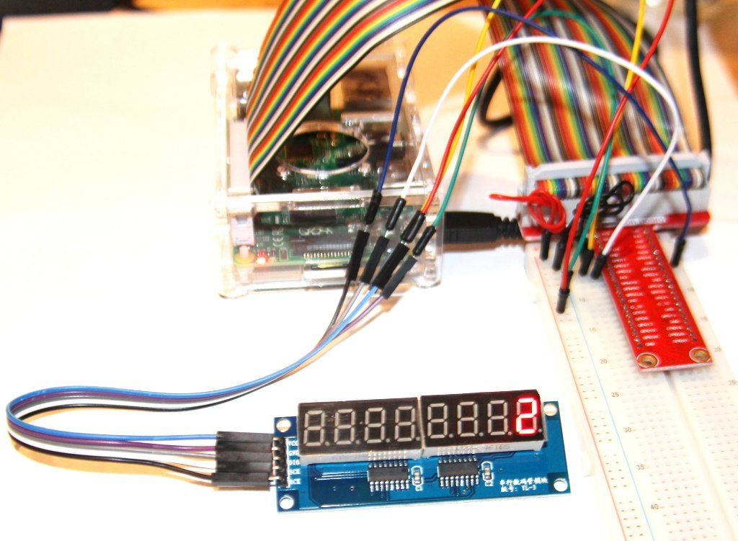
Counter
Challenge
Open existing “logger.py”
and continue coding in it.
Modify your logger.py
program to use the
7-segment LED module,
count your button
presses, and add each
press to the LED
display (starting at zero).
TA Initials

Slide 31
Counter
Solution
Open existing “logger.py”
and continue coding in it.
#import GPIO module and PiSlice module
import RPi.GPIO as GPIO
import PiSlice
#start up 7 segment display
PiSlice.init()
num = 0
while True:
button = GPIO.input(14)
while button == 0:
button = GPIO.input(14)
while button == 1:
button = GPIO.input(14)
num = num + 1
PiSlice.number = num

Slide 32
Sensing temperature
The 1-wire DS18B20 temperature
sensor is a fully embedded, 12bit,
serial (i2c) interfaced temperature
probe that is perfect for simple, fast
temperature data logging in
many modern projects.
All you do it provide it power, ground,
and “one wire” for serial communications
We're talking to it using our PiSlice.py
python module. (next)

Slide 33
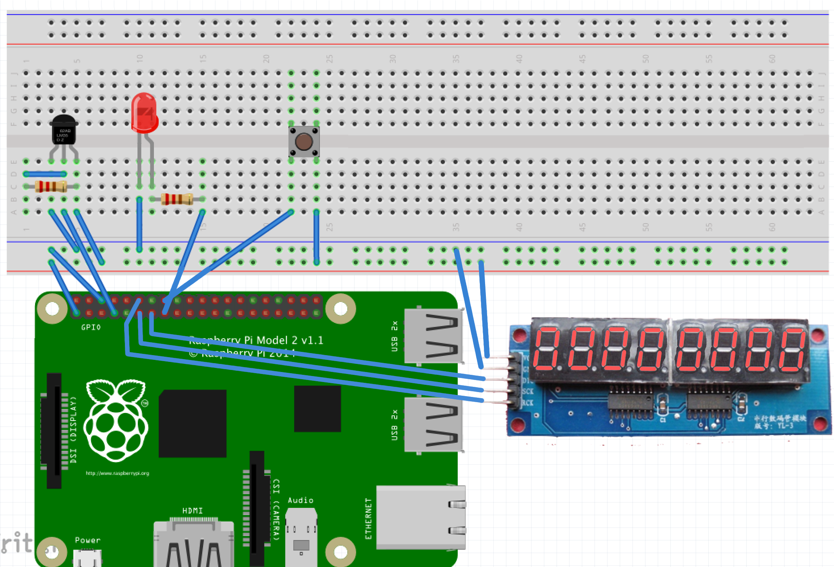
Connecting 1-wire Temp Sensor
NOTE: before hooking this up
POWER OFF! After it's hooked up
as seen below, get TA write off
before powering up and testing
it with code. Neglecting TA sign-off
will result in public humiliation.
GPIO 22
GND
GPIO 23
3v3
GPIO 4
GPIO 27
GPIO 17
GPIO 18
TA Initials

Slide 34
Coding for the 1-wire
Temp Sensor
Now to use the 1-wire temp
sensor, we're just importing the
PiSlice.py module, initializing it,
and calling PiSlice.read_temp() like
this (below). The code below will do
this and then output the fahrenheit
value to the PiSlice.number output (LEDs).
Create a new program
called “temp.py”.
Get it working?
import PiSlice
PiSlice.init()
PiSlice.init_temp()
while True:
c, f = PiSlice.read_temp()
PiSlice.number = f
TA Initials

Slide 35
Combine Temp Sensor
and 7-segment LED
Combine “temp.py” and
the needed code from
“logger.py” into a new
program “piTempLogger.py”.
Now you have the temp sensor
working and the previous LED code
from logger.py. Now combine them
to:
Measure the temperature once per second
Display the temperature on
7-segment LED display
+
TA Initials

Slide 36

Pi in the sky
Getting your Raspberry Pi project online

Slide 37

Email Your Temp Data
Python can send and receive emails using the SMTP protocol.
You can send yourself data logged from the pi over email
Your email address is LetsCodePi@gmail.com
Ask instructor for password

Slide 38

Sending emails
In a new file
called ‘mail.py’
import smtplib
fromaddr = 'LetsCodePi@gmail.com'
toaddrs = 'to@addr.com'
msg = 'testing'
# Credentials (if needed)
username = 'LetsCodePi@gmail.com'
password = 'LetsCode'
# The actual mail send
server = smtplib.SMTP('smtp.gmail.com:587')
server.ehlo()
server.starttls()
server.ehlo()
server.login(username,password)
server.sendmail(fromaddr, toaddrs, msg)
server.quit()

Slide 39

Final challenge
In ‘logger.py’
Make a program based off of the button counter that can show the number of emails you have and the current room's temperature. Cycle through these modes by pressing the button and display your output on the 7 segment displays.

