Slide 1

AIML for Robotics
Module 3
Localization
Section Faculty:
Dr. Sangeetha Viswanathan

Slide 2
The course owner and the authors of this course deck, Prof. Raja vadhana and Dr.Sangeetha, are gratefully acknowledging all authors who made their course materials freely available online.

Slide 3
Course Content
Introduction
  Types of Robots
  Mobile Robots – Use case of Programmable solutions
Components of Programmable Robotic System
  Perception
  Representation
  Motion
Localization
  Taxonomy
  Types
Mapping
  Feature Based
  Grid Based
Path Planning
  Graph Based
  Sample Based
  Evolutional Techniques
Human – Robot Interaction
  Ethics
  Introduction to Visual Bot
  Introduction to Chat Bot

Slide 4
Today's Roadmap
01
What is a map frame?
Global vs robot frame, and the translate + rotate math that bridges them.
02
Where does localization show up?
Mobile robots (Roomba, AMR, Mars rover) and software agents (cyber bots, RPA, crawlers).
03
What kind of localization problem is it?
A four-axis taxonomy: static/dynamic, single/multi, local/global, passive/active.
04
How does grid-based localization work?
The histogram filter end-to-end: predict step (motion) and update step (measurement).
05
Where does AI/ML fit?
Noisy sensors, learned models, action recommendation. And when to switch to Monte Carlo.

Slide 5
The Big Question
“Where am I?”
Every autonomous system — physical or digital — must answer this repeatedly, in real time, from noisy and incomplete information.
PERCEPTION
LOCALIZATION
ACTION
Perception
Localization
Action / Planning
Sense the world — LIDAR, camera, packet, log.
Convert sensing into a belief about state.
Decide what to do given that belief.
← We are here

Slide 6
Map Frame

Slide 7
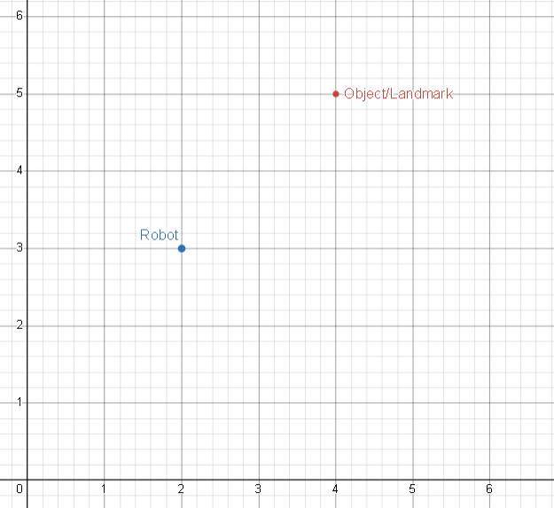

Frame
X=4,Y=5
Global Map Frame
Range(r, o) = ~3.16 meters
$${Pose}_{robot}{=\left[\begin{matrix}x \\ y \\ θ\end{matrix}\right]=\left[\begin{matrix}2 \\ 3 \\ 0\end{matrix}\right]}_{}$$
$${ObjPose}_{r}{=\left[\begin{matrix}x \\ y \\ θ\end{matrix}\right]=\left[\begin{matrix}4 \\ 5 \\ −\end{matrix}\right]}_{}$$
X=2,Y=3

Slide 8
The Global Map Frame
A fixed origin and axes everyone in the system agrees on
All landmarks, walls, and the robot's pose are expressed in one fixed coordinate system.
Y
Landmark (4,5)
Robot pose: (2, 3), θ = 45°
Landmark: (4, 5)
Range: √8 ≈ 2.83 m
KEY IDEA
Robot (2,3,45°)
The map frame is fixed. It does not know or care where the robot is — it is the reference the robot localizes against.
Origin is picked at map-creation time (a warehouse corner, a lat-lon, etc.).
X

Slide 9
The Local Robot Frame
The robot's own system — origin at itself, x-axis along its heading
Everything the robot does — “move forward 1 m”, “scan at +30°”, “wall on my left” — is naturally expressed in this frame.
GLOBAL MAP FRAME
LOCAL ROBOT FRAME
What the map says
What the robot sees
Robot at (2, 3), θ = 45°
Landmark at (4, 5)
Origin = fixed point on the map
Axes along map north / east
Robot at the origin (0, 0)
x'-axis = direction it faces
y'-axis = 90° to the left
Landmark = (2.83, 0) straight ahead
The robot is one object among many here.
Same landmark, two valid coordinates.

Slide 10
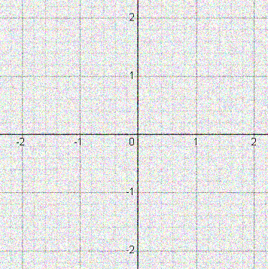
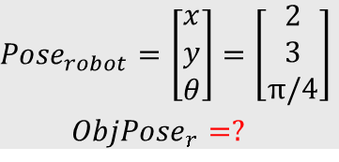
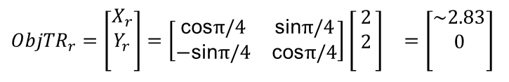

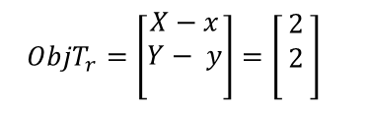
Frame
Rot($\text{θ} )= \left[\begin{matrix}\text{cos}\text{θ} & \text{−}\text{sin}\text{θ} \\ \text{sin}\text{θ} & \text{cos}\text{θ}\end{matrix}\right]$
Rot($−\text{θ} )= \left[\begin{matrix}\text{cos}\text{θ} & \text{sin}\text{θ} \\ −\text{sin}\text{θ} & \text{cos}\text{θ}\end{matrix}\right]$
X=4,Y=5
Local Robot Frame
Translate map point to robot frame
Rotate coordinates by –θ
$${Pose}_{robot}{=\left[\begin{matrix}x \\ y \\ θ\end{matrix}\right]=\left[\begin{matrix}2 \\ 3 \\ π/4\end{matrix}\right]}_{}$$
$${ObjPose}_{r}{=?}_{}$$
X=2,
Y=3,
Θ = 45
$${ObjT}_{r}{=\left[\begin{matrix}X−x \\ Y− y \\ \end{matrix}\right]=\left[\begin{matrix}2 \\ 2 \\ \end{matrix}\right]}_{}$$
X=2,
Y=3,
Θ = 45
${ObjTR}_{r}{=\left[\begin{matrix}X_{r} \\ Y_{r} \\ \end{matrix}\right]=\left[\begin{matrix}\text{cos}π/4 & \text{sin}π/4 \\ −\text{sin}π/4 & \text{cos}π/4\end{matrix}\right]\left[\begin{matrix}2 \\ 2 \\ \end{matrix}\right]}_{}$ $=\left[\begin{matrix}\sim 2.83 \\ 0 \\ \end{matrix}\right]$

Slide 11
Frame
Rot($\text{θ} )= \left[\begin{matrix}\text{cos}\text{θ} & \text{−}\text{sin}\text{θ} \\ \text{sin}\text{θ} & \text{cos}\text{θ}\end{matrix}\right]$
Rot($−\text{θ} )= \left[\begin{matrix}\text{cos}\text{θ} & \text{sin}\text{θ} \\ −\text{sin}\text{θ} & \text{cos}\text{θ}\end{matrix}\right]$
X=4,Y=5
Local Robot Frame
Translate map point to robot frame
Rotate coordinates by –θ
$${Pose}_{robot}{=\left[\begin{matrix}x \\ y \\ θ\end{matrix}\right]=\left[\begin{matrix}2 \\ 3 \\ π/4\end{matrix}\right]}_{}$$
$${ObjPose}_{r}{=?}_{}$$
X=2,
Y=3,
Θ = 45
$${ObjT}_{r}{=\left[\begin{matrix}X−x \\ Y− y \\ \end{matrix}\right]=\left[\begin{matrix}2 \\ 2 \\ \end{matrix}\right]}_{}$$
X=2,
Y=3,
Θ = 45
${ObjTR}_{r}{=\left[\begin{matrix}X_{r} \\ Y_{r} \\ \end{matrix}\right]=\left[\begin{matrix}\text{cos}π/4 & \text{sin}π/4 \\ −\text{sin}π/4 & \text{cos}π/4\end{matrix}\right]\left[\begin{matrix}2 \\ 2 \\ \end{matrix}\right]}_{}$ $=\left[\begin{matrix}\sim 2.83 \\ 0 \\ \end{matrix}\right]$

Slide 12
Frame
Rot($\text{θ} )= \left[\begin{matrix}\text{cos}\text{θ} & \text{−}\text{sin}\text{θ} \\ \text{sin}\text{θ} & \text{cos}\text{θ}\end{matrix}\right]$
Rot($−\text{θ} )= \left[\begin{matrix}\text{cos}\text{θ} & \text{sin}\text{θ} \\ −\text{sin}\text{θ} & \text{cos}\text{θ}\end{matrix}\right]$
X=4,Y=5
Local Robot Frame
Translate map point to robot frame
Rotate coordinates by –θ
$${Pose}_{robot}{=\left[\begin{matrix}x \\ y \\ θ\end{matrix}\right]=\left[\begin{matrix}2 \\ 3 \\ π/4\end{matrix}\right]}_{}$$
$${ObjPose}_{r}{=?}_{}$$
X=2,
Y=3,
Θ = 45
$${ObjT}_{r}{=\left[\begin{matrix}X−x \\ Y− y \\ \end{matrix}\right]=\left[\begin{matrix}2 \\ 2 \\ \end{matrix}\right]}_{}$$
${ObjTR}_{r}{=\left[\begin{matrix}X_{r} \\ Y_{r} \\ \end{matrix}\right]=\left[\begin{matrix}\text{cos}π/4 & \text{sin}π/4 \\ −\text{sin}π/4 & \text{cos}π/4\end{matrix}\right]\left[\begin{matrix}2 \\ 2 \\ \end{matrix}\right]}_{}$ $=\left[\begin{matrix}\sim 2.83 \\ 0 \\ \end{matrix}\right]$

Slide 13
Frame
Rot($\text{θ} )= \left[\begin{matrix}\text{cos}\text{θ} & \text{−}\text{sin}\text{θ} \\ \text{sin}\text{θ} & \text{cos}\text{θ}\end{matrix}\right]$
Rot($−\text{θ} )= \left[\begin{matrix}\text{cos}\text{θ} & \text{sin}\text{θ} \\ −\text{sin}\text{θ} & \text{cos}\text{θ}\end{matrix}\right]$
X=4,Y=5
Local Robot Frame
Translate map point to robot frame
Rotate coordinates by –θ
$${Pose}_{robot}{=\left[\begin{matrix}x \\ y \\ θ\end{matrix}\right]=\left[\begin{matrix}2 \\ 3 \\ π/4\end{matrix}\right]}_{}$$
$${ObjPose}_{r}{=?}_{}$$
X=2,
Y=3,
Θ = 45
$${ObjT}_{r}{=\left[\begin{matrix}X−x \\ Y− y \\ \end{matrix}\right]=\left[\begin{matrix}2 \\ 2 \\ \end{matrix}\right]}_{}$$
${ObjTR}_{r}{=\left[\begin{matrix}X_{r} \\ Y_{r} \\ \end{matrix}\right]=\left[\begin{matrix}\text{cos}π/4 & \text{sin}π/4 \\ −\text{sin}π/4 & \text{cos}π/4\end{matrix}\right]\left[\begin{matrix}2 \\ 2 \\ \end{matrix}\right]}_{}$ $=\left[\begin{matrix}\sim 2.83 \\ 0 \\ \end{matrix}\right]$

Slide 14

Frame
Rot($\text{θ} )= \left[\begin{matrix}\text{cos}\text{θ} & \text{−}\text{sin}\text{θ} \\ \text{sin}\text{θ} & \text{cos}\text{θ}\end{matrix}\right]$
Rot($−\text{θ} )= \left[\begin{matrix}\text{cos}\text{θ} & \text{sin}\text{θ} \\ −\text{sin}\text{θ} & \text{cos}\text{θ}\end{matrix}\right]$
X=4,Y=5
Local Robot Frame
$${Pose}_{robot}{=\left[\begin{matrix}x \\ y \\ θ\end{matrix}\right]=\left[\begin{matrix}0 \\ 0 \\ 0\end{matrix}\right]}_{}$$
$${ObjPose}_{r}=\left[\begin{matrix}2.828 \\ 0 \\ −\end{matrix}\right]$$
X=2,
Y=3,
Θ = 45

Slide 15
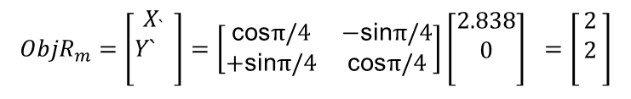
Frame
Rot($\text{θ} )= \left[\begin{matrix}\text{cos}\text{θ} & \text{−}\text{sin}\text{θ} \\ \text{sin}\text{θ} & \text{cos}\text{θ}\end{matrix}\right]$
Rot($−\text{θ} )= \left[\begin{matrix}\text{cos}\text{θ} & \text{sin}\text{θ} \\ −\text{sin}\text{θ} & \text{cos}\text{θ}\end{matrix}\right]$
X=4,Y=5
Local Robot Frame
Rotate coordinates by +θ
$${Pose}_{robot}{=\left[\begin{matrix}x \\ y \\ θ\end{matrix}\right]=\left[\begin{matrix}0 \\ 0 \\ 0\end{matrix}\right]}_{}$$
$${ObjPose}_{r}=\left[\begin{matrix}2.828 \\ 0 \\ −\end{matrix}\right]$$
X=2,
Y=3,
Θ = 45
$${ObjR}_{m}{=\left[\begin{matrix}X_{`} \\ {Y`}_{} \\ \end{matrix}\right]=\left[\begin{matrix}\text{cos}π/4 & −\text{sin}π/4 \\ +\text{sin}π/4 & \text{cos}π/4\end{matrix}\right]\left[\begin{matrix}2.838 \\ 0 \\ \end{matrix}\right]}_{}=\left[\begin{matrix}2 \\ 2 \\ \end{matrix}\right]$$

Slide 16
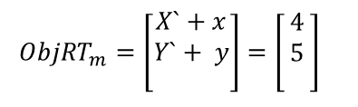
Frame
Rot($\text{θ} )= \left[\begin{matrix}\text{cos}\text{θ} & \text{−}\text{sin}\text{θ} \\ \text{sin}\text{θ} & \text{cos}\text{θ}\end{matrix}\right]$
Rot($−\text{θ} )= \left[\begin{matrix}\text{cos}\text{θ} & \text{sin}\text{θ} \\ −\text{sin}\text{θ} & \text{cos}\text{θ}\end{matrix}\right]$
X=4,Y=5
Local Robot Frame
Rotate coordinates by +θ
Translate robot to map frame
$${Pose}_{robot}{=\left[\begin{matrix}x \\ y \\ θ\end{matrix}\right]=\left[\begin{matrix}0 \\ 0 \\ 0\end{matrix}\right]}_{}$$
$${ObjPose}_{r}=\left[\begin{matrix}2.828 \\ 0 \\ −\end{matrix}\right]$$
X=2,
Y=3,
Θ = 45
$${ObjR}_{m}{=\left[\begin{matrix}X_{`} \\ {Y`}_{} \\ \end{matrix}\right]=\left[\begin{matrix}\text{cos}π/4 & −\text{sin}π/4 \\ +\text{sin}π/4 & \text{cos}π/4\end{matrix}\right]\left[\begin{matrix}2.838 \\ 0 \\ \end{matrix}\right]}_{}=\left[\begin{matrix}2 \\ 2 \\ \end{matrix}\right]$$
$${ObjRT}_{m}{=\left[\begin{matrix}X`+x \\ Y`+ y \\ \end{matrix}\right]=\left[\begin{matrix}4 \\ 5 \\ \end{matrix}\right]}_{}$$

Slide 17
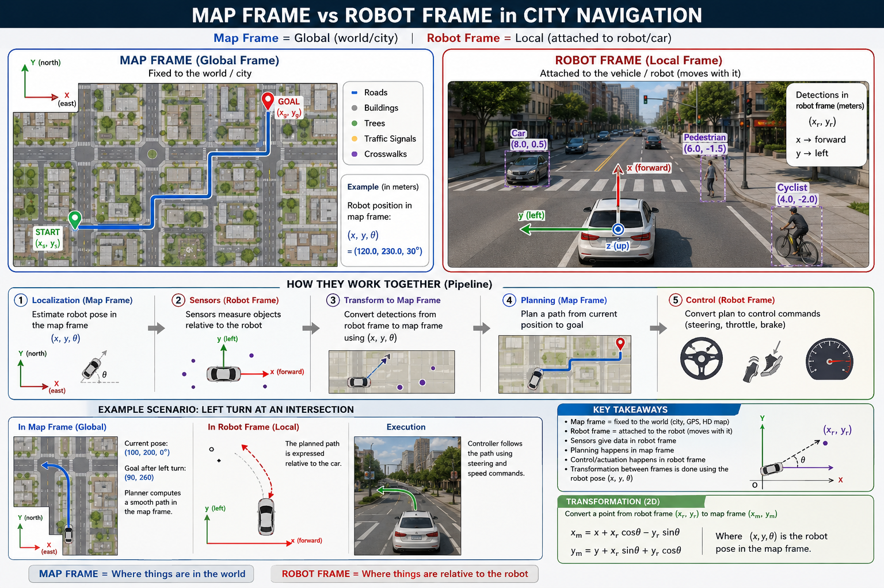

Slide 18
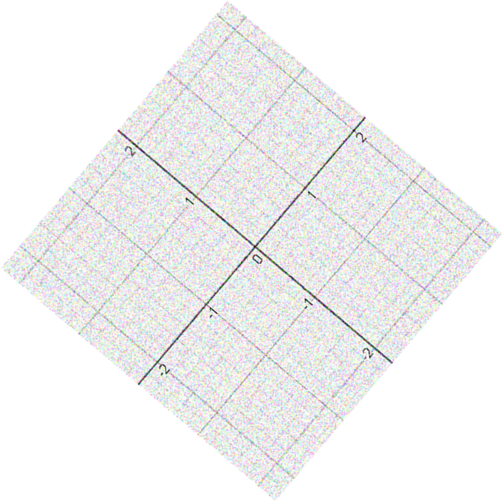
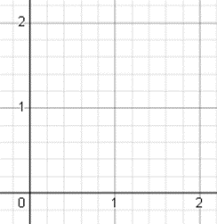
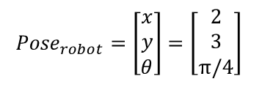
Robot Localization
Sensor Data : Z _{t}
$${Pose}_{robot}{=\left[\begin{matrix}x \\ y \\ θ\end{matrix}\right]=\left[\begin{matrix}2 \\ 3 \\ π/4\end{matrix}\right]}_{}$$

Slide 19
Robot Localization — Formally
A continuous estimation problem, not a one-shot fix
DEFINITION
Localization is the problem of maintaining a probability distribution over the robot's pose, given a map, a sequence of control inputs, and a sequence of sensor measurements.
Inputs
Output
Map (m)
bel(xₜ)
World model — 2D grid, point cloud, topological graph.
Belief — a probability distribution over all possible poses at time t.
Bayes filter
Controls (u₁:t)
Control inputs — wheel velocities, steering, accelerations.
predict + update
Measurements (z₁:t)
Sensor readings — LIDAR, camera, IMU, GPS.
Not a single number — a distribution. “I'm 70% sure I'm here, 25% over there, 5% scattered.”

Slide 20
Use Cases — Mobile Robots
State = (x, y, θ). Sensors = LIDAR, camera, IMU, odometry, GPS.
Warehouse AMR
Roomba / vacuum
Self-driving car
Finds itself in the pallet aisle.
Knows which rooms it cleaned.
Lane-level pose vs HD map.
Mars rover
Delivery drone
Surgical robot
Visual-inertial pose, no GPS.
Geo-pose for last-100m landing.
Tool-tip pose vs anatomy.

Slide 21
Use Cases — Software Agents
State = (host, subnet, privilege). “Sensors” = packets, syscalls, logs.
Pen-test bot
Threat-hunter
SOAR bot
Locates itself in the net graph.
Pinpoints attacker's stage.
Finds the kill-chain stage.
attacker is here
Recon
Foot
Lateral
Exfil
← step?
you are here
Web crawler
RPA bot
Game NPC
Its position in the site graph.
Its place in a workflow.
Pose in a virtual world.
/
/a
/blog
/c
crawler is here
step 3 of 4

Slide 22
The Shared Bayes-Filter Pattern
Physical or digital, the math is the same — only the state changes
THE BAYES-FILTER PATTERN
bel(xₜ) = η · p(zₜ | xₜ) · ∫ p(xₜ | uₜ, xₜ₋₁) · bel(xₜ₋₁) dxₜ₋₁
Predict (motion) → Update (measurement) → Normalize → Loop.
Component
Physical (mobile robot)
Logical (software agent)
State (xₜ)
Pose: (x, y, θ)
Network position: (host, subnet, privilege)
Action (uₜ)
Move forward 1 m, turn 30°
scp file, sudo, click button
Sensor (zₜ)
LIDAR ranges, image, IMU
Packet capture, log line, API response
Goal
Reach pose (xg, yg)
Reach asset (DB server, admin shell)
“Where am I?” is the same question. The substrate changes; the algorithm doesn't.

Slide 23
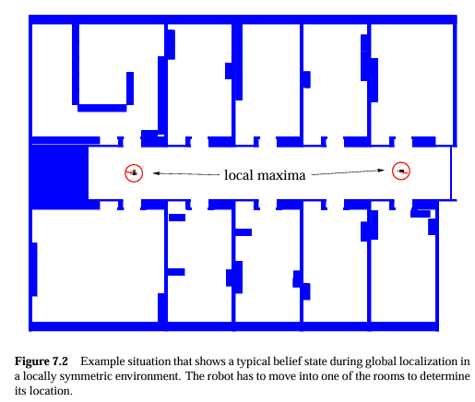
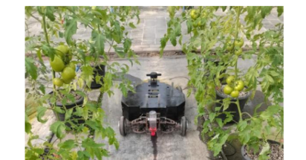
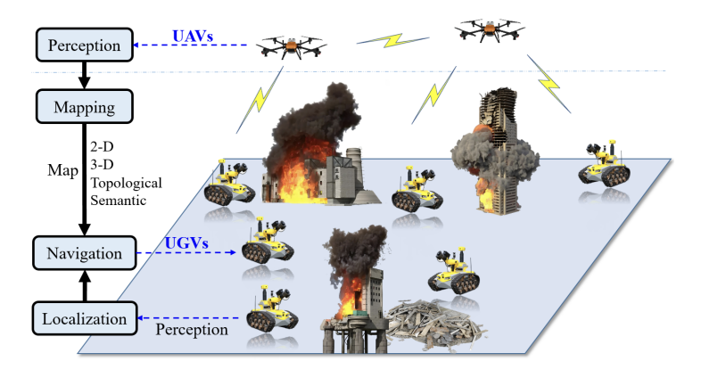
Taxonomy of Localization Problems
Problem Types
Static vs Dynamic
Environment
Single vs multiple
Agent/s
Local vs Global
Knowledge
Passive vs Active
Motion Control
Varying Features of the Environment
Knowledge of Initial Pose
Level of Uncertainty
Recovery from Failures : Kidnapped Robot Problem
Necessity for Real time Control

Slide 24
Four Axes of Localization Problems
Pick a side on each axis — the combination tells you which algorithm applies
Environment
STATIC
DYNAMIC
Walls and landmarks don't move.
vs
People, vehicles, objects move.
Agents
SINGLE
MULTIPLE
One robot, one belief.
vs
Robots share or compete for a map.
Knowledge
LOCAL (tracking)
GLOBAL (kidnapped)
We know roughly where we started.
vs
No initial pose — could be anywhere.
Motion Control
PASSIVE
ACTIVE
Localize from whatever motion happens.
vs
Move on purpose to cut uncertainty.
Example: a Roomba in a quiet room is STATIC · SINGLE · LOCAL · PASSIVE → textbook grid filter works.

Slide 25
Axis 1 — Static vs Dynamic Environment
Does anything in the map move while the robot localizes?
STATIC
DYNAMIC
Map features don't change
Features change over time
Walls, landmarks and obstacles are fixed across the localization window.
People walk through, vehicles move, the attacker pivots between hosts.
EXAMPLES
EXAMPLES
Roomba in an empty room
Warehouse AMR after hours
Mars rover (Mars doesn't move)
Self-driving car in traffic
Service robot in an airport
Threat-hunter chasing a target

Slide 26
Axis 2 — Single vs Multiple Agents
Are we localizing one entity, or many that can share information?
SINGLE AGENT
MULTIPLE AGENTS
One robot, one belief
Several robots, shared map
All information comes from this robot's own sensors and motion history.
Robots observe each other and share beliefs — cooperative localization.
EXAMPLES
EXAMPLES
Single Roomba in a house
Solo Mars rover
One pen-test bot on a target
Warehouse fleet (Amazon, Ocado)
Drone swarm in search & rescue
Connected vehicles (V2V)
WHY HARDER
Joint belief grows exponentially with the number of agents — needs decentralized algorithms.

Slide 27
Axis 3 — Local vs Global Knowledge
How well do we know the initial pose? Can we recover if moved?
LOCAL (tracking)
GLOBAL (kidnapped)
We know where we started
Could be anywhere
Belief is a tight unimodal distribution; the filter tracks small corrections.
Belief starts uniform — every cell equally likely; converge from scratch.
EXAMPLES
EXAMPLES
Roomba returning to dock
Lane keeping in a car
Arm tracking from a zero
Roomba just turned on
Robot picked up and moved
Bot dropped in unknown subnet
KIDNAPPED-ROBOT PROBLEM
A confident robot is teleported. Grid filters keep mass everywhere and can recover; pure Kalman filters collapse to one mode and stay wrong.

Slide 28
Axis 4 — Passive vs Active Localization
Do we choose motions to help ourselves localize?
PASSIVE
ACTIVE
Localize from whatever happens
Move to reduce uncertainty
Motion is dictated by the task; the filter just reads u and z.
Pick the action with the most expected information gain — go disambiguate.
EXAMPLES
EXAMPLES
Roomba runs its clean pattern
Car drives the chosen route
Crawler follows existing links
Drive to a corner to break symmetry
Rover picks informative viewpoint
Active scanning to ID the OS
WHERE RL SHINES
Active localization learns a policy that minimises belief entropy — a major entry point for reinforcement learning.

Slide 29
Where AI/ML Lives Inside Localization
Five entry points into the classical Bayes pipeline
Component
Why classical struggles
Where AI/ML helps
Motion model p(xₜ|uₜ,xₜ₋₁)
Wheels slip, terrain varies.
Learn noise from telemetry (GP regression).
Measurement model p(zₜ|xₜ)
Sensor responses non-Gaussian.
Neural likelihood — CNN(image, pose) → score.
Map representation
Hand-built maps go stale.
Learned features (SuperPoint); NeRF / occupancy fields.
State estimator itself
Real distributions are weird.
DeepKF / deep variational filters learn the update.
Active control policy
Hand-tuned heuristics fall short.
RL — reward = information gain.
ML wins where the analytical model breaks down — unmodellable terrain, non-Gaussian sensors.

Slide 30
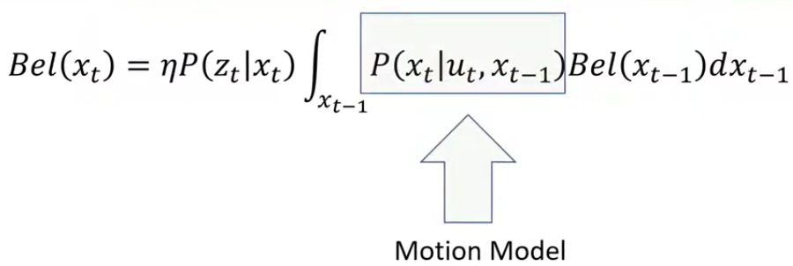
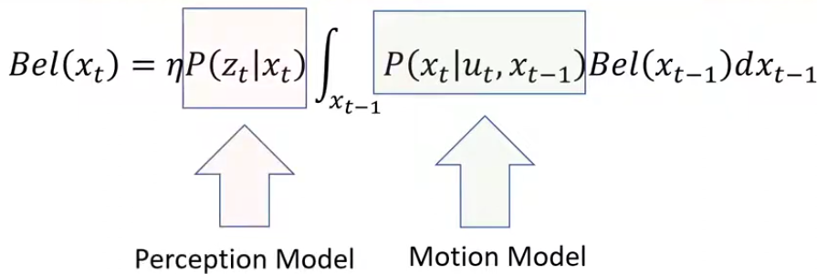
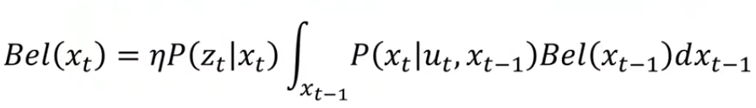
Discrete Bayes Filters

Slide 31
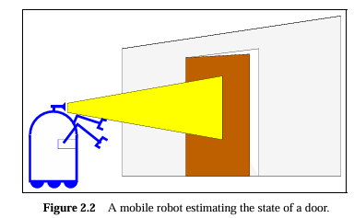
Recursive State Estimation
Bayes Filter Algorithm
X_{t-1} | U_{t} | P(X_{t} =is_open) | P(X_{t} =is_closed)
is_open | push | 1 | 0
Is_closed | Push | 0.8 | 0.2
is_open | do_nothing | 1 | 0
Is_closed | do_nothing | 0 | 1
X₀ | P(X₀)
is_open | 0.5
Is_closed | 0.5
Initial Belief
Control Update
Measurement Update
X_{t} | P(Z_{t = sense_open}) | P(Z_{t = sense_closed})
is_open | 0.6 | 0.4
Is_closed | 0.2 | 0.8

Slide 32
Grid Based Localization
Histogram Filter Approach

Slide 33
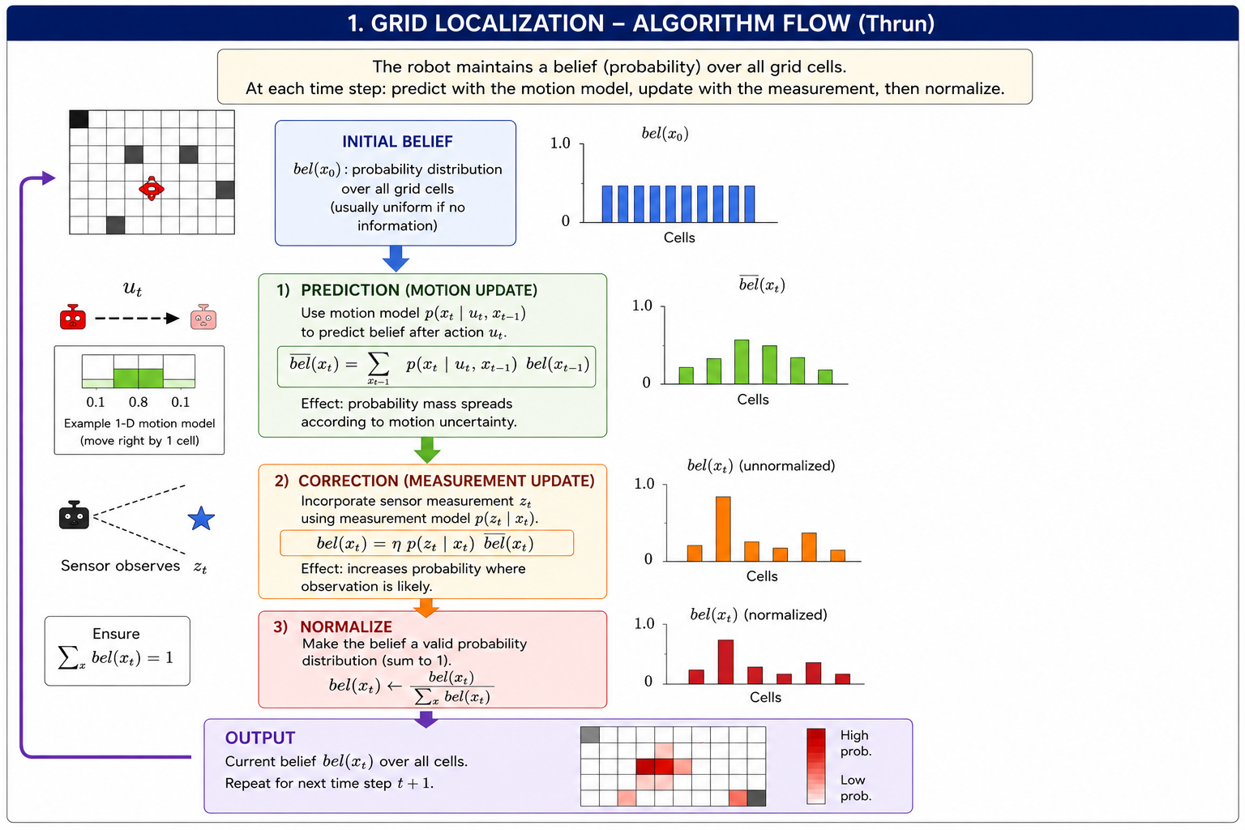
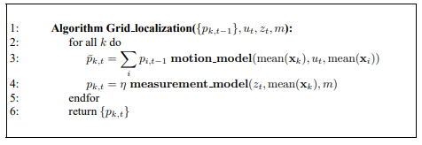

Slide 34
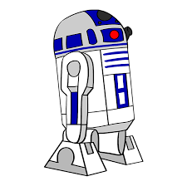
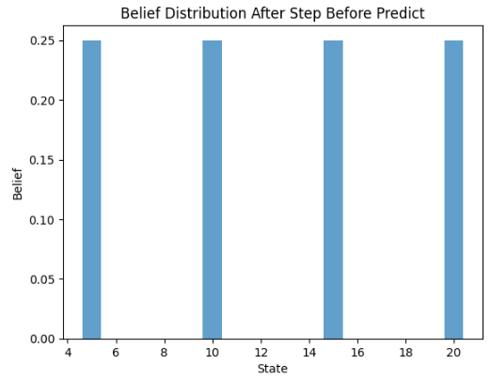
Grid Based Localization
Histogram Filter Approach
X₀ | P(X₀)
5 | 0.25
10 | 0.25
15 | 0.25
20 | 0.25
X=5 | X=10 | X=15 | X=20
X_{t} | P(Z_{t} =5) | P(Z_{t} =10) | P(Z_{t} =15) | P(Z_{t} =20)
5 | 0.8 | 0.1 | 0.1 | 0
10 | 0.3 | 0.4 | 0.2 | 0.1
15 | 0.1 | 0.2 | 0.4 | 0.3
20 | 0 | 0.1 | 0.1 | 0.8

Slide 35
Grid Based Localization
Histogram Filter Approach
X_{t} | P(Z_{t} =15)
5 | 0.1
10 | 0.2
15 | 0.4
20 | 0.1
X₀ | P(X₀)
5 | 0.25
10 | 0.25
15 | 0.25
20 | 0.25
X=5 | X=10 | X=15 | X=20
X_{t-1} | U_{t} | P(X_{t} =5) | P(X_{t} =10) | P(X_{t} =15) | P(X_{t} =20)
5 | → | 0.2 | 0.6 | 0.2 | 0
10 | → | 0.3 | 0.1 | 0.6 | 0.1
15 | → | 0.1 | 0.3 | 0.1 | 0.5
20 | → | 0 | 0.1 | 0.3 | 0.6
Predict Step:
(Motion)
Update Step:
(Measurement)

Slide 36
Grid Based Localization
Histogram Filter Approach
X_{t} | P(Z_{t} =15)
5 | 0.1
10 | 0.2
15 | 0.4
20 | 0.1
X₀ | P(X₀)
5 | 0.25
10 | 0.25
15 | 0.25
20 | 0.25
X=5 | X=10 | X=15 | X=20
X_{t-1} | U_{t} | P(X_{t} =5) | P(X_{t} =10) | P(X_{t} =15) | P(X_{t} =20)
5 | → | 0.2 | 0.6 | 0.2 | 0
10 | → | 0.3 | 0.1 | 0.6 | 0.1
15 | → | 0.1 | 0.3 | 0.1 | 0.5
20 | → | 0 | 0.1 | 0.3 | 0.6
Predict Step:

Slide 37
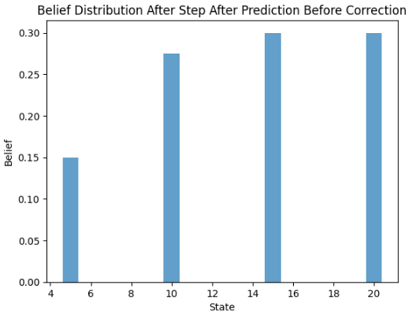
Grid Based Localization
Histogram Filter Approach
X_{t} | P(Z_{t} =15)
5 | 0.1
10 | 0.2
15 | 0.4
20 | 0.1
X₀ | P(X₀)
5 | 0.25
10 | 0.25
15 | 0.25
20 | 0.25
X=5 | X=10 | X=15 | X=20
X_{t-1} | U_{t} | P(X_{t} =5) | P(X_{t} =10) | P(X_{t} =15) | P(X_{t} =20)
* | → | 0.15 | 0.275 | 0.3 | 0.3
Predict Step:

Slide 38
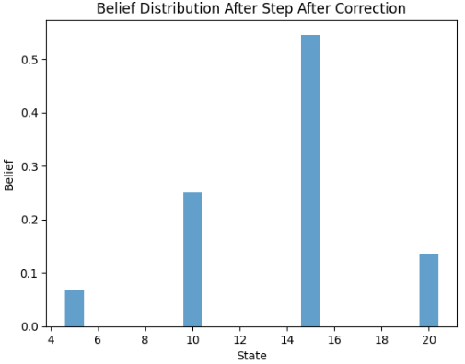
Grid Based Localization
Histogram Filter Approach
X_{t} | P(Z_{t} =15)
5 | 0.1
10 | 0.2
15 | 0.4
20 | 0.1
X₀ | P(X₀)
5 | 0.25
10 | 0.25
15 | 0.25
20 | 0.25
X=5 | X=10 | X=15 | X=20
X_{t-1} | U_{t} | P(X_{t} =5) | P(X_{t} =10) | P(X_{t} =15) | P(X_{t} =20)
* | → | 0.15 | 0.275 | 0.3 | 0.3
 |  | 0.015 | 0.055 | 0.12 | 0.03
 |  | 0.06 | 0.25 | 0.55 | 0.14
Update Step:

Slide 39
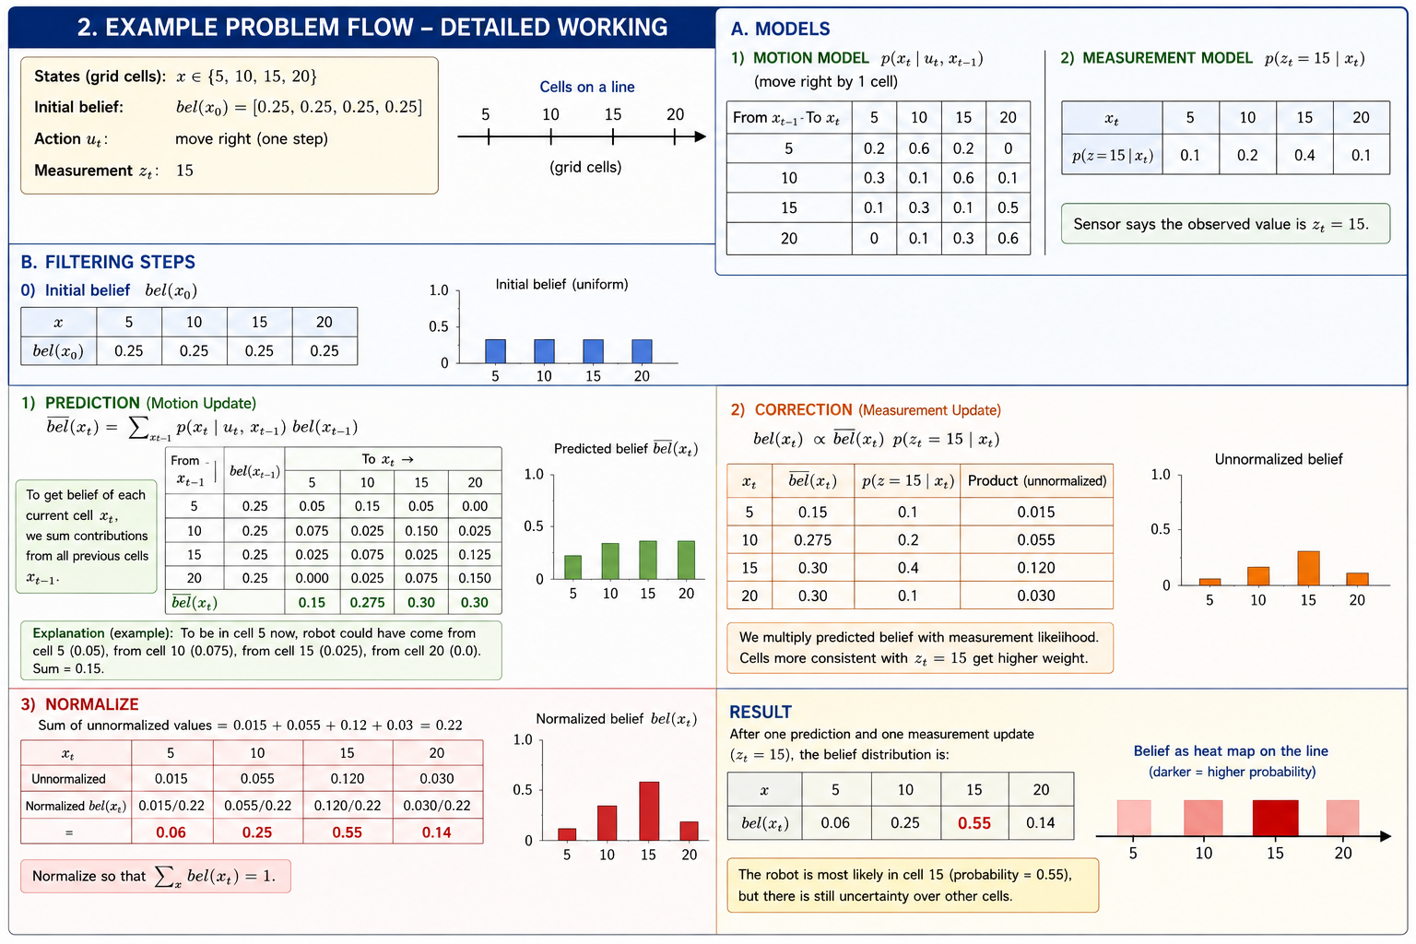

Slide 40
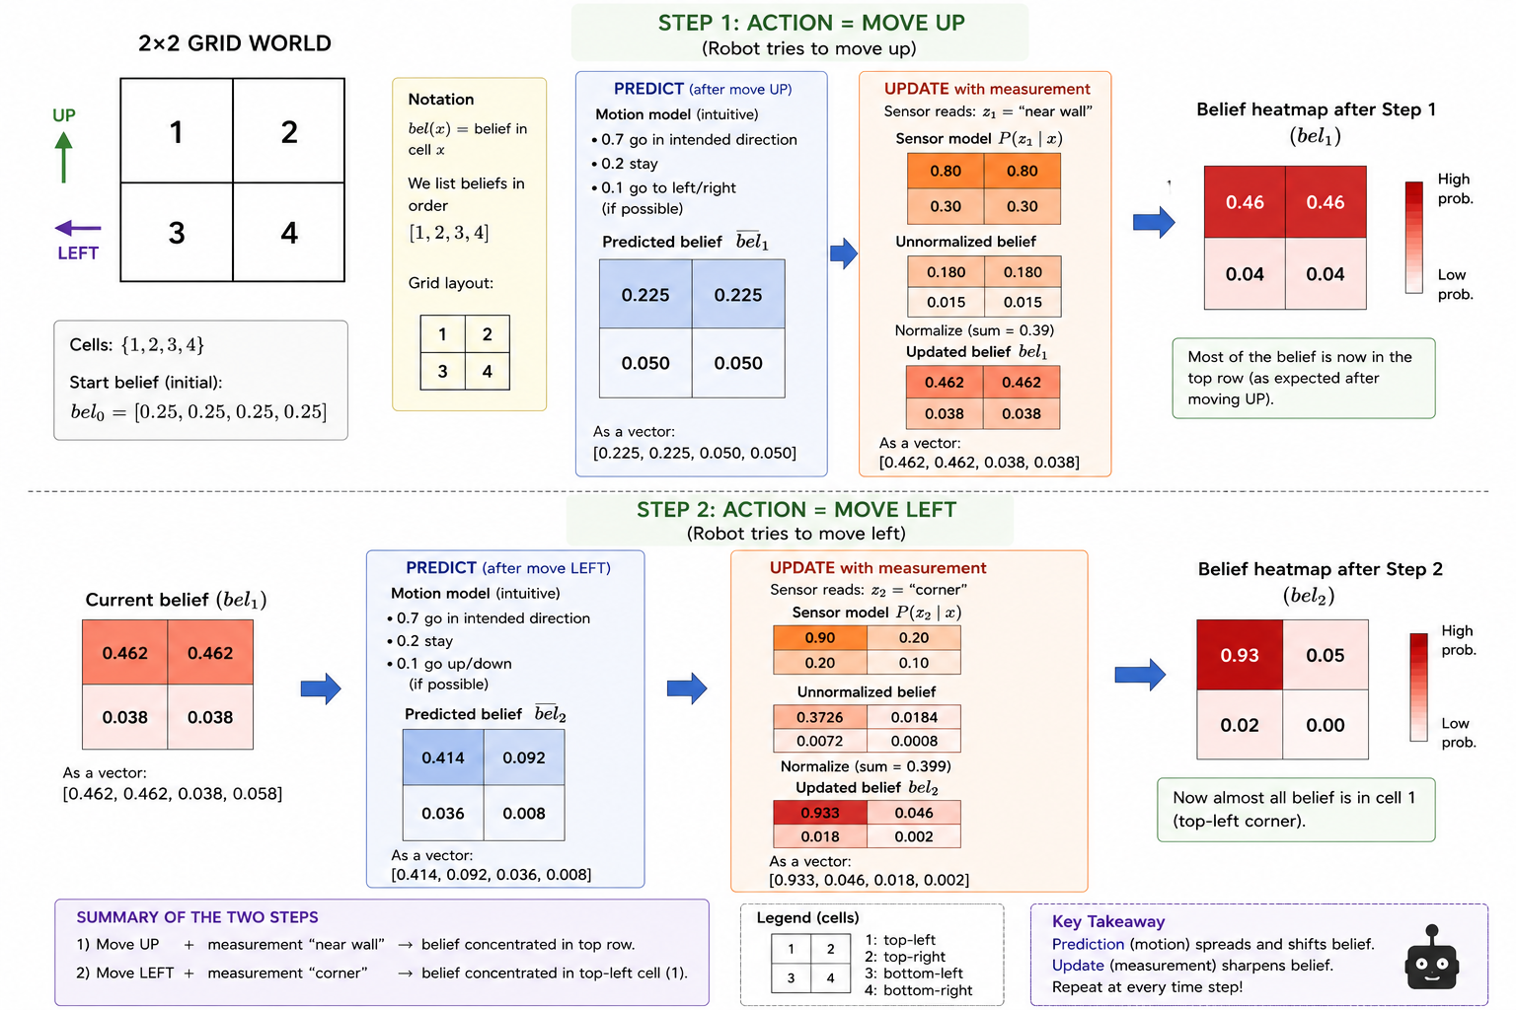

Slide 41
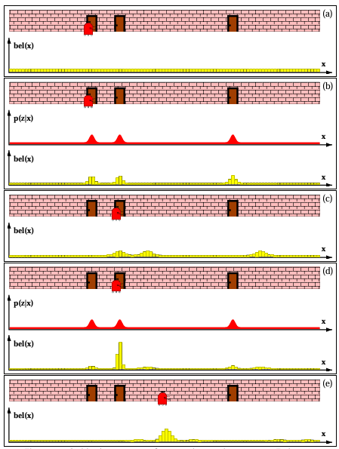
Grid Based Localization
Histogram Filter Approach

Slide 42
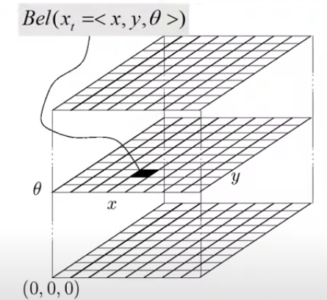
Grid Based Localization :
Piecewise Constant Approximation
Accuracy Vs Resource Intensive

Slide 43
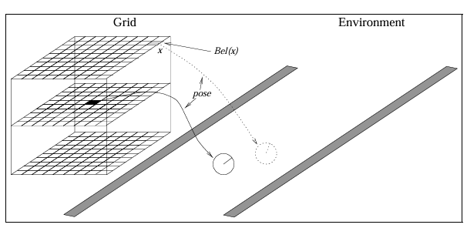
Grid Based Localization :
Optimization Techniques
Fine Grained Representation with fixed Grid Structures

Slide 44
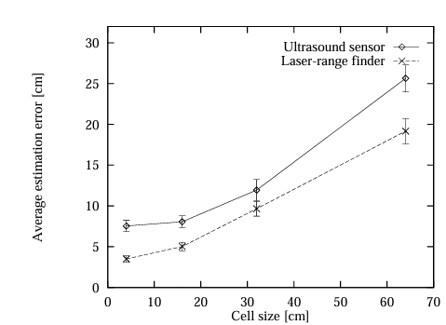
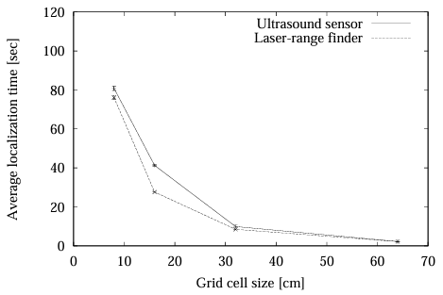
Grid Based Localization :
Optimization Techniques
Fine Grained Representation with fixed Grid Structures

Slide 45
AIML in Grid Localization :
Use Cases:
Multiple Sensor Input are available . Measurement Models are noisy.
Image Captured from camera as streams
Recommend Actions for localization

Slide 46
Grid Based Localization :
Optimization Techniques
Fine Grained Representation with fixed Grid Structures
Pre-caching
Sensor Sub Sampling
Delayed Motion Updates
Selective Updating
Heuristics

Slide 47
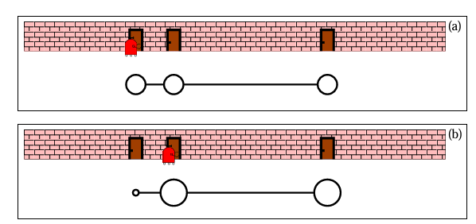
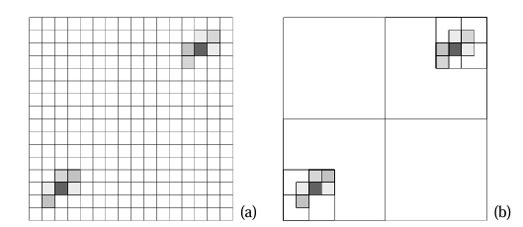
Grid Based Localization :
Optimization Techniques
Coarse Grained Representation with Dynamic Grid Structures
Topological Representation
Inflate Motion Noise
Inflate Measurement Noise

Slide 48
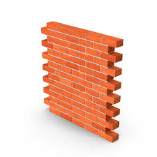
Grid Based Localization :
Optimization Techniques
Time | Pose | Grid | Bel(0) | Bel(1)
Coarse Grained Representation with Dynamic Grid Structures
Topological Representation
Inflate Motion Noise
Inflate Measurement Noise
1m Grid
Robot moves right to 0.2m from x=0
Landmark at 3m
0 | 0.0 | 0 | 1.0 | 0
1 | 0.2 | 0 | 1.0 | 0
2 | 0.4 | 0 | 1.0 | 0
3 | 0.6 | 0 | 1.0 | 0
4 | 0.8 | 0 | 1.0 | 0
5 | 1.0 | 1 | 0 | 1.0
G=0 (0,0) | G=1 | G=2 | G=3

Slide 49
Grid Based Localization :
Optimization Techniques
Time | Pose | Grid | Bel(0) | Bel(1)
Coarse Grained Representation with Dynamic Grid Structures
Topological Representation
Inflate Motion Noise
Inflate Measurement Noise
1m Grid
Robot moves right to 0.2m from x=0
Landmark at 3m
0 | 0.0 | 0 | 1.0 | 0
1 | 0.2 | 0 | 0.8 | 0.2
2 | 0.4 | 0 | 0.64 | 0.36
3 | 0.6 | 0 | 0.512 | 0.488
4 | 0.8 | 0 | 0.41 | 0.59
5 | 1.0 | 1 | 0.33 | 0.67
Add Noise to Motion by adding small probability proportional to movement / cellSize = 20%
G=0 (0,0) | G=1 | G=2 | G=3

Slide 50
Grid Based Localization :
Optimization Techniques
Coarse Grained Representation with Dynamic Grid Structures
Topological Representation
Inflate Motion Noise
Inflate Measurement Noise
1m Grid
At t=2, Robot is at 0.4m and senses landmark at 2.6m
Keep sensor noise = 0.1
Landmark at 3m= Mean
P(Z | X) = 0.0003 (Apply Gaussian Dist)
Inference :
Most likely the robot is not in Grid 0 !!!!
P(Z | X) = 0.73 (Apply Gaussian Dist)
Inference :
Most likely the robot is not in Grid 0 !!!!
Grid | Mean | P(Z|X)0.1 | P(Z|X) 0.5
0 | 3m | 0.003 | 0.73
1 | 2m | ~0 | 0.37
2 | 1m | ~0 | 0.03
Add Noise to Motion Model Eg., 0.5
G=0 (0,0) | G=1 | G=2 | G=3

Slide 51
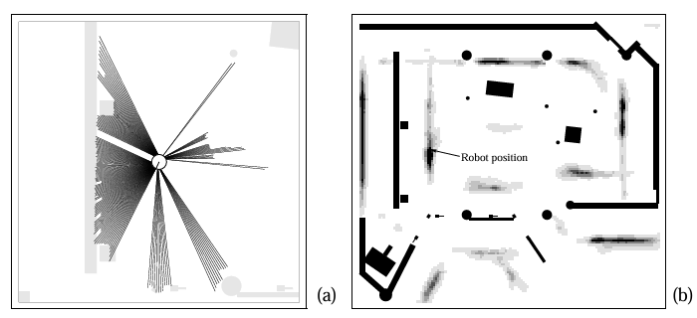
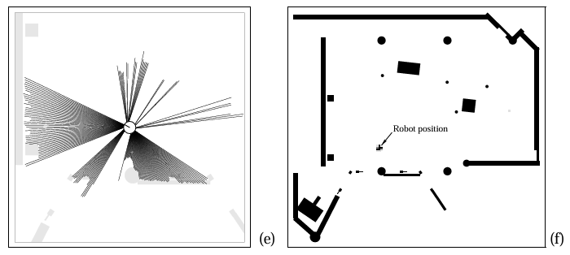
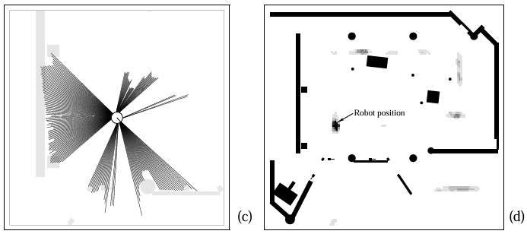
Grid Based Localization :
Illustration
Set up 1:
15 centimeter and an angular resolution of 5 degrees
Two Laser Finders
Bean Sensor Model
Subsampling

Slide 52
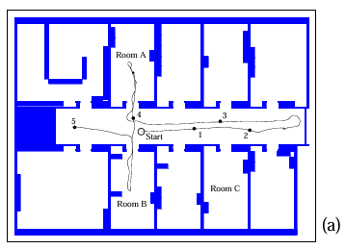
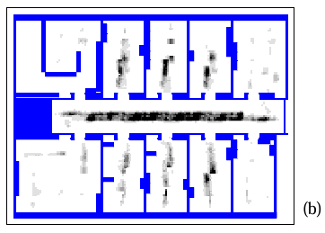
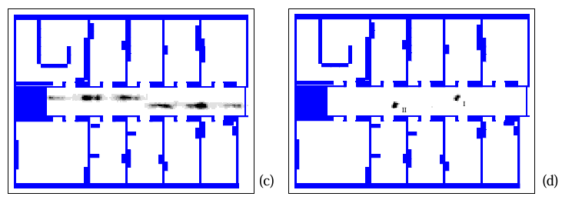
Grid Based Localization :
Illustration

Slide 53
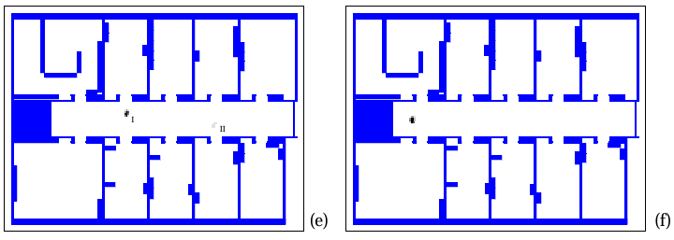
Grid Based Localization :
Illustration

Slide 54
AI/ML in Grid-Based Localization, Specifically
Four very concrete places it pays off
01
Fusing many noisy sensors
LIDAR + camera + IMU + WiFi together: train a net mapping (cell, raw packet) → likelihood, plug into the histogram update.
USE CASE → multi-sensor mobile robot
02
Camera streams as measurements
A frame is too high-dim for an analytical likelihood. A CNN outputs a heatmap over cells — that heatmap IS p(zₜ|xₜ).
USE CASE → visual localization, no LIDAR
03
Action recommendation (active)
Which action maximises info gain? Classical entropy calc is slow; RL learns a policy π(u | bel) directly.
USE CASE → kidnapped-robot recovery
04
Learning the motion noise
Instead of hand-picking 20% / 50% inflation, train a model to predict per-cell noise from odometry vs ground truth.
USE CASE → AMR on slippery surfaces

Slide 55
Required Reading
T1 Chapter #4, #7, #8
T2 Chapter #6.1, #6.2
Next Class Plan
Monte Carlo Based Localization

