Slide 1

AIML for Robotics
Module 3
Localization
Section Faculty:
Raja vadhana Prabhakar

Slide 2
The course owner and the authors of this course deck, Prof. Raja vadhana and Dr.Sangeetha, are gratefully acknowledging all authors who made their course materials freely available online.

Slide 3
Course Content
Introduction
  Types of Robots
  Mobile Robots – Use case of Programmable solutions
Components of Programmable Robotic System
  Perception
  Representation
  Motion
Localization
  Taxonomy
  Types
Mapping
  Feature Based
  Grid Based
Path Planning
  Graph Based
  Sample Based
  Evolutional Techniques
Human – Robot Interaction
  Ethics
  Introduction to Visual Bot
  Introduction to Chat Bot

Slide 4
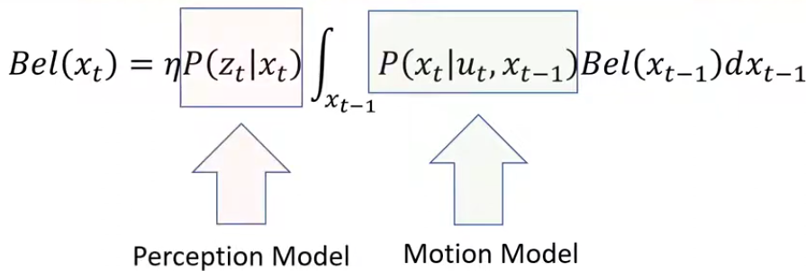
Monte Carlo Based Localization
Particle Filter Approach

Slide 5
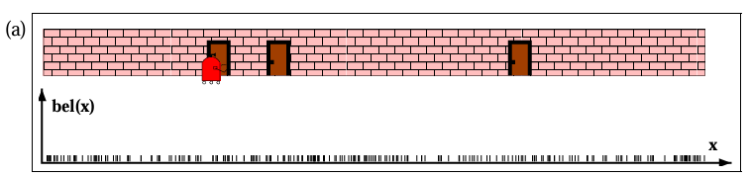
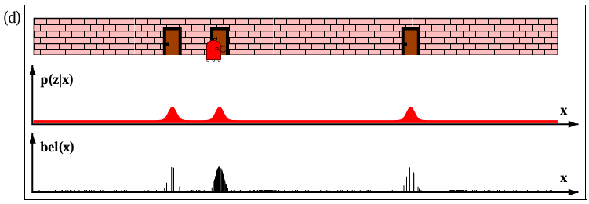
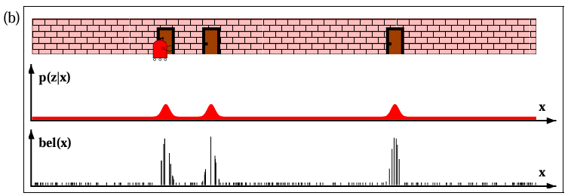
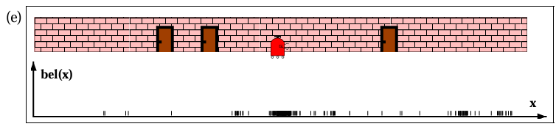
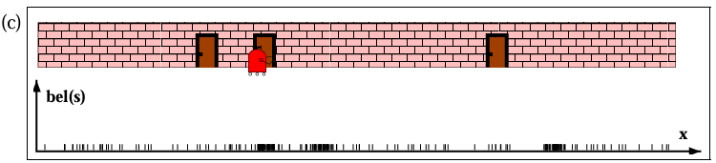
Monte Carlo Based Localization
Particle Filter Approach

Slide 6
Monte Carlo Based Localization
Particle Filter Approach
Initialize
Predict : Motion Update
Correct : Measurement Update
Preprocess
Weigh
Resample
Repeat
Initialize M Particles P_{i} with uniform belief
Move each P_{i} based on robot motion model
Compare predicted sensor reading Z _{expected} with actual sensor reading Z _{measured}
Optionally filter out surprising measurements
Weigh each P_{i} based on importance weights
Resample for particle set for next iteration based on Darwinian approach
Reset the belief of particles with equal likelihood

Slide 7
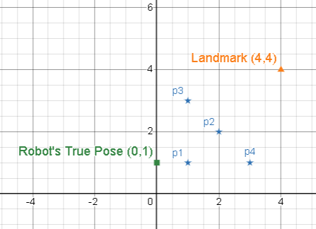
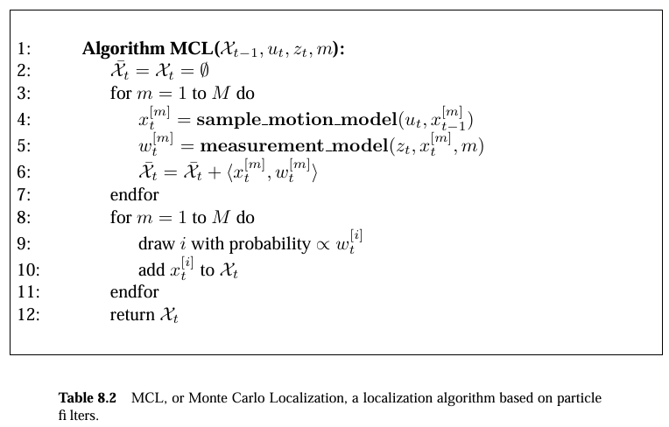
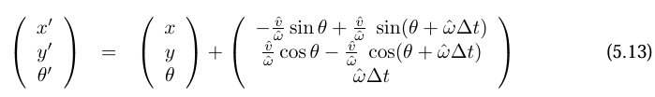
Monte Carlo Based Localization
MCL Algorithm
Initialize : M=4, 2D, 5X5, L(4.4), Move 1m east, Sensor noise = 0.5, Z _{m} = 5m
Predict : Motion Update
Correct : Measurement Update
Preprocess
Weigh
Resample
Repeat
 | P1 | P2 | P3 | P4
Pose $X_{0}$ | (1,1,0) | (2,2,0) | (3,1,0) | (1,3,0)
Bel($X_{0}^{m})$ | 0.25 | 0.25 | 0.25 | 0.25

Slide 8
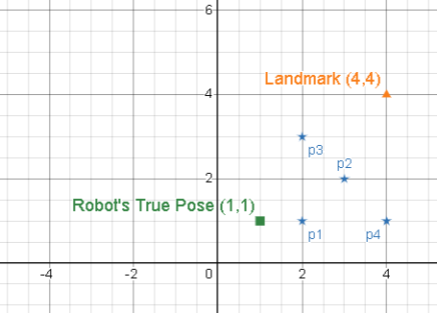
Monte Carlo Based Localization
MCL Algorithm
Initialize : M=4, 2D, 5X5, L(4.4), Move 1m east, Sensor noise = 0.5, Z _{m} = 5m
Predict : Motion Update
Correct : Measurement Update
Preprocess
Weigh
Resample
Repeat
 | P1 | P2 | P3 | P4
Pose $X_{0}$ | (1,1,0) | (2,2,0) | (3,1,0) | (1,3,0)
Bel($X_{0}^{m})$ | 0.25 | 0.25 | 0.25 | 0.25
$$X_{1}$$ | (2,1,0) | (3,2,0) | (4,1,0) | (2,3,0)
Inefficient form (modified for simplicity)
$\left(\begin{aligned}x_{t} \\ y_{t} \\ θ_{t}\end{aligned}\right)=\left(\begin{aligned}x_{t−1} \\ y_{t−1} \\ θ_{t−1}\end{aligned}\right)$+$\left(\begin{aligned}vcosθ∆t \\ vsinθ∆t \\ w∆t\end{aligned}\right)$
Linear Regression Model $x_{t}$ = $x_{t−1}$ +1

Slide 9


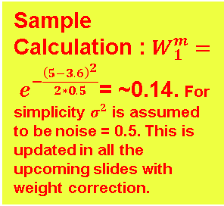
Monte Carlo Based Localization
MCL Algorithm
Initialize : M=4, 2D, 5X5, L(4.4), Move 1m east, Sensor noise = 0.5, Z _{m} = 5m
Predict : Motion Update
Correct : Measurement Update
Preprocess
Weigh
Resample
Repeat
 | P1 | P2 | P3 | P4
Pose $X_{0}$ | (1,1,0) | (2,2,0) | (3,1,0) | (1,3,0)
Bel($X_{0}^{m})$ | 0.25 | 0.25 | 0.25 | 0.25
$$X_{1}$$ | (2,1,0) | (3,2,0) | (4,1,0) | (2,3,0)
Z _{e} | 3.6 | 2.24 | 3 | 2.24
Sample Calculation :$W_{1}^{m}= e^{−\frac{{\left(5−3.6\right)}^{2}}{2∗0.5}}$= ~0.14. For simplicity $σ^{2}$ is assumed to be noise = 0.5. This is updated in all the upcoming slides with weight correction.
(modified for simplicity)

Slide 10
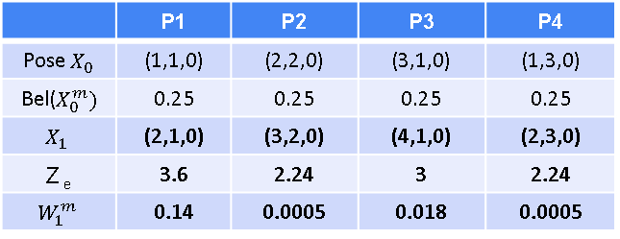
Monte Carlo Based Localization
MCL Algorithm
Initialize : M=4, 2D, 5X5, L(4.4), Move 1m east, Sensor noise = 0.5, Z _{m} = 5m
Predict : Motion Update
Correct : Measurement Update
Preprocess
Weigh
Resample
Repeat
 | P1 | P2 | P3 | P4
Pose $X_{0}$ | (1,1,0) | (2,2,0) | (3,1,0) | (1,3,0)
Bel($X_{0}^{m})$ | 0.25 | 0.25 | 0.25 | 0.25
$$X_{1}$$ | (2,1,0) | (3,2,0) | (4,1,0) | (2,3,0)
Z _{e} | 3.6 | 2.24 | 3 | 2.24
$$W_{1}^{m}$$ | 0.14 | 0.0005 | 0.018 | 0.0005
(modified for simplicity)

Slide 11
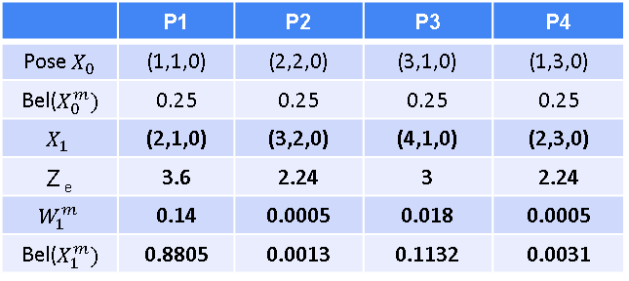
Monte Carlo Based Localization
MCL Algorithm
Initialize : M=4, 2D, 5X5, L(4.4), Move 1m east, Sensor noise = 0.5, Z _{m} = 5m
Predict : Motion Update
Correct : Measurement Update
Preprocess
Weigh
Resample
Repeat
 | P1 | P2 | P3 | P4
Pose $X_{0}$ | (1,1,0) | (2,2,0) | (3,1,0) | (1,3,0)
Bel($X_{0}^{m})$ | 0.25 | 0.25 | 0.25 | 0.25
$$X_{1}$$ | (2,1,0) | (3,2,0) | (4,1,0) | (2,3,0)
Z _{e} | 3.6 | 2.24 | 3 | 2.24
$$W_{1}^{m}$$ | 0.14 | 0.0005 | 0.018 | 0.0005
Bel($X_{1}^{m})$ | 0.8805 | 0.0013 | 0.1132 | 0.0031
(modified for simplicity)

Slide 12
Monte Carlo Based Localization
MCL Algorithm
Initialize : M=4, 2D, 5X5, L(4.4), Move 1m east, Sensor noise = 0.5, Z _{m} = 5m
Predict : Motion Update
Correct : Measurement Update
Preprocess
Weigh
Resample
Repeat
 | P1 | P2 | P3 | P4
Pose $X_{0}$ | (1,1,0) | (2,2,0) | (3,1,0) | (1,3,0)
Bel($X_{0}^{m})$ | 0.25 | 0.25 | 0.25 | 0.25
$$X_{1}$$ | (2,1,0) | (3,2,0) | (4,1,0) | (2,3,0)
Z _{e} | 3.6 | 2.24 | 3 | 2.24
$$W_{1}^{m}$$ | 0.14 | 0.0005 | 0.018 | 0.0005
Bel($X_{1}^{m})$ | 0.8805 | 0.0013 | 0.1132 | 0.0031

Slide 13
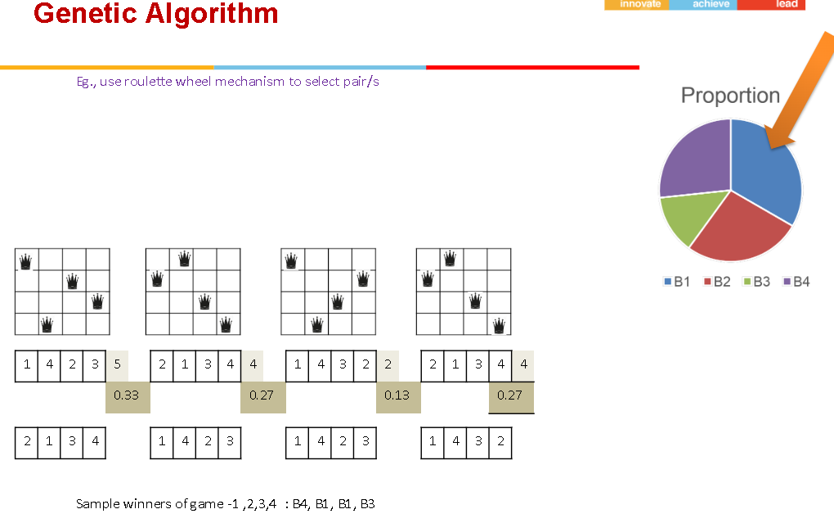

Slide 14
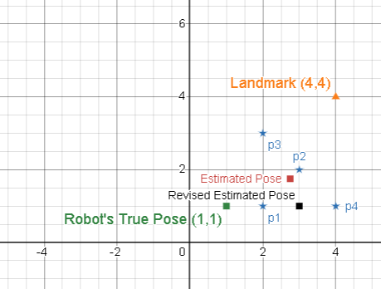
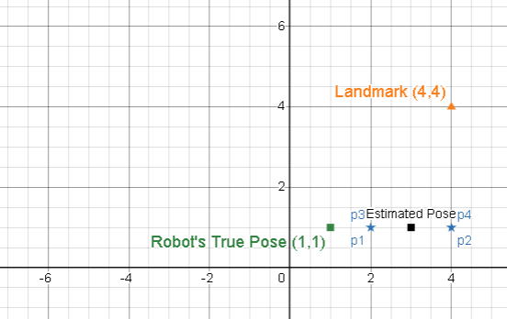
Monte Carlo Based Localization
MCL Algorithm
Initialize : M=4, 2D, 5X5, L(4.4), Move 1m east, Sensor noise = 0.5, Z _{m} = 5m
Predict : Motion Update
Correct : Measurement Update
Preprocess
Weigh
Resample
Repeat
One Naïve Estimation Model :
Average of Particles = (3,1,0)
 | P1 | P2 | P3 | P4
Pose $X_{0}$ | (1,1,0) | (2,2,0) | (3,1,0) | (1,3,0)
Bel($X_{0}^{m})$ | 0.25 | 0.25 | 0.25 | 0.25
$$X_{1}$$ | (2,1,0) | (3,2,0) | (4,1,0) | (2,3,0)
Z _{e} | 3.6 | 2.24 | 3 | 2.24
$$W_{1}^{m}$$ | 0.14 | 0.0005 | 0.018 | 0.0005
Bel($X_{1}^{m})$ | 0.8805 | 0.0013 | 0.1132 | 0.0031
 | P1 | P2 | P3 | P4
$$X_{1}$$ | (2,1,0) | (4,1,0) | (4,1,0) | (2,1,0)
Bel($X_{1}^{m})$ | 0.25 | 0.25 | 0.25 | 0.25

Slide 15
Monte Carlo Based Localization
Particle Filter Approach
Initialize
Predict : Motion Update
Correct : Measurement Update
Preprocess
Weigh
Resample
Repeat
Initialize M Particles P_{i} with uniform belief
Move each P_{i} based on robot motion model
Compare predicted sensor reading Z _{expected} with actual sensor reading Z _{measured}
Optionally filter out surprising measurements
Weigh each P_{i} based on importance weights
Resample for particle set for next iteration based on Darwinian approach
Reset the belief of particles with equal likelihood

Slide 16
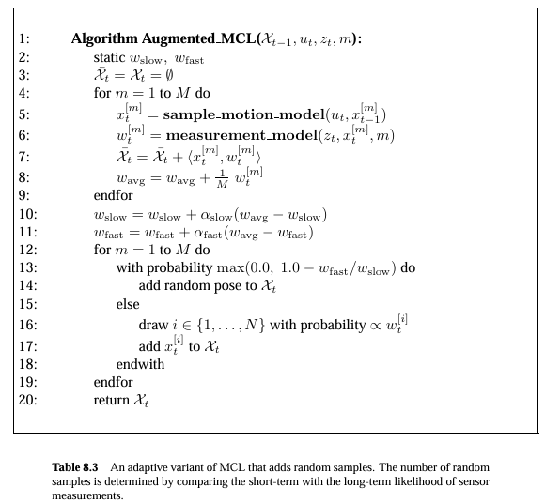
Monte Carlo Based Localization
Augmented MCL Algorithm
Initialize : M=4, 2D, 5X5, L(4.4), Move 1m east, Sensor noise = 0.5, Z _{m} = 5m, α _{fast} = 0.5, α _{slow} = 0.1
Predict : Motion Update
Correct : Measurement Update
Preprocess
Weigh
Resample
Repeat
 | P1 | P2 | P3 | P4
Pose $X_{0}$ | (1,1,0) | (2,2,0) | (3,1,0) | (1,3,0)
Bel($X_{0}^{m})$ | 0.25 | 0.25 | 0.25 | 0.25
No Change

Slide 17
Monte Carlo Based Localization
Augmented MCL Algorithm
Initialize : M=4, 2D, 5X5, L(4.4), Move 1m east, Sensor noise = 0.5, Z _{m} = 5m , α _{fast} = 0.5, α _{slow} = 0.1
Predict : Motion Update
Correct : Measurement Update
Preprocess
Weigh
Resample
Repeat
 | P1 | P2 | P3 | P4
Pose $X_{0}$ | (1,1,0) | (2,2,0) | (3,1,0) | (1,3,0)
Bel($X_{0}^{m})$ | 0.25 | 0.25 | 0.25 | 0.25
$$X_{1}$$ | (2,1,0) | (3,2,0) | (4,1,0) | (2,3,0)
No Change
(modified for simplicity)
$\left(\begin{aligned}x_{t} \\ y_{t} \\ θ_{t}\end{aligned}\right)=\left(\begin{aligned}x_{t−1} \\ y_{t−1} \\ θ_{t−1}\end{aligned}\right)$+$\left(\begin{aligned}vcosθ∆t \\ vsinθ∆t \\ w∆t\end{aligned}\right)$
Linear Regression Model $x_{t}$ = $x_{t−1}$ +1

Slide 18
Monte Carlo Based Localization
Augmented MCL Algorithm
Initialize : M=4, 2D, 5X5, L(4.4), Move 1m east, Sensor noise = 0.5, Z _{m} = 5m , α _{fast} = 0.5, α _{slow} = 0.1
Predict : Motion Update
Correct : Measurement Update
Preprocess
Weigh
Resample
Repeat
 | P1 | P2 | P3 | P4
Pose $X_{0}$ | (1,1,0) | (2,2,0) | (3,1,0) | (1,3,0)
Bel($X_{0}^{m})$ | 0.25 | 0.25 | 0.25 | 0.25
$$X_{1}$$ | (2,1,0) | (3,2,0) | (4,1,0) | (2,3,0)
Z _{e} | 3.6 | 2.24 | 3 | 2.24
No Change
(modified for simplicity)

Slide 19
Monte Carlo Based Localization
Augmented MCL Algorithm
Initialize : M=4, 2D, 5X5, L(4.4), Move 1m east, Sensor noise = 0.5, Z _{m} = 5m , α _{fast} = 0.5, α _{slow} = 0.1
Predict : Motion Update
Correct : Measurement Update
Preprocess
Weigh
Resample
Repeat
 | P1 | P2 | P3 | P4
Pose $X_{0}$ | (1,1,0) | (2,2,0) | (3,1,0) | (1,3,0)
Bel($X_{0}^{m})$ | 0.25 | 0.25 | 0.25 | 0.25
$$X_{1}$$ | (2,1,0) | (3,2,0) | (4,1,0) | (2,3,0)
Z _{e} | 3.6 | 2.24 | 3 | 2.24
$$W_{1}^{m}$$ | 0.14 | 0.0005 | 0.018 | 0.0005
No Change
(modified for simplicity)

Slide 20
Monte Carlo Based Localization
Augmented MCL Algorithm
Initialize : M=4, 2D, 5X5, L(4.4), Move 1m east, Sensor noise = 0.5, Z _{m} = 5m , α _{fast} = 0.5, α _{slow} = 0.1
Predict : Motion Update
Correct : Measurement Update
Preprocess
Weigh
Resample
Repeat
 | P1 | P2 | P3 | P4
Pose $X_{0}$ | (1,1,0) | (2,2,0) | (3,1,0) | (1,3,0)
Bel($X_{0}^{m})$ | 0.25 | 0.25 | 0.25 | 0.25
$$X_{1}$$ | (2,1,0) | (3,2,0) | (4,1,0) | (2,3,0)
Z _{e} | 3.6 | 2.24 | 3 | 2.24
$$W_{1}^{m}$$ | 0.14 | 0.0005 | 0.018 | 0.0005
Bel($X_{1}^{m})$ | 0.8805 | 0.0013 | 0.1132 | 0.0031
No Change
(modified for simplicity)

Slide 21
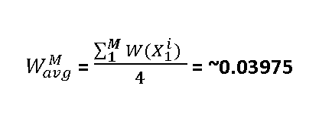
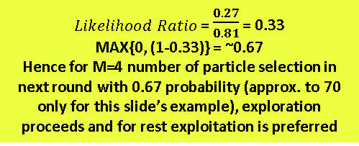
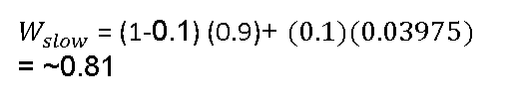
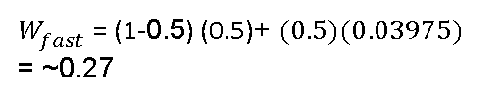
Monte Carlo Based Localization
Augmented MCL Algorithm
Note : Changes are made to illustrate both the process. Assume Short term likelihood = 0.5 instead of 0 and long term likelihood of 0.9 instead of 0.
Since initial values used in live class room discussion was not yielding the expected inference this is updated.
Initialize : M=4, 2D, 5X5, L(4.4), Move 1m east, Sensor noise = 0.5, Z _{m} = 5m , α _{fast} = 0.5, α _{slow} = 0.1
Predict : Motion Update
Correct : Measurement Update
Preprocess
Weigh
Resample
Repeat
One Naïve Estimation Model :
Average of Particles = (3,1,0)
$W_{avg}^{M}$ = $\frac{\sum_{1}^{M}{{W(X}_{1}^{i}) }}{4}$ = ~0.03975
 | P1 | P2 | P3 | P4
Pose $X_{0}$ | (1,1,0) | (2,2,0) | (3,1,0) | (1,3,0)
Bel($X_{0}^{m})$ | 0.25 | 0.25 | 0.25 | 0.25
$$X_{1}$$ | (2,1,0) | (3,2,0) | (4,1,0) | (2,3,0)
Z _{e} | 3.6 | 2.24 | 3 | 2.24
$$W_{1}^{m}$$ | 0.14 | 0.0005 | 0.018 | 0.0005
Bel($X_{1}^{m})$ | 0.8805 | 0.0013 | 0.1132 | 0.0031
$W_{fast}^{}$ = (1- α _{fast}) $W_{fast}^{}$ + ${\text{α} \text{fast} W}_{avg}^{}$
$W_{fast}^{}$ = (1-0.5) (0.5)+ ${(0.5)(0.03975)}_{}^{}$
= ~0.27
$W_{slow}^{}$ = (1- α _{slow}) $W_{slow}^{}$ + ${\text{α} slow W}_{avg}^{}$
$Likelihood Ratio$ = $\frac{0.27}{0.81}$ = 0.33
MAX{0, (1-0.33)} = ~0.67
Hence for M=4 number of particle selection in next round with 0.67 probability (approx. to 70 only for this slide’s example), exploration proceeds and for rest exploitation is preferred
$W_{slow}^{}$ = (1-0.1) (0.9)+ ${(0.1)(0.03975)}_{}^{}$
= ~0.81
Inference : Approx. 30% of Particles are Informative. Retain them . Need randomization for other 70% of M particles!

Slide 22
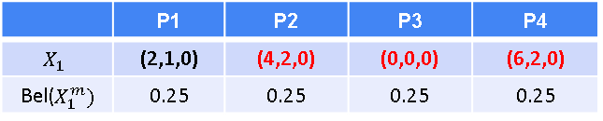
Monte Carlo Based Localization
Augmented MCL Algorithm
Initialize : M=4, 2D, 5X5, L(4.4), Move 1m east, Sensor noise = 0.5, Z _{m} = 5m , α _{fast} = 0.5, α _{slow} = 0.1
Predict : Motion Update
Correct : Measurement Update
Preprocess
Weigh
Resample
Repeat
One Naïve Estimation Model :
Average of Particles = (2,1,0)
 | P1 | P2 | P3 | P4
Pose $X_{0}$ | (1,1,0) | (2,2,0) | (3,1,0) | (1,3,0)
Bel($X_{0}^{m})$ | 0.25 | 0.25 | 0.25 | 0.25
$$X_{1}$$ | (2,1,0) | (3,2,0) | (4,1,0) | (2,3,0)
Z _{e} | 3.6 | 2.24 | 3 | 2.24
$$W_{1}^{m}$$ | 0.14 | 0.0005 | 0.018 | 0.0005
Bel($X_{1}^{m})$ | 0.8805 | 0.0013 | 0.1132 | 0.0031
 | P1 | P2 | P3 | P4
$$X_{1}$$ | (2,1,0) | (4,2,0) | (0,0,0) | (6,2,0)
Bel($X_{1}^{m})$ | 0.25 | 0.25 | 0.25 | 0.25
Based on previous assumptions note that for next iteration 3 particles are picked from random process and only one (30%) of M is from old pool ie., P1. Proceed next iteration with this resampled pool of M particles!

Slide 23
Monte Carlo Based Localization
Particle Filter Approach
Initialize
Predict : Motion Update
Correct : Measurement Update
Preprocess
Weigh
Resample
Repeat
Initialize M Particles P_{i} with uniform belief
Move each P_{i} based on robot motion model
Compare predicted sensor reading Z _{expected} with actual sensor reading Z _{measured}
Optionally filter out surprising measurements
Weigh each P_{i} based on importance weights
Resample for particle set for next iteration based on Darwinian approach augmented with short term vs long term likelihood ratio
Reset the belief of particles with equal likelihood

Slide 24
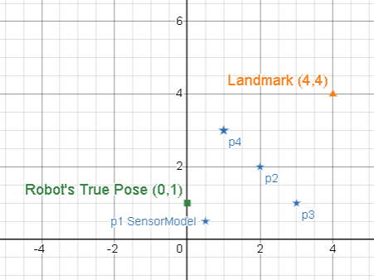
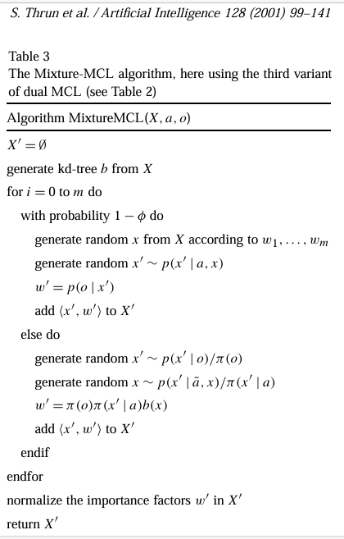
Monte Carlo Based Localization
Mixture(Dual) MCL Algorithm
Initialize : M=4, 2D, 5X5, L(4.4), Move 1m east, Sensor noise = 0.5, Z _{m} = 5m, Φ = 0.25
Predict
Correct
Preprocess
Weigh
Resample
Repeat
 | P1 | P2 | P3 | P4
Pose $X_{0}$ | (0.5, 0.5, 0) | (2,2,0) | (3,1,0) | (1,3,0)
Bel($X_{0}^{m})$ | 0.25 | 0.25 | 0.25 | 0.25
Important Note :The picture with algorithm is a variation of standard Mixture MCL for reference but the given numerical problem is a flavor of vanilla Mixture MCL.

Slide 25
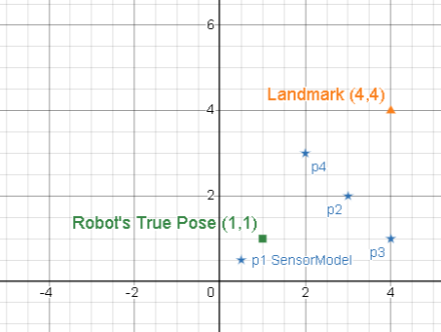
Monte Carlo Based Localization
Mixture(Dual) MCL Algorithm
Initialize : M=4, 2D, 5X5, L(4.4), Move 1m east, Sensor noise = 0.5, Z _{m} = 5m, Φ = 0.25
Predict
Correct
Preprocess
Weigh
Resample
Repeat
 | P1 | P2 | P3 | P4
Pose $X_{0}$ | (0.5, 0.5, 0) | (2,2,0) | (3,1,0) | (1,3,0)
Bel($X_{0}^{m})$ | 0.25 | 0.25 | 0.25 | 0.25
$$X_{1}$$ | (0.5, 0.5, 0) | (3,2,0) | (4,1,0) | (2,3,0)
(modified for simplicity)
$\left(\begin{aligned}x_{t} \\ y_{t} \\ θ_{t}\end{aligned}\right)=\left(\begin{aligned}x_{t−1} \\ y_{t−1} \\ θ_{t−1}\end{aligned}\right)$+$\left(\begin{aligned}vcosθ∆t \\ vsinθ∆t \\ w∆t\end{aligned}\right)$
Linear Regression Model $x_{t}$ = $x_{t−1}$ +1
P1 is drawn from the distribution of sensor measurement! Since P1will not be affected by motion model due to swap of role, its (x,y…) values remain same.

Slide 26
Monte Carlo Based Localization
Mixture(Dual) MCL Algorithm
Initialize : M=4, 2D, 5X5, L(4.4), Move 1m east, Sensor noise = 0.5, Z _{m} = 5m, Φ = 0.25
Predict
Correct
Preprocess
Weigh
Resample
Repeat
 | P1 | P2 | P3 | P4
Pose $X_{0}$ | (0.5, 0.5, 0) | (2,2,0) | (3,1,0) | (1,3,0)
Bel($X_{0}^{m})$ | 0.25 | 0.25 | 0.25 | 0.25
$$X_{1}$$ | (0.5, 0.5, 0) | (3,2,0) | (4,1,0) | (2,3,0)
Z _{e} | ~4.95 | 2.24 | 3 | 2.24
Ze is measured using this form as usual.
But for P1 alternatively you may redesign a motion model based estimator like
this to determine Ze,1
(modified for simplicity)

Slide 27
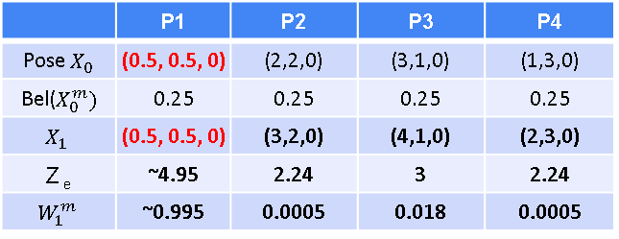
Monte Carlo Based Localization
Mixture(Dual) MCL Algorithm
Initialize : M=4, 2D, 5X5, L(4.4), Move 1m east, Sensor noise = 0.5, Z _{m} = 5m, Φ = 0.25
Predict
Correct
Preprocess
Weigh
Resample
Repeat
 | P1 | P2 | P3 | P4
Pose $X_{0}$ | (0.5, 0.5, 0) | (2,2,0) | (3,1,0) | (1,3,0)
Bel($X_{0}^{m})$ | 0.25 | 0.25 | 0.25 | 0.25
$$X_{1}$$ | (0.5, 0.5, 0) | (3,2,0) | (4,1,0) | (2,3,0)
Z _{e} | ~4.95 | 2.24 | 3 | 2.24
$$W_{1}^{m}$$ | ~0.995 | 0.0005 | 0.018 | 0.0005
(modified for simplicity)

Slide 28
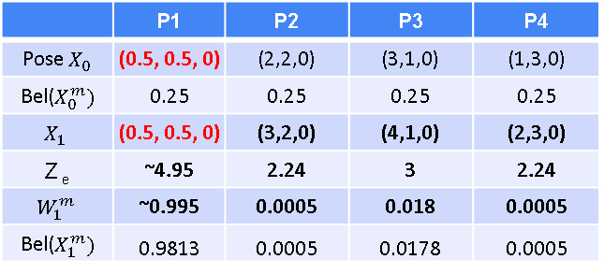
Monte Carlo Based Localization
Mixture(Dual) MCL Algorithm
Initialize : M=4, 2D, 5X5, L(4.4), Move 1m east, Sensor noise = 0.5, Z _{m} = 5m, Φ = 0.25
Predict
Correct
Preprocess
Weigh (Not efficient in pooling diverse particles in next iteration. Assumed that P1 uses Ze for W1 update)
Resample
Repeat
 | P1 | P2 | P3 | P4
Pose $X_{0}$ | (0.5, 0.5, 0) | (2,2,0) | (3,1,0) | (1,3,0)
Bel($X_{0}^{m})$ | 0.25 | 0.25 | 0.25 | 0.25
$$X_{1}$$ | (0.5, 0.5, 0) | (3,2,0) | (4,1,0) | (2,3,0)
Z _{e} | ~4.95 | 2.24 | 3 | 2.24
$$W_{1}^{m}$$ | ~0.995 | 0.0005 | 0.018 | 0.0005
Bel($X_{1}^{m})$ | 0.9813 | 0.0005 | 0.0178 | 0.0005
(modified for simplicity)

Slide 29
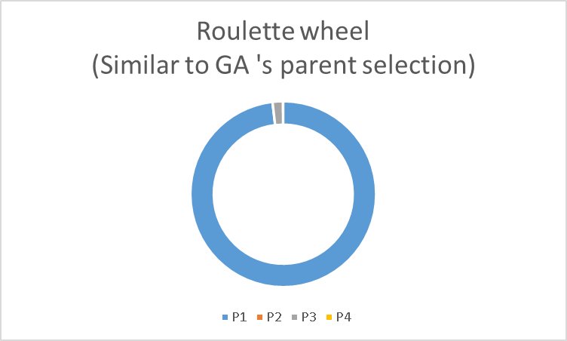
Monte Carlo Based Localization
Mixture(Dual) MCL Algorithm
Initialize : M=4, 2D, 5X5, L(4.4), Move 1m east, Sensor noise = 0.5, Z _{m} = 5m, Φ = 0.25
Predict
Correct
Preprocess
Weigh
Resample
Repeat
One Naïve Estimation Model :
Average of Particles = (1.4,0.6,0)
 | P1 | P2 | P3 | P4
Pose $X_{0}$ | (0.5, 0.5, 0) | (2,2,0) | (3,1,0) | (1,3,0)
Bel($X_{0}^{m})$ | 0.25 | 0.25 | 0.25 | 0.25
$$X_{1}$$ | (0.5, 0.5, 0) | (3,2,0) | (4,1,0) | (2,3,0)
Z _{e} | ~4.95 | 2.24 | 3 | 2.24
$$W_{1}^{m}$$ | ~0.995 | 0.0005 | 0.018 | 0.0005
Bel($X_{1}^{m})$ | 0.9813 | 0.0005 | 0.0178 | 0.0005
Observe : Though the mixture model is able to handle noisy motion model from influencing the M, due to high Wi of Sensor model based particle P1, its not efficient in pooling diverse particles in next iteration if roulette wheel based mechanism is used.
Solutions: Use AIML to determine the balance between exploration vs exploitation OR use traditional Augmented MCL technique OR use Mixture model ratio to pool for next iteration!! ☺
 | P1 | P2 | P3 | P4
$$X_{1}$$ | (0.5, 0.5, 0) | (4,1,0) | (0.5, 0.5, 0) | (0.5, 0.5, 0)
Bel($X_{1}^{m})$ | 0.25 | 0.25 | 0.25 | 0.25

Slide 30
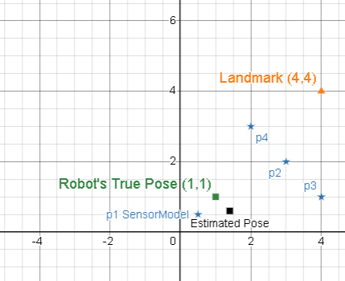

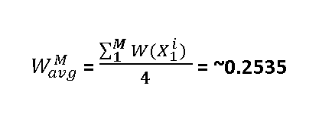
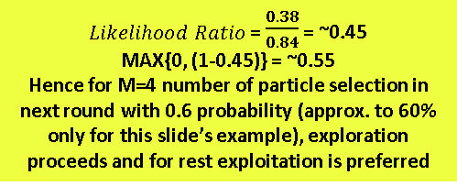
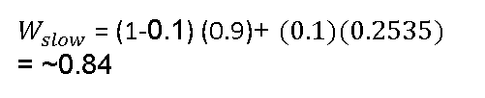
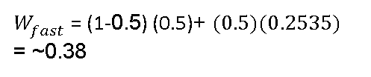

Monte Carlo Based Localization
Idea 2: (Augmented)Mixture(Dual) MCL Algorithm
Initialize : M=4, 2D, 5X5, L(4.4), Move 1m east, Sensor noise = 0.5, Z _{m} = 5m, Φ = 0.25
Predict
Correct
Preprocess
Weigh
Resample
Repeat
One Naïve Estimation Model :
Average of Particles = (1.4,0.6,0)
$W_{avg}^{M}$ = $\frac{\sum_{1}^{M}{{W(X}_{1}^{i}) }}{4}$ = ~0.2535
 | P1 | P2 | P3 | P4
Pose $X_{0}$ | (0.5, 0.5, 0) | (2,2,0) | (3,1,0) | (1,3,0)
Bel($X_{0}^{m})$ | 0.25 | 0.25 | 0.25 | 0.25
$$X_{1}$$ | (0.5, 0.5, 0) | (3,2,0) | (4,1,0) | (2,3,0)
Z _{e} | ~4.95 | 2.24 | 3 | 2.24
$$W_{1}^{m}$$ | 0.995 | 0.0005 | 0.018 | 0.0005
Bel($X_{1}^{m})$ | 0.9813 | 0.0005 | 0.0178 | 0.0005
$W_{fast}^{}$ = (1- α _{fast}) $W_{fast}^{}$ + ${\text{α} \text{fast} W}_{avg}^{}$
$W_{fast}^{}$ = (1-0.5) (0.5)+ ${(0.5)(0.2535)}_{}^{}$
= ~0.38
$W_{slow}^{}$ = (1- α _{slow}) $W_{slow}^{}$ + ${\text{α} slow W}_{avg}^{}$
$Likelihood Ratio$ = $\frac{0.38}{0.84}$ = ~0.45
MAX{0, (1-0.45)} = ~0.55
Hence for M=4 number of particle selection in next round with 0.6 probability (approx. to 60% only for this slide’s example), exploration proceeds and for rest exploitation is preferred
$W_{slow}^{}$ = (1-0.1) (0.9)+ ${(0.1)(0.2535)}_{}^{}$
= ~0.84
Resampling Effect : Approx. 40% of Particles are Informative. Retain them . Need randomization for other 60% of M particles!

Slide 31
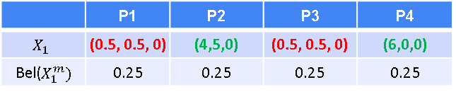
Monte Carlo Based Localization
Idea 2: (Augmented)Mixture(Dual) MCL Algorithm
Initialize : M=4, 2D, 5X5, L(4.4), Move 1m east, Sensor noise = 0.5, Z _{m} = 5m, Φ = 0.25
Predict
Correct
Preprocess
Weigh
Resample
Repeat
One Naïve Estimation Model :
Average of Particles = (2.75,1.5,0)
 | P1 | P2 | P3 | P4
Pose $X_{0}$ | (0.5, 0.5, 0) | (2,2,0) | (3,1,0) | (1,3,0)
Bel($X_{0}^{m})$ | 0.25 | 0.25 | 0.25 | 0.25
$$X_{1}$$ | (0.5, 0.5, 0) | (3,2,0) | (4,1,0) | (2,3,0)
Z _{e} | ~4.95 | 2.24 | 3 | 2.24
$$W_{1}^{m}$$ | 0.995 | 0.0005 | 0.018 | 0.0005
Bel($X_{1}^{m})$ | 0.9813 | 0.0005 | 0.0178 | 0.0005
Resampling Effect : Approx. 40% of Particles are Informative. Retain them . Resample 2 particles using roulette tech from existing pool (red colored)
Need randomization for other 60% of M particles! Ie. Approx 2 particles(green colored)
 | P1 | P2 | P3 | P4
$$X_{1}$$ | (0.5, 0.5, 0) | (4,5,0) | (0.5, 0.5, 0) | (6,0,0)
Bel($X_{1}^{m})$ | 0.25 | 0.25 | 0.25 | 0.25

Slide 32
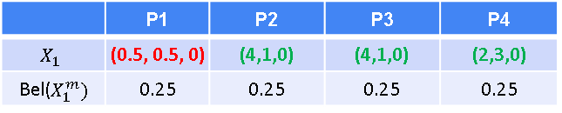
Monte Carlo Based Localization
Idea 3: Mixture(Dual) MCL Algorithm
Initialize : M=4, 2D, 5X5, L(4.4), Move 1m east, Sensor noise = 0.5, Z _{m} = 5m, Φ = 0.25
Predict
Correct
Preprocess
Weigh
Resample
Repeat
One Naïve Estimation Model :
Average of Particles = (2.63,1.38,0)
 | P1 | P2 | P3 | P4
Pose $X_{0}$ | (0.5, 0.5, 0) | (2,2,0) | (3,1,0) | (1,3,0)
Bel($X_{0}^{m})$ | 0.25 | 0.25 | 0.25 | 0.25
$$X_{1}$$ | (0.5, 0.5, 0) | (3,2,0) | (4,1,0) | (2,3,0)
Z _{e} | ~4.95 | 2.24 | 3 | 2.24
$$W_{1}^{m}$$ | 0.995 | 0.0005 | 0.018 | 0.0005
Bel($X_{1}^{m})$ | 0.9813 | 0.0005 | 0.0178 | 0.0005
Resampling Effect Sample 25% of next iteration particles from sensor model pool. Resample 1 particle using roulette wheel (if many particles like P1 are available) ie., P1 (red colored)
Sample 75% of next iteration particles from motion model Resample 3 particle using roulette wheel ie., P2,3,4 (green colored) . Here old P3 is selected twice and old P4 is selected once.
 | P1 | P2 | P3 | P4
$$X_{1}$$ | (0.5, 0.5, 0) | (4,1,0) | (4,1,0) | (2,3,0)
Bel($X_{1}^{m})$ | 0.25 | 0.25 | 0.25 | 0.25

Slide 33
Monte Carlo Based Localization
Particle Filter Approach
Initialize
Predict
Correct
Preprocess
Weigh
Resample
Repeat
Initialize M Particles P_{i} with uniform belief
Move each P_{i} based on robot motion model
Compare predicted sensor reading Z _{expected} with actual sensor reading Z _{measured}
Optionally filter out surprising measurements
Weigh each P_{i} based on importance weights
Resample for particle set for next iteration based on Darwinian approach augmented with short term vs long term likelihood ratio
Reset the belief of particles with equal likelihood

Slide 34
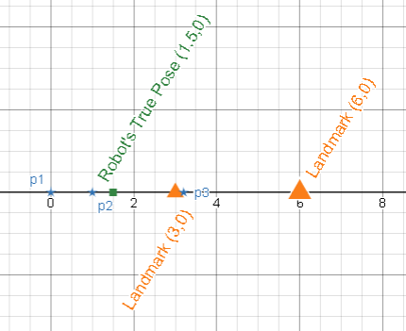
Monte Carlo Based Localization
MCL Algorithm
Initialize : M=3, 1D, 5X5, L(3 & 6), Move 1m east, ﬡ= 0.5, Z _{m} = 0.5m
Predict : Motion Update
Correct : Measurement Update
Preprocess
Weigh
Resample
Repeat
 | P1 | P2 | P3
Pose $X_{1}$ | -1 | 0 | 2
Bel($X_{0}^{m})$ | 1/3 | 1/3 | 1/3

Slide 35
Monte Carlo Based Localization
MCL Algorithm
Initialize : M=3, 1D, 5X5, L(3 & 6), Move 1m east, ﬡ= 0.5, Z _{m} = 0.5m
Predict : Motion Update
Correct : Measurement Update
Preprocess
Weigh
Resample
Repeat
 | P1 | P2 | P3
Pose $X_{1}$ | 0 | 1 | 3
Bel($X_{0}^{m})$ | 1/3 | 1/3 | 1/3
(modified for simplicity)
$\left(\begin{aligned}x_{t} \\ y_{t} \\ θ_{t}\end{aligned}\right)=\left(\begin{aligned}x_{t−1} \\ y_{t−1} \\ θ_{t−1}\end{aligned}\right)$+$\left(\begin{aligned}vcosθ∆t \\ vsinθ∆t \\ w∆t\end{aligned}\right)$
Linear Regression Model $x_{t}$ = $x_{t−1}$ +1

Slide 36
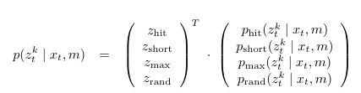
Monte Carlo Based Localization
MCL Algorithm
Initialize : M=3, 1D, 5X5, L(3 & 6), Move 1m east, ﬡ= 0.5, Z _{m} = 0.5m
Predict : Motion Update
Correct : Measurement Update
Preprocess
Weigh
Resample
Repeat
 | P1 | P2 | P3
Pose $X_{1}$ | 0 | 1 | 3
Bel($X_{0}^{m})$ | 1/3 | 1/3 | 1/3
Z _{e} | 3 | 2 | 3
Used Manhattan Distance
Restricted view measured w.r.t 2nd landmark from P3

Slide 37
Monte Carlo Based Localization
MCL Algorithm
 | Mixture weights P(C ) | Measurement Likelihood P(Z=0.5 | C)
Hit | 0.8 | 0.01 | Z _{m} = Z _{e}
Short | 0.1 | 0.95 | Z _{m} < Z _{e}
Max | 0.05 | 0.01 | Z _{m} = Max
Rand | 0.05 | 0.2 | Others
Initialize : M=3, 1D, 5X5, L(3 & 6), Move 1m east, ﬡ= 0.5, Z _{m} = 0.5m
Predict : Motion Update
Correct : Measurement Update
Preprocess
Weigh
Resample
Repeat
 | P1 | P2 | P3
Pose $X_{1}$ | 0 | 1 | 3
Bel($X_{0}^{m})$ | 1/3 | 1/3 | 1/3
Z _{e} | 3 | 2 | 3
May be | Short | Short | Short

Slide 38
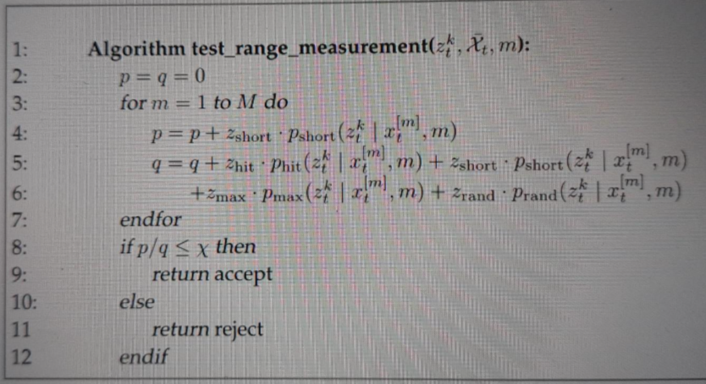
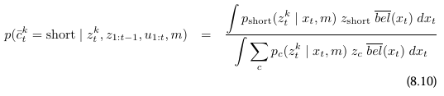
Monte Carlo Based Localization
MCL Algorithm
 | Mixture weights P(C ) | Measurement Likelihood P(Z=0.5 | C)
Hit | 0.8 | 0.01 | Z _{m} = Z _{e}
Short | 0.1 | 0.95 | Z _{m} < Z _{e}
Max | 0.05 | 0.01 | Z _{m} = Max
Rand | 0.05 | 0.2 | Others
Initialize : M=3, 1D, 5X5, L(3 & 6), Move 1m east, ﬡ= 0.5, Z _{m} = 0.5m
Predict : Motion Update
Correct : Measurement Update
Preprocess
Weigh
Resample
Repeat
 | P1 | P2 | P3
Pose $X_{1}$ | 0 | 1 | 3
Bel($X_{0}^{m})$ | 1/3 | 1/3 | 1/3
Z _{e} | 3 | 2 | 3
May be | Short | Short | Short
P(C _{short} |Z _{m} ) | 0.1*0.95*0.33 | ~0.0314 | ~0.0314

Slide 39
Monte Carlo Based Localization
MCL Algorithm
 | Mixture weights P(C ) | Measurement Likelihood P(Z=0.5 | C)
Hit | 0.8 | 0.01 | Z _{m} = Z _{e}
Short | 0.1 | 0.95 | Z _{m} < Z _{e}
Max | 0.05 | 0.01 | Z _{m} = Max
Rand | 0.05 | 0.2 | Others
Initialize : M=3, 1D, 5X5, L(3 & 6), Move 1m east, ﬡ= 0.5, Z _{m} = 0.5m
Predict : Motion Update
Correct : Measurement Update
Preprocess
Weigh
Resample
Repeat
p = ~0.09
q = Denominator = ~0.11
p/q = ~0.84
p/q > ﬡ
Inference :
Reject the Z _{m .} Z. Stop this iteration. No resampling .
Use the same particles again to begin next iteration.
 | P1 | P2 | P3
Pose $X_{1}$ | 0 | 1 | 3
Bel($X_{0}^{m})$ | 1/3 | 1/3 | 1/3
Z _{e} | 3 | 2 | 3
May be | Short | Short | Short
P(C _{short} |Z _{m} ) | 0.1*0.95*0.33 | ~0.0314 | ~0.0314

Slide 40
Monte Carlo Based Localization
Particle Filter Approach
Initialize
Predict
Correct
Preprocess
Weigh
Resample
Repeat
Initialize M Particles P_{i} with uniform belief
Move each P_{i} based on robot motion model
Compare predicted sensor reading Z _{expected} with actual sensor reading Z _{measured}
Optionally filter out surprising measurements
Weigh each P_{i} based on importance weights
Resample for particle set for next iteration based on Darwinian approach augmented with short term vs long term likelihood ratio
Reset the belief of particles with equal likelihood
CAN BE APPLIED TO GRID BASED LOCALIZATION AS WELL WITH CAREFUL CUSTOMIZATION

Slide 41
Required Reading
T1 Chapter 4.2: 4.2.1, 4.2.2, 4.2.4, 8.3: 8.31, 8.3.2, 8.3.3, 8.3.4, 8.4
Next Class Plan :
Mapping
Occupancy Grid Mapping

