Slide 1
Project Management Timeline
Requirements
Analysis
2/1 - 4/10
Design
4/10 - 4/25
Implementation
4/25 - 5/7
Testing
5/7 - 5/20
Deployment
Maintenance
5/20 - 6/1
Milestone 2 Here
Milestone 4 Here
04/25
05/20
Milestone 1 Here
Milestone 3 Here
Milestone 5 Here
4/10
05/07
06/01
Feb
Mar
Apr 1 2018
Apr 15
May 1
May 15
Jun
July
Today

Slide 2
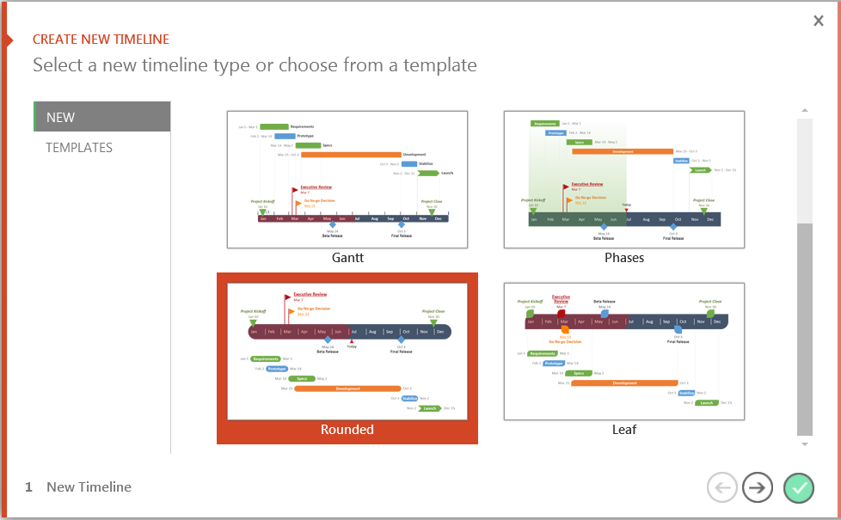
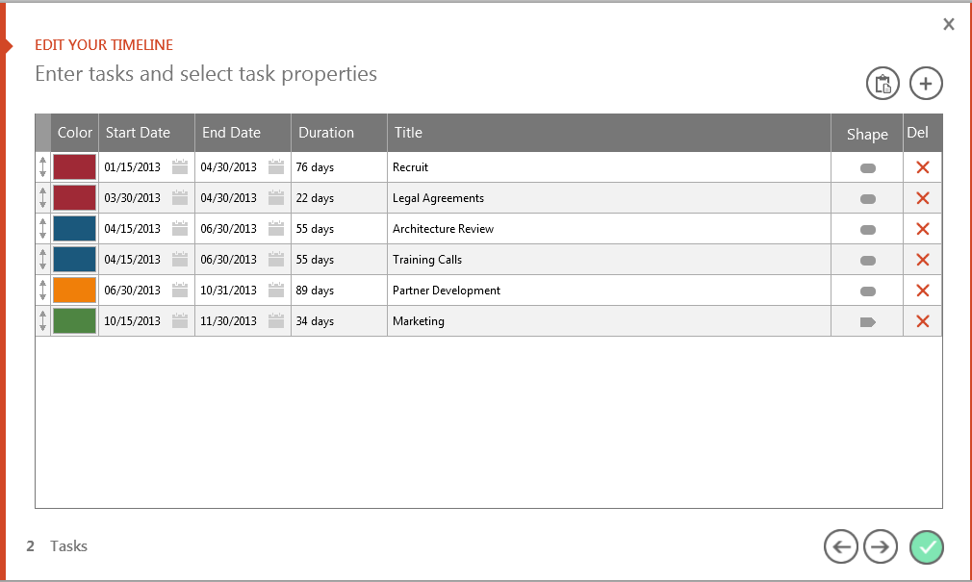
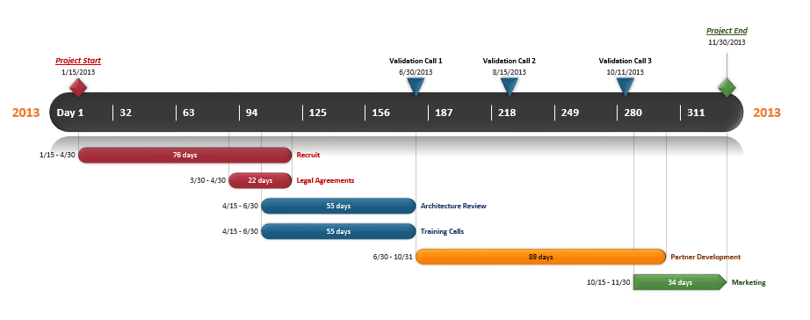
You can easily change this template or build new timelines quickly, right inside PowerPoint!
Office Timeline is a FREE, award winning, timeline maker that's really easy to use.
Simple, easy-to-use wizards.
Professional, quick results.
Built directly into PowerPoint
1
Open your template or select a new one.
2
Choose dates, colors and shapes.
3
Click Finish to create your slide.

Slide 3

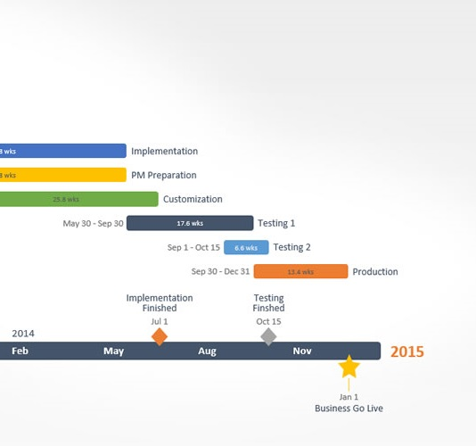
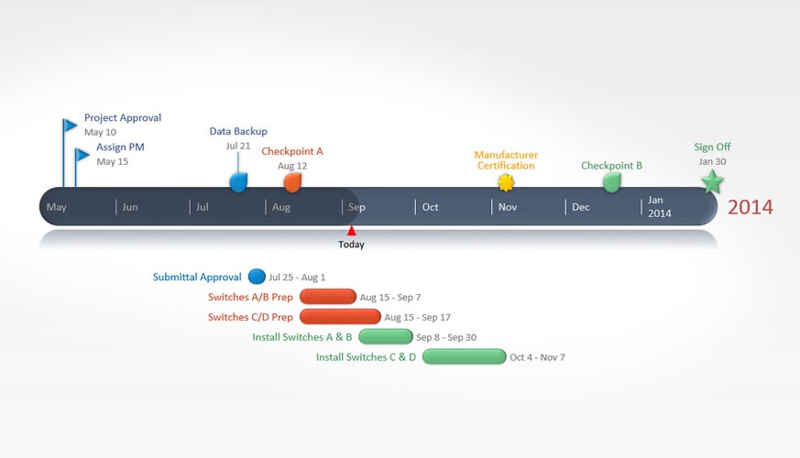
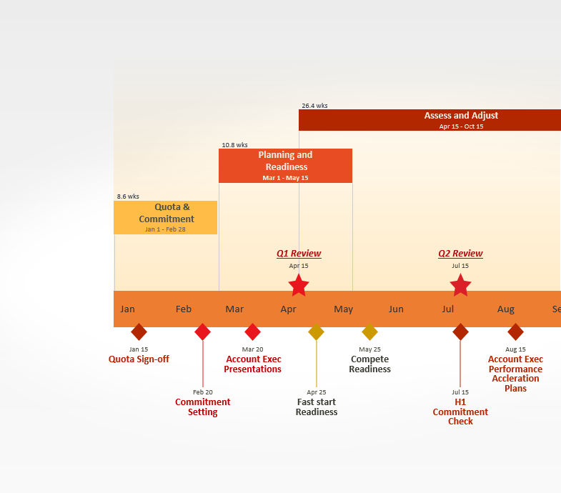

Get the Free Edition Now
FREE DOWNLOAD
Easily edit this template and create other beautiful timelines quickly, right inside PowerPoint.
Copyright © 2012, Office Timeline, LLC. All rights reserved.
Download Now
www.FPPT.com/OfficeTimeline

Slide 4
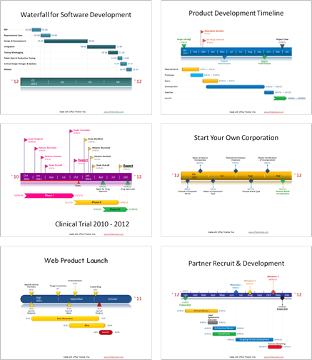
Stand out in a competitive market.
Impress customers, colleagues, and managers with professional timeline presentations built right from PowerPoint.
“
“I love this! I’ve been creating all these graphics manually for months and just wanted to smack myself upside the head when I saw this.”
“I can’t believe I’ve been using VISIO all these years! I've been missing out.”
“I've been building timelines for 22 years and this is the first tool I have found that quickly makes the kinds of slides my clients and management expect to see.
Copyright © 2012, Office Timeline, LLC. All rights reserved.

