Slide 1
domenic virtual machine -dvm
Team #7 - Domenic Melcher

Slide 2

Team
Domenic Melcher
Domenic Melcher
Domenic Melcher
Domenic Melcher

Slide 3

Facts about the dvm
stack based, only one register for the instruction pointer
VM is written in Rust
No external library other than serde for deserialization of the .dvm –files into opcodes
Every memory access is checked explicitly
Every math operation is checked explicitly

Slide 4
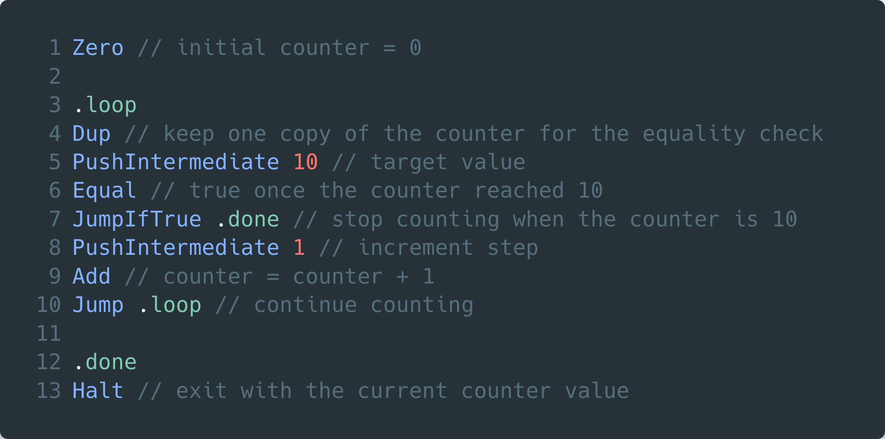
Example Project

Slide 5
Architecture - Memory
Stack based
Memory lanes (fixed size Heap)
files can be memory mapped into the VM

Slide 6
Architecture - Frontend
.dvm source code -> IR (Optimization Passes, Labels) -> Opcodes
Optimization Passes
Noop
ConstantFoldMath
Add
Mul
Sub
Div
PushIntermediate
Zero
Label replacing

Slide 7
Opcodes
Read
Write
SwitchMemoryLane
SizeOfMemoryLane
Noop
Pop
Pop32bits
Dup
DupN
Swap
Xor
And
Or
Zero
PushIntermediate
Add
Sub
Mul
Div
Mod
ShiftLeft
ShiftRight
SmallerThan
SmallerOrEqual
Equal
GreaterThan
GreaterOrEqual
JumpIfTrue
Not
Print
PrintN
Jump
OperationCount
Halt

Slide 8
Features of the VM
dvm run <program.dvm>
dvm run --perf <program.dvm>
dvm debug <program.dvm>

Slide 9
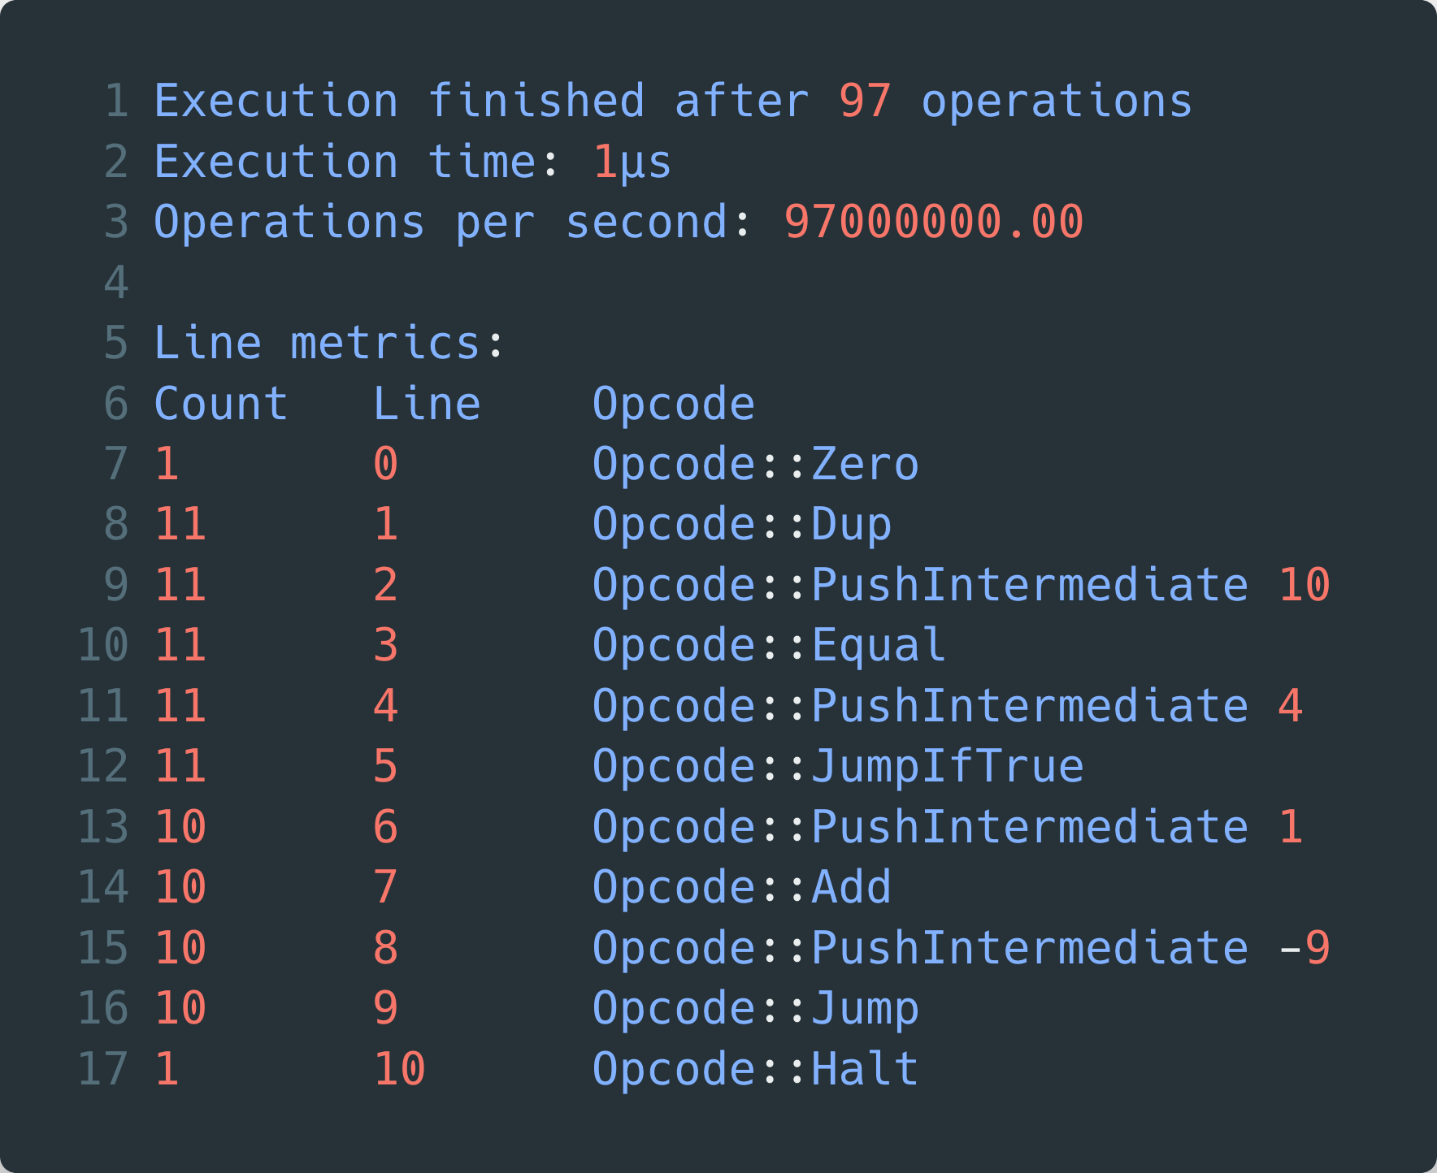
Features of the VM - run
runs the given program in the interpreter
perf
Shows after the program exists a simple perf count for each line
performance
~ 130.000.000 ops/s on a larger program (2.600.000 operations)
test run on Apple M1 Pro 8 performance + 2 efficiency

Slide 10
Features of the VM - debugger
next
ip
ops
execute OPCODE
run
break IP
stack
quit
Go to the next instruction
Print the current instruction pointer
Print all opcodes and their instruction pointer
Execute the given OPCODE with the current stack
Run the program until the first break point is hit
Toggle breakpoint on instruction pointer
Show the current stack
Exit the debugger and program

Slide 11
Ideas for the future
FFI with methods in Rust
Multithreading? Multiple IPs?
Implement an async model
Implement error handling in .dvm
Floating point support
Linker for multiple .dvm files
“Compile” mode to generate an ahead-of-time executable
In perf labels auflösen

