Slide 1
CYBR 601 Intro to Data Science
Professor Terrance Oey
Masters in Professional Studies: Cybersecurity, University of Maryland Baltimore County
Rajat Bisht/nw57095

Slide 2
Failed Bank List
Federal Deposit Insurance Corporation (FDIC) is official website of the United States. It ensure financial safety for depositors across America
Data-set used for Project 1 is take from FDIC for failed bank. This data-set contains information about the banks that failed with their city and state, their cert, acquiring institution of the bank, with closing date and fund.

Slide 3
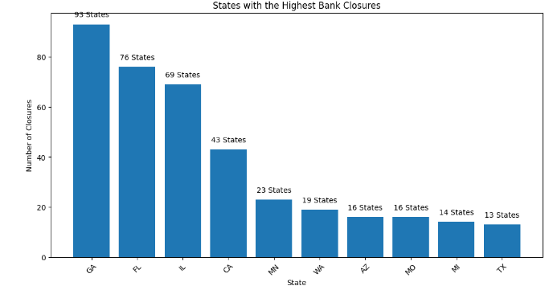
Facts with Data-Set
The state with highest
number of bank closures
is Georgia with 93 states,
while the least bank closure
State was Texas.

Slide 4
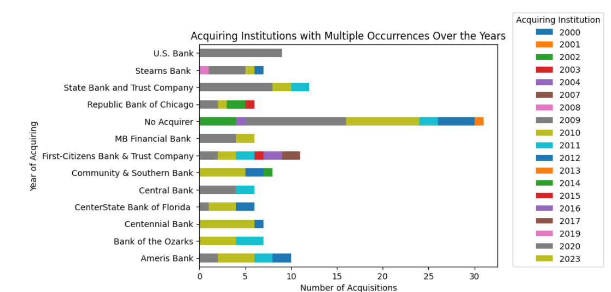
Facts with Data-Set
This graph displays the
acquiring institutions with
more than 5 occurrences.
30 banking companies were
not acquired by any institution.
State bank and trust company
acquired 12 banks(GA location)

Slide 5
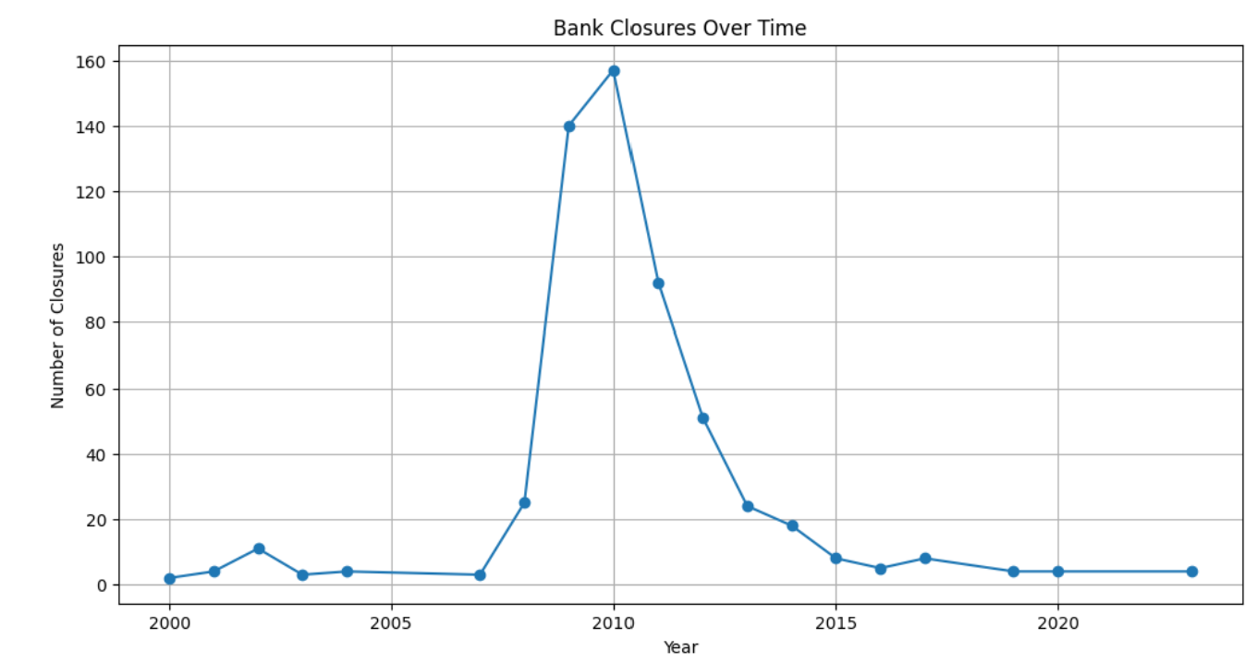
Facts with Data-Set
Highest number of bank closure was observed in
year 2010.
The bank closure showed
spike in between 2005 and
2010 and gradually it
declined in 2015.

Slide 6
Conclusion
The data-set from FDIC for failed bank list helped us to review the state and cities which has experienced the most bank closure
We were able to identify the trend of bank closure, further analysis in it could help to predict the bank failure before hand.
We were able to track the list of most active participants to support bank closure.

