Slide 2
好 0.4
界 0.1
你 0.3
世 0.1
好 0.1
界 0.5

Slide 3
Database from Web Crawler
Word Count with N-Grams
Frequency Count
Term Weighting
TF-IDF
Data supplied by users
Normalized Documents
Word and Part-of-speech
Segments
Corpora
Text Summarization
Data
Cleaning and
Normalization
Word Segmentation
Corpora
Building
LSI & LDA
Documents Recommendation
Chinese Dictionaries
LSI &
Similarity Matrix
Word Recommendation
Word2Vec

Slide 4
]

Slide 5
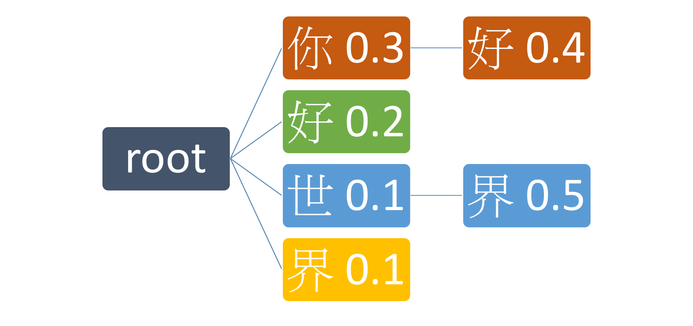
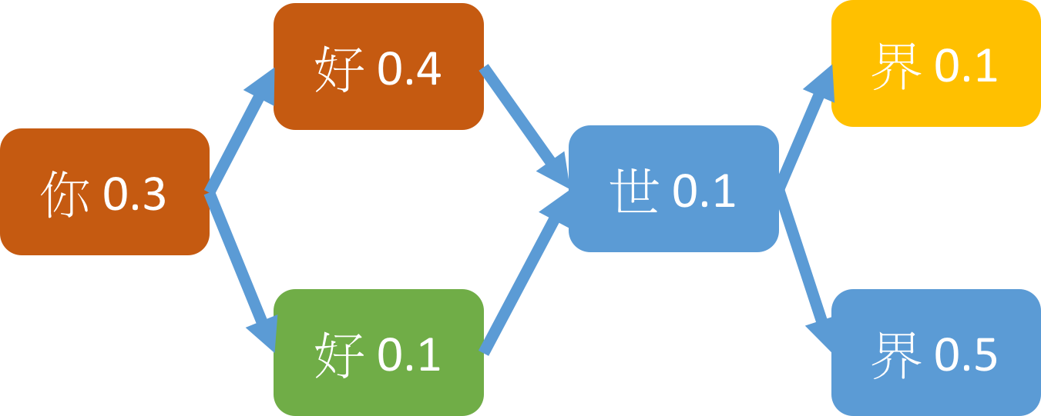
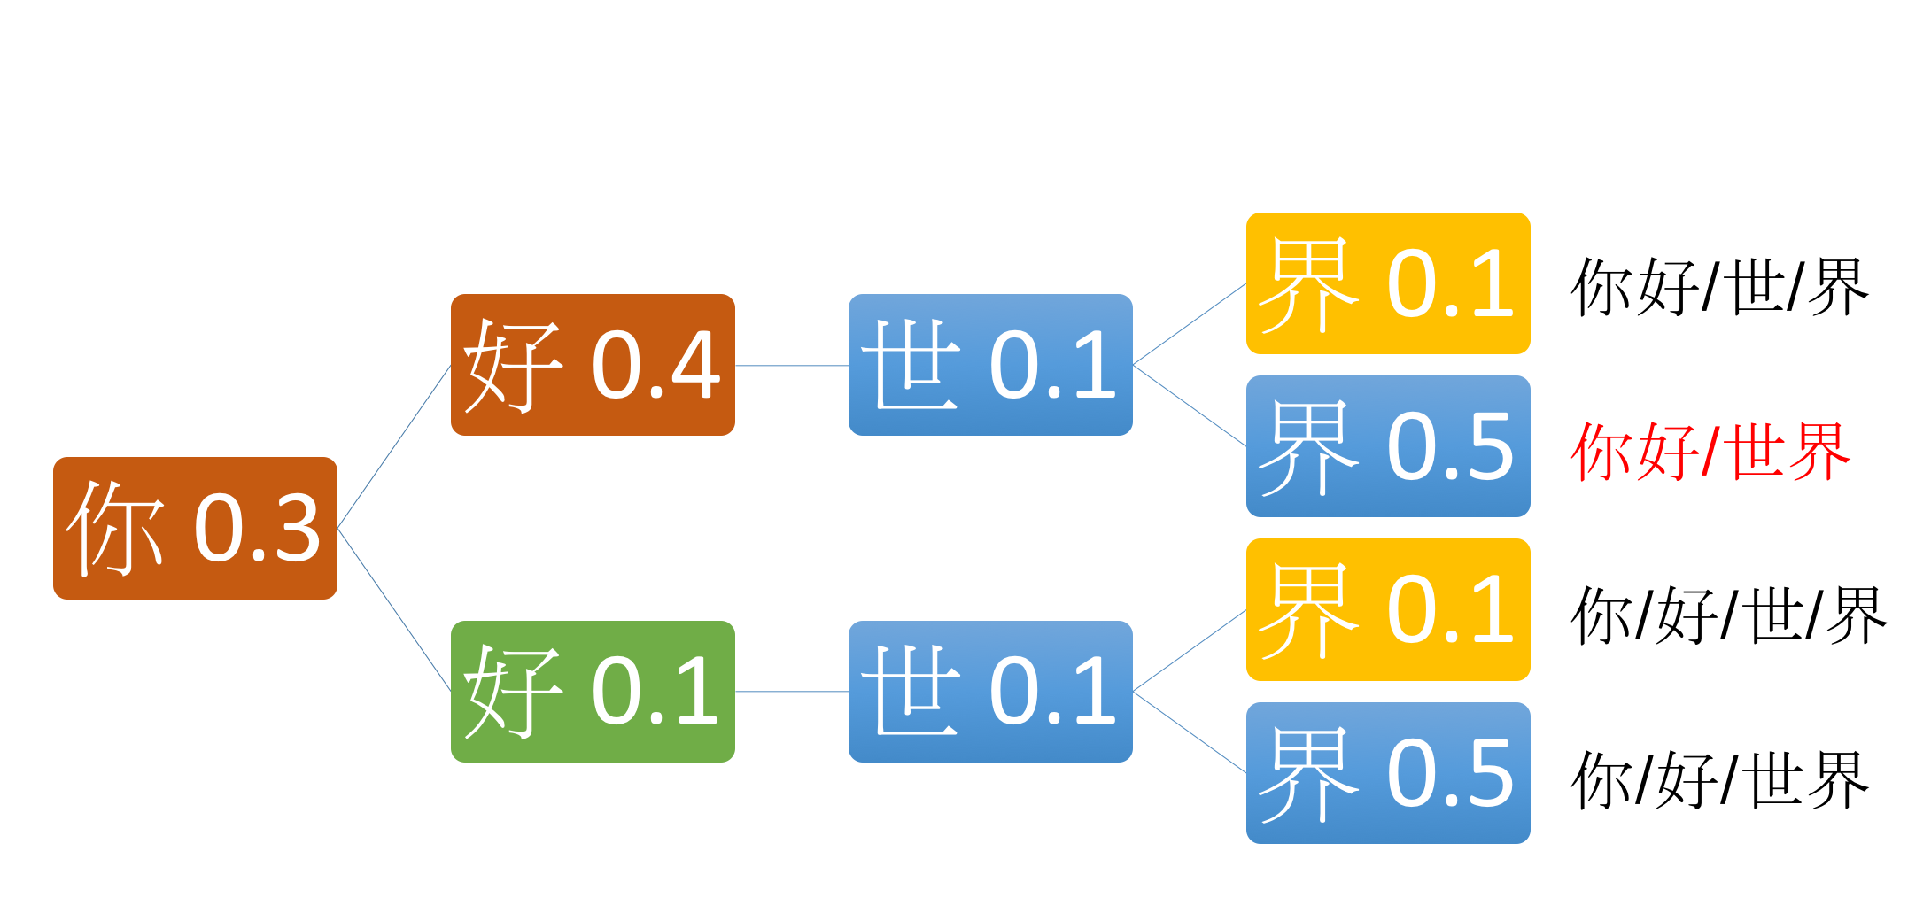
Prefix Tree
DAG

Slide 6
#[(40, 1.0), (20733, 0.95213395), (94363, 0.95173347), (199968, 0.95007229), # (63281, 0.94930953), (55712, 0.94783223), (225236, 0.94558185), (7930, 0.94430256), # (63259, 0.94354367), (12311, 0.9380967), (2379, 0.93661648), (2254, 0.93655413), ......
Document Index | 1 | 2 | … | 237633 | 237634
1 | 1 | 0.952 | 0.952 | 0.948 | 0.949
2 |  | 1 | 0.945 | 0.938 | 0.935
… |  |  | 1 | 0.961 | 0.945
237633 |  |  |  | 1 | 0.923
237634 |  |  |  |  | 1

