Slide 1
IDP Group M212 First Presentation 08/11/22
Mechanical: Tae and Ginny
Electrical: TJ and Will
Software: Lev, Luke and Talha

Slide 2
Plan
Build first iteration out of cardboard that can move
Follow a line on the table
Turn at junctions
Deal with the ramp/ tunnel
Be able to pick up and move with a block
Be able to locate blocks
Be able to sort blocks
Be able to do all that reliably

Slide 3
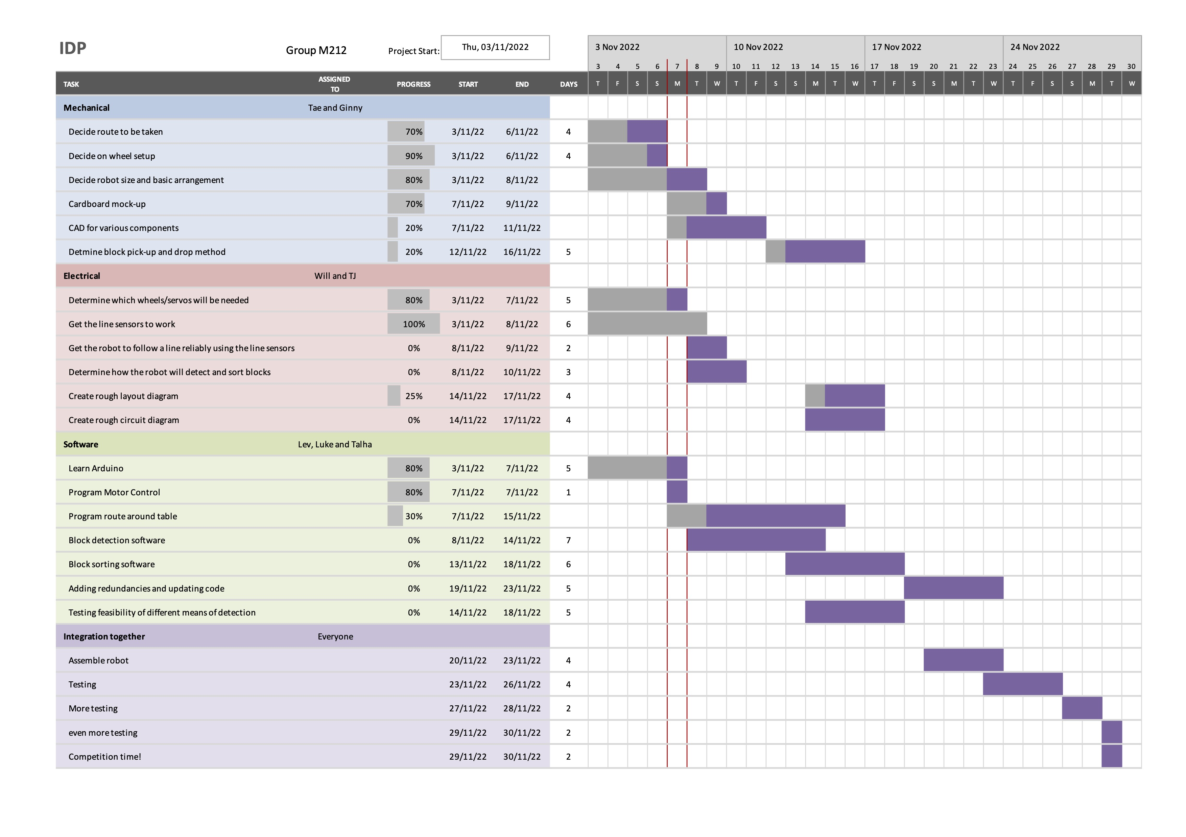
Gantt Chart

Slide 4
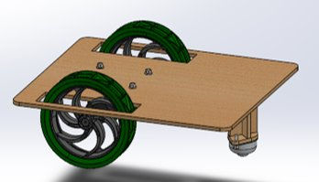
Mechanical
Tasks
Making general shape of the robot
Locating and fixing motors of the wheels
Designing grabbing hands
Designing grabbing mechanism with a servo and gears
Locating and fixing ultrasound sensor

Slide 5
Mechanical
Problem
Where to locate a servo to move grabbing hands
How to design grabbing hands
How to fix the line following sensors in the correct location.
How to build mechanical system to move grabbing hands with a servo and a grabbing hand.

Slide 6
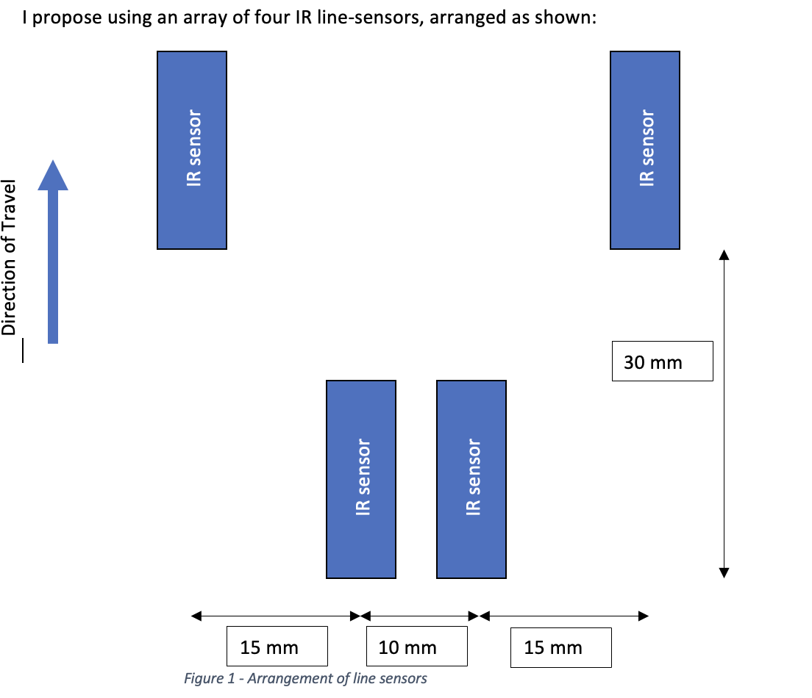
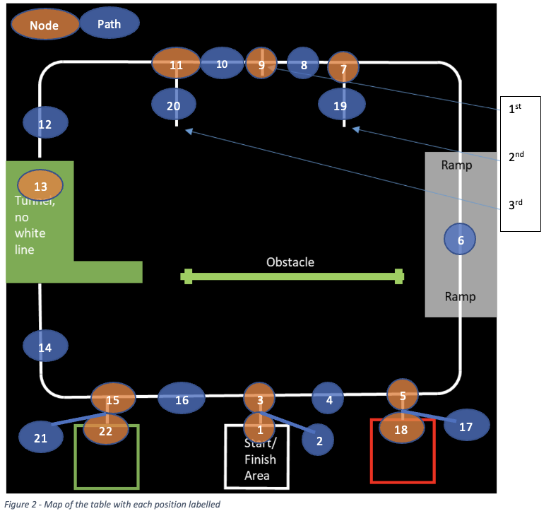
Line following system

Slide 7
Difficulties/things to be tested
The locations of the IR sensors
Two sensors at the front may hit the ramp
Distance to the ground (3mm is the best according to the internet, but practically it was not)
Schmitt Trigger seems ineffective?
Add a distance detector for the distance to the wall – tunnel strategy

Slide 8
Foam density recognition
Resistive touch sensors test the force applied
could design a lever arm to dip a set amount and test force at that point?
IRLED & phototrasistor to test light reflecitvity or pass-through
either be front to back, with a "crane" that comes down over the cube, or side to side, with a lobster-like set of grabbers
Speaker and microphone to identify how well the sound passes through the foam

Slide 9
Software tasks
Program proportional-integral controller to optimise steering
Design error handling systems e.g. if no line sensors detect the line
Program tunnel direction control – distance sensor
Block detection and transport systems depend on mechanisms and strategies yet to be confirmed

Slide 10
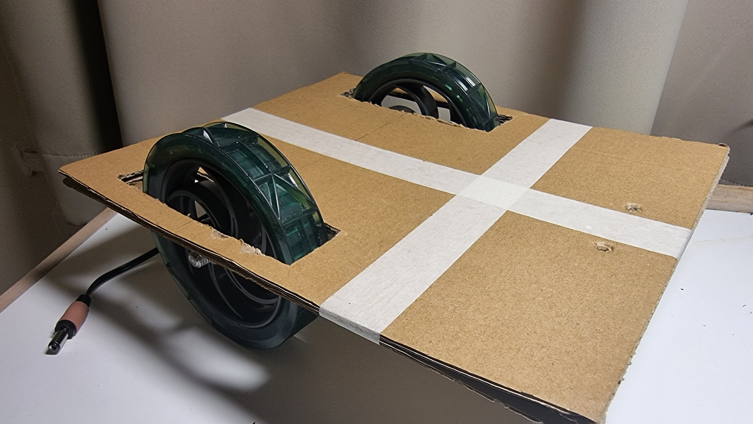
Conclusion
In conclusion, we are going to be the best team

