Slide 1
IDP Group M212 First Presentation 08/11/22
Mechanical: Tae and Ginny
Electrical: TJ and Will
Software: Lev, Luke and Talha

Slide 2
Plan
Build first iteration out of cardboard that can move
Follow a line on the table
Turn at junctions
Deal with the ramp/ tunnel
Be able to pick up and move with a block
Be able to locate blocks
Be able to sort blocks
Be able to do all that reliably

Slide 3
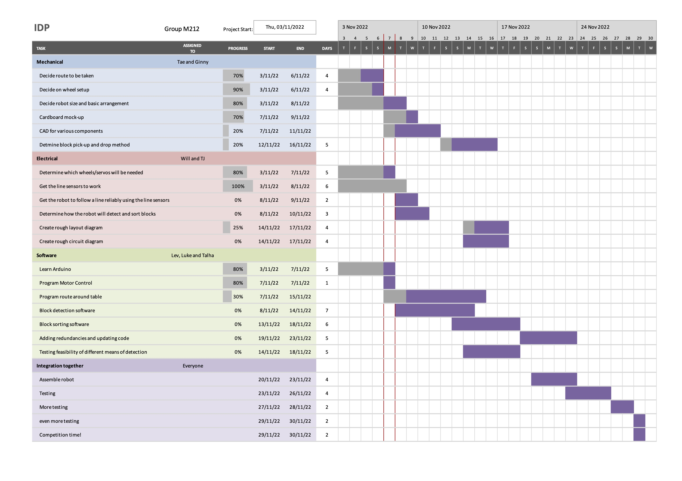
Gantt Chart

Slide 4
Mechanical

Slide 5
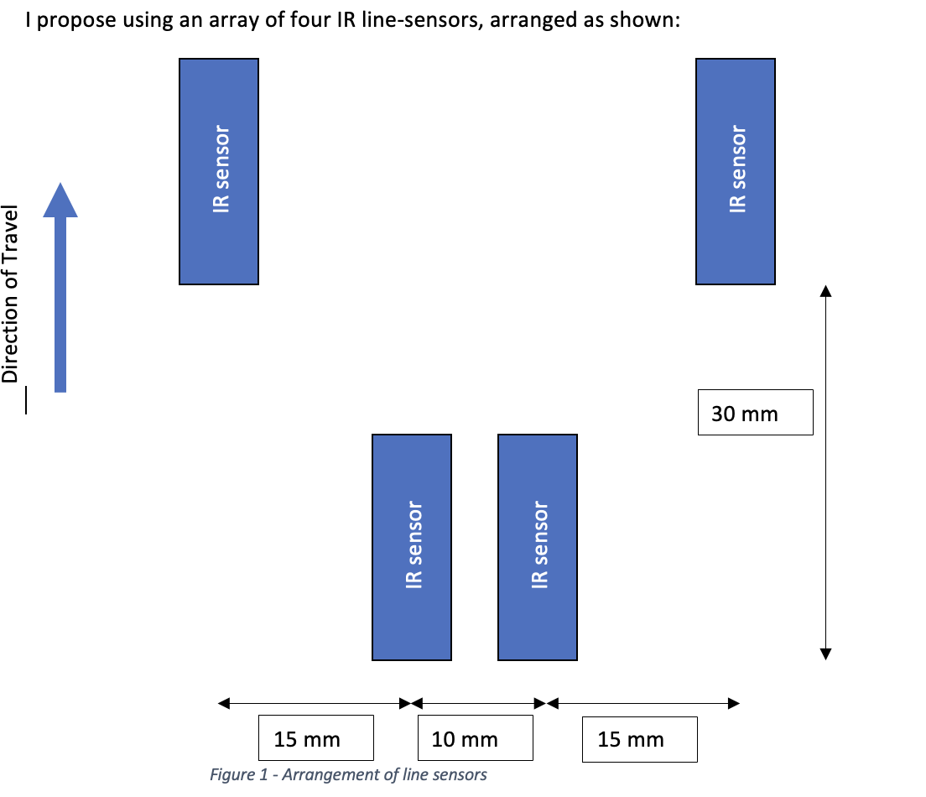
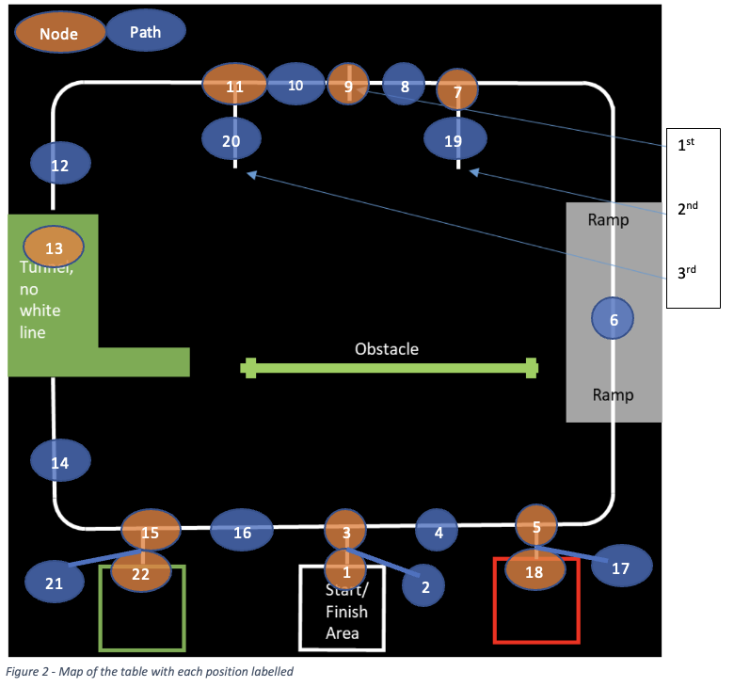
Line following system

Slide 6
Software (done)
Line following system
Motor speed conditional on sensor detection
Speed fading
Delay for allowing updated sensor reading inputs
Currently in Arduino
Sensor detection tested
Line following system tested to work

Slide 7
Sensor-motor interaction
“Fading”
void loop() {
//sensorValue = analogRead(signalPin);
sensorLeft = digitalRead(signalPin1);
sensorRight = digitalRead(signalPin2);
if (( sensorLeft && sensorRight ) == 1) {
motorLeft->run(FORWARD);
motorRight->run(FORWARD);
} else if (sensorLeft == 0 && sensorRight == 1){
motorLeft->run(RELEASE);
motorRight->run(FORWARD);
} else if (sensorRight == 0 && sensorLeft == 1){
motorLeft->run(FORWARD);
motorRight->run(RELEASE);
} else if ((sensorLeft && sensorRight) == 0) {
motorLeft->run(RELEASE);
motorRight->run(RELEASE);
}
}
if (sensorState1 == 0){
myMotor1->run(FORWARD);
for(i=0,i<255,i++){
myMotor1->setSpeed(i);
delay(10);
}
while(sensorState1 == 0){
myMotor1->run(FORWARD);
}
}
}else {
myMotor1->run(RELEASE);
}
sensorState2 = digitalRead(signalPin2);
Serial.println(sensorState2);
if (sensorState2 == 0){
myMotor2->run(FORWARD);
for(i=0,i<255,i++){
myMotor2->setSpeed(i);
delay(10);
}
}

Slide 8
Software (future)
Ultrasonic sensor for wall/block detection (no white line)
Python + PySerial for greater allowed code complexity
Implementation of context
Redundancies
Conditions for transportation based on block type
Further testing for all of the above

Slide 9
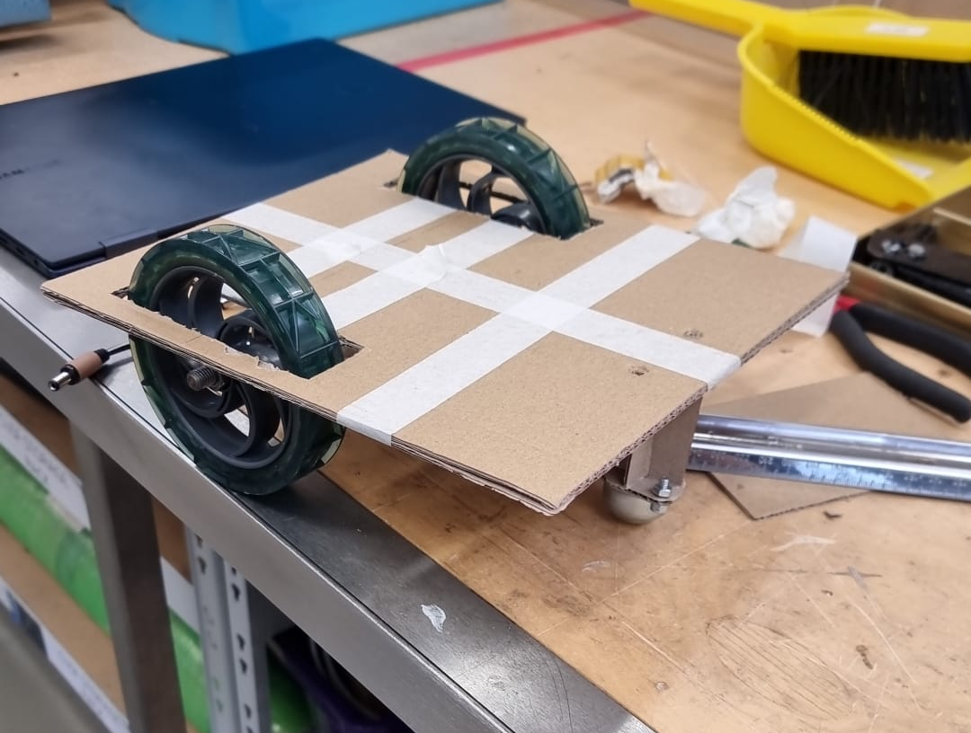
Conclusion
In conclusion, we are going to be the best team

