Slide 1
IDP Group M212 First Presentation 08/11/22
Mechanical: Tae and Ginny
Electrical: TJ and Will
Software: Lev, Luke and Talha

Slide 2
Plan
Build first iteration out of cardboard that can move
Follow a line on the table
Turn at junctions
Deal with the ramp/ tunnel
Be able to pick up and move with a block
Be able to locate blocks
Be able to sort blocks
Be able to do all that reliably

Slide 3
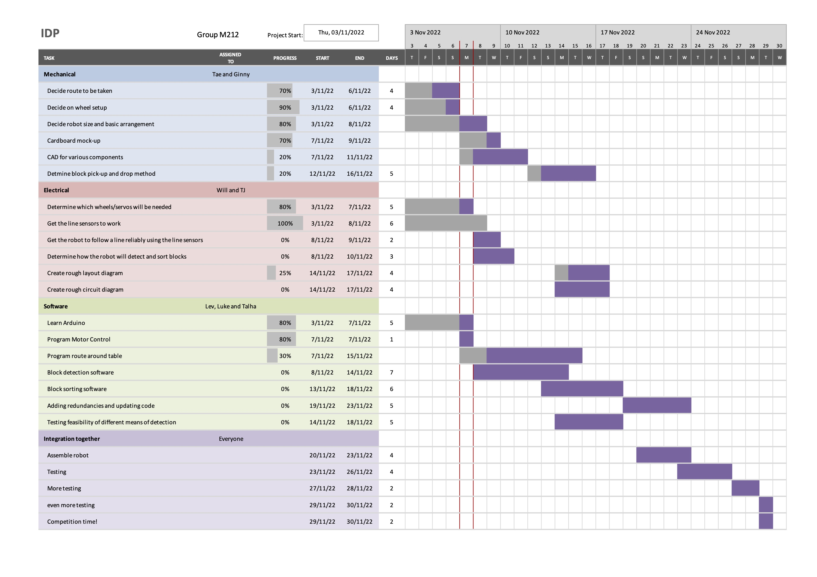
Gantt Chart

Slide 4
Mechanical

Slide 5
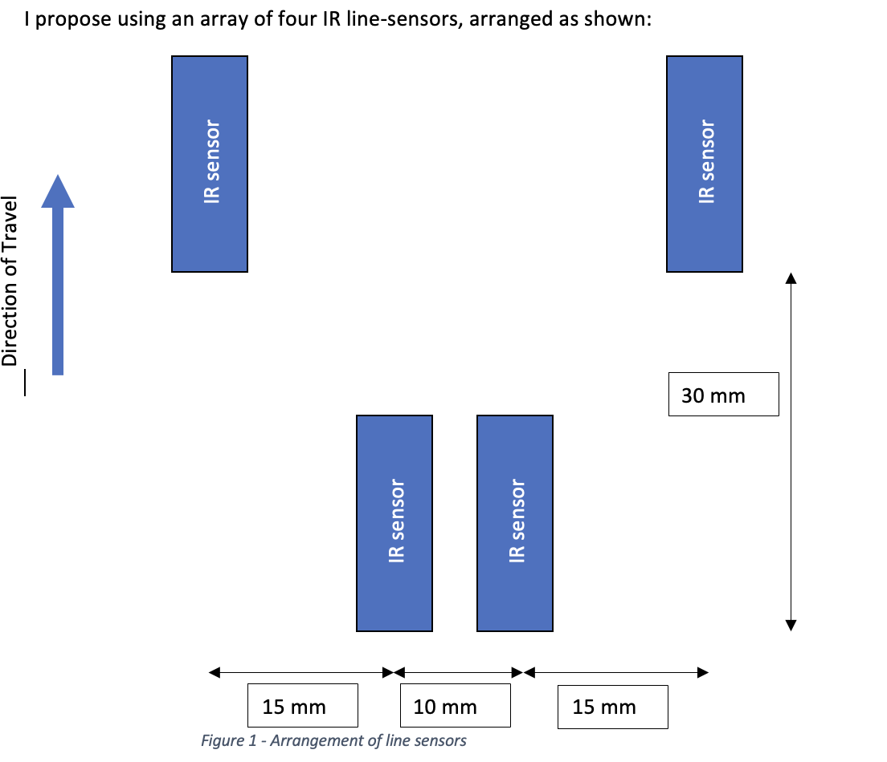
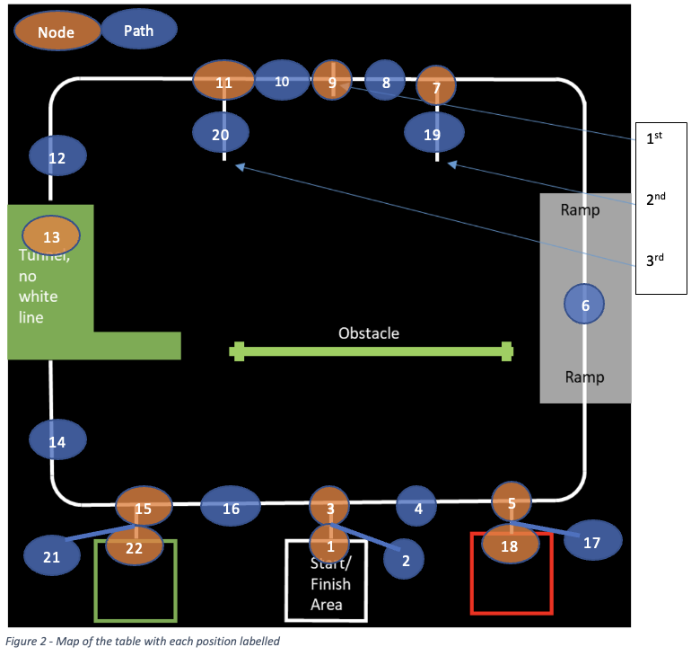
Line following system

Slide 6
Software

Slide 7
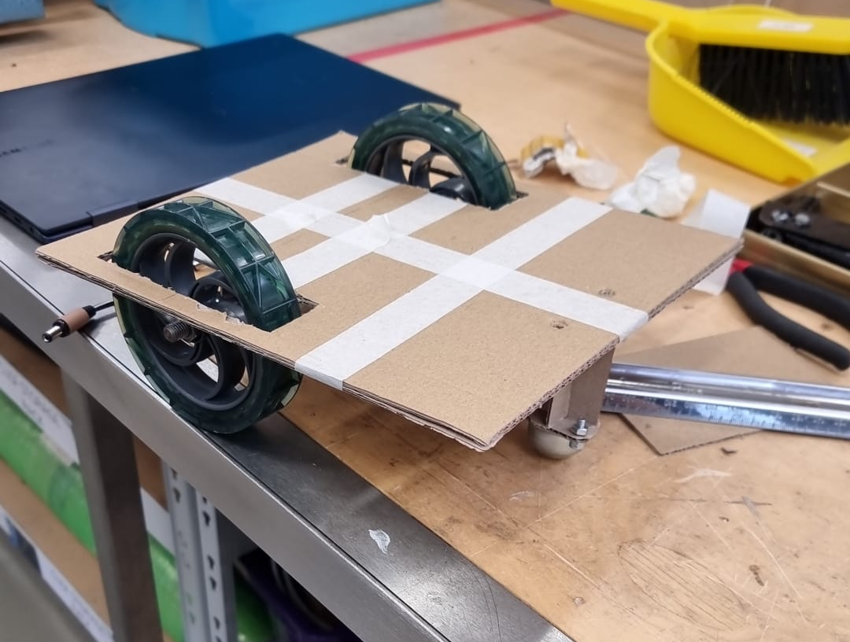
Conclusion
In conclusion, we are going to be the best team

