Slide 1
Tests, Mocks and refactoring code

Slide 2
Tests

Slide 3

Why do we test?

Slide 4

Table test

Slide 5
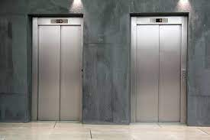
Elevator tests

Slide 6
Tests - When do we encounter them
Any new feature – we write tests
Any code change – we make the tests pass
Local example
Almost every pull request contains test changes
https://github.com/pallets/flask/pull/4560/files#diff-6dac16e531fedf499195fee037bf7dffefe2dfe778c153f96d6c782e3657031b

Slide 7
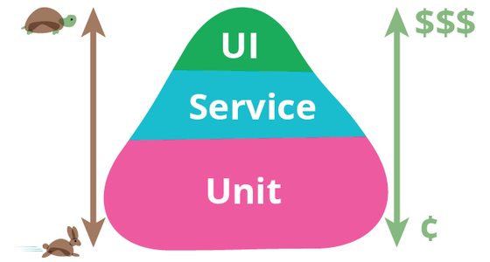
How much tests is too many?
Unit tests
In an ideal world, a single unit test has only one thing that can cause it to fail, and that one thing can only cause that test to fail.
Never the actual case
Testing each path of the code

Slide 8
Good test coverage - importance
Only way to ensure big code is working
What is a good test coverage?
https://www.youtube.com/watch?v=6LhslWDXg10
https://www.youtube.com/watch?v=NmIB2tfshyY

Slide 9
Setting up the environment
May involve more then code setup
Vms\dockers
Databases
Other components
Mocks

Slide 10
Using tests in pycharm
Example

Slide 11
Testable code
Testable code
https://www.youtube.com/watch?v=2b2-WPzWl6c
How much tests is too much
https://www.youtube.com/watch?v=6LhslWDXg10

Slide 12
TDD
TDD stands for Test-Driven Development, which is a software development methodology that emphasizes writing tests before writing the actual code. The process typically involves the following steps:
Write a test: The developer writes a test that defines the behavior they want to implement in the code.
Run the test: The test is run, and it should fail because the behavior has not yet been implemented in the code.
Write the code: The developer writes the code necessary to make the test pass.
Run the test: The test is run again, and it should pass this time.
Refactor the code: The developer may refactor the code to improve its design or readability, while still ensuring that the test passes.

Slide 13
Assertions
Assertions are statements in your code that assert or verify that certain conditions are true at specific points in your program. They are commonly used in testing to ensure that code is working as expected, by checking that certain conditions or assumptions hold true during program execution.

Slide 14
Mocks
Mock Objects: These are objects that simulate the behavior of real objects in your code. They can be created using the unittest.mock module in Python.
Patching: This is the process of replacing real objects in your code with mock objects during tests. This can be done using the patch function from the unittest.mock module.
Assertions: These are statements in your test code that verify that certain conditions are met during tests. They can be used to ensure that your code is behaving as expected.

Slide 15
Monkey patching
The dynamic replacement of attributes at runtime.
Python classes are mutable, and methods are just attributes of the class, you can do this as much as you like
Replacing classes and functions in a module As well
https://stackoverflow.com/questions/5626193/what-is-monkey-patching
Monkeypatching is often used for bug fixes or prototyping software, especially when using external APIs or libraries.
https://stackoverflow.com/questions/41701226/what-is-the-difference-between-mocking-and-monkey-patching

Slide 16
Tests in other languages
Testing in different languages is related
https://semaphoreci.com/community/tutorials/stubbing-and-mocking-with-mockito-2-and-junit
https://chromium.googlesource.com/external/github.com/google/googletest/+/refs/tags/release-1.8.0/googlemock/docs/ForDummies.md

Slide 17
mocks
Python mocks are objects that simulate the behavior of real objects in your code during tests. They can be used to isolate the code you are testing from dependencies, allowing you to test specific parts of your code in isolation.

Slide 18


Refactoring

Slide 19
Refactoring code
The process of improving the design and structure of existing code without changing its behavior.

Slide 20
Refactoring code
Understand
Understand the code: Before you start refactoring, make sure you have a good understanding of the existing code and its behavior. You should also identify the parts of the code that need to be refactored.
Write Tests
Write tests: Make sure you have a comprehensive suite of tests that cover the existing behavior of the code. This will help you to ensure that your refactoring doesn't introduce new bugs or break existing functionality.
Small Changes
Make small changes: Refactor the code in small, incremental steps. This will help you to keep the changes manageable and reduce the risk of introducing new bugs.
Best Practices
Use best practices: Use best practices and design patterns to improve the structure and readability of your code. This may include techniques like extracting methods, removing duplication, and simplifying complex logic.
Always Test
Test frequently: After making each change, run your tests to ensure that the code still behaves as expected. This will help you to catch any issues early on and avoid having to debug large chunks of code later on.
Repeat
Repeat: Continue to iterate on the code, making small changes and testing frequently, until you are satisfied with the overall design and structure.

